Slide 1
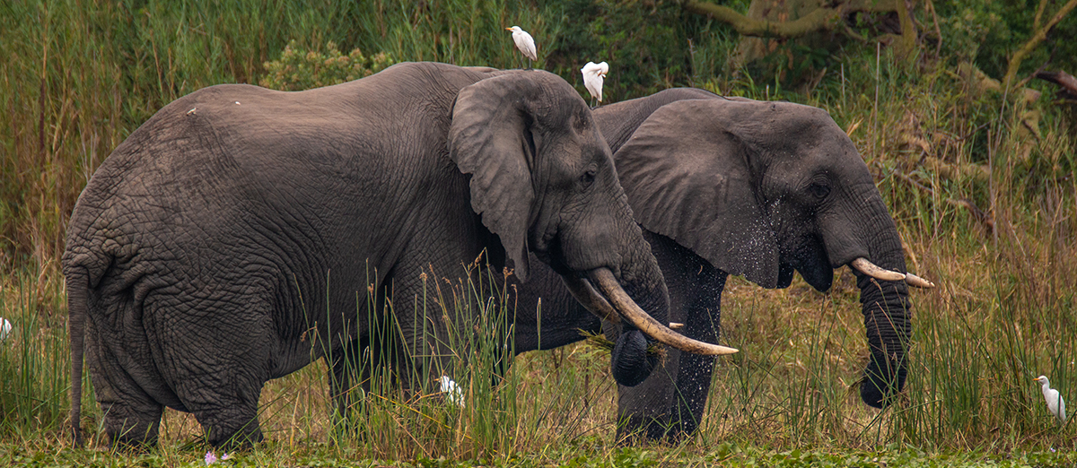
Convention on Migratory Species
Third Meeting Of The Signatories To The Memorandum Of Understanding Concerning Conservation Measures For The West African Populations Of The African Elephant (Loxodonta Africana)
30 November and 1 December 2021
Country Report for COUNTRY

Slide 2
Implementation of the MOU in country

Slide 3
Implementation of the MOU in country

Slide 4
Future plans for implementation

Slide 5
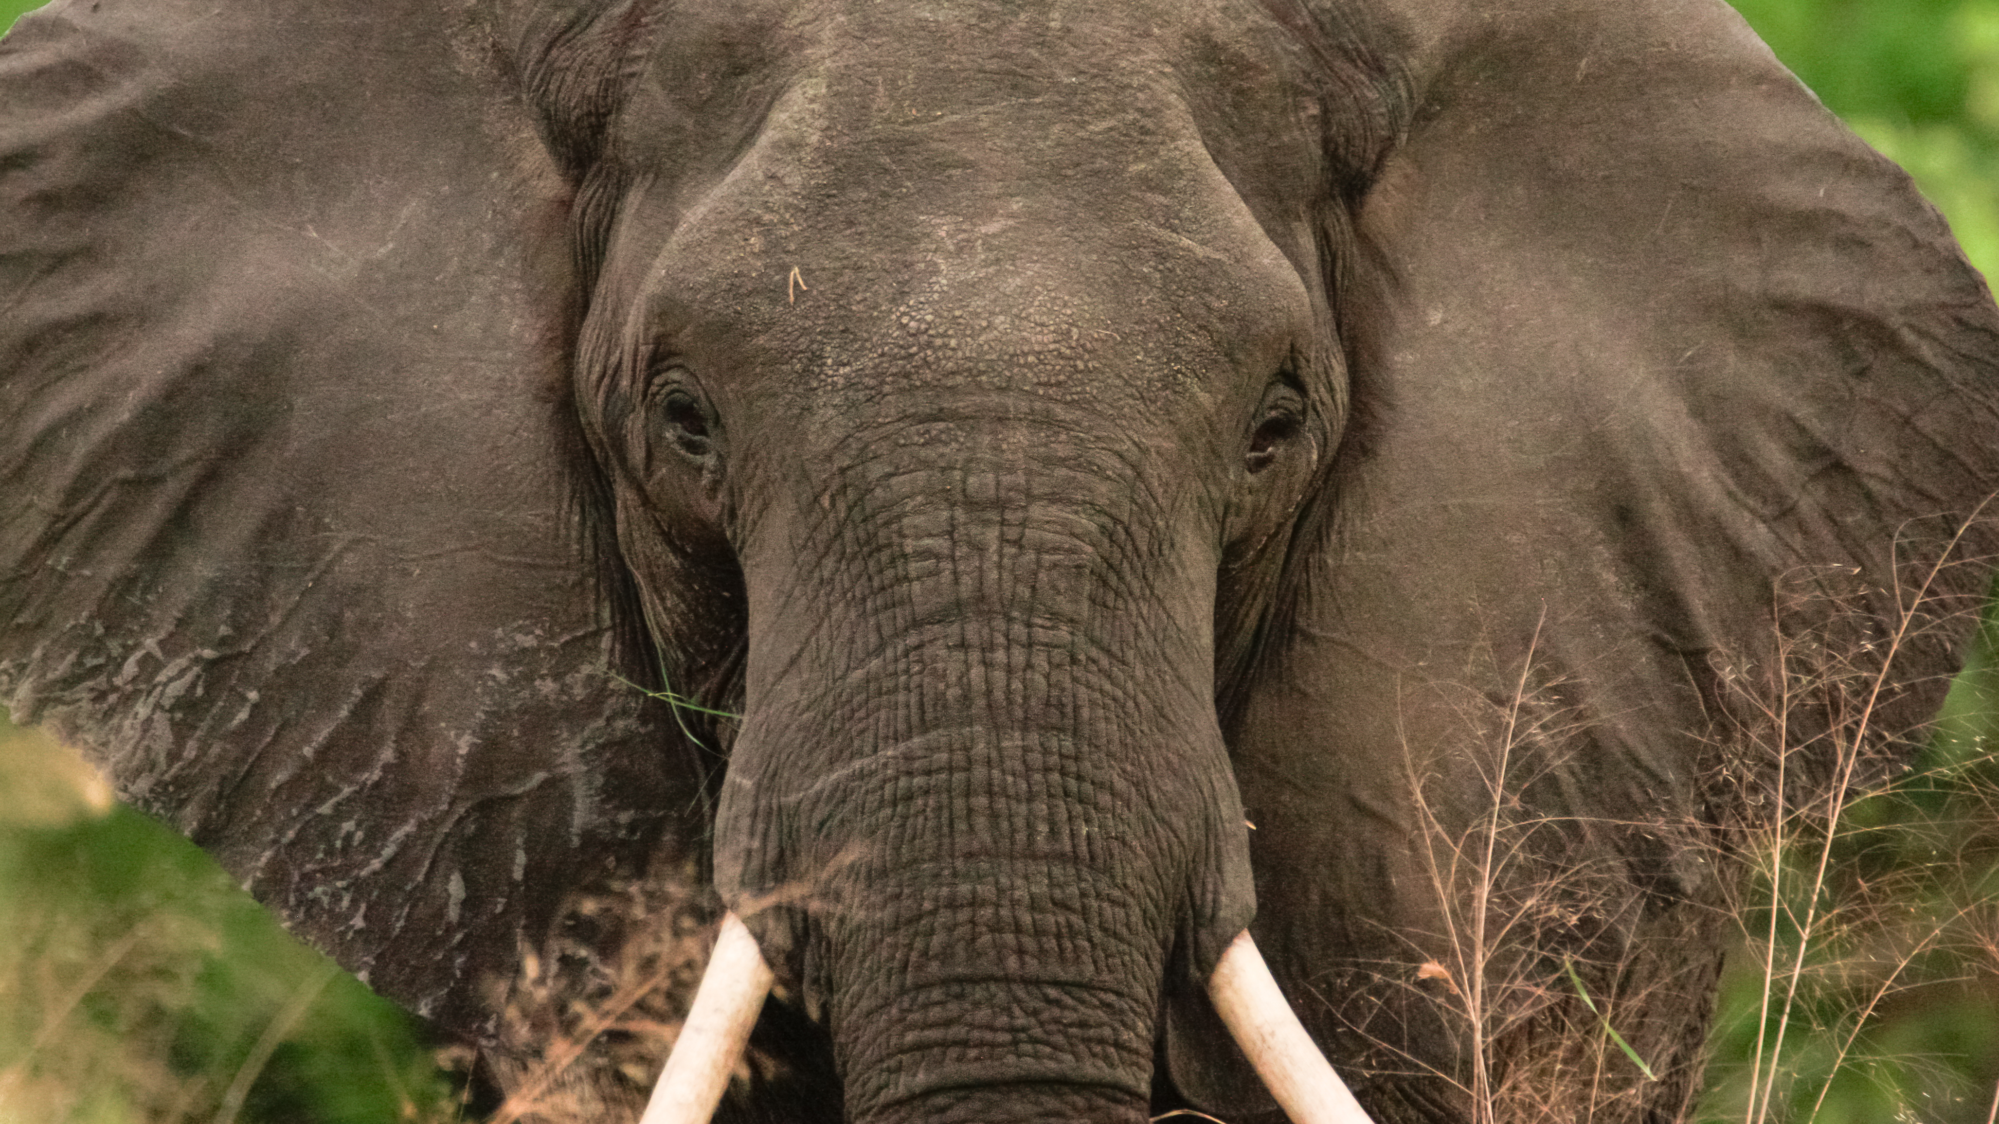
THANK YOU

