Slide 1
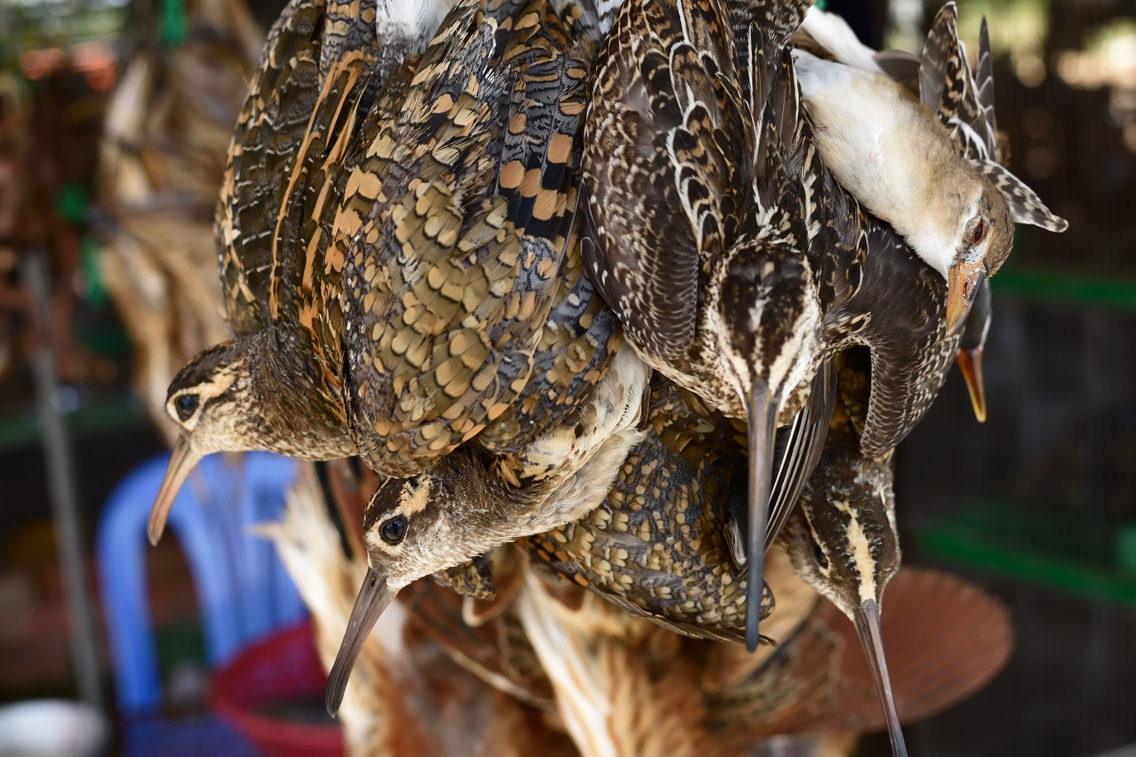
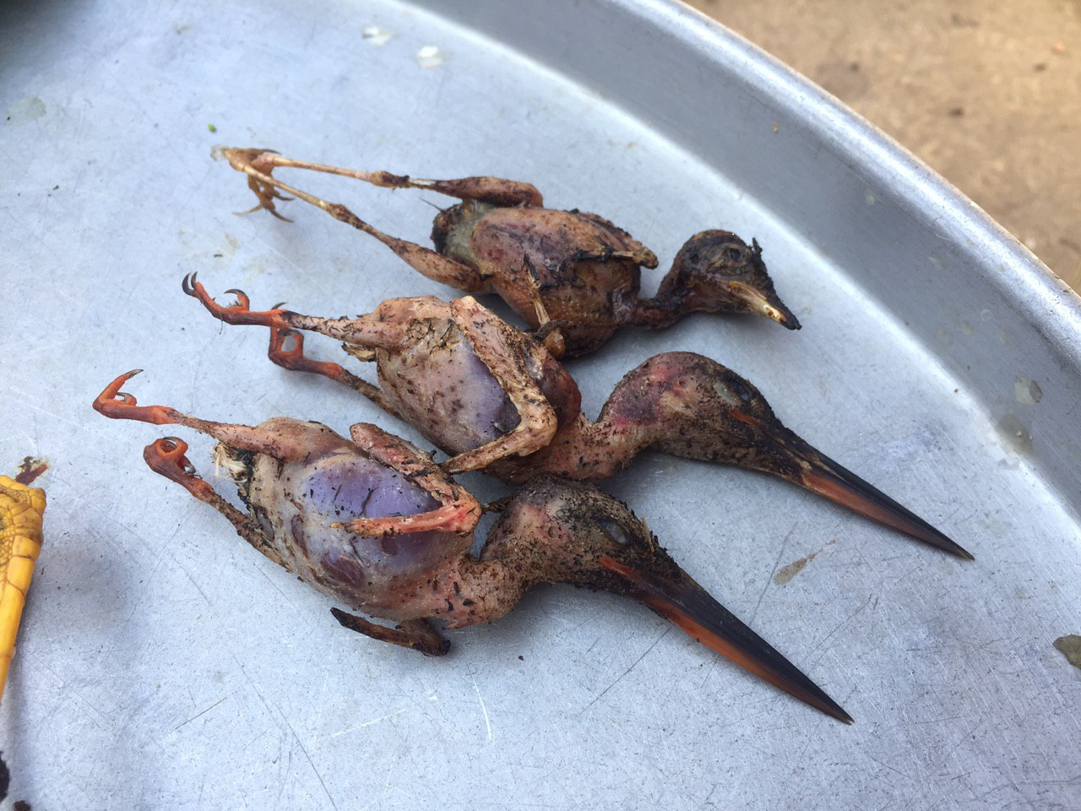
Assessing the extent of bird hunting in the Southeast Asian region from market surveys

Slide 2
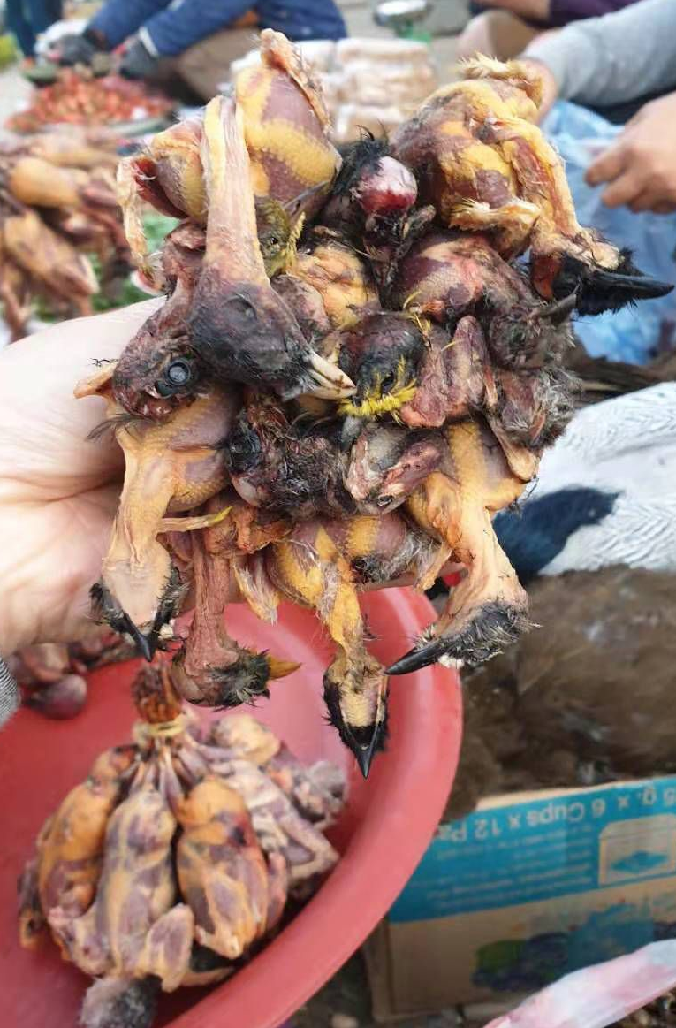
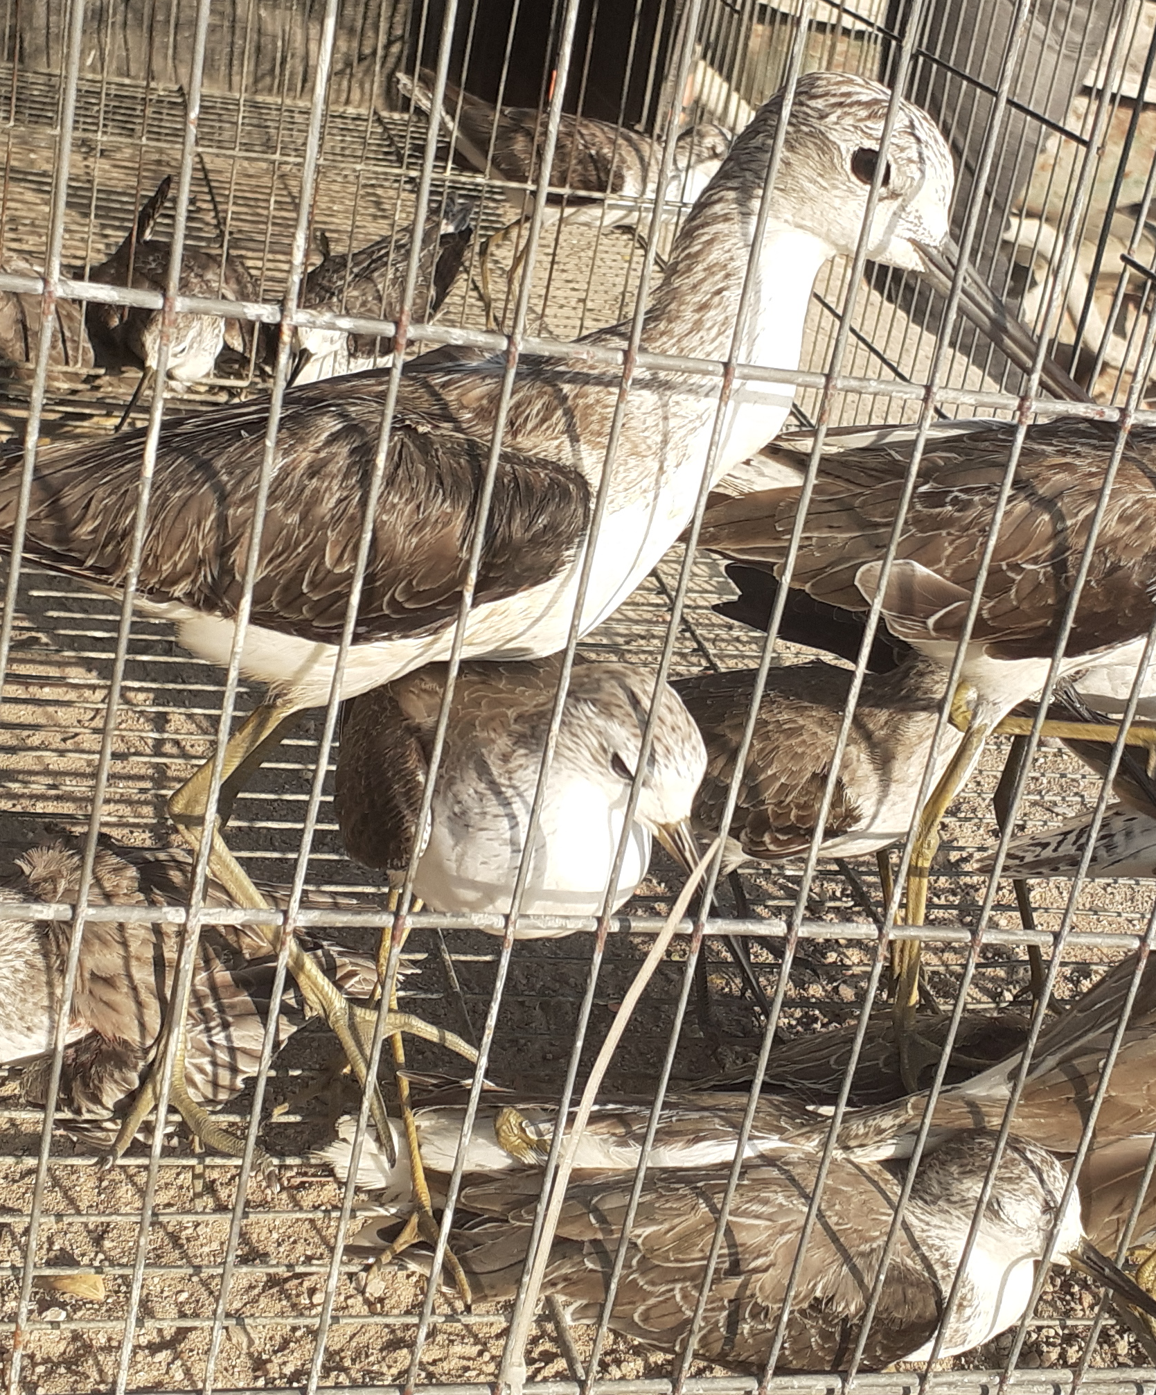
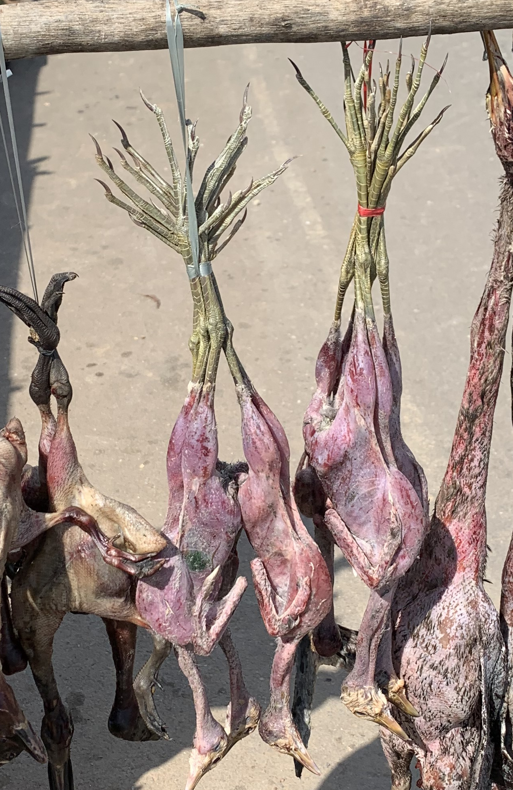
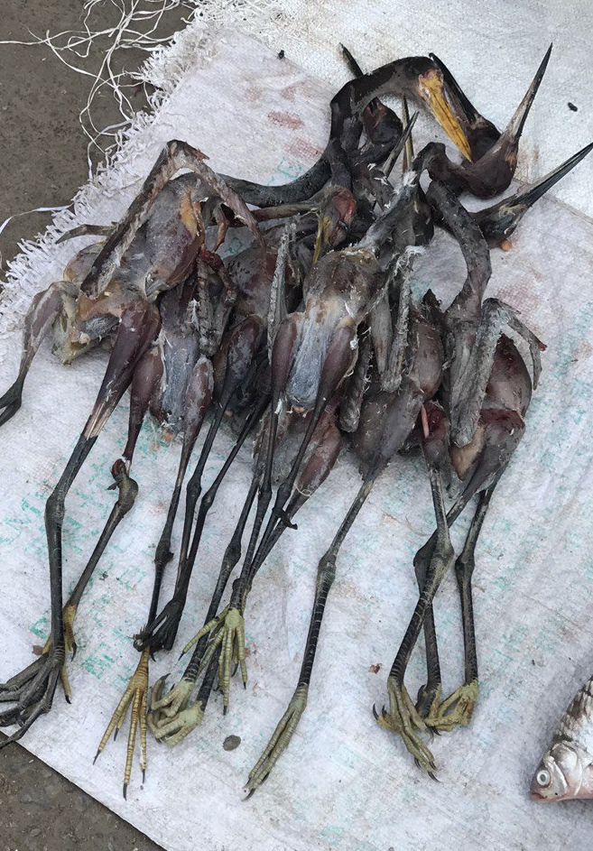
Recap · Key groups of species documented
Shorebirds trapped from intertidal flats and fishponds
Herons and bitterns in paddy fields
Rails and crakes in paddy fields
Passerines in paddy fields, marshes and forests

Slide 3
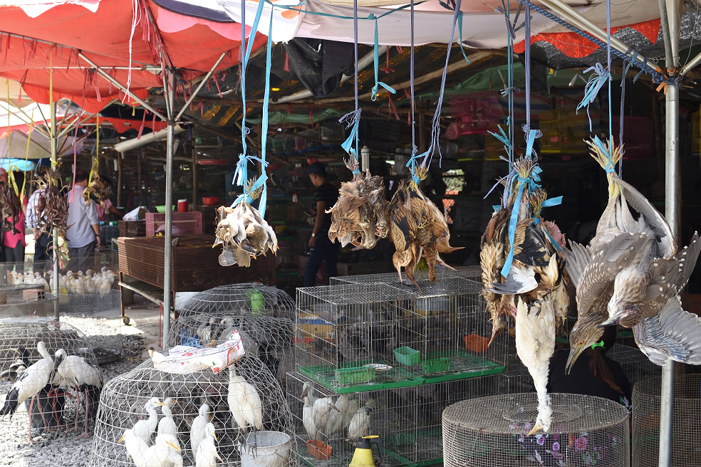
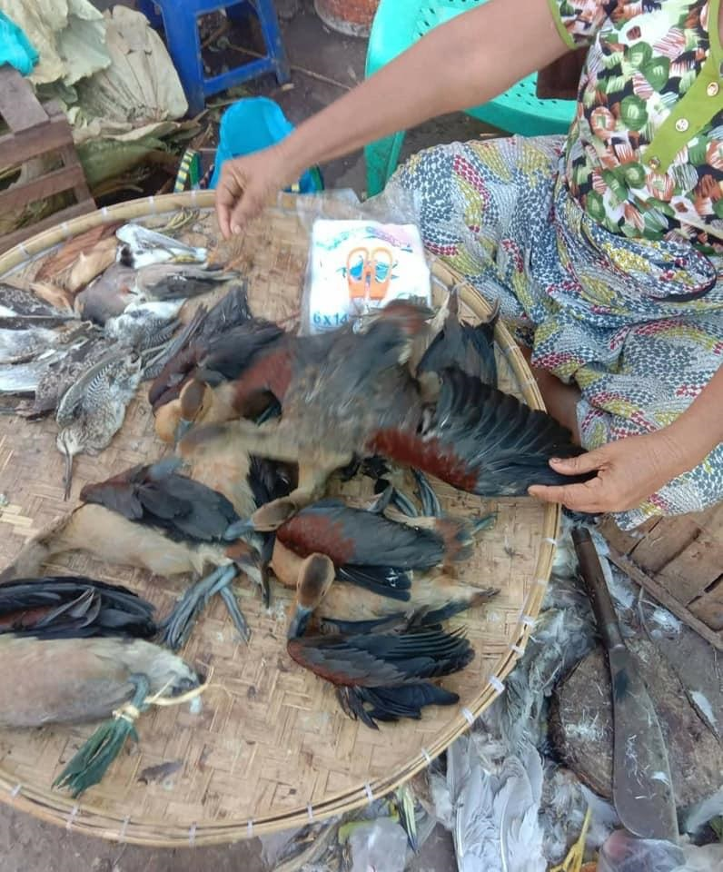
Recap · evidence of large-scale trade of avian wild meat in SEA
Widespread and open trading of wild birds in food markets in Vietnam (left) and Myanmar (right)
Notes:
Surveys in Mekong delta, Vietnam – commercial sale of mostly waterbirds
(Nguyen Hoai Bao) – over 120 bird species hunted in Vietnam alone

Slide 4
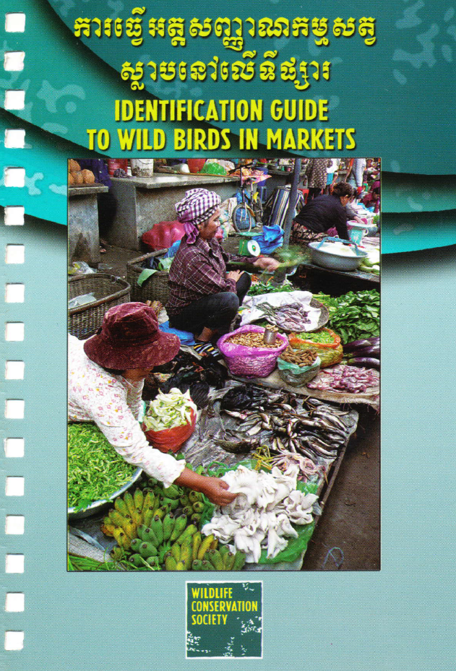
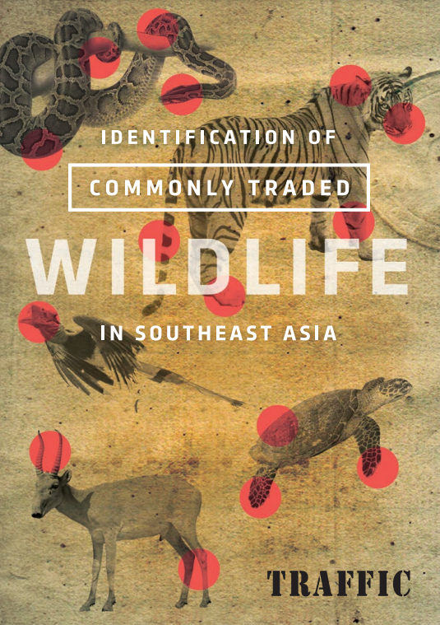
Recap · lessons learnt
Hard to determine turnover over the day (and season) so data is essentially ‘snapshot’
Hard to identify species in limited time window, or if birds sold were de-feathered
Not all markets have stalls/vendors selling wildlife or birds
Wild birds (and bird meat) often sold alongside fish and vegetable vendors (who may pick it up from middlemen in morning or afternoon). Some sold for merit releases
Not all of what is sold may be exhibited

Slide 5
Planning and designing market surveys
Be clear what you are surveying for
  Is the study a snapshot, or is it longitudinal, to map change/turnover
  How would the data be managed and used?
Identify markets and time-frames for surveys
Plan for teams of surveyors and define roles of each member
Market surveys can be complemented with interview questionnaires
Be aware of survey conditions in different markets
Safety issues
Permits, ethics process (if academic studies)

Slide 6
Other considerations
Consider the seasonal nature (goes without saying if you are working on migratory species)
Consult local stakeholders for information on markets
Partnering with government agencies can strengthen your mandate
Synergies with work on wildlife diseases
Manage your own expectations

