Slide 1
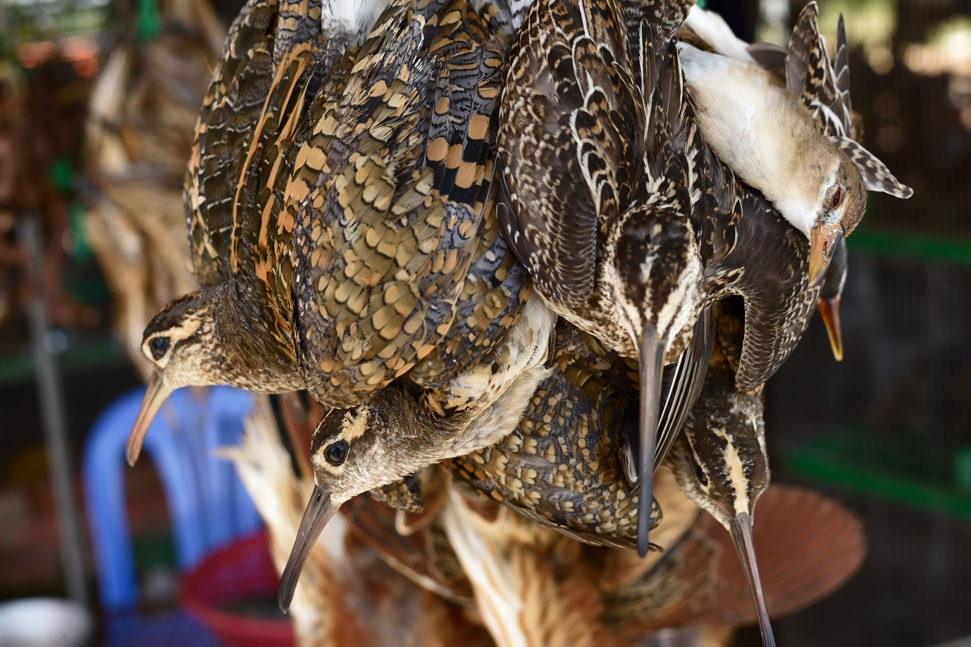
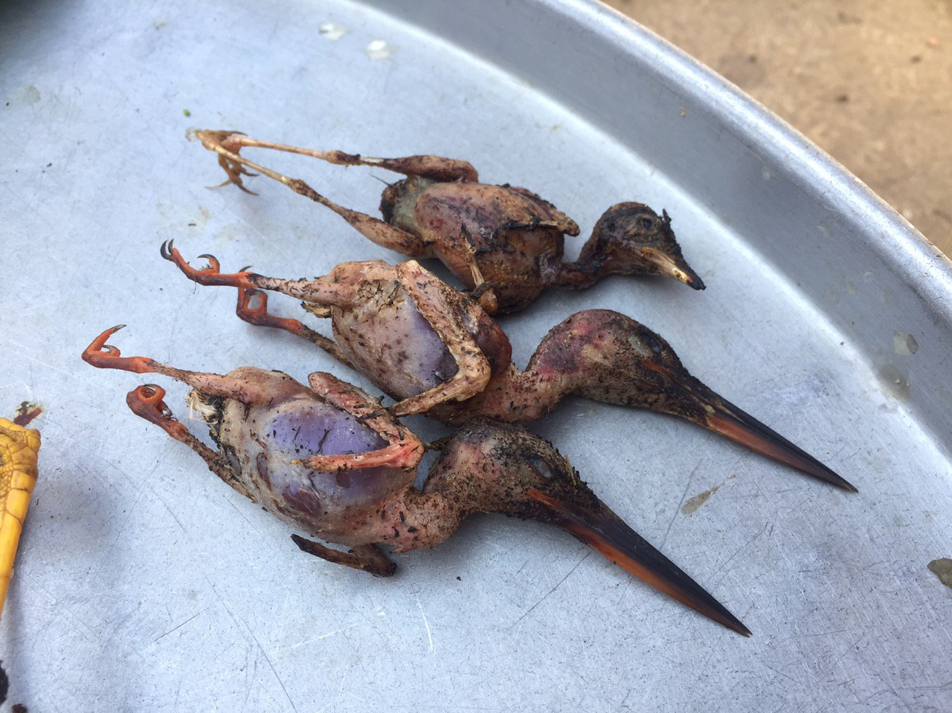
Assessing the extent of bird hunting in the Southeast Asian region from market surveys

Slide 2
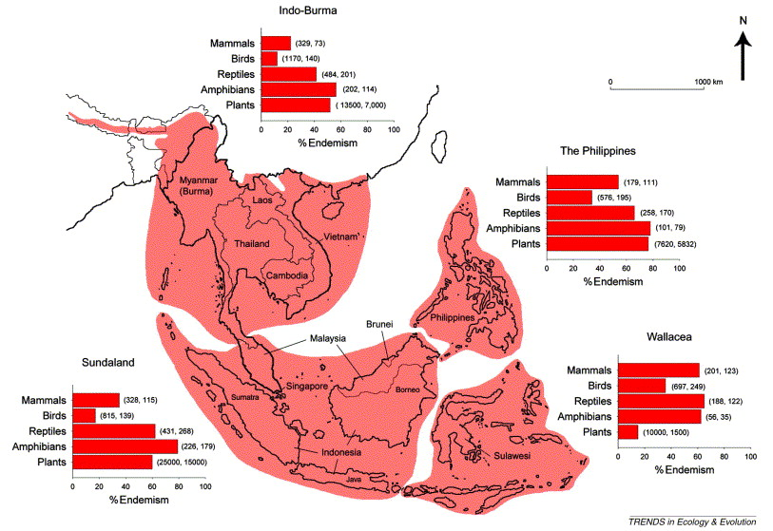
Southeast Asia – a region important for biodiversity globally

Slide 3
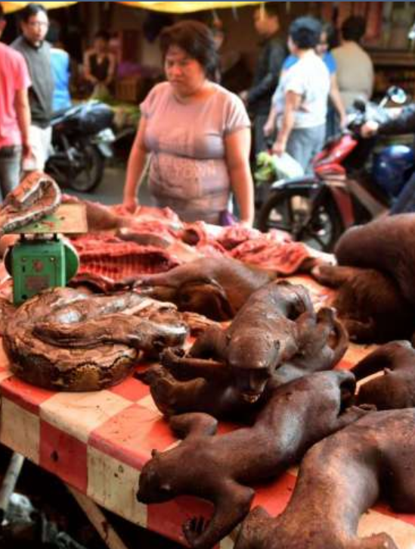
Hunting a key threat to wildlife in Southeast Asia
Hunting the greatest immediate threat to Southeast Asia’s biodiversity, especially vertebrates
There is also widespread targeted hunting of high‐value species
Wildlife hunting in SEA not generally considered to be sustainable
Focus on cross‐border trade is insufficient to address overexploitation of wildlife because hunting of wildlife also significant at local scales
Wild meat in Indonesian markets (Source: The Straits Times)

Slide 4
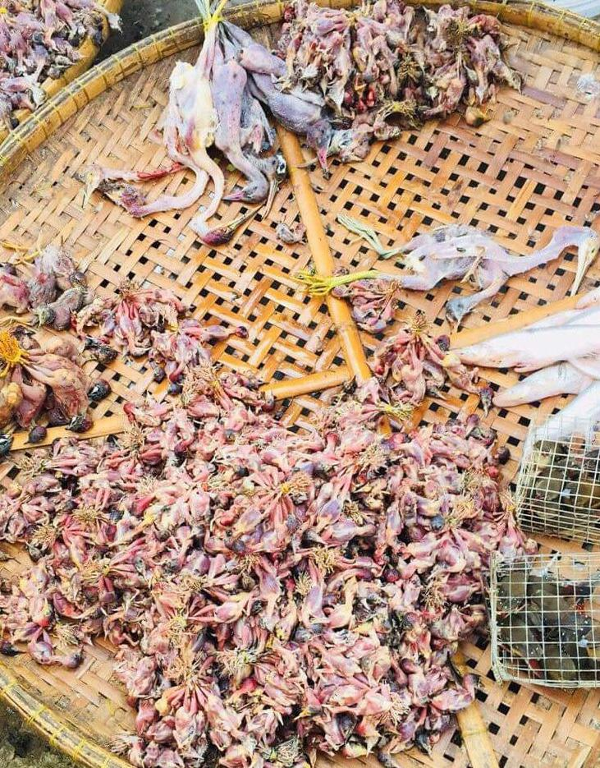
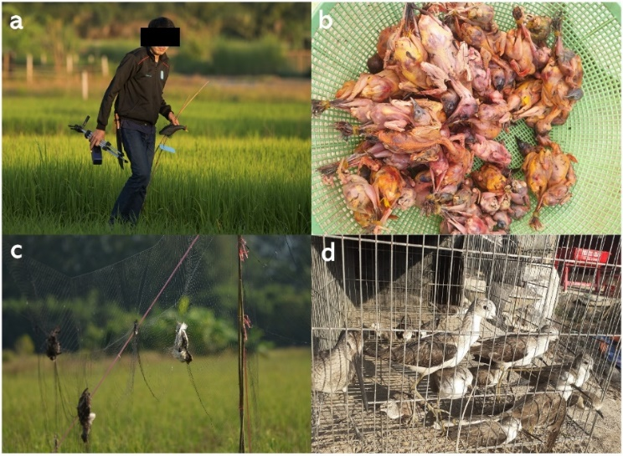
Scale of bird hunting in Southeast Asia
Large numbers of waterbirds taken across the region for food (and domestic trade for wild meat)
Also large scale trapping of small-bodied birds like swallows, wagtails, buntings in many parts of Indo-Burma
Little systematic survey of bird hunting and trade (at local level) for food and other uses
Wild birds harvested by farmers from rice fields in SE Asia (Source: Anon)

Slide 5
Objectives of BirdLife-led situation analysis on bird hunting
To develop an assessment and synthesis of wildlife protection and protected area legislation in each Southeast Asian country
To identify the scale of (lethal) hunting of birds and develop a quantitative assessment of species being hunted.
To develop road-map(s) for subsequent efforts and action plans at the national level to tackle illegal hunting and trade
  Provide evidence base for monitoring, policy changes and enforcement
  Contribute to the work of the CMS-EAAFP Task Force on the Illegal hunting, taking and trade of migratory birds

Slide 6
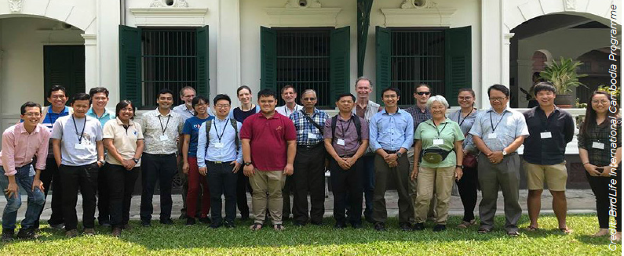
Multi-country team
Wildlife Conservation Society Lao PDR
NatureLife Cambodia
Biodiversity and Nature Conservation Association
Viet Nature Conservation Centre

Slide 7
(Snapshot) market surveys in Indo-Burma countries
Geographic scope (Laos, Vietnam, Cambodia and Myanmar); focus on provincial capitals
Determine species diversity and relative abundance (of hunted species)
Each market is typically sampled once between Sep 2019- Mar 2020
1-2 experts to walk through markets to check stalls selling wild birds and bird meat

Slide 8
Considerations and limitations
Snapshot – hard to determine turnover over the day and season
Not all markets have stalls/vendors selling wildlife or birds
Anxiety from sellers
  Difficulties in getting information from vendors on site
Not all of what is sold may be exhibited

Slide 9
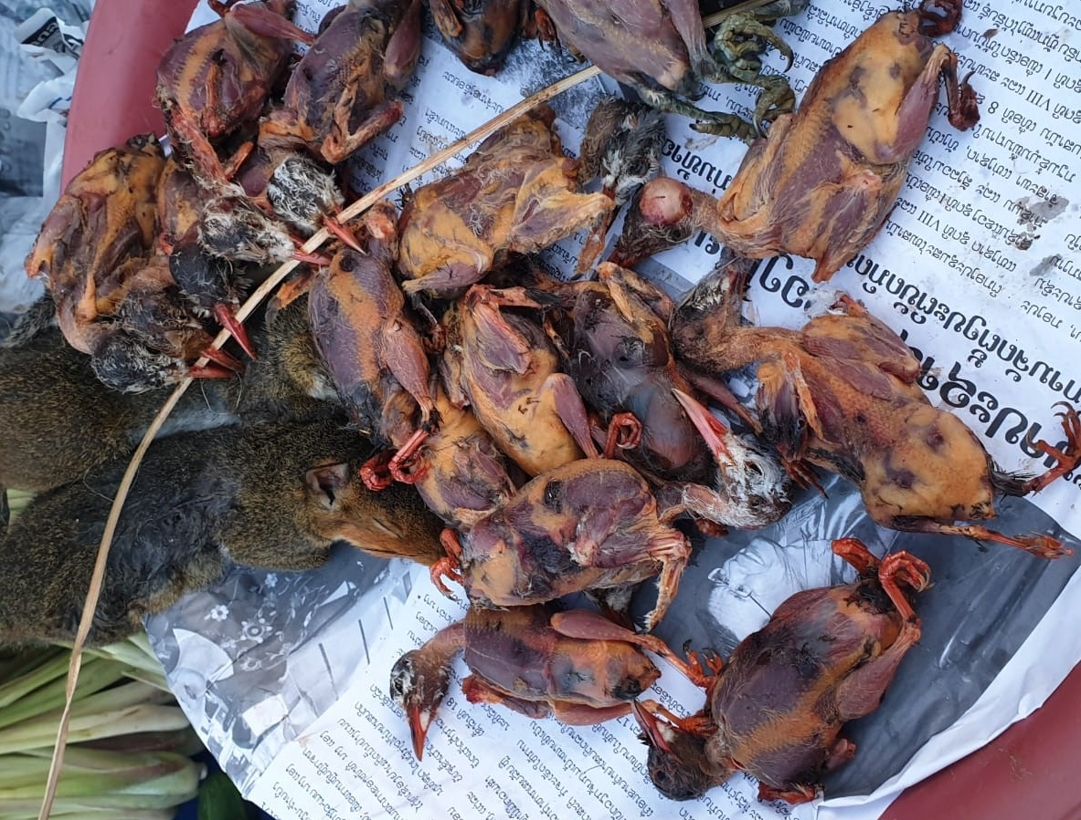
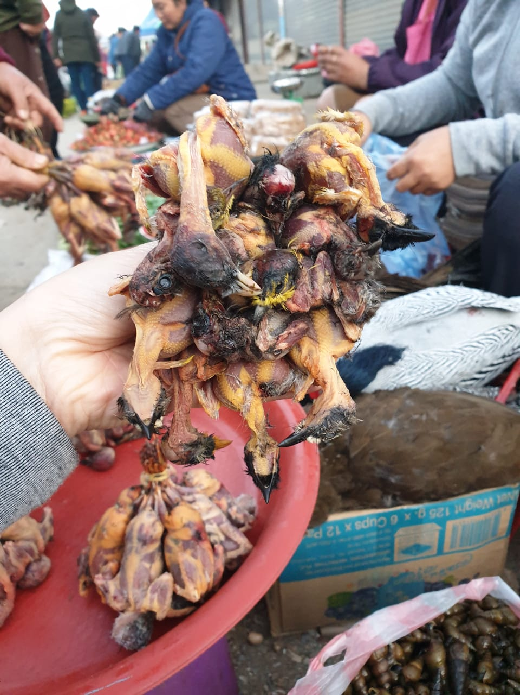
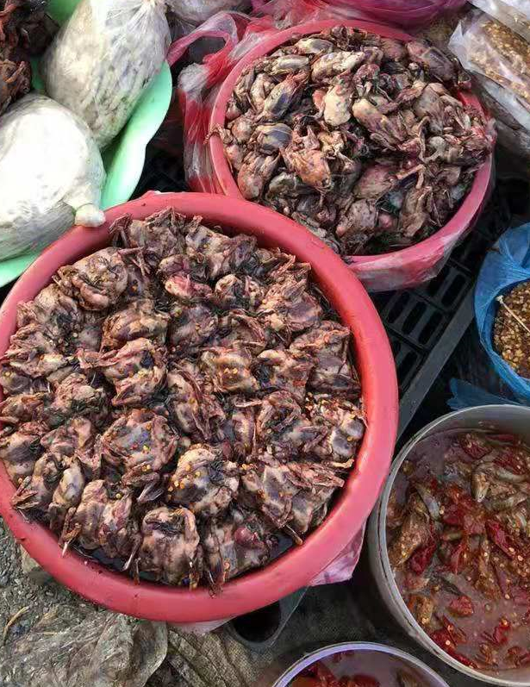
Xiangkhouang- Paek market

Slide 10
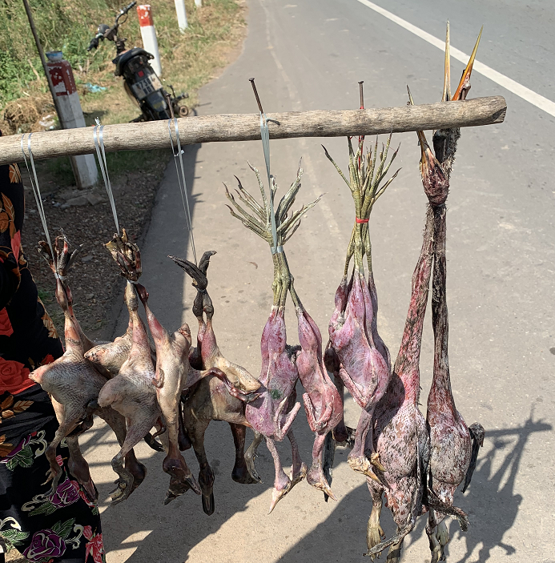
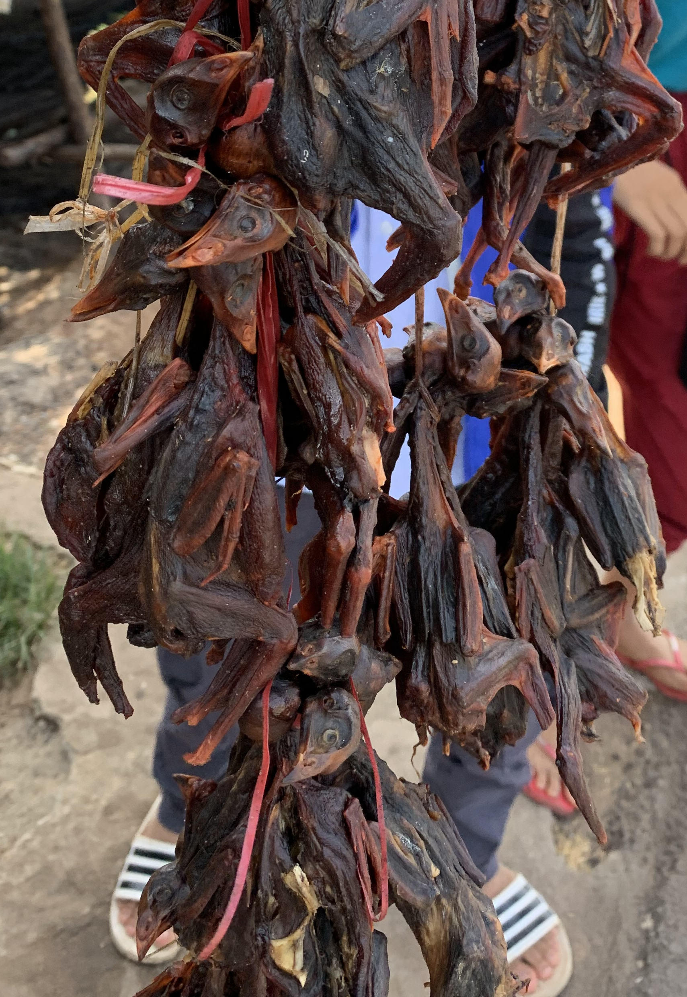
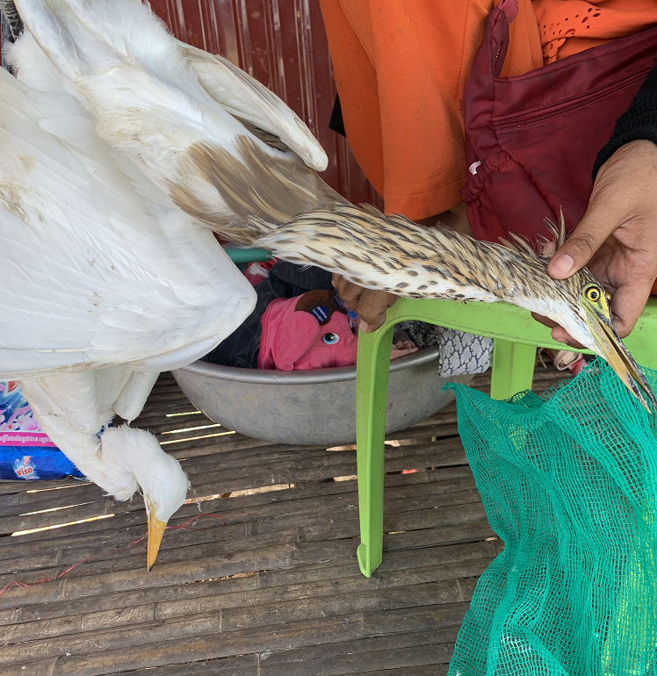
Kampong Cham - Banteay roadside market

Slide 11
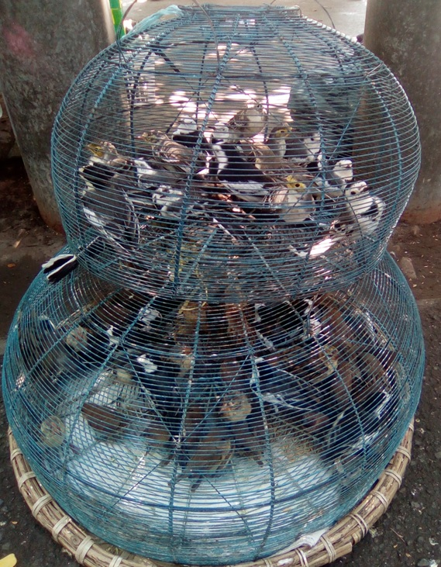
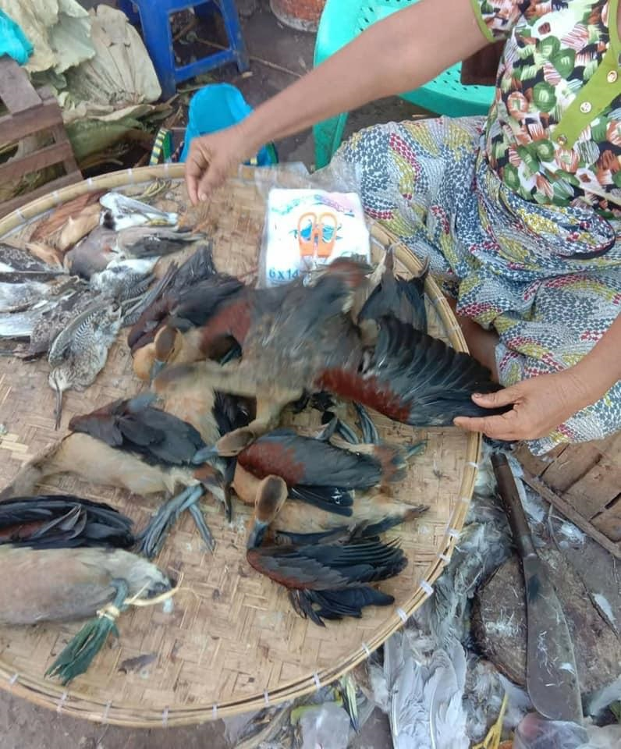
Mandalay market 1

Slide 12
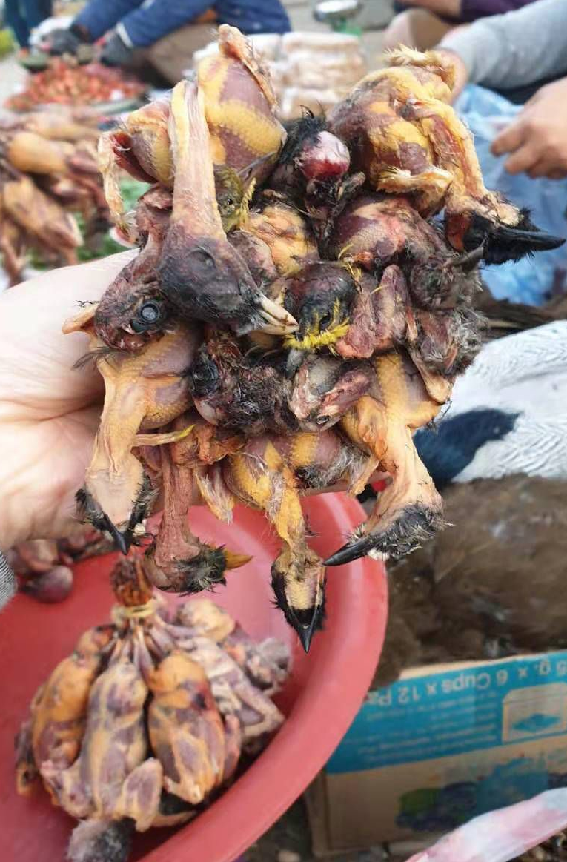
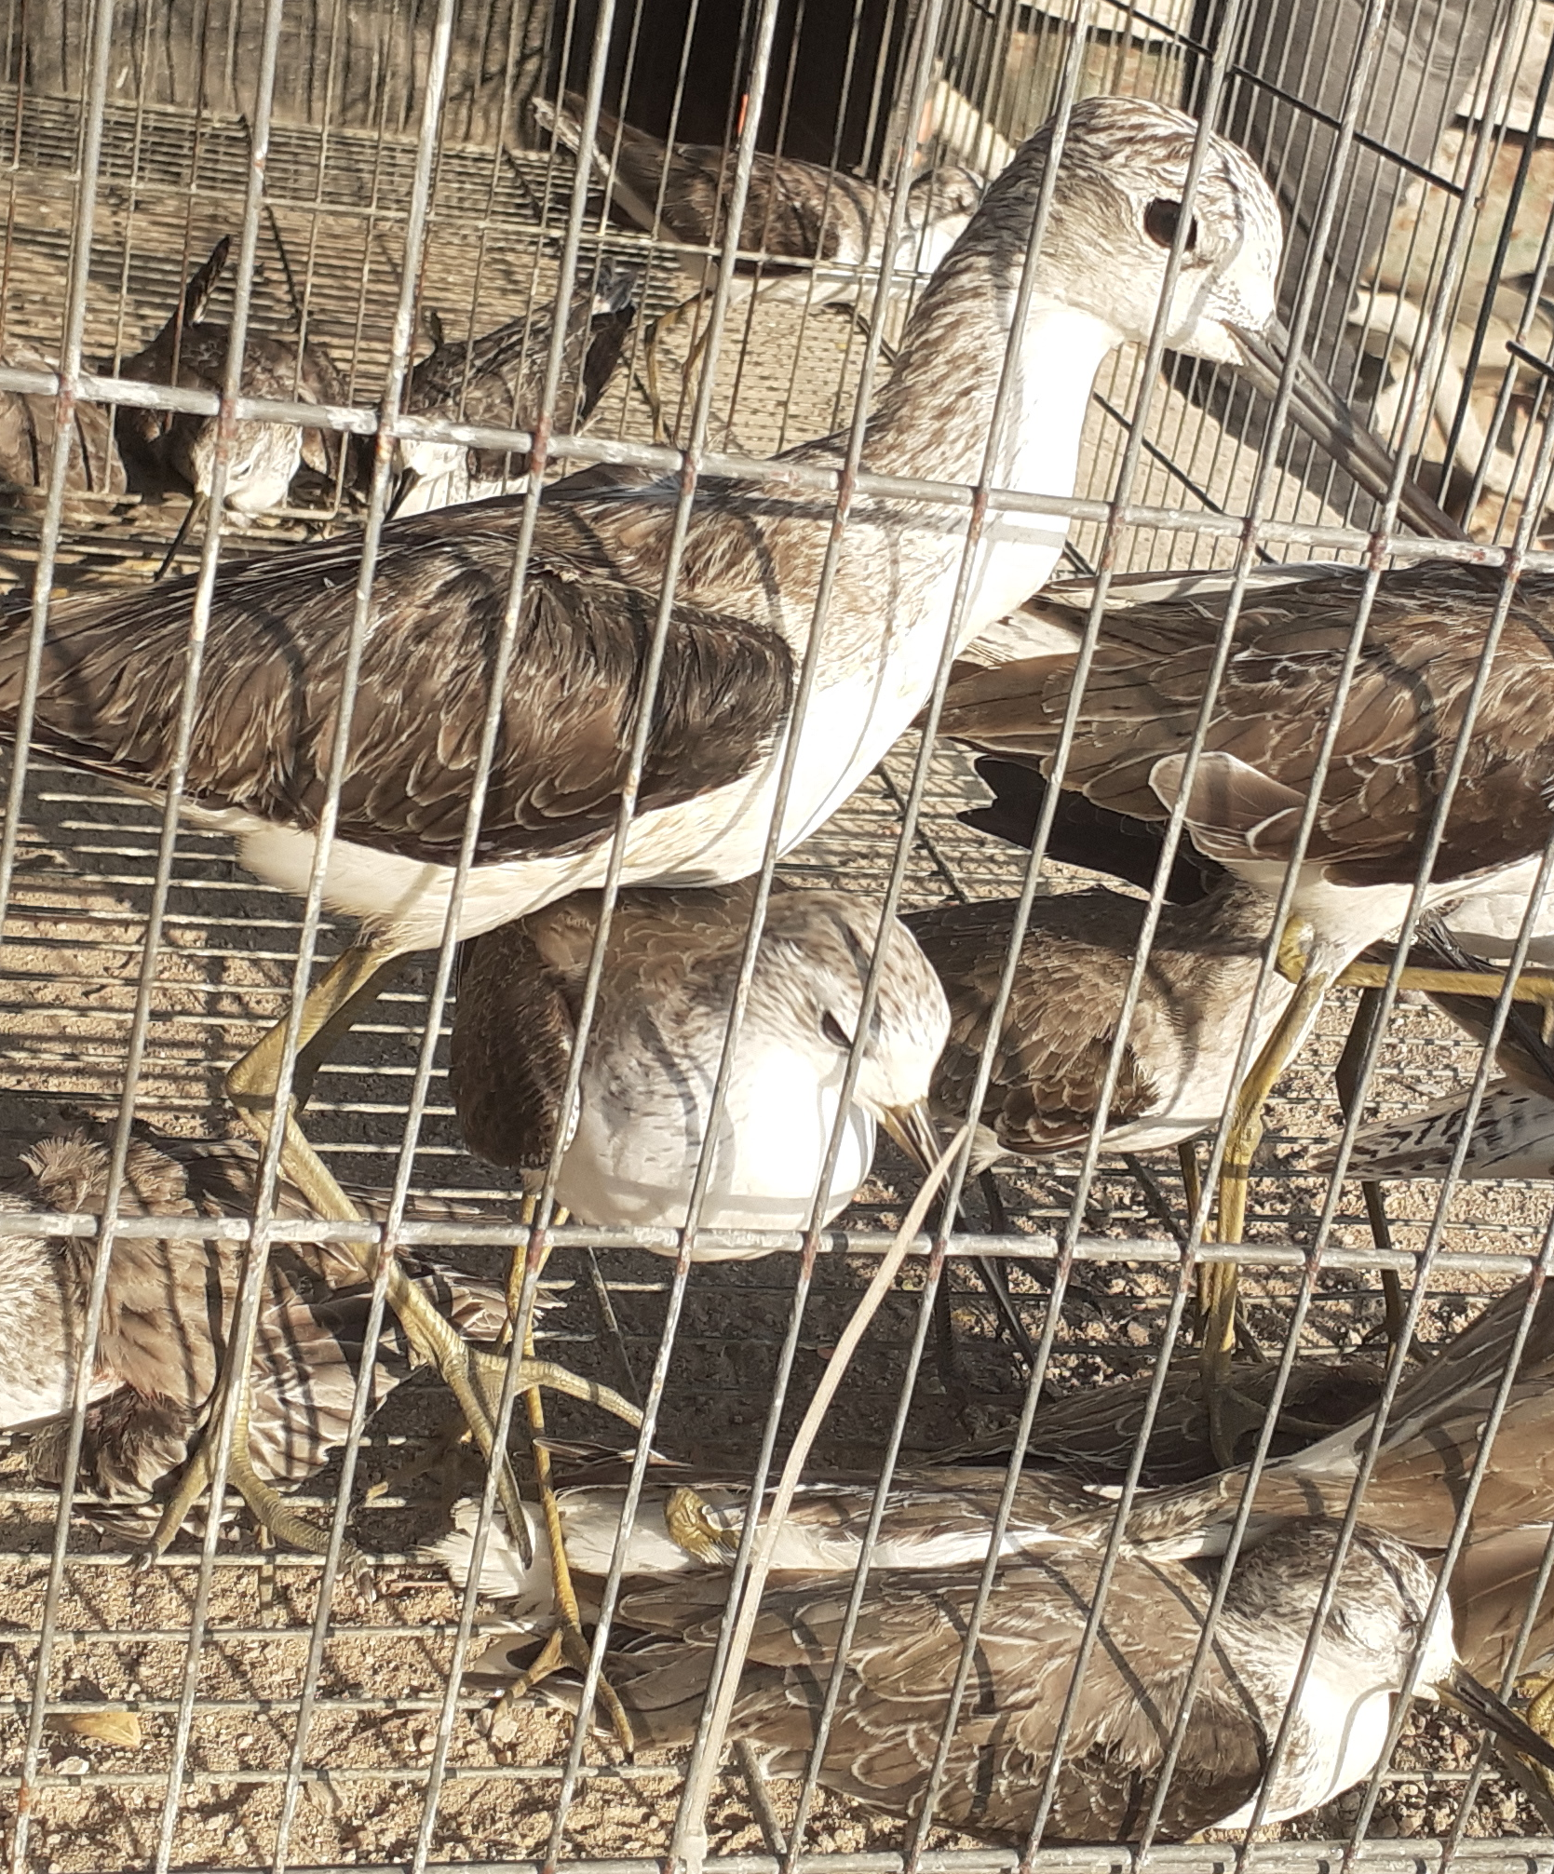
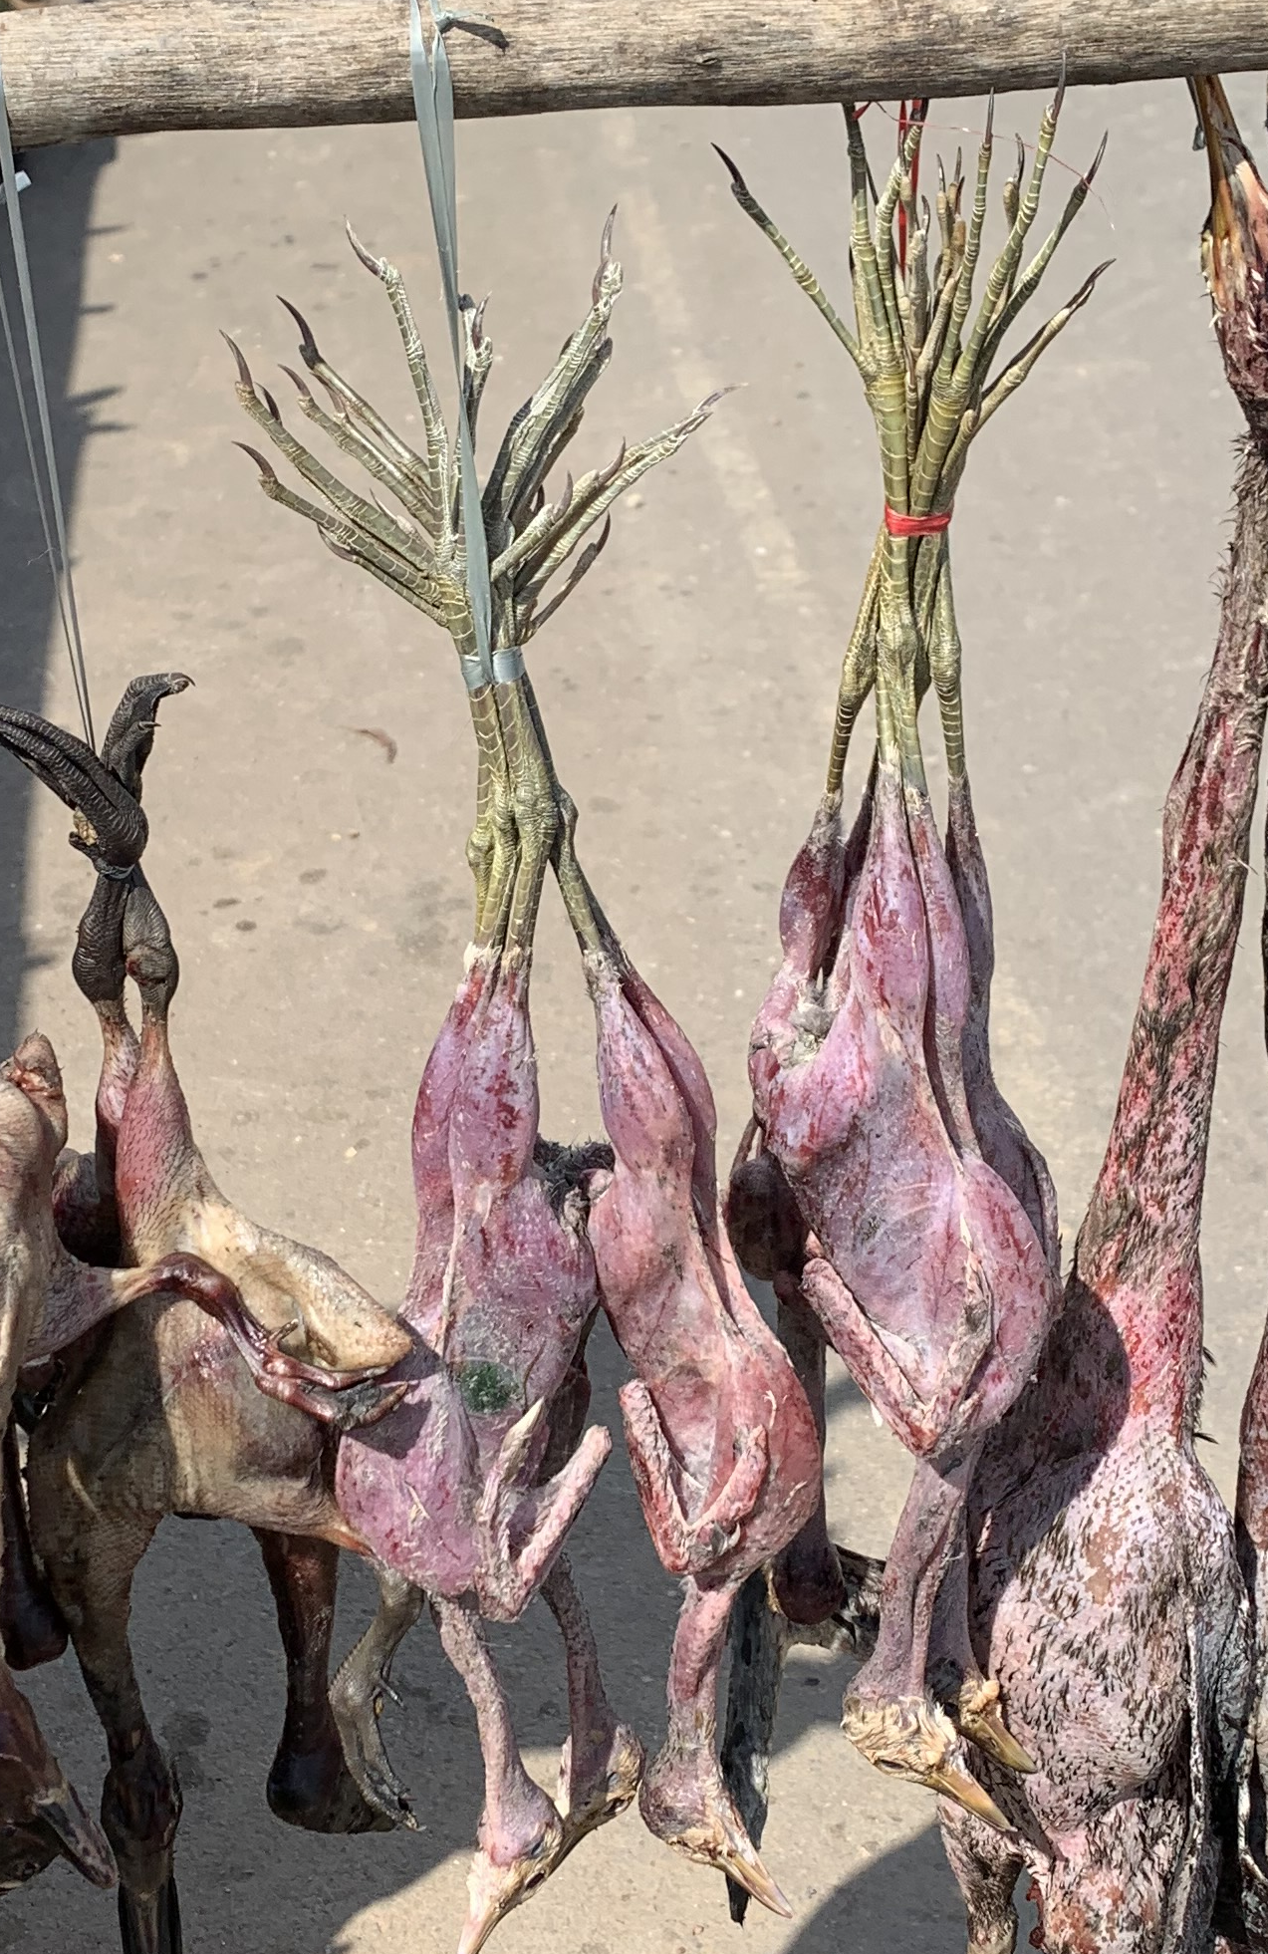
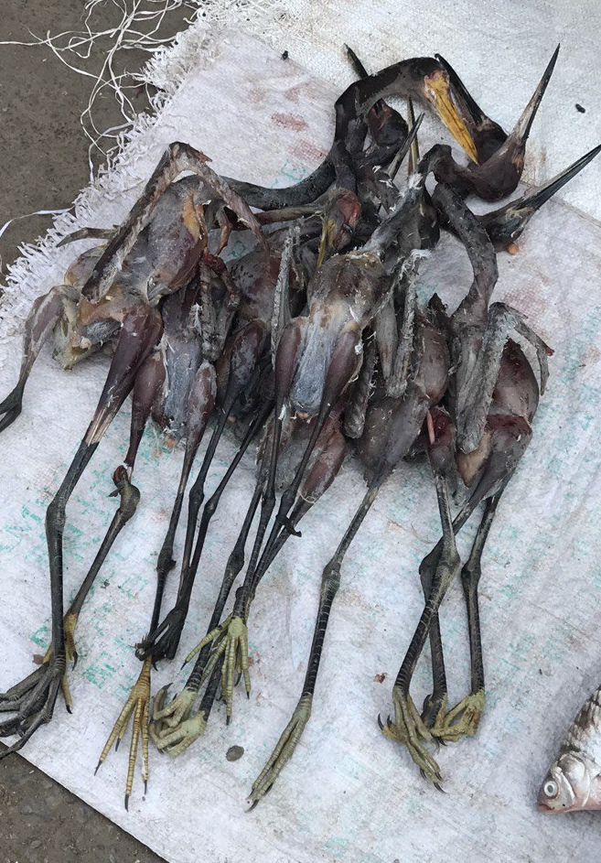
Key groups of species documented
Shorebirds trapped from intertidal flats and fishponds
Herons and bitterns in paddy fields
Rails and crakes in paddy fields
Passerines in paddy fields, marshes and forests

Slide 13
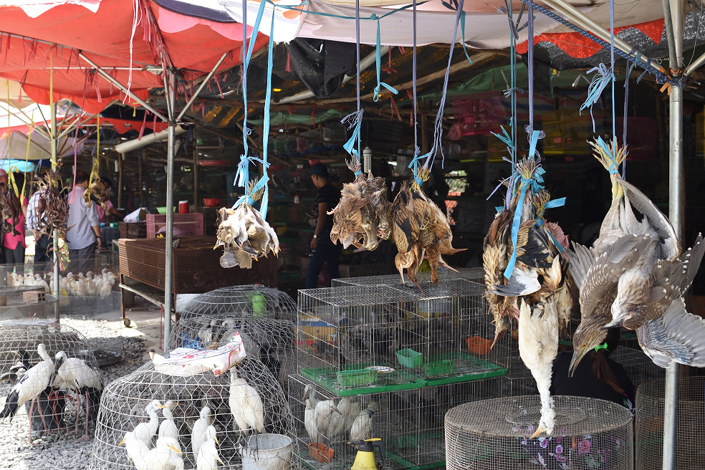
Evidence of large-scale trade of waterbirds for food
Widespread and open trading of wild birds in food markets in Vietnam (left) and Myanmar (right)
Notes:
Surveys in Mekong delta, Vietnam – commercial sale of mostly waterbirds
(Nguyen Hoai Bao) – over 120 bird species hunted in Vietnam alone

Slide 14
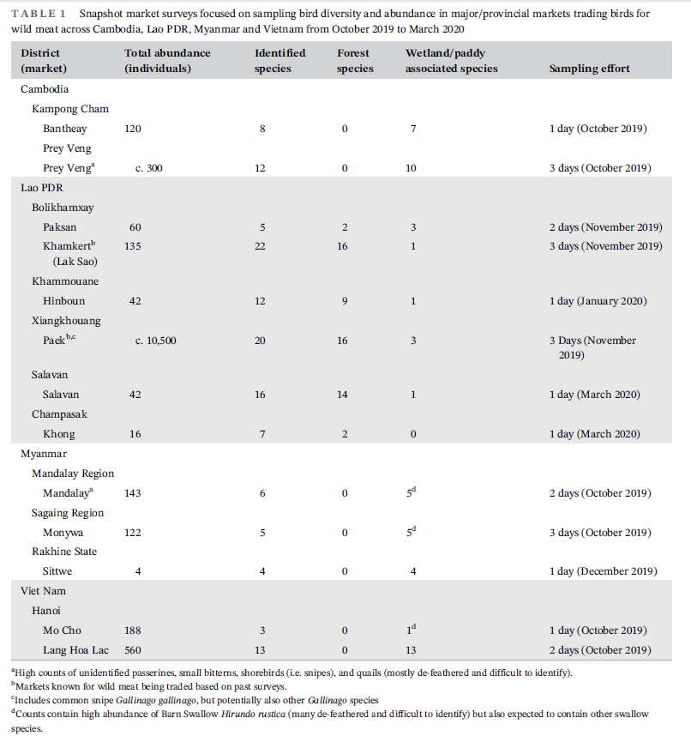
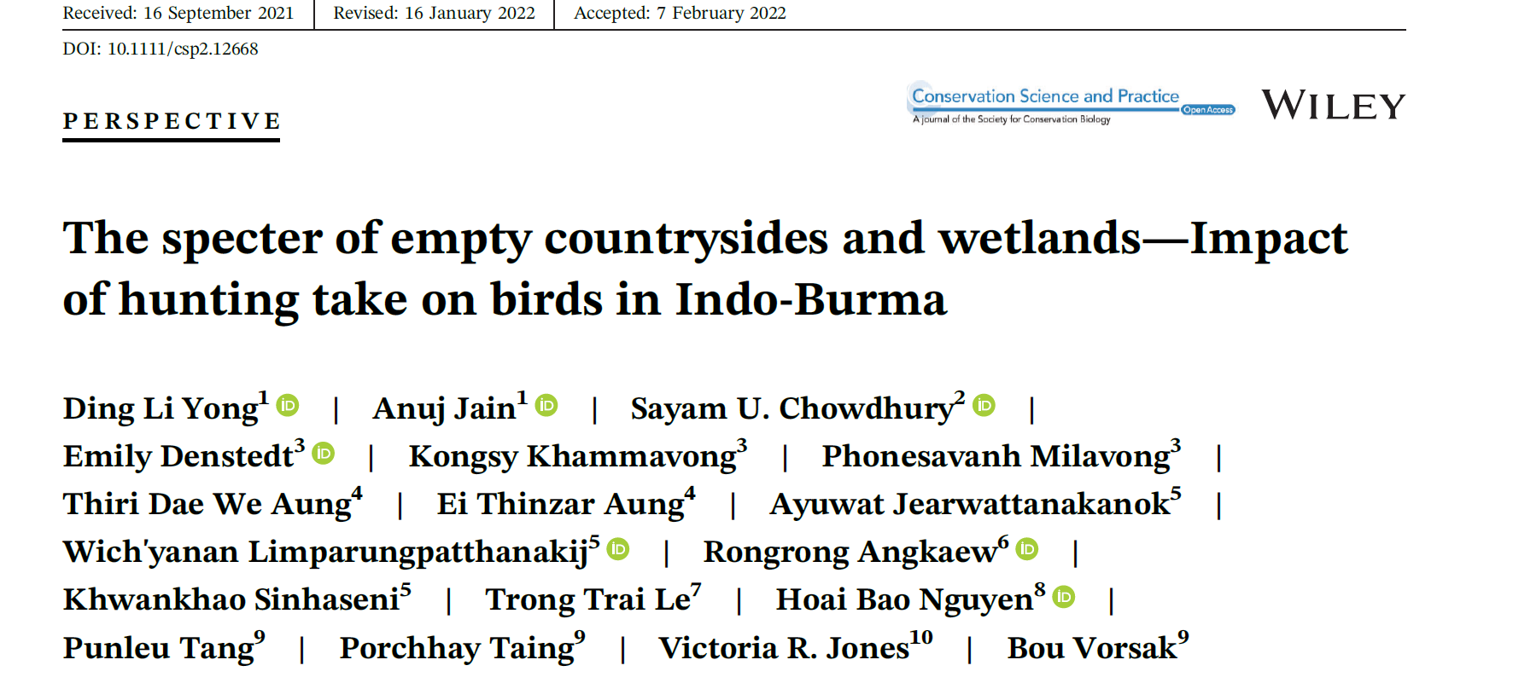

Slide 15
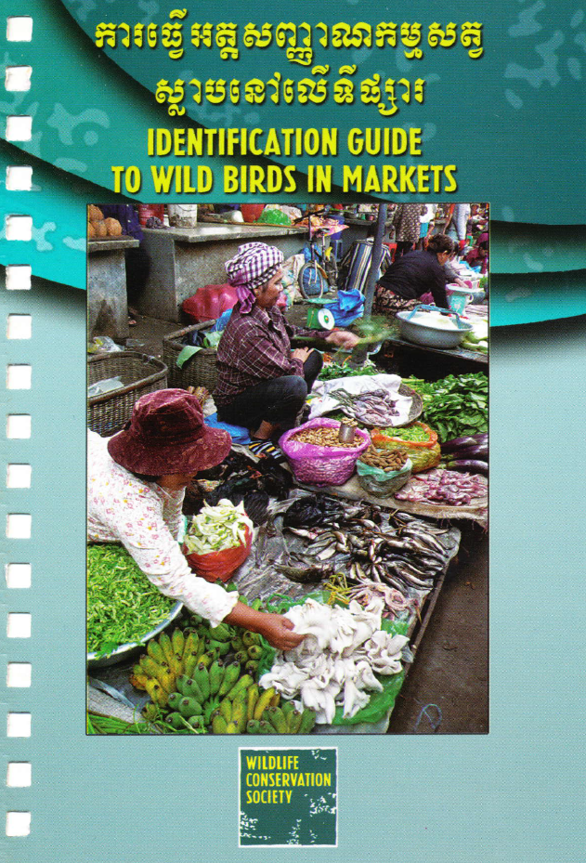
Lessons learnt
Hard to determine turnover over the day (and season) so data is essentially ‘snapshot’
Hard to identify species in limited time window, or if birds sold were de-feathered
Not all markets have stalls/vendors selling wildlife or birds
Wild birds (and bird meat) often sold alongside fish and vegetable vendors (who may pick it up from middlemen in morning or afternoon). Some sold for merit releases
Not all of what is sold may be exhibited

Slide 16
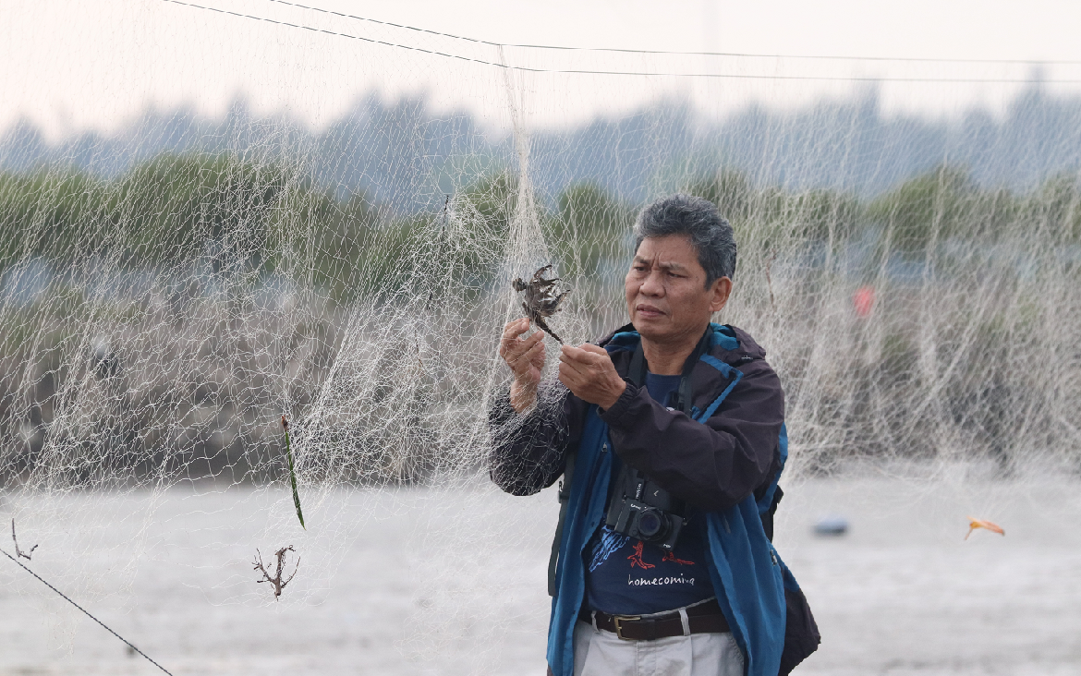
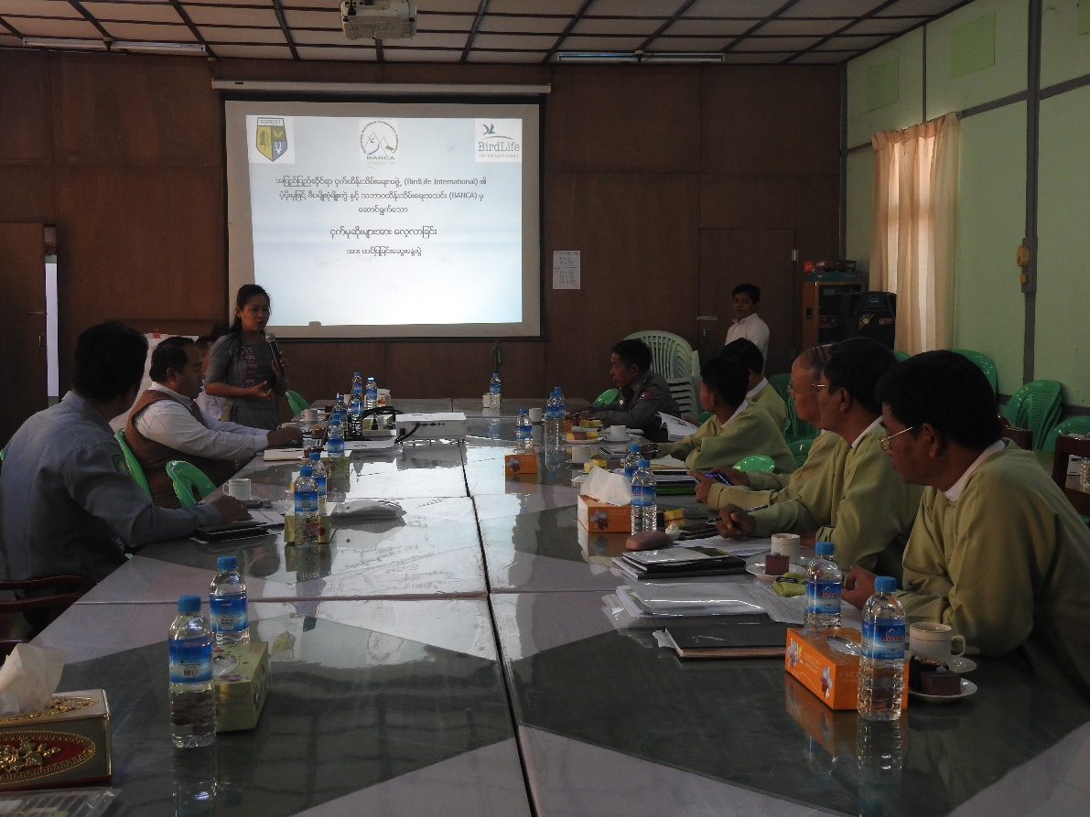
Feedback of bird hunting survey findings to governments
Myanmar
Thailand
Cambodia
Vietnam
Malaysia
Lao PDR

Slide 17
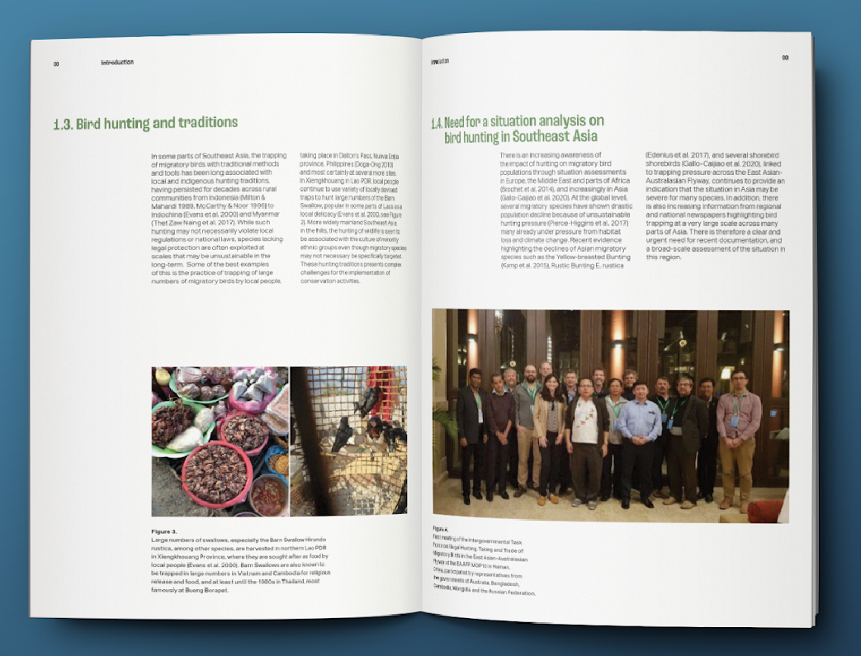
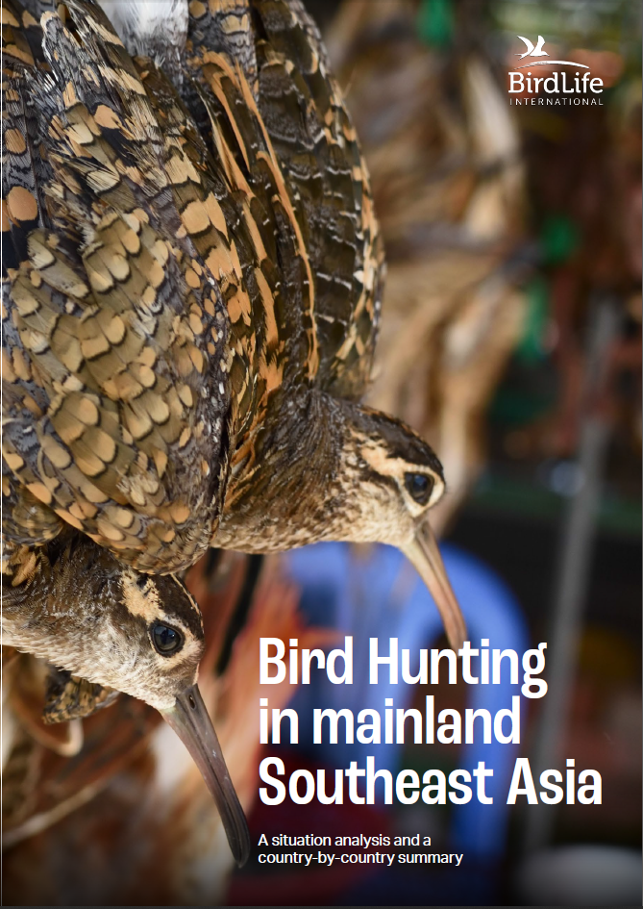
Situation analysis to be released at CMS COP in 2024

