Slide 1
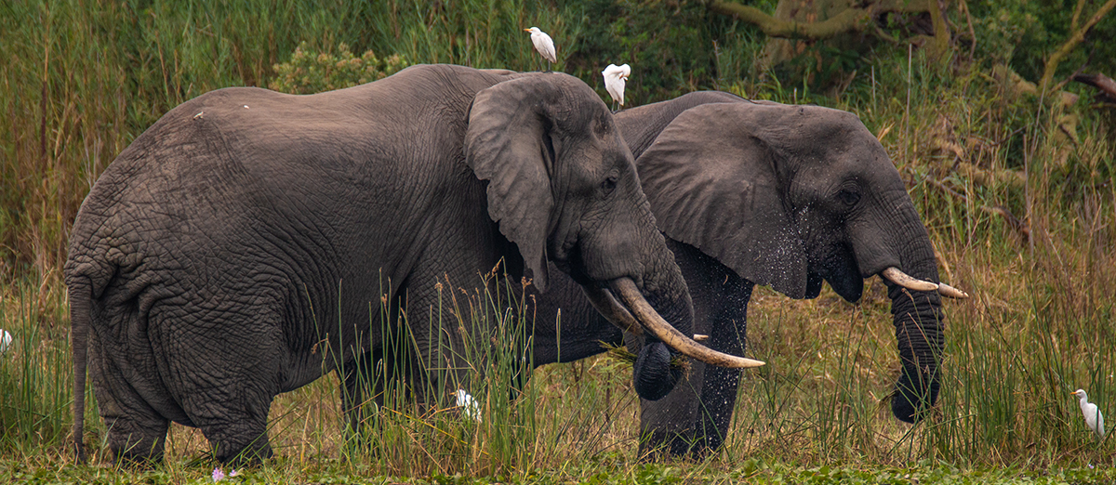
Convention on Migratory Species
Third Meeting Of The Signatories To The Memorandum Of Understanding Concerning Conservation Measures For The West African Populations Of The African Elephant (Loxodonta Africana)
30 November and 1 December 2021
Future of the MOU

Slide 2
Background
The African Elephant MOU was established in 2005
There are 13 Signatories to the MOU.
The MOU was concluded to address the dire status of elephant populations in West Africa
Attached to the MOU is the Strategy for the Conservation of West African Elephants. However, this was never fully implemented.
The funding of the MOU has been a challenge, resulting in inadequate coordination and implementation of the MOU.
At the CMS COP10 (Norway, 2011) it was decided that MOU implementation would no longer be funded.

Slide 3
Policy developments since 2005
At the Conference of the Parties to CITES (COP15, Doha, 2010) African Elephant Range States came together to negotiate and agree the African Elephant Action Plan (he AEAP).
The AEAP was agreed by all 37 African elephant Range States.
CMS COP12 (Philippines, 2017) endorsed opted CMS Resolution 12.19 recognizing the AEAP as the principal strategy for the conservation of African Elephants.
At the same time the African Elephant Fund (AEF) was established to allow Range States to implement the Plan.
In 2019, the Range States decided to start a process to update the AEAP. The revised plan should become available in 2022.

Slide 4
In the margins of COP13 (India, 2020) there was an informal meeting of Signatories to the West African Elephant MOU.
It became apparent that many representatives of the Signatories at COP were not very familiar with the MOU.
As a result of this informal meeting COP13, CMS Parties adopted Decisions 13.99 – 13.100 African Elephant Action Plan, providing:
Decision 13.99: The Signatories of the West African Elephant MOU) are encouraged to consider replacing their Work Programme with the African Elephant Action Plan (AEAP) and to implement the MOU through the AEAP and the African Elephant Fund structure. The Signatories of this MOU are encouraged to meet and decide on the future of this MOU.
Decision 13.100: Subject to external resources, the Secretariat shall facilitate communication among the Signatories of the West African Elephant MOU, in order to assist their discussions and catalyze conclusions as per Decision 13.99.
In line with Decisions 13.99-13.100, the Secretariat has organized this MOS3 of the MOU.

Slide 5
IUCN species nomenclature and Red List Assessment 2021
On 25 March 2021, the International Union for Conservation of Nature (IUCN) announced that it now recognizes L. africana and L. cyclotis as two distinct species. This is now aligned with the CMS.
the IUCN African Elephant Specialist Group revised its assessment of the conservation status of African Elephants, finding that L. cyclotis is Critically Endangered, and L. africana is Endangered.
In deliberating the future of the MOU, the Signatories are, thus, encouraged to consider the recommendation of the Scientific Council.

Slide 6
Discussion and analysis
Against the backdrop of policy developments set out above and in light of the challenges experienced by the Signatories, the Secretariat and other stakeholders in raising funds for the coordination and implementation of the MOU, a number of options can be envisaged for the future of the MOU:
Termination of the MOU
B. Amendment of the MOU
C. Maintaining the status quo
Recommended actions
The Signatories are recommended to:
Discuss options a., b. and c. on the future of the MOU.
Come to a unanimous agreement on the future of the MOU.
Direct the Secretariat to facilitate any agreed changes to the MOU, if any.

Slide 7
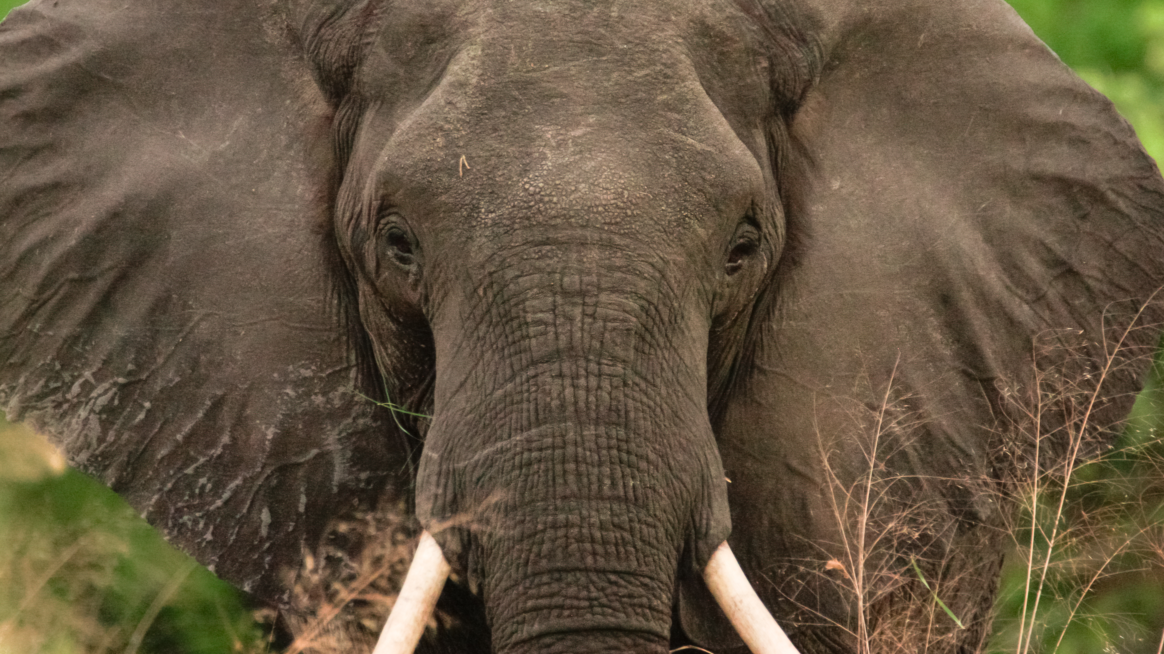
THANK YOU

