Slide 1

African Elephant Fund
Presentation at the Meeting of the CMS West African Elephant MOU Signatories
30 November – 1 December 2021

Slide 2
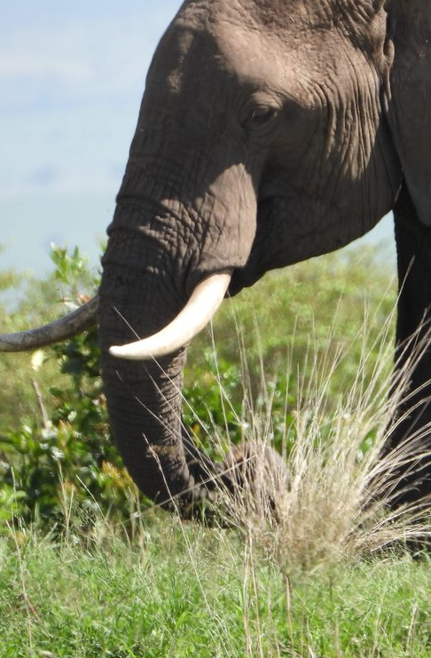
Background
The African Elephant Action Plan and the African Elephant Fund was initiated in 2007 through Decisions 14.75 – 14.79 of CITES COP14.
The African Elephant Action Plan officially adopted at CITES COP15 in 2010.
CMS endorsed the AEAP through Resolution 12.19 of CMS COP12.
CMS encouraged Signatories of the West African Elephant MOU to implement MOU through the AEAP through Decision 13.99 of CMS COP13.
CITES Resolution Conf. 16.9 of COP16 further encourages the implementation and support of the AEAP.
Notes:
At the 14th meeting of the Conference of the Parties to CITES, the Parties adopted Decisions 14.75 to 14.79 regarding the conservation of the African elephant.
These decisions mandated the African elephant range States to develop an African Elephant Action Plan and African Elephant Fund.
After a collaborative development process, African Elephant Action Plan was finalized and approved as a consensus document by all 37 (now 38) African elephant range States in the margins of the 15th meeting of the Conference of the Parties (Doha, 2010).
The Twelfth Session of the Conference of the Parties to CMS endorsed the AEAP contained in the Annex to CMS resolution 12.19 as the principal strategy adopted by the African elephant range States under the support of CITES for the conservation of African elephants.
During the CMS COP14, the Signatories of the West African Elephant MOU were encouraged to consider replacing their Work Programme with the AEAP and to implement the MOU through the AEAP and the African Elephant Fund.
Resolution Conf.16.9 on the African Elephant Fund and the African Elephant Action Plan further encourages the African elephant range States and other stakeholders to implement the AEAP and to support it through the AEF.

Slide 3
African Elephant Action Plan
To reduce illegal killing of elephants and illegal trade in elephant products
To maintain elephant habitats and restore connectivity
To reduce human-elephant conflict
To increase awareness on elephant conservation and management of key stakeholders
To strengthen range States knowledge on African elephant management
To strengthen cooperation and understanding among range States
To improve local communities cooperation and collaboration on African elephant conservation
To effectively implement the African Elephant Action Plan.
An overarching framework for actions to be taken for the effective conservation of elephants.
Sets 8 priority objectives.
Owned and managed by African elephant range States.
Review process being finalized.
Notes:
The African Elephant Action Plan was developed in recognition of the increasing threats to African elephant populations and to provide an urgent and coordinated response.
The AEAP outlines across 8 strategic objectives the actions that must be taken in order to effectively conserve elephants in Africa across their range.
It is not intended to be an exhaustive analysis of the status of elephant populations and their conservation across Africa, but rather a concise and clear statement of those activities which must be implemented and most urgently require funding if Africa’s elephants throughout their range are to be protected from the threats faced.
It is fully owned and managed by the African elephant range States.
The AEAP is currently undergoing a review process to update it to reflect the current realities. Inputs have been received from the African elephant range States and other stakeholders which are being consolidated into the final document. This will be circulated to the range Stated for final review and endorsement.

Slide 4
Governance of the AEF
38 African Range States
Western Africa
Eastern Africa
Benin, Burkina Faso, Côte d’Ivoire, Ghana, Guinea, Guinea-Bissau, Liberia, Mali, Niger, Nigeria, Senegal, Sierra Leone, Togo
Eritrea, Ethiopia, Kenya, Rwanda, Somalia, South Sudan, Tanzania, Uganda
Central Africa
Southern Africa
Cameroon, Central African Republic, Chad, Democratic Republic of Congo, Gabon, Republic of Congo, Equatorial Guinea
Angola, Botswana, Eswatini, Lesotho, Malawi, Mozambique, Namibia, South Africa, Zambia, Zimbabwe
Notes:
The African Elephant Fund is composed of the 38 African range States that adopted the African Elephant Action Plan, donors and ex-officio members.
It should be noted that the focal points for the AEF and the West Africa MOU signatories are different.

Slide 5











Governance of the AEF Cont.
Donors
Belgium, China, European Commission, France, Germany, Netherlands, South Africa, United Kingdom
Ex-Officio Members
UNEP
CITES
CMS
Notes:
CITES - Convention on International Trade in Endangered Species of Wild Fauna and Flora
CMS - Convention on Migratory Species

Slide 6
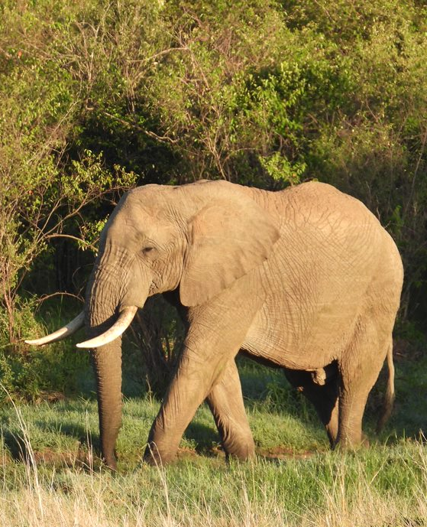
Governance Cont:
AEF Steering Committee
The African Elephant Fund(AEF) is governed by the AEF Steering Committee.
The Steering Committee is guided by the Terms of Reference and Rules of Procedure.
Current Composition:
8 Range States (Cameroon, Chad, Namibia, Niger, Tanzania, Uganda, Zimbabwe).
3 Donor Members (European Commission, France, Netherlands).
3 Ex-Officio Members (CITES, CMS, UNEP).
Notes:
The African Elephant Fund Steering Committee is the main decision making organ for the African Elephant Fund and supports and advises the African elephant range States on the implementation of the Action Plan.
In consultation with the 38 range States, donors, ex-officio members and other stakeholders, the ToRs and RoPs of the AEF were developed. These detail the purpose, authority and scope of the AEFSC and its operations. The review and updating of the ToRs is currently being finalized.
As per these documents, the Steering Committee is composed of eight African elephant range States, three donor States and three ex-officio members.
The membership of the Steering Committee is valid for three years. The current membership runs from 2021 - 2023.
The Chair and Vice-Chair positions are held by members from the same region on a rotational basis amongst the 4 sub-regions and serve for three years. The current Chair and Vice-Chair are from the Central Africa sub-region.
In addition, Belgium and Germany are observer donors to the AEFSC.

Slide 7




Role and Functions of the AEF Steering Committee
Administration
Administration
Proposal Selection
Proposal Selection
AEFSC Elections
Resource Mobilization
Advisory
Oversight
Monitor the overall implementation of the AEAP
Establishment of mechanisms for AEF’s operations
Evaluation and selection of project proposals to be funded
Consult and advise range States in collaborative activities
Notes:
As mentioned, the ToRs outlines the role of the AEFSC. The key responsibilities include:
Monitor and evaluate the overall implementation of the AEAP.
Establishment and implementation of appropriate mechanisms for the operation of the Fund, including issuing calls for proposals, reporting requirements, monitoring and evaluation, and awareness-raising and outreach tools.
Evaluation and selection of project proposals submitted by the African range States when a call for proposals is issued.
Consult, advise and support range States in collaborating in order to minimize duplication of efforts in the allocation of money from the Fund or in implementing actions under the AEAP.

Slide 8
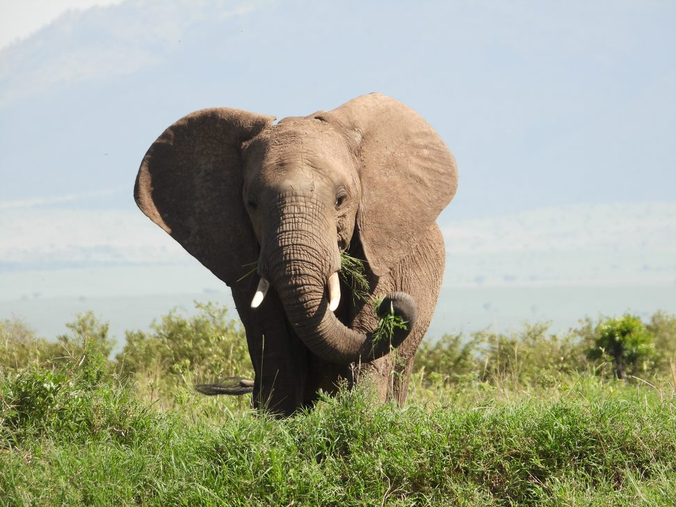

Role and Functions of the AEF Secretariat
Hosted by UNEP
Financial and administrative support to AEF and AEFSC
Communication/liaison
Visibility
Resource Mobilization
Notes:
The AEF Secretariat, hosted by UNEP, supports the AEF and the AEFSC in carrying out its functions to ensure that its objectives are met.
It provides administrative support and prepares the Fund’s financial and progress reports on the implementation of approved projects being implemented.
It coordinates the activities of the AEFSC (meetings, etc.) and the Fund including issuing calls for project proposals, pre-evaluation of project proposals received and monitoring implementation of approved projects. It also disburses the funds to the implementing partners.
It also maintains and promotes liaison between the AEFSC, governments, implementing partners and other stakeholders.
It develops the communication/visibility materials for the promotion of the AEF.
The AEF Secretariat also identifies and explores fundraising and resource mobilization opportunities for the Fund.

Slide 9
Implementation of the AEAP
66
Projects Initiated
40
Projects Completed
26
Projects Ongoing
4.8M
USD Funding Received
3.6M
USD Funding Allocated
Covid-19 Response
19
Projects Approved
2
Projects Completed
13
Projects Ongoing
Notes:
Since the inception of the AEF, 66 projects have been initiated of which 40 have been completed and 26 are currently marked as ongoing.
The Fund has received USD 4,834,206 to date, of which USD 3,625,396 has been allocated to the various projects.
In 2020, in response to the outbreak of the Covid-19 pandemic, the AEF issued an emergency call for proposals to provide funding to range States to address elephant conservation challenges related to the pandemic.
19 project proposals were approved for a total funding of USD 933,590.
2 projects have been completed, 13 are ongoing and 3 are undergoing payment processing.

Slide 10

Implementation of the AEAP Cont.
Projects completed per region
West Africa: 12 Projects
Southern Africa: 10 Projects
Multi-country: 2 Projects
East Africa: 11 Projects
Central Africa: 5 Projects
Notes:
Of the 40 projects completed, 12 projects were implemented in the West African sub-region, 5 in Central Africa, 11 in East Africa and 10 in the Southern Africa sub-region.
2 projects were cutting across the range States, both implemented by the IUCN. This included the project on preparing technical inputs for the revision of the AEAP.

Slide 11
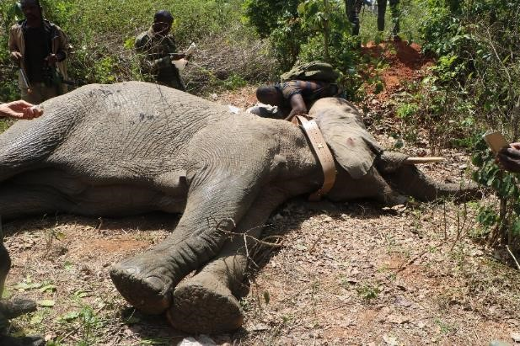
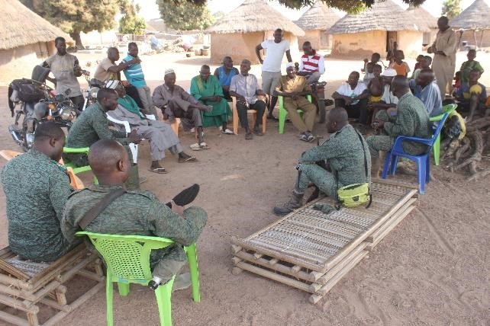

General Achievements and Impacts of the AEAP
Objective 1: Improvement in national legislation and enforcement capacity.
Objective 2: Use of monitoring systems to track elephants and restoration of elephant corridors.
Objective 3: Use of technologies to reduce elephant encroachment.
Objective 4: Capacity building of law enforcement officers and other stakeholders.
Objective 5: Improved technologies for DNA testing for traceability studies.
Objective 6: Increased joint actions among range State governments.
Objective 7: Closer collaboration between local communities and enforcement agencies.
Training on strengthening law enforcement against poaching and ivory trafficking in Uganda
Fitting of elephant tracking collars in Cote d’Ivoire
Community sensitization meeting in Cote d’Ivoire
Capacity building on alternative elephant pushback techniques in Ghana
Notes:
Reduced illegal killing of elephants and illegal trade in elephant products: There is a marked improvement in national legislation and enforcement capacity. Increased persecution and conviction rates and institution of more stringent penalties.
Maintenance of elephant habitats: There has been an increase in the use of monitoring systems to track elephants and restoration of elephant corridors.
Reduced HEC: More range States are employing technologies to reduce elephant encroachment into farmland and human settlements.
Increased awareness on elephant conservation: There has been an increase in capacity building activities for law enforcement officers and other stakeholders.
Increased awareness on elephant management: Use of improved technologies for DNA testing for traceability studies which has further contributed towards informing conservation efforts (e.g. understanding elephant population distributions, their genetic diversity).
Strengthened cooperation and understanding among range States: Through various projects, there have been more joint actions among range State governments to generate and share knowledge on the conservation of the African elephant.
Improved cooperation of local communities on African elephant conservation: There is more involvement of local communities by governments and enforcement agencies in elephant conservation and management activities.

Slide 12

For more Information, visit AEF website: www.africanelephantfund.org
Or email us at: africanelephantfund@unep.org
Thank You
Get Involved
African Elephant Fund
United Nations Environment Programme
P.O Box 30552, Nairobi 00100, Kenya
Email: africanelephantfund@unep.org
www.africanelephantfund.org

