Slide 1


African forest and savanna elephants treated as separate species: Implications
Rob Slotow¹, Kathleen Gobush², John Hart³, Ben Okita-Ouma¹ and Mohammed Yahya⁴
¹Co-Chairs, IUCN SSC African Elephant Specialist Group
²AfESG Red-list Authority Coordinator
³AfESG Taxonomy Task Force Convenor
⁴AfESG Programme Officer
Third Meeting Of The Signatories To The Memorandum Of Understanding Concerning Conservation Measures For The West African Populations Of The African Elephant (Loxodonta Africana)
30 November and 1 December 2021

Slide 2
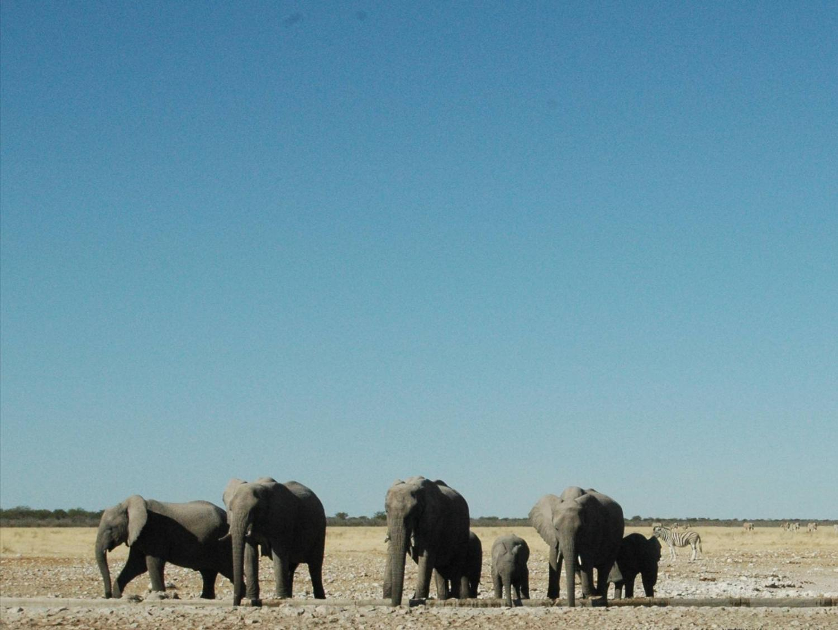
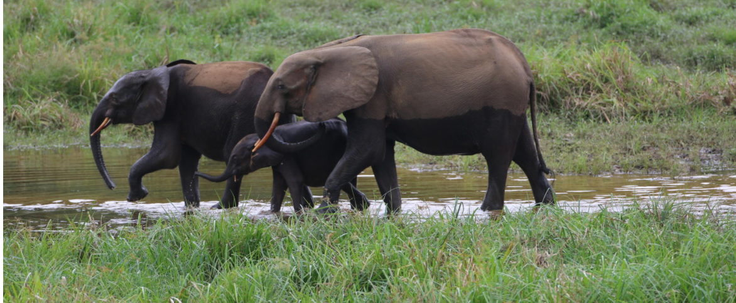
IUCN Red List Assessments for African Elephants

Slide 3
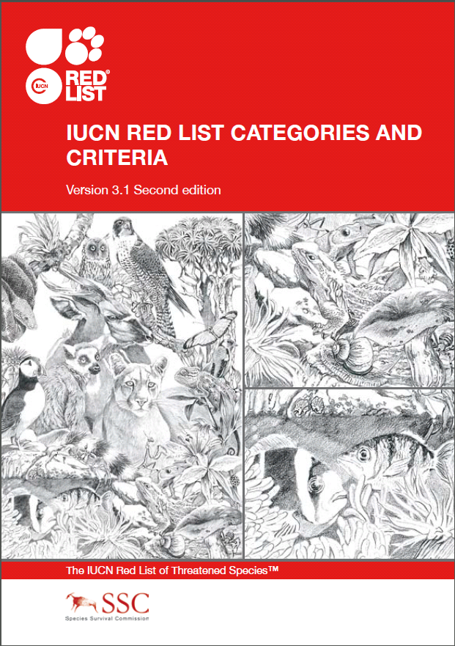
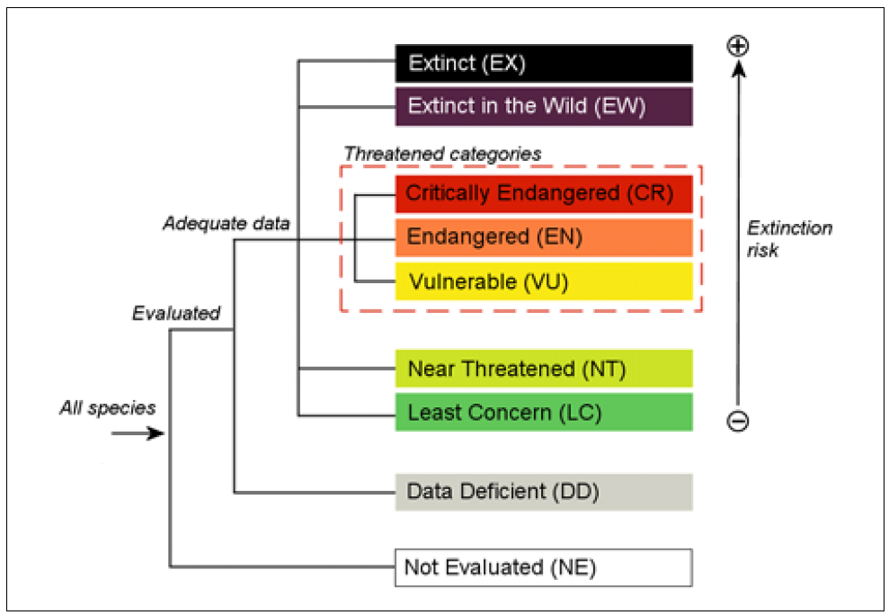
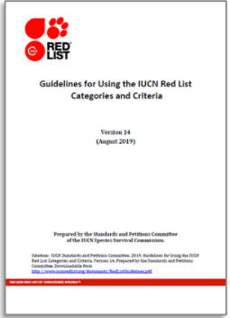
IUCN Red List Catégories & Criteria
http://www.iucnredlist.org/documents/RedListGuidelines.pdf
Notes:
The IUCN Red List examines risk of extinction and categorizes species into 1 of 8 categories ranging from least concern to extinct in wild etc. according to standardized criteria; the Red List can be considered to be a global database on how species are faring worldwide; more than 130k species have been assessed to date.
Our team was tasked with biologically RE-assessing the risk of extinction of the two African elephant species using as much available data as possible and according to the IUCN Red List Guidelines (2019, v1.4)
Assessments and Supp Materials doc on website. Our model code is available upon request. Shared process summaries along the way; presented prelim results in July 2019 in person meeting and Q&A today.

Slide 4
Red List Assessment of the African elephant
A team of six assessors from the African Elephant Specialist Group (AfESG) was established to re-assess the Red List status of the African Elephant in July 2017.
The Team included experts with experience of forest and savannah elephant populations across all regions of the continent, as well as an expert modeller.
There were high levels of scrutiny at different stages, including by the IUCN Red List Standards and Petitions Committee (SPC).
Despite the challenges of compiling and incorporating historical datasets, the outcomes of the model are robust and provide a sound assessment.

Slide 5
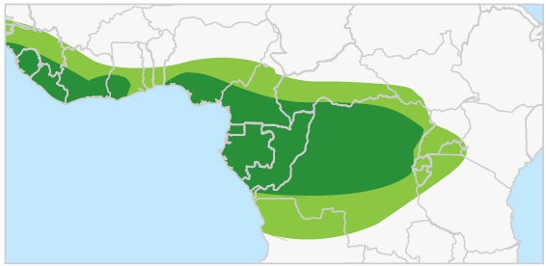
Two Species
Two Assessments
Genetic, ecological, behavioral, reproductive and other data support two distinct species
IUCN Red List generally follows Mammal Species of the World (MSW) as its main taxonomic source for mammals.MWS was the first to formally designate 2 species
Assessment team consulted Mondol et al. 2015, confirmed by Kim& Wasser 2019
Make explicit that some sites need genetic confirmation; assumption that small errors are not likely influential
Mondol et al. 2015
Roca et al. 2015
Notes:
IUCN Red List generally follows Mammal Species of the World (MSW) as its main taxonomic source for mammals.
MWS was the first to formally designate 2 species
Red List Unit: “Two species are already described and recognized and there is no problem with us adopting this for the Red List”
Preponderance of genetic, ecological, behavioral, reproductive and other data support two distinct species
Taxonomic Note & basic species assignment based on best available science- stated assumptions & caveats
For the nuts and bolts of these assessments-
Consulted Mondol et al 2015, confirmed with analysis by Kim and Wasser 2019
Hybridization is rare when you consider vast forest-savanna ecotone– only at 14 sites of more than 100 examined, all F2 hybrids, most very small N, a few hotspots, primarily in Uganda/DRC, otherwise very very small populations
Some sites need confirmation yet/ some small errors assumed not to influence overall outcome– the categorization in terms of species extinction risk of thse assessments
AfESG decided to deviate from this for the 2008 assessment
Mondol, S., Moltke, I., Hart, J., Keigwin, M., Brown, L., Stephens, M., Wasser, S.K., 2015. New evidence for hybrid zones of forest and savanna elephants in Central and West Africa. Mol Ecol 24, 6134-6147.
Roca, A.L., Ishida, Y., Brandt, A.L., Benjamin, N.R., Zhao, K., Georgiadis, N.J., 2015. Elephant Natural History: A Genomic Perspective. Ann Rev Animal Biosciences 3, 139-167.

Slide 6
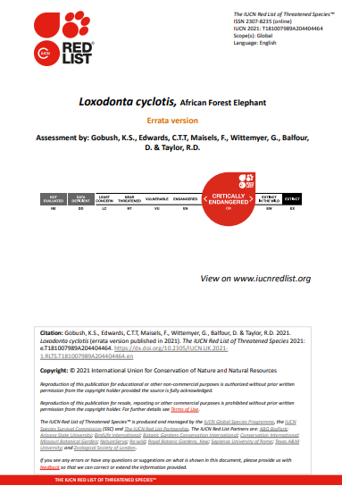
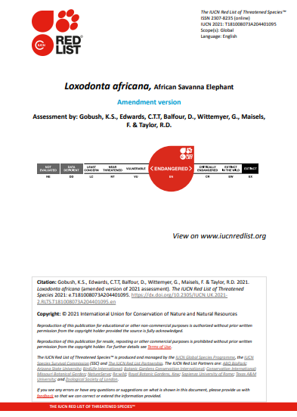

Slide 7
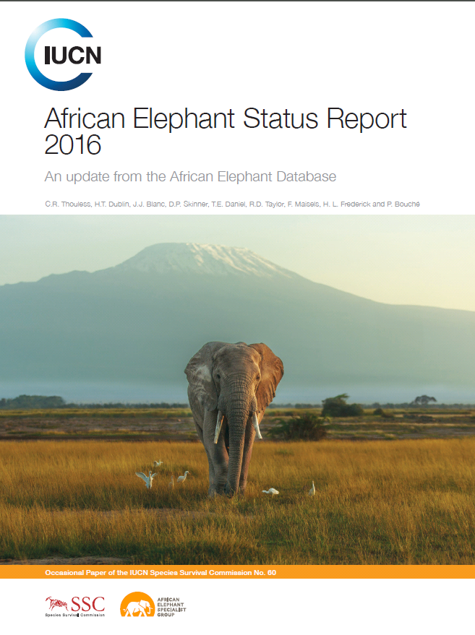
Data Inputs
Primary inputs: From AED - population data up to end of 2015
(as presented in AESRs; reliability A-D [omitted E- “other guess”]; >1200 estimates)
Site level estimates of population size or density + area + source
(no extrapolations or summarized values (unless area was indicated)
Pre-AED survey data from AEAP 1979 & via AEL search
(not comprehensive and no reliability index assigned – resulted in 127 estimates)
Notes:
2008 RLA – population data presented in the 2007 African Elephant Status Report (AESR) representing surveys in AED up to 2006
Alternative estimates from 1979 African Elephant Action Plan (AEAP) used (not specified)
Extrapolations reported in 1979 AEAP excluded
Estimates from Gabon and Liberia excluded due to unlikely increasing trends
**note: survey data of protected areas and better
protected/higher density often
were repeatedly surveyed; therefore, potential (unavoidable) bias
Thouless, C.R., Dublin, H.T., Blanc, J.J., Skinner, D.P., Daniel, T.E., Taylor, R.D., Maisels, F., Frederick, H.L., Bouché, P., 2016. African Elephant Status Report 2016. An update from the African Elephant Database. Occasional paper of the IUCN Species Survival Commission No. 60. IUCN/ SSC African Elephant Specialist group., Gland, Switzerland.

Slide 8
Data Inputs
Taxon | L. africana | L. cyclotis | Combined
Sites | 334 | 161 | 495
Countries | 23 | 20 | 37*
Surveys | 980 | 403 | 1390
Notes:
34 sites had time series that ended in 0 (extirpated)
185 sites had repeated surveys (37.4% of sites)
* Some countries have both species

Slide 9
Modelling Approach

Slide 10
Modelling approach
A data-driven model-based approach implemented by Charlie Edwards (fisheries modeler)
Differed from previous assessments: focused on increased statistical rigor, reproducibility and transparency in terms of clearly documented methods
The model can be viewed as a mechanism for extracting and summarizing information from the survey data

Slide 11
Modelling approach
Example survey data (Forest Elephants)

Slide 12
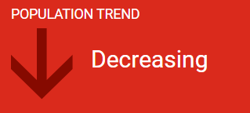
Summary of results
L. africana
.
L. cyclotis
Population reduction (%) 1940-2015* (IUCN Red List Category) | 95% Cred. Inter-vals | Probability that reduction is consistent with IUCN category
 |  | CR | EN | VU | Not thrt
60 ENDANGERED | 15 - 88 | 0.08 | 0.63 | 0.25 | 0.04
Population reduction (%) 1922-2015* (IUCN Red List Category) | 95% Cred. Inter-vals | Probability that reduction is consistent with IUCN category
 |  | CR | EN | VU | Not thrt
86 CRITICALLY ENDANGERED | 58 - 98 | 0.71 | 0.28 | 0.01 | 0.00
*According to our assumption that there was no population change from 1940 to 1964
(L. africana) and 1922-1983 (L. cyclotis)
Notes:
Our effort represents two separate assessments that consider the African forest elephant and African savanna elephant as individual species for the first time.
We attempted to comprehensively account for as much quality data as is available going as far back as the 1970's for the forest elephant and to the 1960's for the savanna elephant.
EN and CR now, was one species and assessed as VU in 2008
Both species are in decline- as stated in the AESR 2016, the primary drivers of this decline is the poaching of elephants for the illegal ivory trade and habitat loss/degradation
The forest elephant is critically endangered with fewer sites and a decline steeper compared to the savanna species, plus data quantity, quality and standardization approaching that of the savanna elephant only since the turn of this century.
Overall, savanna elephants are endangered from the macroscopic viewpoint, however many populations in the south are thriving at the site-level, thus caution is required when translating these results into policy across the board

Slide 13
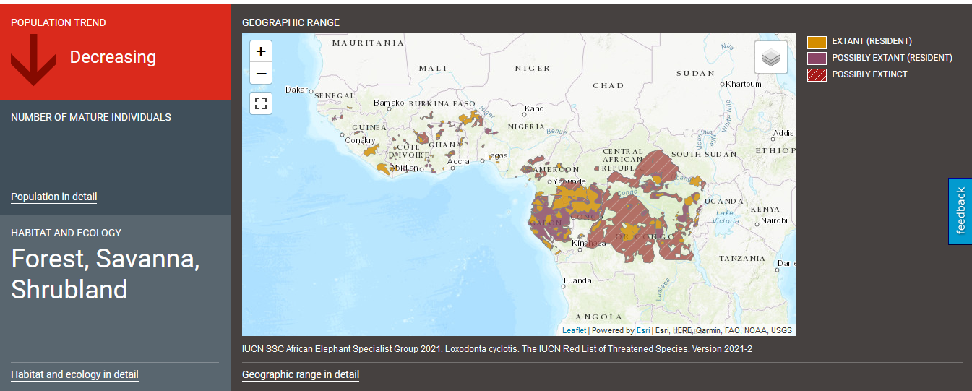
Distribution of African Forest Elephant

Slide 14
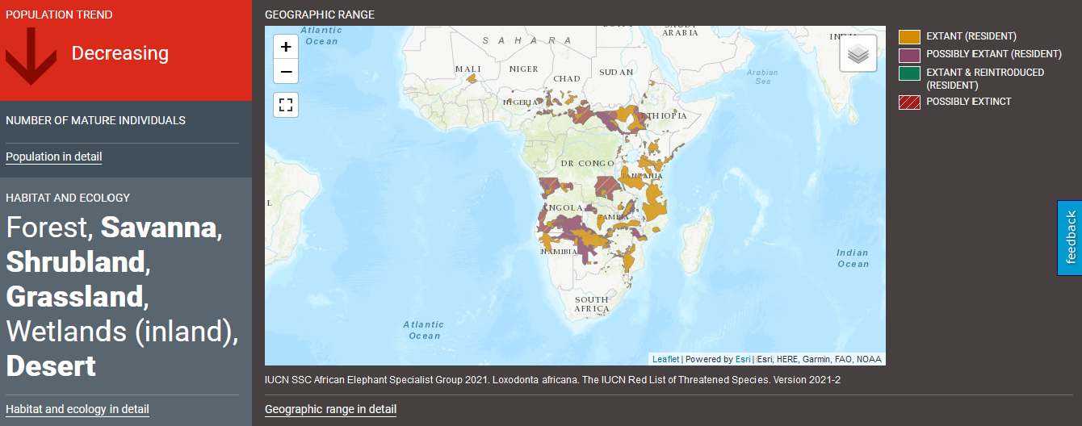
Distribution of African Savanna Elephant

Slide 15
Density derived population estimates used to derive weighted trend
Country | Site | Area (km2) | Population size 1965 | Population size 2015 | Population reduction
Angola | Ambriz Reserve | 94857 | 6066 | 1843 | 72.5%
Angola | Bikuar National Park | 6954 | 134 | 44 | 64.6%
Angola | Kambondo Forest | 75 | 44 | 13 | 70.4%
Angola | Luiana | 8163 | 6963 | 1805 | 74.0%
Angola | Quicama National Park | 9500 | 233 | 52 | 77.9%
Angola | Southern Mupa | 240024 | 12409 | 3665 | 69.9%
Botswana | Chobe | 11675 | 6234 | 46628 | -634.1%
Botswana | Ghanzi District | 51269 | 247 | 1021 | -326.0%
Botswana | Northern Botswana excluding Chobe | 111247 | 30238 | 175513 | -479.4%
Botswana | Okavango | 17160 | 2562 | 45699 | -1726.9%
Botswana | Tuli | 1320 | 841 | 1403 | -64.1%
Cameroon | Benoue | 1800 | 179 | 246 | -43.8%
Cameroon | Bouba Ndjidah | 2200 | 448 | 277 | 38.9%
Cameroon | Faro National Park | 3486 | 35 | 20 | 43.6%
Cameroon | Sudanian Area | 14300 | 564 | 209 | 64.6%
Cameroon | Waza National Park | 1700 | 1264 | 543 | 58.3%
Notes:
Table 3 same as this for forest elephants
Not population estimates for each site!!!!

Slide 16
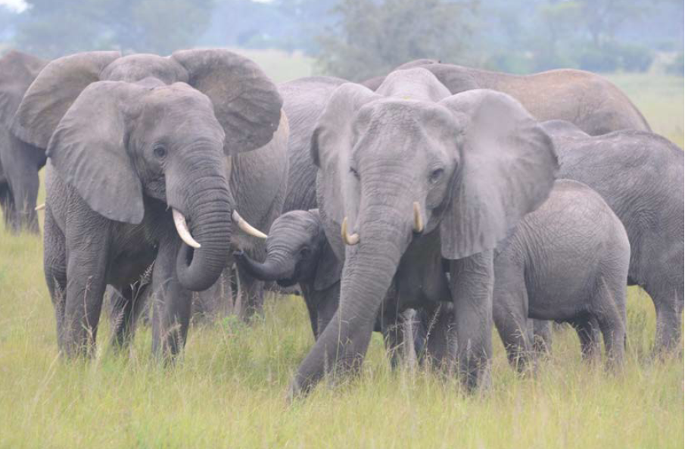
Beyond the Assessments

Slide 17
The African Elephant Specialist Group (AfESG) will now treat African elephants as two species: the forest elephant Loxodonta cyclotis and the savanna elephant Loxodonta africana.
This concurs with Wilson & Reader (Mammal Species of the World, 2005), the primary IUCN reference on mammalian taxonomy.
CMS currently uses two species classification, CITES one species.
The species separation was reflected in IUCN’s Red List assessment update for African elephants.
Also, so will the next iteration of the African Elephant Status Report, delayed to 2022/3 they will be 2 reports one for forest elephant and other for savannah elephant.

Slide 18
In separating the two species, the AfESG highlights three consequences:
Firstly, L. cyclotis is listed in CITES Appendices under L. africana. This could
be maintained;
changed to Loxodonta spp., as is the case for monk seals (Monachus spp.), under Appendix I or II (depending on range state), which would allow inclusion of hybrid elephants and unclassified populations;
a Party could request an updated reference in CITES nomenclature to recognize both species.
Under CITES rules, if L. africana were split into L. africana and L. cyclotis, all L. cyclotis would remain on Appendix I (as only some populations of L. africana are currently on
Appendix II, with specific annotations).
An appropriate approach should be identified for the regional and continental treatment of other African elephant issues, such as crossborder movements.

Slide 19
Secondly, the Red List assessments provide species specific lists of range states, based on the best current information. However, legislative nomenclature varies by country. The two-species listing will assist range states in harmonization of nomenclature in national legislation, and focus attention on the differing management and conservation issues faced by the two species.
Thirdly, there may be uncertainty as to whether one or both species occur in a country. The
two-species listing will encourage the genetic investigation of hitherto taxonomically undefined populations, to examine the importance and dynamics of hybridization.
The AfESG has established a taxonomy task force to develop supporting documentation for the economic, political, and conservation implications of the two-species listing of the
African elephant. It will further recommend support for range states in addressing the implications identified.

Slide 20
References
Gobush, K.S., Edwards, C.T.T, Balfour, D., Wittemyer, G., Maisels, F. & Taylor, R.D. 2021. Loxodonta africana (amended version of 2021 assessment). The IUCN Red List of Threatened Species 2021: e.T181008073A204401095. https://dx.doi.org/10.2305/IUCN.UK.2021-2.RLTS.T181008073A204401095.en. Downloaded on 23 November 2021.
Gobush, K.S., Edwards, C.T.T, Maisels, F., Wittemyer, G., Balfour, D. & Taylor, R.D. 2021. Loxodonta cyclotis (errata version published in 2021). The IUCN Red List of Threatened Species 2021: e.T181007989A204404464. https://dx.doi.org/10.2305/IUCN.UK.2021-1.RLTS.T181007989A204404464.en. Downloaded on 23 November 2021.
Hart, J., Gobush, K., Maisels, F., Wasser, S., Okita-Ouma, B. & Slotow, R. African forest and savannah elephants treated as separate species. Oryx, 2021, 55(2), 169–172. https://doi.org/10.1017/S0030605320001386
Kim, J., & Wasser, S. K. 2019. Loxodonta africana subspecies distribution across African Elephant Database Input Zones. Center for Conservation Biology, Department of Biology, University of Washington.
Okita-Ouma, B., & Slotow, R (2021) African Elephant Specialist Group Chair report/ Rapport du Groupe de Spécialistes de l’Eléphant d’Afrique. Pachyderm, 62, 1-16.
Mondol, S., Moltke, I., Hart, J., Keigwin, M., Brown, L., Stephens, M. and Wasser, S.K. 2015. New evidence for hybrid zones of forest and savanna elephants in Central and West Africa. Molecular Ecology 24(24): 6134–6147. DOI: 10.1111/mec.13472

Slide 21
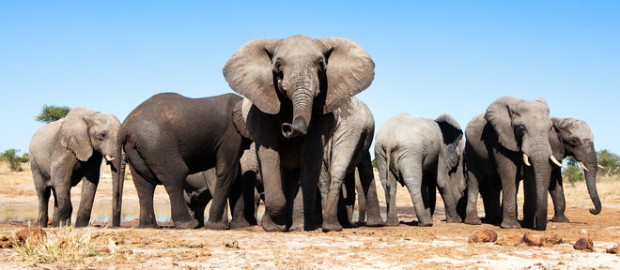
Thank you!
Special thanks & acknowledgment of the support & contribution of Holly Dublin, Ross Perran, Craig Hilton-Taylor, Federica and our formal and informal reviewers, plus all the survey teams that collected data over the
decades to make these data-driven assessments possible!

