Slide 1
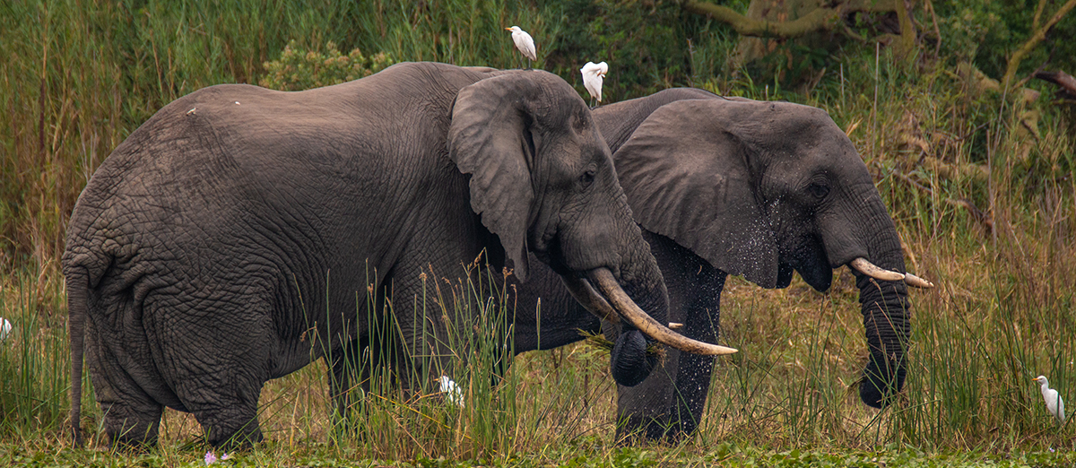
Convention on Migratory Species
Third Meeting Of The Signatories To The Memorandum Of Understanding Concerning Conservation Measures For The West African Populations Of The African Elephant (Loxodonta Africana)
30 November and 1 December 2021
Country Report for Liberia by Mr. Blamah S. Goll and Abednego Gbarway

Slide 2
Implementation of the MOU
Liberia took a leading stance on elephant conservation. In 2015, the country became the first West African country to pledge support for the Elephant Protection Initiative – an African-led, intergovernmental initiative to protect elephants and stop illegal ivory trade. With the new action plan in place, Liberia will now be eligible for funding under this initiative

Slide 3
Background and Introduction
Most of Liberia`s elephants are elusive and live in remote parts of the state, often inaccessible habitat. This means they’ve received little attention compared to savanna elephants.
While there are no reliable national population estimates of forest elephant, Liberia is home to two of the three remaining large blocks of the Upper Guinea forest, and therefore offers one of the best chances of survival for the forest elephant in West Africa. However, the major direct threats facing forest elephants in Liberia is human encroachment and disturbance of elephant habitats, and the resulting human-elephant conflicts and poaching.
In the 20th Century, the illegal killing of elephant and Ivory exports in Liberia continued to grow in volume.
The Forest elephants in Liberia are found mainly in two forest blocks- Northwestern and South eastern parts of the country. In short, While there are no reliable national population estimates of forest elephant, Liberia is home to two of the three remaining large blocks of the Upper Guinea forest, and therefore offers one of the best chances of survival for the forest elephant in West Africa. However, the major direct threats facing forest elephants in Liberia is human encroachment and disturbance of elephant habitats, and the resulting human-elephant conflicts and poaching.
Most of them were long ago hunted by poachers for their ivory and traded in Asia, Europe, America, Africa and some other states of the global community during centuries . Firstly, hunting for ivory increased during the 19th Century in Liberia, especially after 1980 Military Coupe especially when the military ascended to power and begun hiring hunters to kill many of our elephants indiscriminately for facilitate transboundary and long range states trade facilitation .

Slide 4
CURRENT STATUS OF LIBERIA ELEPHANTS
Elephants are distributed unevenly in Liberia. They occupy most parts of our remaining tropical rainforest ecosystem in Liberia. A very optimistic estimate would put the number of elephants in Liberia at below 300. It would appear that elephants are deserting the primary forests where they are too vulnerable to man and are taking refuge in the marshland or bush which man cannot penetrate easily in Liberia. Forest elephants in Liberia are also scarce. A lack of systematic study makes it difficult to accurately estimate numbers, but one conservation NGO active in Liberia estimates the population to as low as 300 individuals (FFI 2017).

Slide 5
CURRENT STRATEGIES INSTITUTED BY LIBERIA FOR ELEHANTS CONSERVATION TO SUPPORT THE WEST AFRICAN ELEPHANT MOU
Liberia developed the National Elephant Action Plan (NEAP) “This action plan allow Liberians to obtain a better understanding of the issues surrounding the distribution and conservation of Liberia’s elephants, identify the key threats and establish a Programme of measures to ensure the survival of the species in Liberia
Gazettement of additional Protected Areas and trained many forest rangers on the use of SMART TOOL for data collection, analysis, and reporting
Conducting elephant status and distribution surveys and data collection
Revised our National Wildlife Legislation in compliance with CITES Protocol
Organized the National Species Working Group of Liberia and hosting regular meetings monthly to support species conservation an protection
Liberia has revised her National Biodiversity Strategy and Action Plan (NBSAP) with a long-term vision to have society lives in harmony with its wildlife and natural environment
Strengthen wildlife regulations and CITES enforcement
• Strengthen ability to combat wildlife
trafficking, including interagency and
interregional coordination
Strengthen technical capacity of FDA and EPA

Slide 6
Raising awareness of the plight of the forest elephant forms an important part of the conservation effort of Liberia
Build capacity in law enforcement and Better equip enforcement officials
Support situational law enforcement to engage communities in elephant Conservation and protection
Promoted inclusive governance and effective institutions for elephant conservation and natural resource management at all levels, including the continuation of on-going activities that promote land tenure, land reform, natural-resource governance, and land tenure and property rights for women.
Train customs agents, public prosecutors , commercial staff at transportation hubs and borders to recognize products such as elephant products of wildlife crimes
Strengthen wildlife regulations and CITES enforcement
Strengthen ability and capacities of the FDA, EPA and other relevant national government institutions and CSOs to combat wildlife trafficking and improve elephant management

Slide 7
Strengthen ability to combat wildlife trafficking, including interagency and Inter sectoral and interregional institutional collaboration and coordination
Drafting and completion of a national strategy on human-elephant conflict prevention and management
Identify and promote culturally appropriate best practices for elephant conservation
Train communities and journalists on forest elephants conservation and biodiversity issues
Develop community monitoring of elephant populations
Improve access to remote sensing data and using SMART at all Protected Areas in Liberia to collect, analyze and share data on elephant Conservation-Generate, analyze, and share data between relevant Liberia institutions and development partners

Slide 8
In 2013 and 2014, Liberia participated in regional wildlife law enforcement operations which led to arrests and seizures of processed ivories with a total worth of US$155,000.
First elephant done in the 1980s while the Sapo National Park elephant census done in 2009
Liberia have signed two Transboundary Legal Framework Agreements and Memorandum of Understanding between Sierra Leone and Liberia and Guinea and Liberia for sustainable forest and wildlife species protection and management
A nationwide forest elephant survey began in 2020 and will be concluded early 2022.
Liberia has established the Wildlife Crime Task Force(WCTF,2018) to combat poaching, trafficking and trade in protected species including the forest elephant.
Liberia Protected of two orphaned forest elephants that crossed over from the Ziama forest in Guinea to Liberia from August 2020 to September 2021.
-Government of Liberia has approved the National Elephant Action Plan 2016 which aims to protect the critically endangered species and its habitat

Slide 9
Implementation of the MOU in Liberia
Seizures forest elephant ivories
S/N | Description | Quantity | Location | Year
1 | Raw(unprocessed) ivory | 2 | ITI, Rivercess County | 2012
2 | Raw(unprocessed) ivory | 2 | Gola Konneh, Grand Cape Mount | 2019
3 | Raw(unprocessed) ivory | 2 | Sapo National Park | 2020

Slide 10
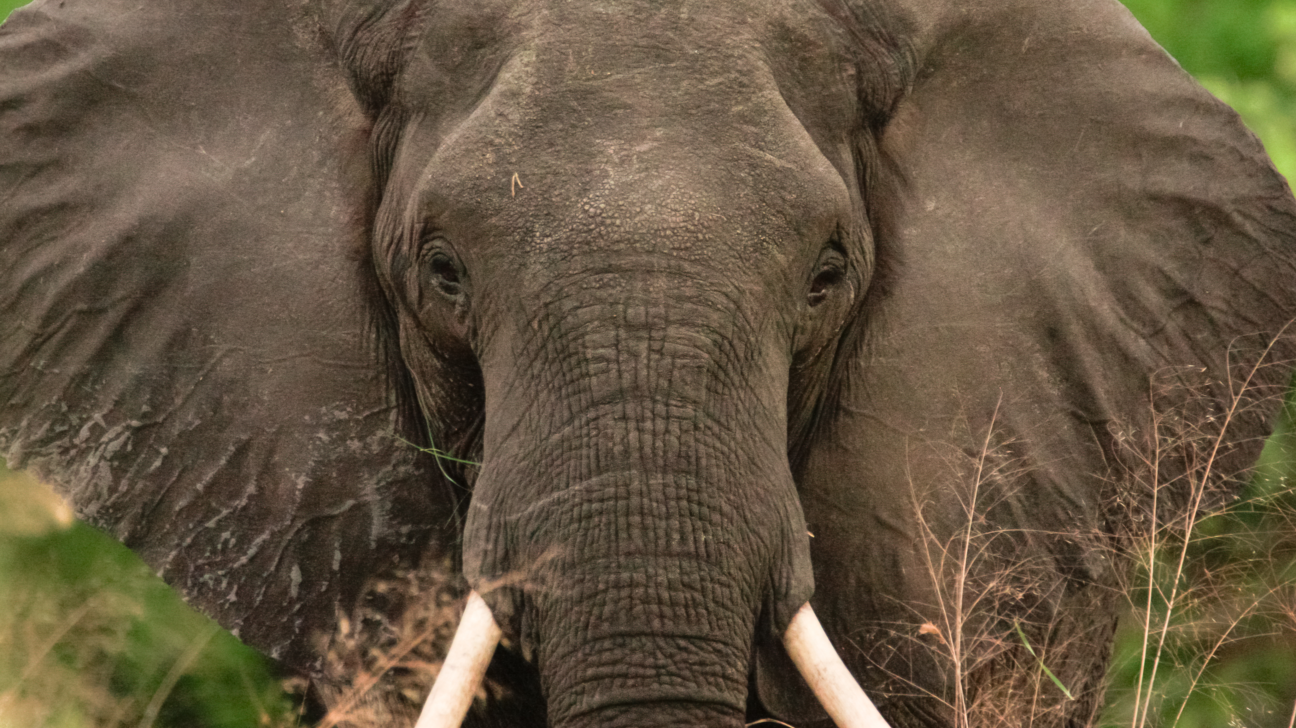
THANK YOU

