Slide 1
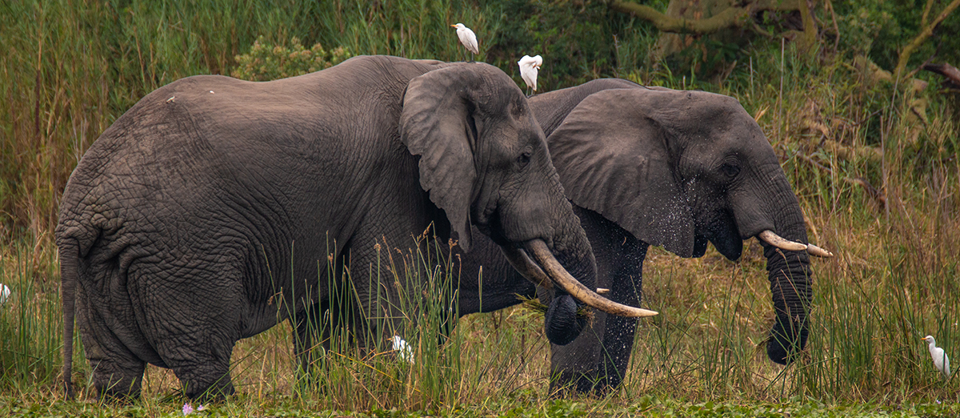
Convention on Migratory Species
Third Meeting Of The Signatories To The Memorandum Of Understanding Concerning Conservation Measures For The West African Populations Of The African Elephant (Loxodonta Africana)
30 November and 1 December 2021
Report of the Secretariat

Slide 2
Background and membership of the MOU
The African Elephant MOU was concluded in 2005.
The CMS Secretariat acts as the Secretariat for the MOU. It also acts as the MOU’s depositary.
Coordination of the implementation of the MOU
Coordination services were first provided by the International Union for the Conservation of Nature’s (IUCN) African Elephants Specialist Group (AfESG) from 2006 - 2008.
Prior to the Second Meeting of the Signatories in 2011 (MOS2), it was agreed that MIKE West Africa would coordinate for nine months.
Thereafter the CMS Secretariat resumed the coordination role, albeit with limited budget and staff capacity.
The CMS Secretariat circulated a questionnaire seeking an assessment of the Signatories’ needs related to elephant conservation and their expectations from the MOU.
On average, respondents indicated to be moderately familiar with the MOU and that the implementation of the Medium-Term International Work Programme 2012-2014 was low to medium
Following the survey, the CMS Secretariat was not able to further support of the MOU until 2020

Slide 3
Meetings
The MOU tasks the CMS Secretariat with convening Signatory meetings. The Secretariat organized MOS2 in 2011 in Niamey, Niger and is now holding the MOS 3 online.
Project development
Based on the discussions at MOS1, the CMS Secretariat supported the development of 12 project proposals for the conservation of transboundary elephant populations and submission of project proposals to the AEF or other donors.
List of Designated Focal Points
MOU paragraph 6 invites Signatories to designate a competent authority as a contact point for the MOU, confirmation and updates should be submitted to the Secretariat.
National Reports
Considering the very short preparation time for this meeting the secretariat has requested oral reports using a standardised slide presentation format.

Slide 4
Policy developments since the establishment of the MOU
After the CITES COP15 in 2010 rage states negotiated and agreed on the African Elephant Action Plan (AEAP).
the African Elephant Fund (AEF) was created to implement the Action Plan.
CMS COP12 accepted the AEAP as the principal strategy for elephant conservation under CMS.
Budget and fundraising
No funding was made available to the MOU after MOS2.
Following COP13 Decisions 13.99 and 13.100 and with the generous contribution from the Government of Germany the Third Meeting of the Signatories could now be organized.
Action requested
The Signatory States are invited to take note of the report.

Slide 5
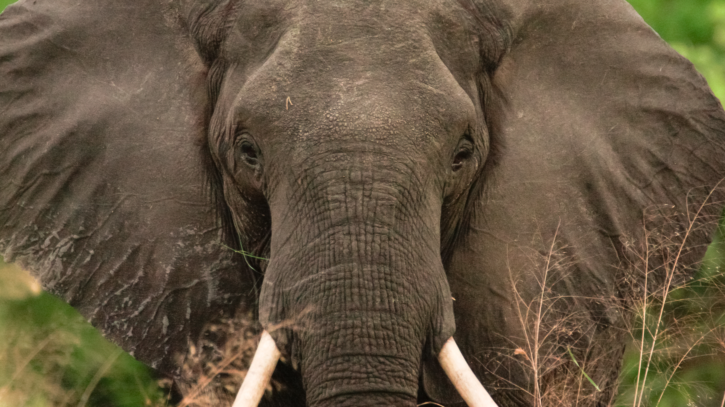
THANK YOU

