Slide 1
ACBK, Kazakhstan:
3. Legislation
3.5, 3.6 (b), (c), 3.12, 3.13
4. Transboundary Cooperation
4.3 , 4.4
5. Ecological Connectivity
5.4, 5.6
6. Protected and Conserved Areas
6.1, 6.2
7. Illegal Hunting, Possession and Trade
7.2, 7.3, 7.4, 7.7, 7.8, 7.10
8. Land use and Human-wildlife Conflict and Coexistence
8.5, 8.7, 8.8
10. Species Monitoring and Research
10.1, 10.2, 10.3, 10.4, 10.5, 10.8
11. Education, Community and Communication
11.1, 11.2, 11.3, 11.4

Slide 2
Кыргызстан: вклад ОФ САМР Алатоо в реализацию Рабочей программы ЦАИМ (2026–2032)
Направление | № | Краткое содержание
Реализация и координация | 1.5, 1.9 | Встречи координаторов ЦАИМ, семинары CAMI, CBD, UNCCD
Финансирование | 2.2, 2.5 | OECM, устойчивое финансирование, микрозаповедники
Законодательство и стратегии | 3.1, 3.5, 3.12 | Интеграция в NBSAP, экокоридоры, пастбища
Трансграничное сотрудничество | 4.3 | Обучение егерей и пограничников
Экологическая взаимосвязь | 5.3, 5.5, 5.6, | Сбор информации воздействия объектов инфраструктуры, семинары воздействия инф-ры, создание экокоридоров, ОЕСМ
Охраняемые и сохраненные территории | 6.1, 6.3, | Применять различные руководства МСОП, оценка планов управления ООПТ (ИК, адаптации)
Незаконная охота, хранение и торговля | 7.3, 7.4, 7.5, 7.7. | Новые технологии и инструменты, борьба с браконьерством (SMART), обучение и инфор-е
Землепользование и конфликты между человеком и дикими животными | 8.1, 8.2,8.3, 8.4, 8.5, 8.6,8.7,8.8,8.9,8.10, 8.11 | Укрепление потенциала, Семинары по планированию зем-я с учетом биоразн, обмен по сниж. конф. стимул, снижение негатив. взаимод-я, туризм, механизмы дохода..
Единое здоровье | 9.2, 9.3, 9,4, 9.5, 9.6 | Реагирование, платформы, вакцинация, точки водос-я, наблюдение
Мониторинг и участие | 10.1, 10.4, 10.5, 10.7, 10.9 | Сбор данных, обучения, платформы, обмен инфы, оценка климатич. уязвимости,
Образование, сообщество и коммуникация | 11.1, 11.2, 11.4, 11.5, 11.6, 11.7 | Повышение информированности, экообразование, брошюры, ролики

Slide 3
Conservation X Labs (CXL) /TeamBars Turkmenistan involvement in implementation of the CAMI WP 2026-2032
Proposed CU:
Western and Southern Ustyurt – CXL ongoing activities on camera-trapping and SMART-monitoring; monitoring of Persian Leopard, Urial, Goitered Gazelle, Asiatic Wild Ass (Kulan) + Saiga (?). Ongoing CXL transboundary project on conservation of Persian Leopard (Kaz) and Snow Leopard (Kyr); support the Min.Env on establishment of new Balkan Protected Area (clusters: Big Balkan, Small Balkan and Garabogazgol/Ustyrt); CXL can support activities to implement the MoU on Ustyurt and it’s Roadmap together with MSF; IKI-IUCN One Health project (Kaplankyr PA) and ongoing GEF/UNDP Aral Project (Kaplankyr PA as part of Ustyurt CU).
Kopetdag – CXL can support activities on conservation and monitoring of Persian Leopard, Urial, Goitered Gazelle, Asiatic Wild Ass (Kulan) + Pallas’s Cat; ongoing activities on camera-trapping and SMART-monitoring.
Koytendag/Kugitang – CXL/CLLC/MSF – support activities on conservation and monitoring of Urial, Goitered Gazelle, Eurasian Lynx; ongoing activities on SMART-monitoring; support in preparation of the nomination dossier for UNESCO WH List together with MSF and Uzbekistan. IKI-IUCN One Health project.

Slide 4
IUCN plans to support the following activities:
1.13 Request IUCN Eastern Europe and Central Asia Regional Office to be considered for support under the CBD Technical and Scientific Cooperation mechanism.
2.5 Develop joint funding proposals and innovative financial mechanisms, involving relevant Range States for the conservation of CUs, identified in this WP and submit to relevant donors.
3.5 Use the IUCN Guidelines for Conserving Connectivity through Ecological Networks and Corridors and examples from the region (e.g. developed within CAMCA project in Kyrgyzstan) to define ecological corridors and integrate such corridors into national legislation to implement appropriate measures to conserve CAMI species, building on experience in the region and beyond.
3.10 Where relevant, bring species assessment procedures for national Red Books in line with the Guidelines for Using the IUCN Red List Categories and Criteria at the national level.
4.4 Support recognition of selected border areas as OECMs.
5.6 Plan and create Protected Areas, OECMs and eco-corridors to ensure habitat connectivity for CAMI species and to facilitate conservation of larger areas of their habitat (see Activity 6.2).

Slide 5

IUCN plans to support the following activities:
6.1 Apply IUCN’s various guidelines to promote good practices relating to identifying, reporting, monitoring and strengthening OECMs in support of GBF Target 3.
6.2 Support CAMI Range States in efforts to achieve the GBF Target 3’s 30 x 30 goal to ensure that the protected …..
7.2 Increase and strengthen the wages, prestige, social security and technical capacity of rangers and other relevant enforcement personnel to counteract illegal hunting, possession, use and trade of CAMI species, including the provision of training and equipment and scaling up the use of SMART.
8.1 Build the capacity of decision-makers in applying the IUCN SSC Guidelines on Human-wildlife Conflict and Coexistence, and the recommendations of the CMS report on the Potential for Community-based Wildlife Management in Central Asia
All of activities in group 9
All in group 10 except for the last one (for now at least)
11.1 Raise awareness on threats affecting CAMI species and necessary behavioural change.

Slide 6
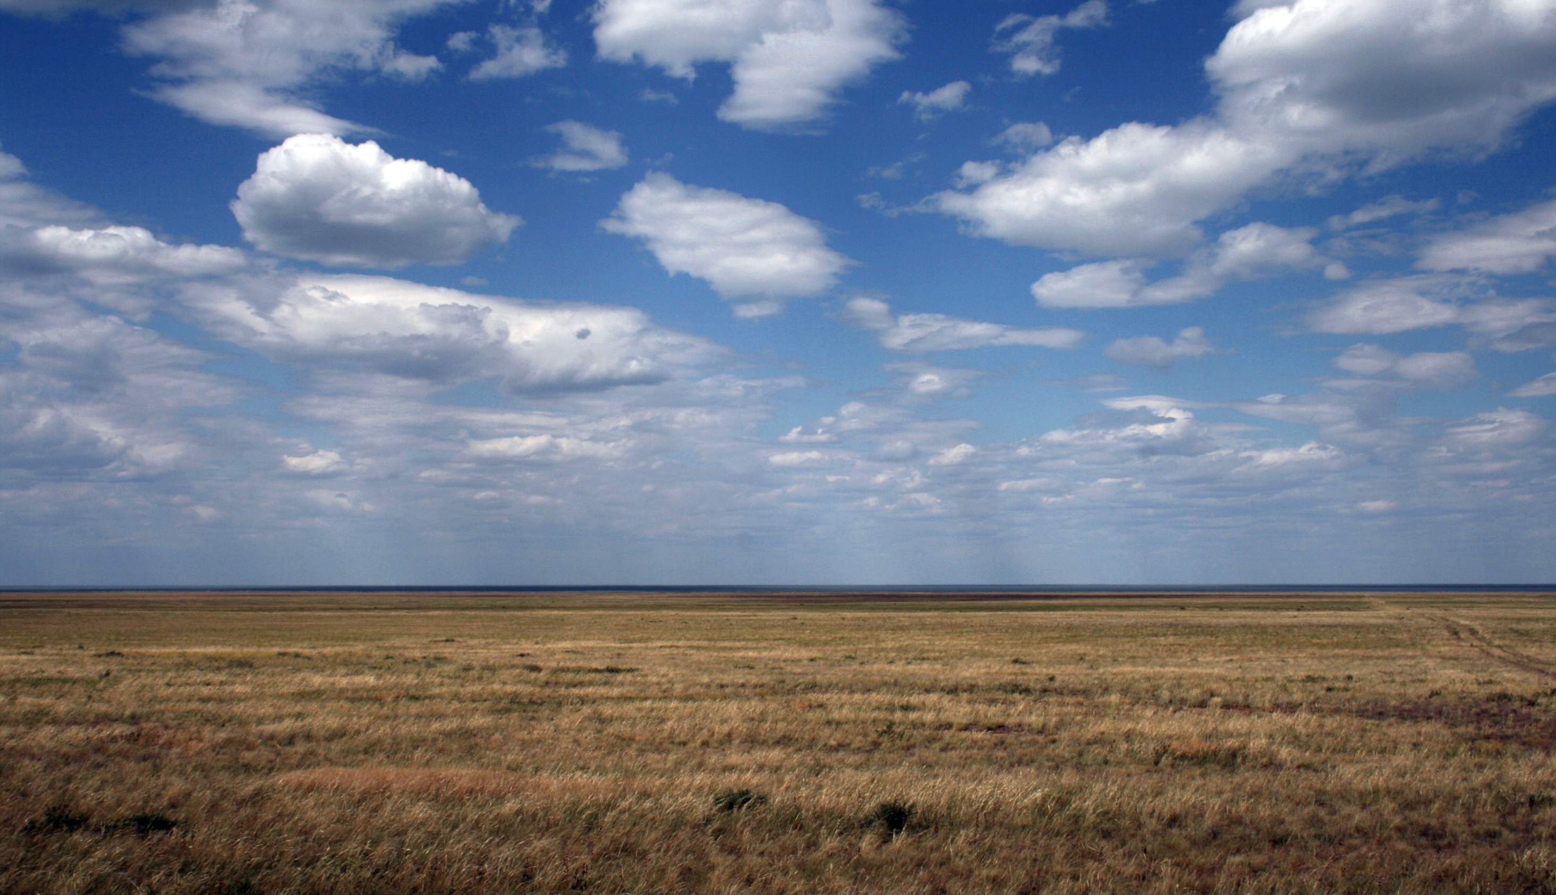



Identification and preparation of new PAs and OECMs
Maintaining or establishing connectivity by mitigating barrier effects of infrastructure, developing PCA networks and raising capacity
Development of legislation and raising capacity in the field of mitigation of barrier effects of infrastructure, anti-poaching and sustainable use
Improving wildlife health procedures
Mapping wildlife movements, conducting surveys and training rangers
Frankfurt
Zoological Society
supports CAMI through the
Altyn Dala Conservation
Initiative
Solving human-wildlife conflicts and community engagement
International events and awareness raising
Use of new technologies for anti-poaching and fighting illegal trade
Activities at the Northern and western Ustyurt

Slide 7
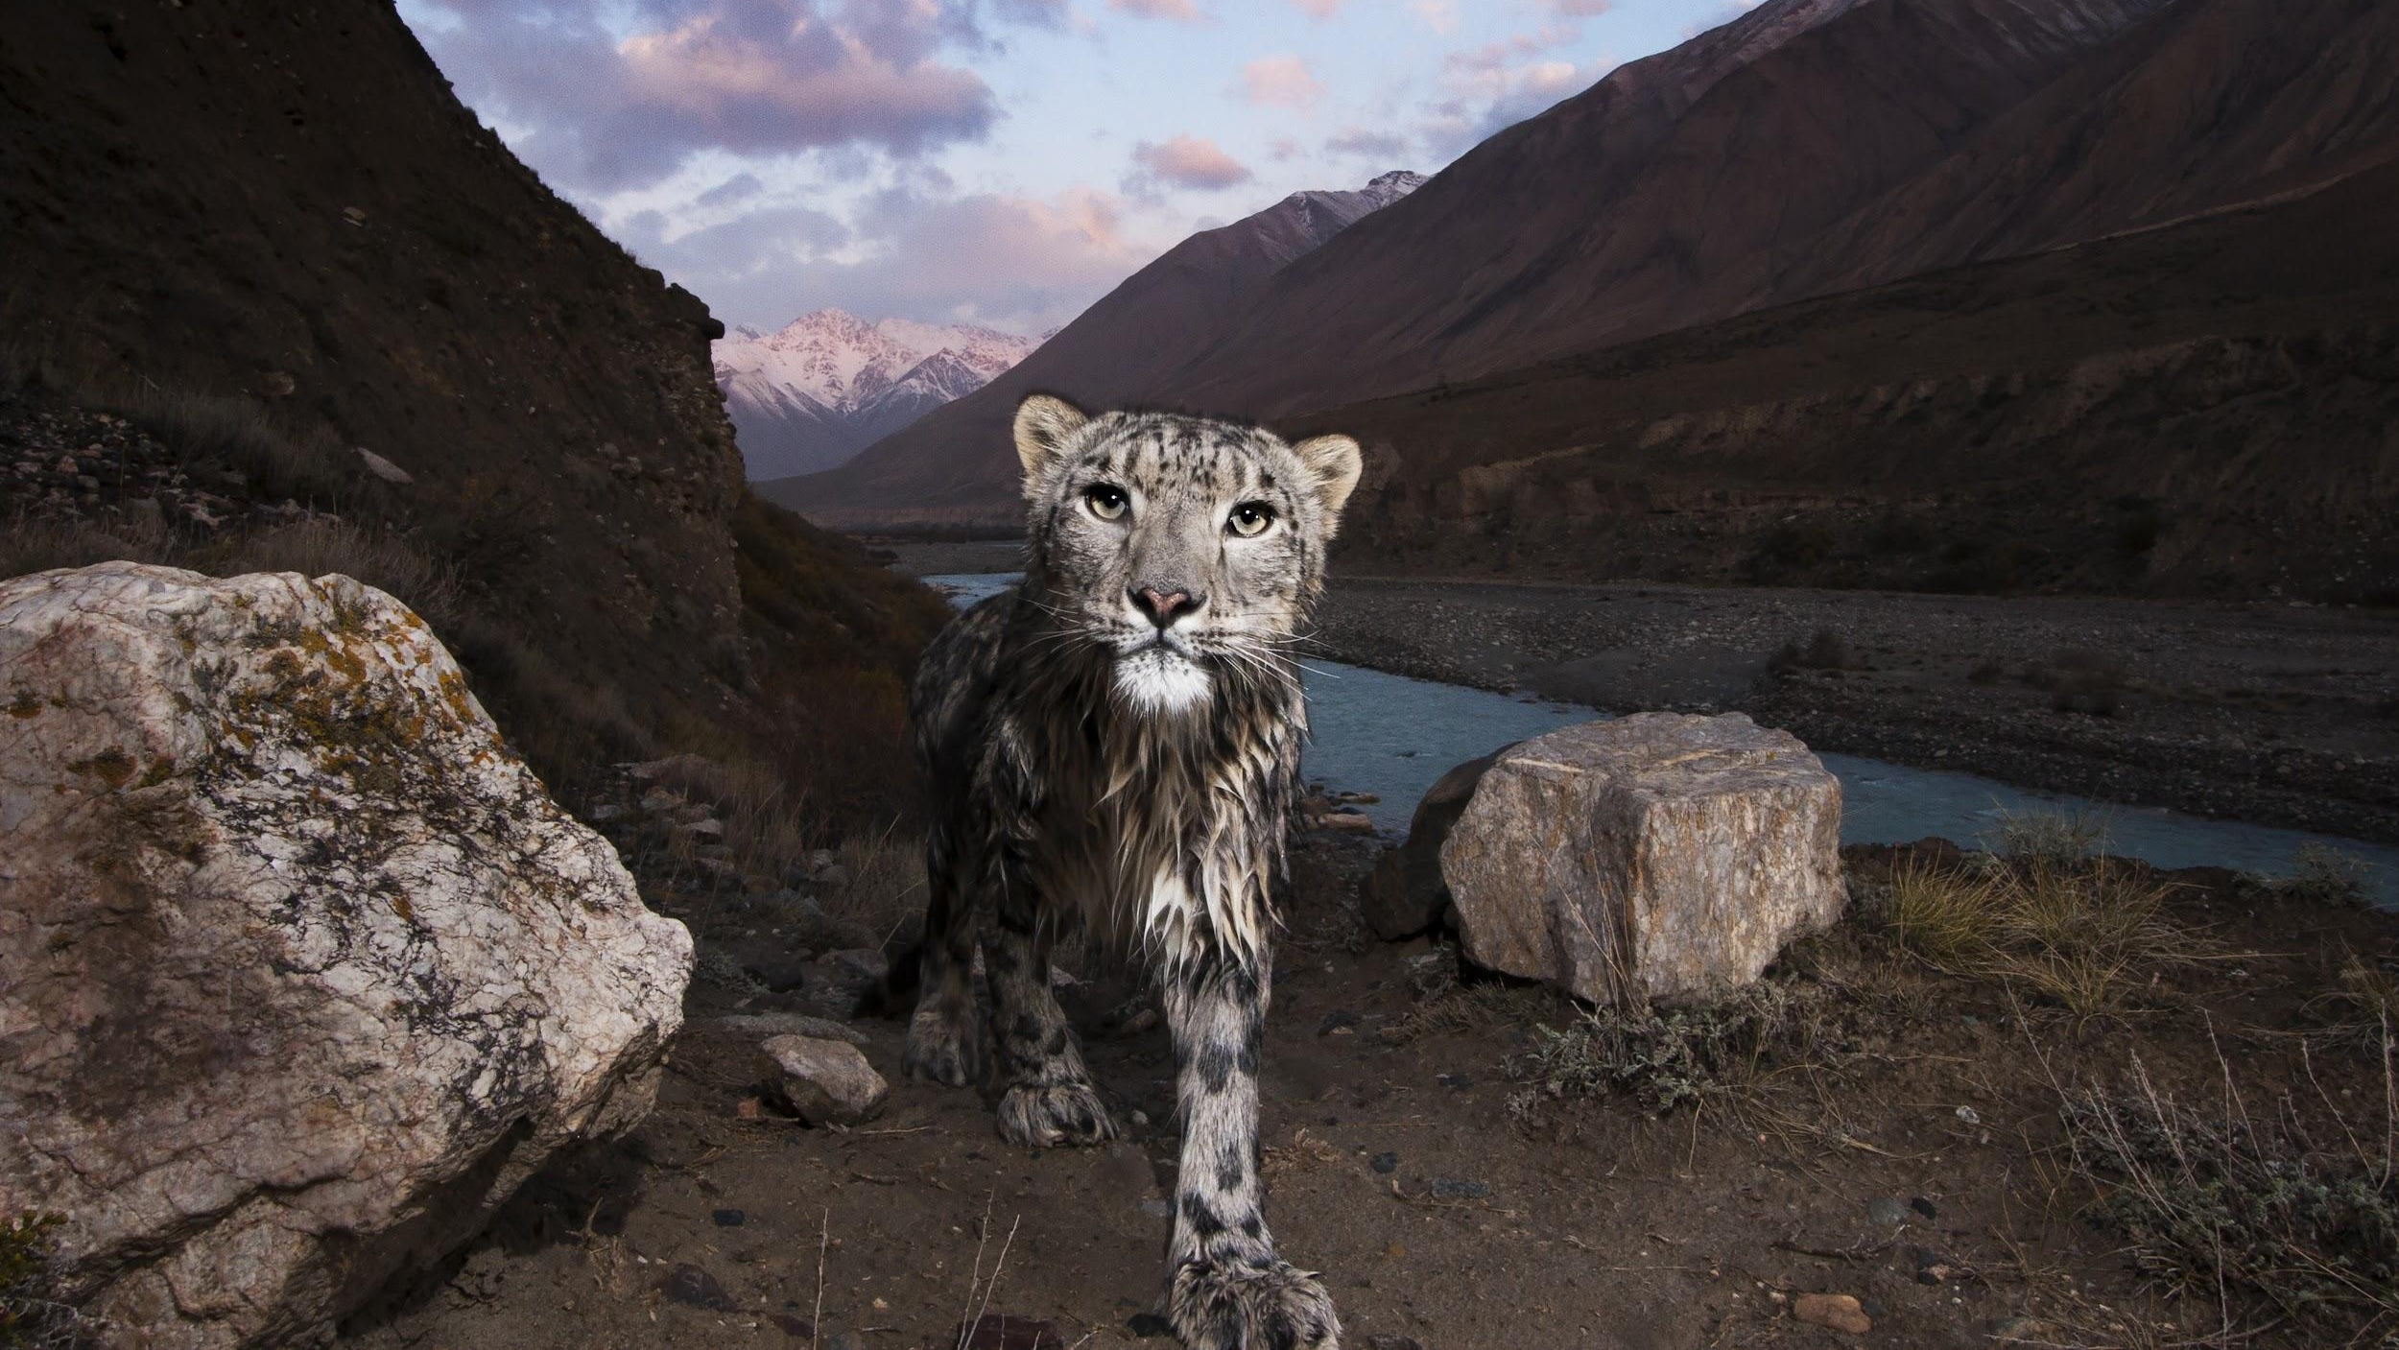


Zairbek Kubanychbekov

Slide 8
Виды ЦАИМ: Архар, Снежный барс, рысь, манул
Географический охват: Северный, Внутренний и Западный Тянь-Шань
Главы | Мероприятия, которые должны быть реализованы к 2032 году | Активная реализация пунктов | Содействие в реализации | Экспертная поддержка
1 | Реализация и координация РП ЦАИМ |  |  | 1.2; 1.4; 1.5; 1.9; 1.10
3 | Законодательство |  |  | 3.7 3.8 3.13
4 | Трансграничное сотрудничество | 4.1; |  | 4.2; 4.5; 4.3;
5 | Экологическая взаимосвязь |  |  | 5.1; 5.2; 5.4; 5.6
6 | Охраняемые и сохраненные территории | 6.1 | 6.1; | 6.2; 6.3
7 | Незаконная охота, хранение и торговля | 7.2; 7.3; 7.4; 7.5; 7.7; 7.8; 7.10 | 7.6 | 7.9
8 | Землепользование и конфликты между человеком и дикими животными и их сосуществование | 8.2; 8.5; 8.9 | 8.3; 8.4; 8.6; 8.7; 8.8 | 8.1; 8.10
9 | Единое здоровье | 9.5; 9.6 | 9.2; 9.4
10 | Мониторинг и исследование видов | 10.1; 10.3; 10.8 | 10.2; 10.9 | 10.4; 10.5; 10.6; 10.7; 10.8
11 | Образование, сообщество и коммуникация |  | 11.1; 11.4 | 11.2; 11.3
17 | Западный Тянь-Шань (Казахстан, Кыргызстан, Узбекистан) | 17.1; 17.3 | 17.1; 17.5 | 17.2;
18 | Северный и Внутренний Тянь-Шань (Китай, Казахстан, Кыргызстан)- 7 Виды: архар, рысь, манул, снежный барс | 18.1; 18.6 |  | 18.7; 18.9; 18.2; 18.5; 18.9
19 | Высокий Памир/Вахан (Афганистан, Китай, Кыргызстан, Пакистан, Таджикистан) - 8 Виды: архар, рысь, манул, снежный барс, уриал | 19.4 |  | 19.1; 19.3

Slide 9
Activity Number | NABU Contributions to CAMI Work Programme 2026–2032 | Type of Partnership
1 (1.9) | Co-organize regional meetings and platforms for coordination of efforts to conserve migratory mammals | All levels, project-based and linked to the snow leopard habitats.
2 (1.10) | Promote transboundary cooperation between Kyrgyzstan, Uzbekistan, and Tajikistan for Argali conservation | All levels, project-based and linked to Snow leopard
3 (1.13) | Continue implementing activities under signed MOUs with range states | All levels described in MoU
4 (2) | Mobilize funding for priority areas of the Work Programme | Financial to the NABUs and ist partners project areas
5 | Potential Contribution to activities (4, 6.2, 7, 10, 11) | All levels and within the linkage to selected activities
6 | Implement activities for the conservation of the snow leopard and its ecosystems | All levels in KGZ, TJK, UZB, Nepal, project based
7 | Within NABU BAG - Partnership for the conservation of the saiga | Limited but at all levels
8 | Scientific cooperation for the conservation of the Bukhara deer | Scientific and in TJK only
9 | Enhanced actions for the conservation of Argali (Action Plan) | All levels
10 | Support the conservation of the urial in combination with Argali efforts | Only in combitation with Argali possible.

Slide 10
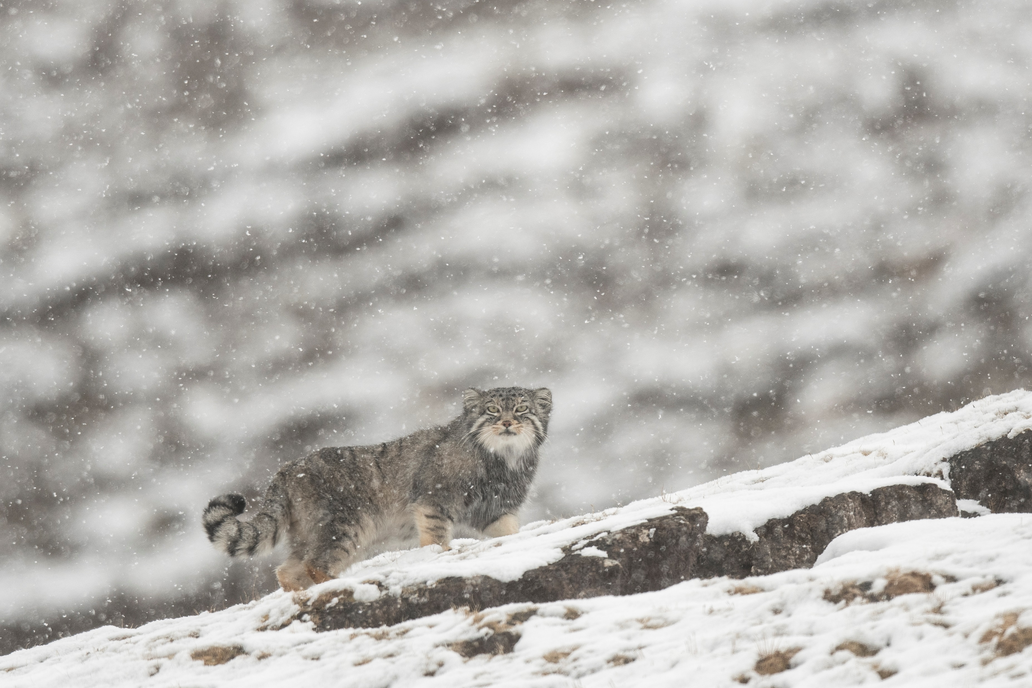





Pallas’s cat International Conservation Alliance
Conservation of the Pallas’s cat through capacity building, research & global planning
Goal: advancing conservation efforts for the Pallas’s cat/manul across its range in Central Asia and beyond
Key activities: improving knowledge and awareness, developing tools and resources for practitioners, building conservation capacity, raising funds, connecting strategy with policy makers (alongside Manul Working Group)
Pallas’s cat Conservation Strategy (2019) developed by IUCN Cat SG, MWG, PICA- basis for Concerted Action
PICA Small Grant Programme: so far supported 18 projects in 9 range countries with a total of €150,000
PICA and CAMI implementation:
Pallas’s cat present in all CAMI countries and 90% of range lies within region covered by CAMI
Synergies between implementation of the Conservation Strategy and the CAMI WP. Main areas of support:
  Regionwide measures, in particular all actions under Section 10 (Species Monitoring and Research), selected actions under Sections 3, 4, 5, 6, 8, and 11 as well as Objective 9.4
  Selected actions in all Conservation Units where the Pallas’s cat is listed (4 Kopetdag, 7 Northern and Inner Tian Shan, 8 High Pamirs, 9 Altai, 10 Daurian Steppe, 11 Gobi, 12 Western Trans Himalaya)

Slide 11
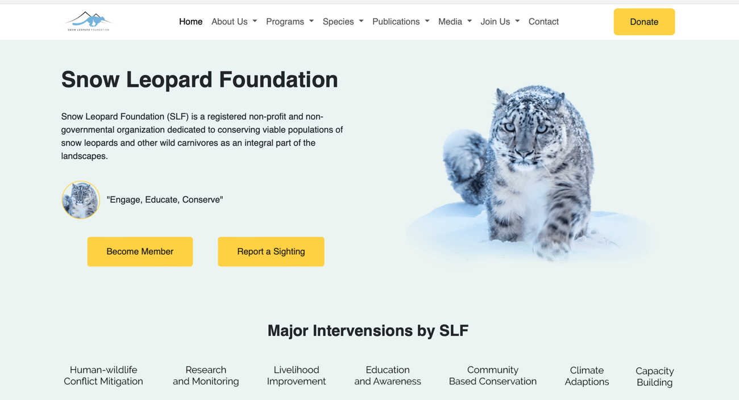
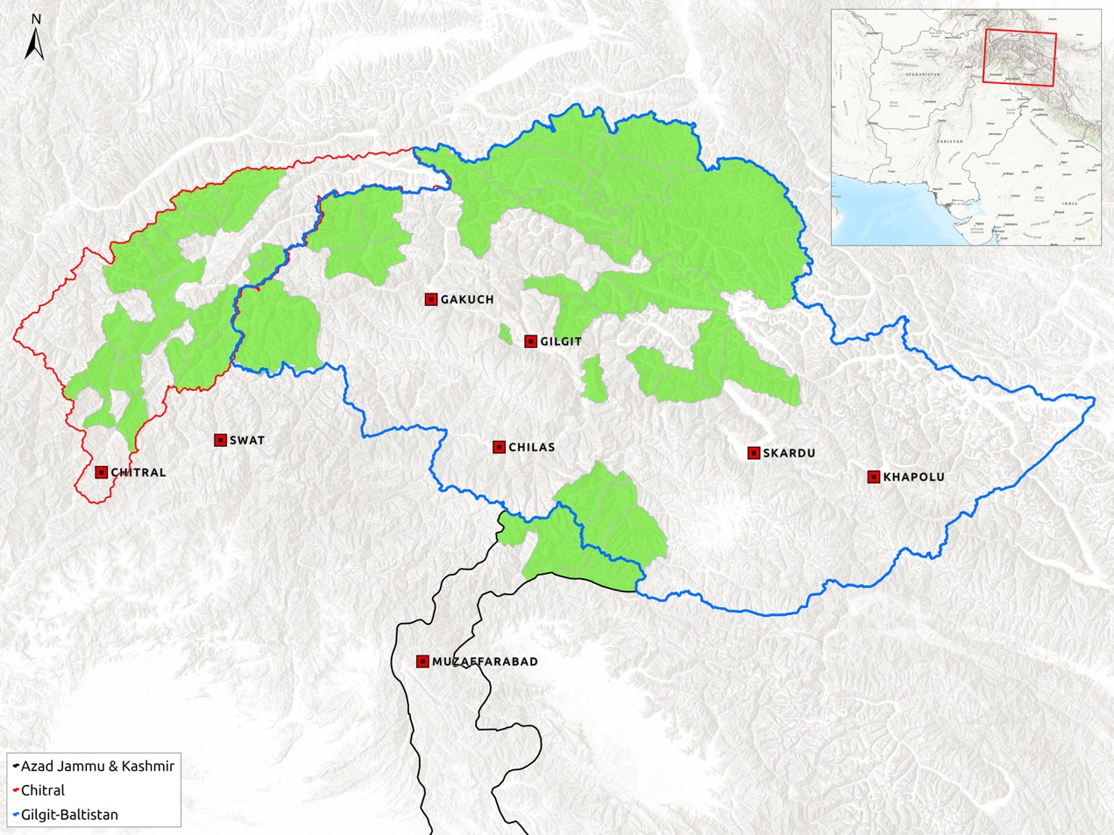
CAMI-SLF Partnership Areas
https://slf.org.pk
5. Ecological Connectivity
Activities (5.6, 5.7): PAs, OECMs, Migration corridors
6. Protected and Conserved Areas
Activities (6.2, 6.3): Pas expansion, management planning, and baseline studies
7. Illegal Hunting, Possession and Trade
Activities (7.3, 7.5, 7.6): surveys and developing data base
8. Land use and Human-wildlife Conflict and Coexistence
  Activities (8.4, 8.5): surveys and developing data base
  9. One Health
  Activity 9.4 Support the targeted vaccination of livestock
  10. Species Monitoring and Research
  Activities: 10.1 to 10.10 for Snow Leopard, Urial, Argali, Brown bear
  11. Education, Community and Communication
  Activities (11.1, 11.2): Awareness and conservation education
  Conservation Units (CUs)
  Pamir-Alai-Karakoram)-8
  Species: Argali, Lynx, Pallas’s Cat, Snow Leopard, Urial
SLF Work Areas

Slide 12


Current plans
Capacity building
Capacity building of the members (e.g. Mongolia and Nepal) and hopefully India to train 15 practitioners
Maintaining PeLeWG online library
Joining up with PICA, SLN and SCB for continental events
Anti-poaching
Ranger Awards in the less supported countries of Afghanistan, Iraq (Kurdistan Region) and Pakistan
Technical expertise and monitoring
IUCN Red List and Green List assessments of the Persian leopard
Evaluating leopard conservation led by the WWF in Caucasus
Developing a range wide monitoring, based on citizen science, for leopards and their prey
Participation in conferences (SCB Conservation Social Science) and webinars (CMS, Snow Leopard Network etc.)
Publishing (4 articles in newsletters, chapter for IBCA leopard book, report on leopard recovery in the Lesser Caucasus)

Slide 13
CAMI-SLF Partnership Areas
https://slf.org.pk
5. Ecological Connectivity
Activities (5.6, 5.7): PAs, OECMs, Migration corridors
6. Protected and Conserved Areas
Activities (6.2, 6.3): Pas expansion, management planning, and baseline studies
7. Illegal Hunting, Possession and Trade
Activities (7.3, 7.5, 7.6): surveys and developing data base
8. Land use and Human-wildlife Conflict and Coexistence
  Activities (8.4, 8.5): surveys and developing data base
  9. One Health
  Activity 9.4 Support the targeted vaccination of livestock
  10. Species Monitoring and Research
  Activities: 10.1 to 10.10 for Snow Leopard, Urial, Argali, Brown bear
  11. Education, Community and Communication
  Activities (11.1, 11.2): Awareness and conservation education
  Conservation Units (CUs)
  Pamir-Alai-Karakoram)-8
  Species: Argali, Lynx, Pallas’s Cat, Snow Leopard, Urial
SLF Work Areas

Slide 14




Ассоциация «Табиги Орта»
Виды ЦАИМ: сайгак, уриал, джейран, переднеазиатский леопард
Географический охват (ЕС): Западный и южный Устюрт; Северный и Восточный Устюрт
Главы | Мероприятия, которые должны быть реализованы к 2032 году | Активная реализация | Содействие в реализации | Экспертная поддержка
1 | Реализация и координация РП ЦАИМ |  |  | 1.2; 1.4; 1.10
4 | Трансграничное сотрудничество |  |  | 4.2; 4.5;
5 | Экологическая взаимосвязь |  | 5.1 | 5.2; 5.4
6 | Охраняемые и сохраненные территории |  | 6.1 | 6.2
7 | Незаконная охота, хранение и торговля | 7.2; 7.4; 7.5
8 | Землепользование и конфликты между человеком и дикими животными и их сосуществование | 8.5; 8.9 | 8.6; 8.7; 8.8 | 8.1
9 | Единое здоровье |  | 9.2; 9.5
10 | Мониторинг и исследование видов | 10.1; 10.3 | 10.2; 10.9 | 10.4; 10.5; 10.6; 10.7; 10.8
11 | Образование, сообщество и коммуникация |  | 11.1; 11.4 | 11.2; 11.3
12 | Западный и Южный Устюрт (Туркменистан, Узбекистан, Казахстан) |  | 12.1 | 12.2; 12.3; 12.6; 12.7
13 | Северный и Восточный Устюрт (Казахстан, Узбекистан) | 13.7 | 13.4; | 13.1; 13.6; 13.8
24-26 июня, Ташкент, Узбекистан; Третья встреча стран ареала Инициативы по сохранению млекопитающих Центральной Азии (ЦАИМ) Aйбат Музбай

Slide 15

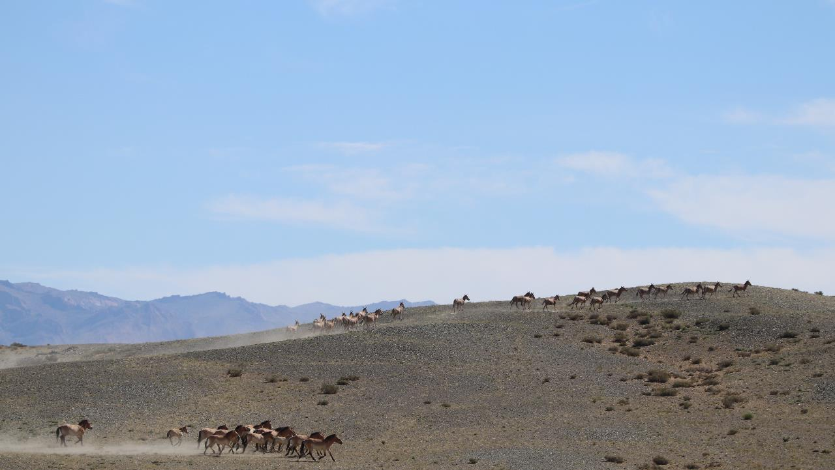
The International Takhi Group (ITG)
Supporting governments and other relevant agencies in building a self-sustaining takhi (Equus ferus przewalskii) population in Central Asia to develop a long-term perspective for the takhi in its native habitat;
Supporting governments and other relevant agencies in the conservation and management of protected areas in Central Asia with a focus on takhi and consideration of the socio-economic issues of local communities;
…
…
Promote and support national and international cooperation between partners on takhi conservation in Central Asia.
ITG’s offer to CAMI
Advice and support Mongolia and China in implementing the CAMI work programme 2026-2032 (activities 22.1’, 22.5 - 22.11) in the Conservation Unit ‘Gobi’

Slide 16
WCPF - 22. Gobi (China, Mongolia)-11
Activities to be implemented by 2032 |  | Responsible
22. Gobi (China, Mongolia) – 11
22.1 | Establish and continue collaboration between China and Mongolia through increasing awareness on transboundary issues and improving communication between agency personnel, biologists, and conservationists working on CAMI species conservation in China and Mongolia | Wild Camel Protection Foundation Institute of Zoology, Mongolia Parthners: Gobi Bear Society Border Protection Agency, Great Gobi A SPA Institute of Remote Sensing, China ITG
22.2 | Initiate communication and wildlife-related data sharing between both countries.
22.3 | wildlife movements and distributions, and coordinate field surveys along the border between China and Mongolia
22.5 | Identify, describe and map human footprint (e.g., mining sites) and water points on both sides of the border between China and Mongolia, based on most recent satellite images
22.7 | Explore possibilities of the enlargement of the protected area network in the region of Great Gobi A SPA in Mongolia and MaJu Shan LPA
22.17 | Establish an appropriate national legal framework to prevent hybridization of wild camels with domestic camels and to allow removal of hybrids.

Slide 17
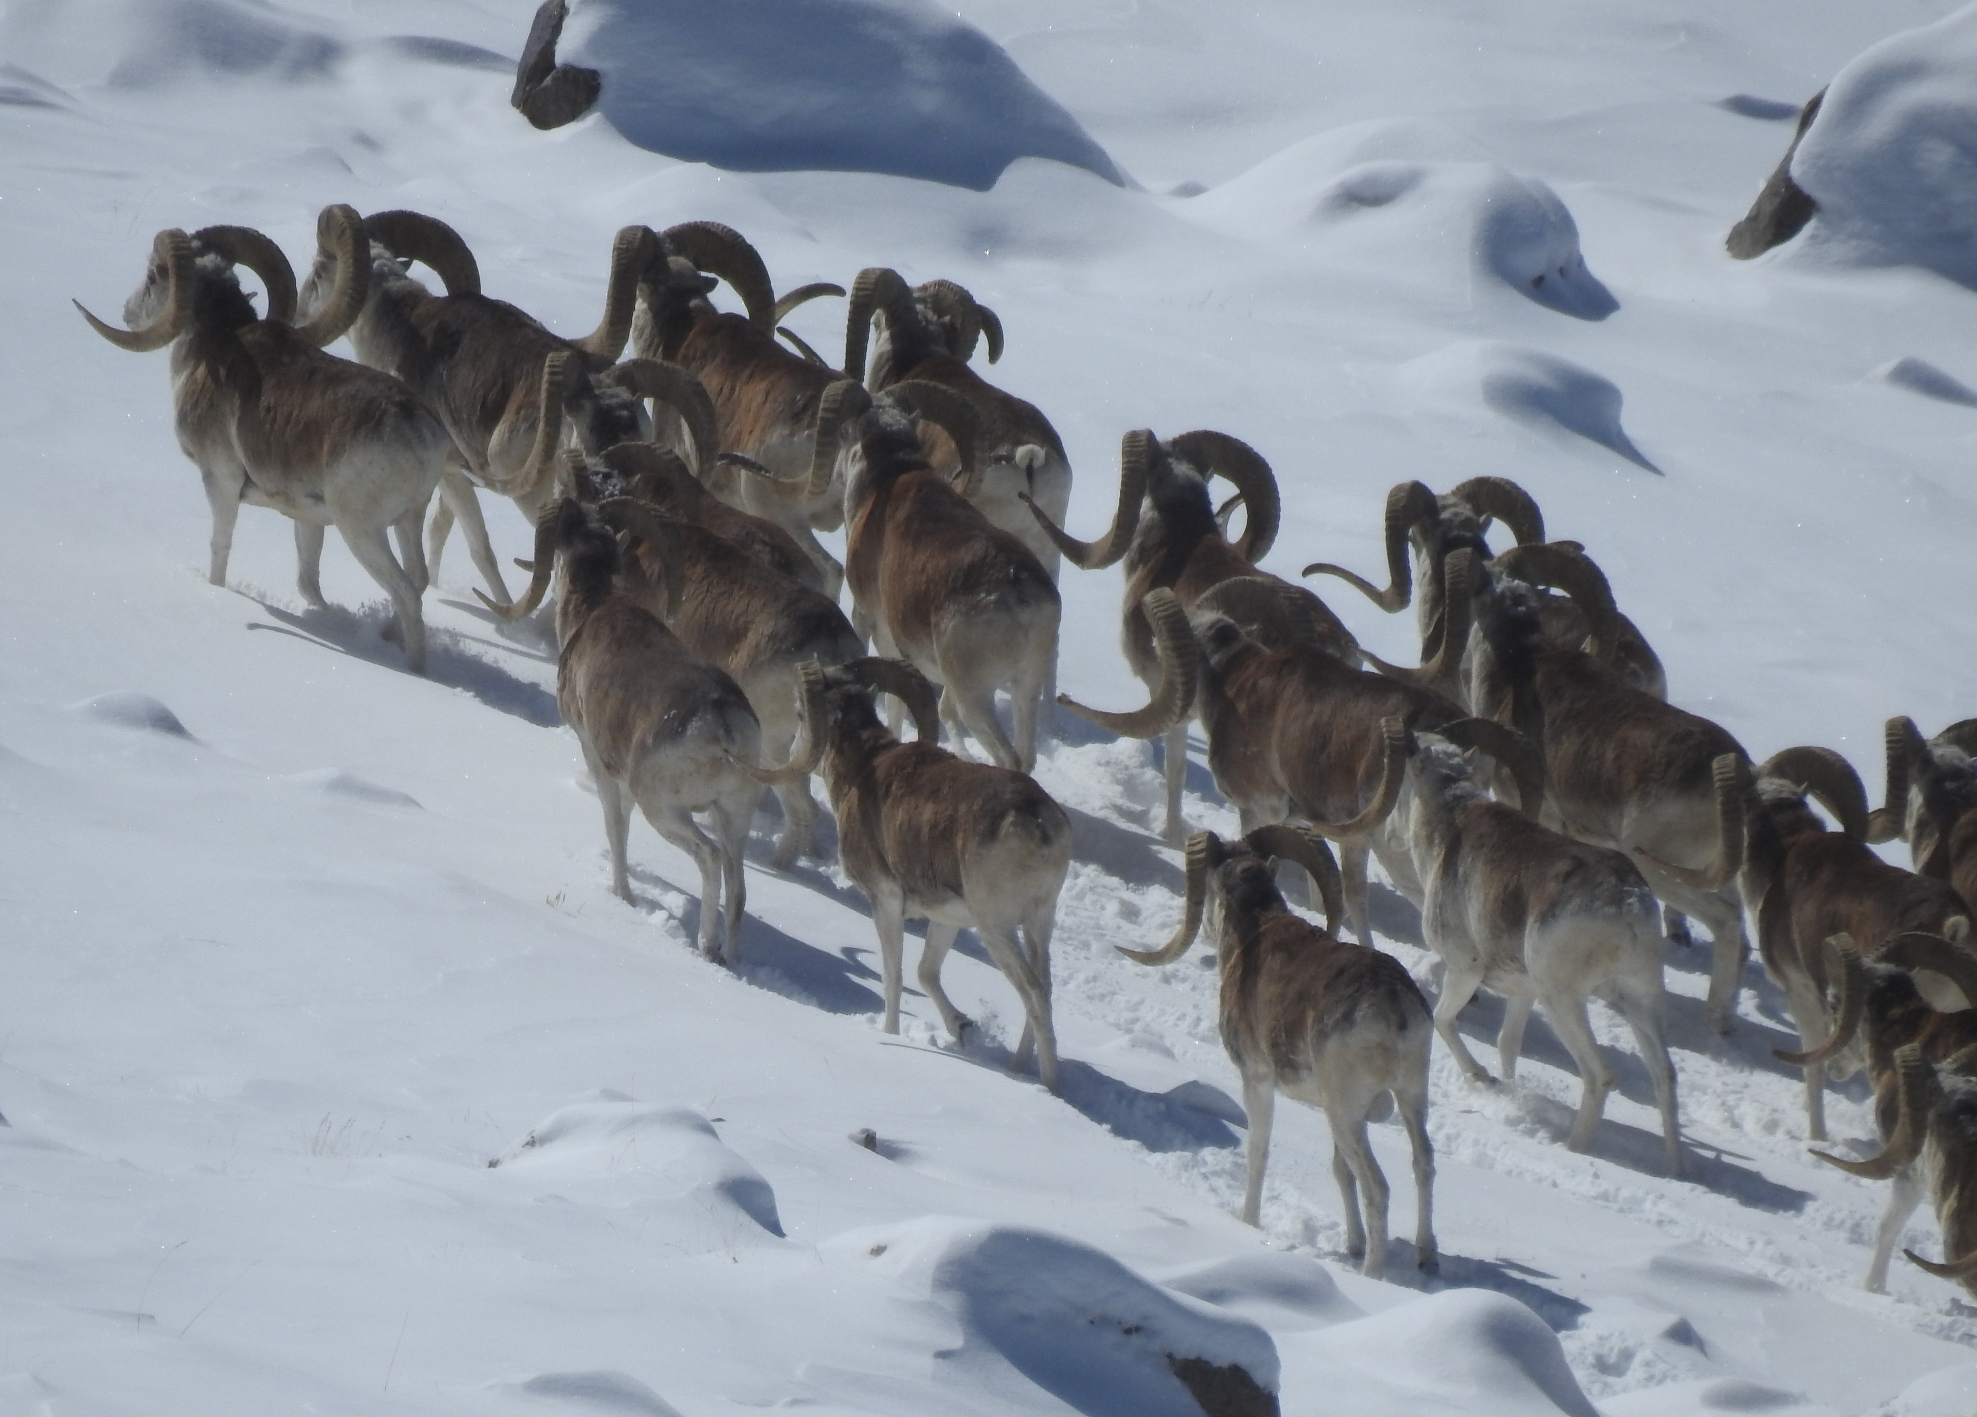

WCS contribution to the CMS/CAMI Programme of Work 2026–2032
Conservation Unit :
  CU19. High Pamir/Wakhan
  CU21. Daurian Steppe
  CU22. Gobi
CAMI species (relevant according to the CU): Argali, Asiatic Wild Ass, (Eurasian Lynx); Goitered Gazelle, Mongolian Gazelle, (Pallas’s Cat), Snow Leopard, and Urial.
High Priority activities:
  Medium/Low Priority activities: not listed here.
4.1 | Assist CAMI Range States in implementing transboundary agreements outlined in the WP.
4.4 | Advancing OECM recognition in border areas
5.3 | Assessing and advancing infrastructure mitigation for CMS species
5.6 | Enhancing habitat connectivity through Pas, OECMs and eco-corridors
7.3 | Introducing Innovative Enforcement Technologies for Wildlife Protection
7.4 | Using SMART to Strengthen Anti-Poaching Strategies"
8.2 | Workshops on Inclusive Landscape Planning for CAMI Habitats
8.8 | Assess water and grazing availability in conflict areas and apply targeted conservation actions for CAMI species.
8.9 | Scaling Up Livelihood Initiatives Linked to Conservation
10.1 | Tracking CAMI Species to Guide Conservation and Connectivity
10.2 | Monitoring CAMI Species Populations for Informed Conservation
11.1 | Coordinated Awareness-Raising for CAMI Species Conservation
11.5 | Promoting Central Asia’s Role in CAMI Species Conservation

Slide 18

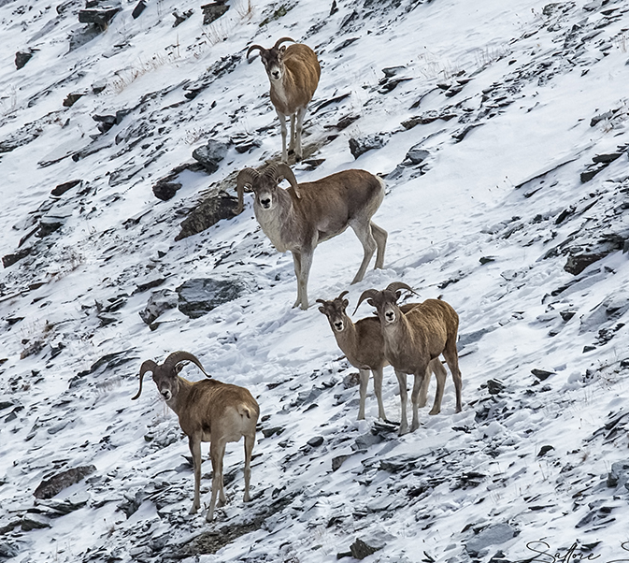
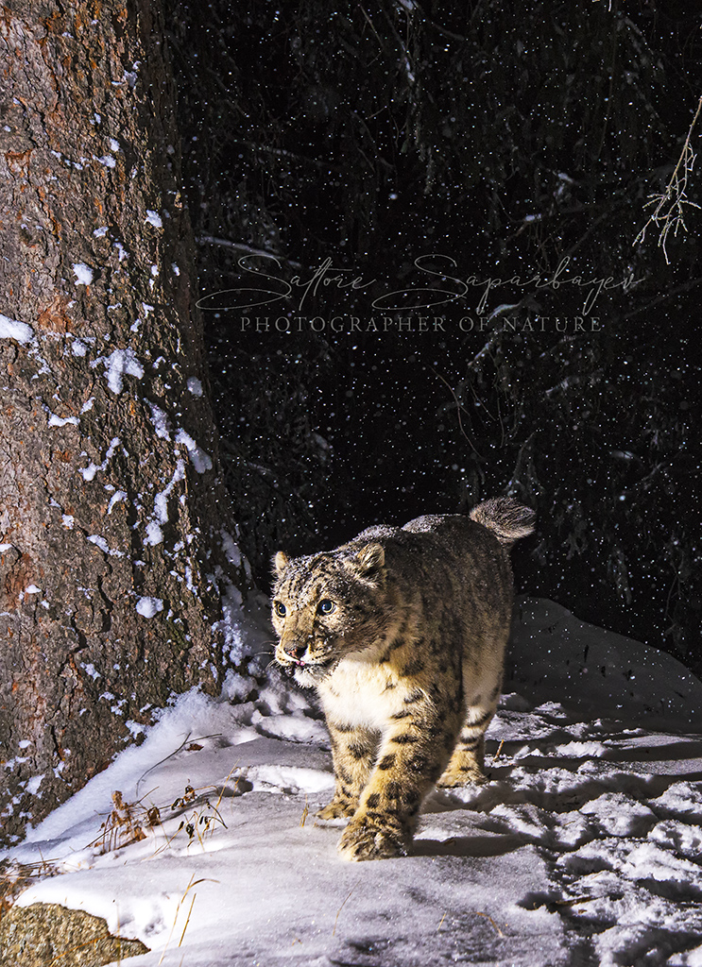
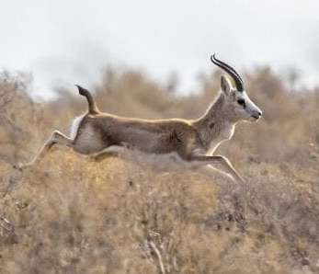
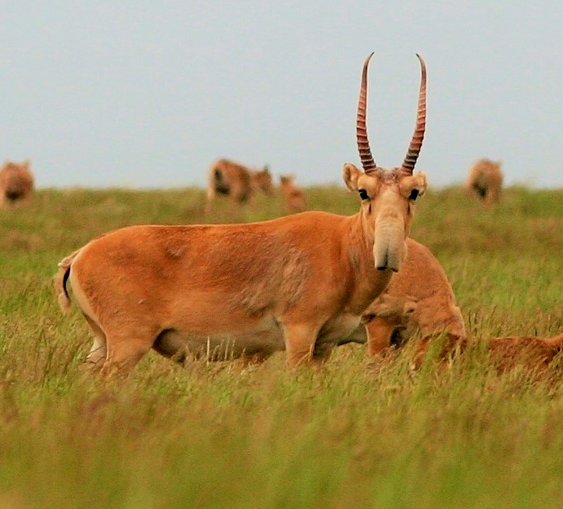
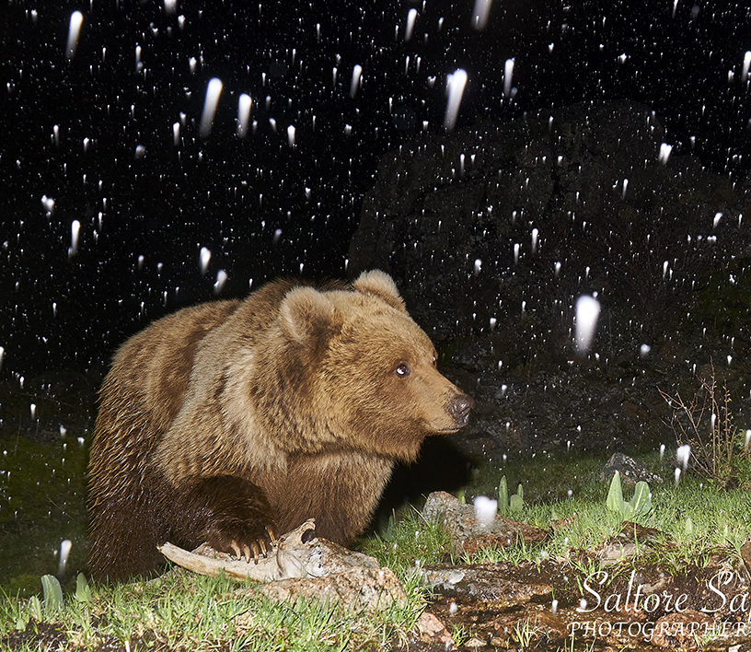
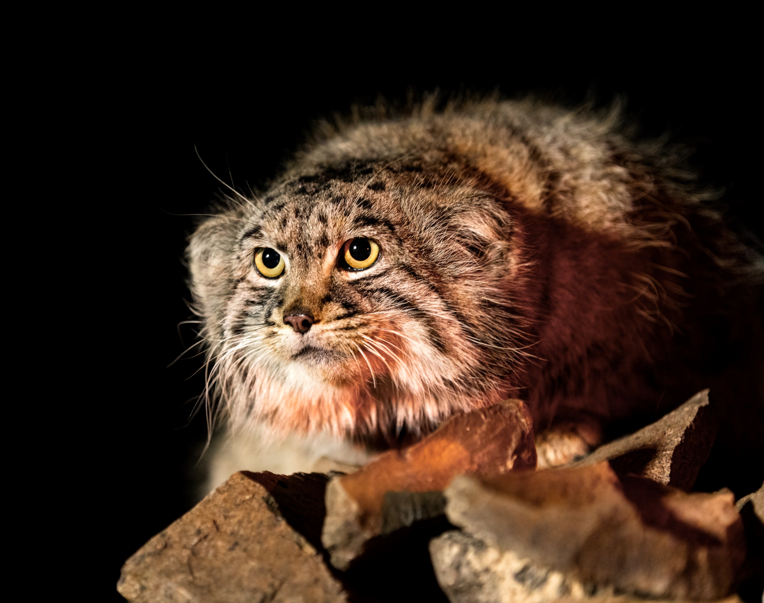
Wildlife Without Borders is a non-governmental organization focused on conserving Kazakhstan’s biodiversity, with a particular emphasis on maintaining landscape connectivity for migratory and rare species such as the Saiga, Goitered gazelle, Argali, Snow leopard, Turkestan lynx, and Brown bear, and other vulnerable species. The organization also prioritizes transboundary conservation efforts and works to mitigate the impacts of climate change.
Over the past seven years, the organization has successfully implemented around 20 conservation projects supported by IUCN, UNDP, WWF, CEPF, NABU, GIZ, Rufford, and others.
CU | Activities to be implemented by 2032
Western and Southern Ustyurt (12) | 5.8; 10.1; 10.2; 10.3; 10.4; 10.7; 10.8; 10.9; 11.5; 12.6; 12.7.
Northern and Eastern Ustyurt (13) | 10.1; 10.2; 10.3; 10.4; 10.7; 10.8; 10.9; 11.5; 13.4; 13.5.
Aralkum / North-Western Kyzylkum Desert (14) | 10.1; 10.2; 10.3; 10.4; 10.7; 10.8; 10.9; 11.5; 14.2; 14.5; 14.6; 14.10.
Western Tian Shan (17) | 5.8; 8.3; 8.8; 9.5; 10.1; 10.2; 10.3; 10.4; 10.7; 10.8; 10.9; 11.1; 11.5; 17.1; 17.2; 17.3; 17.5.
Northern and Inner Tian Shan (18) | 4.1; 5.8; 8.3; 8.8; 9.5; 10.1; 10.2; 10.3; 10.4; 10.7; 10.8; 10.9; 11.1; 11.5; 18.1; 18.2; 18.3; 18.4; 18.5; 18.7; 18.8.
Altai (20) | 10.1; 10.2; 10.3; 10.4; 10.7; 10.8; 10.9; 11.1; 11.5; 20.1; 20.2; 20.3.
https://wwb.kz/
www.instagram.com/wwb_kz

