Slide 1
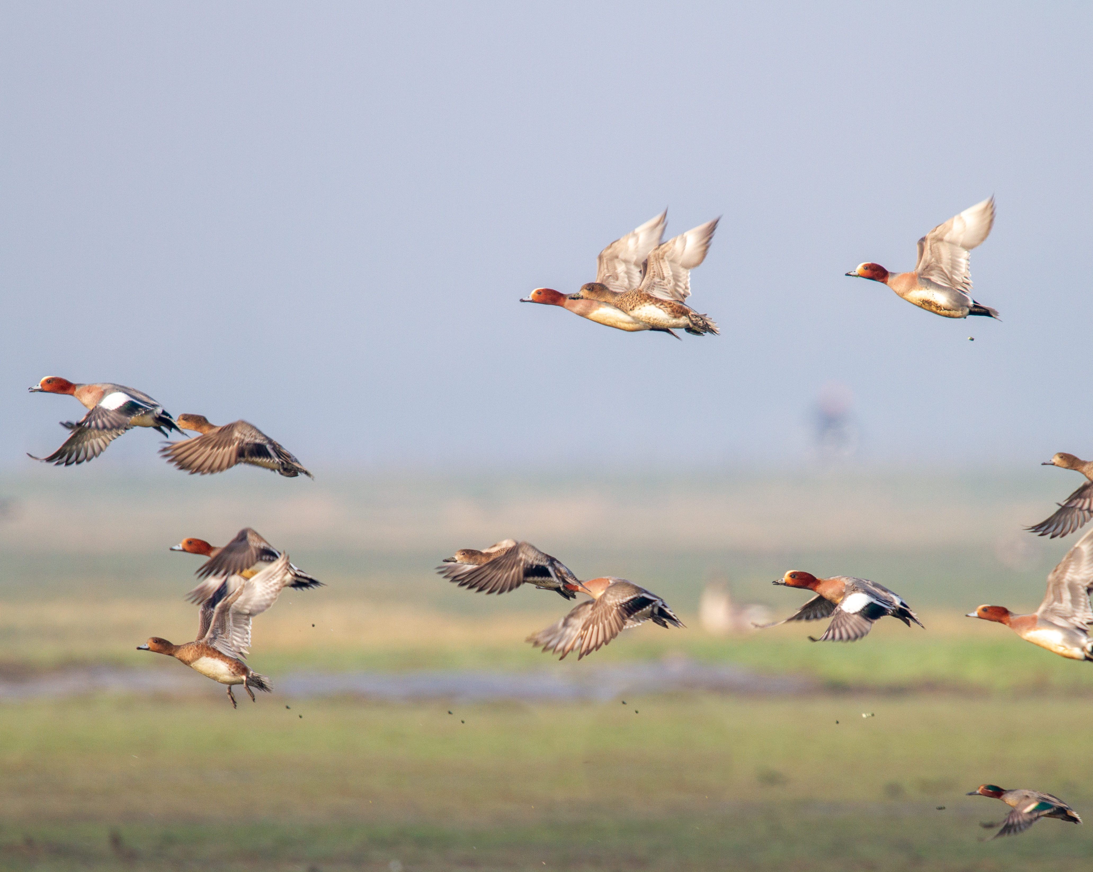
Movement data to flyway decisions
Making migration data usable for conservation policy
Luca Guitink | Wetlands International Europe | AEWA
CMS Atlas of Animal Migration workshop, Vasto | October 2026
Photo by Szabolcs Nagy
Notes:
I would like to look at the CMS Migration Atlas particularly from the perspective of conservation policy and implementation: how can we move from increasingly detailed information on animal movements to information that governments and conservation practitioners can actually use?

Slide 2
Framing movement data
Raw data → context-specific interpretation → policy relevant
AEWA
Ramsar Criterion 6
Flyway conservation
Interpretation needed
Interpretation needed
Interpretation needed
Which biogeographic population is involved?
What is its status and trend?
Which population estimate and 1% threshold apply to the site count?
Which sites and countries are connected?
Where are bottlenecks or shared dependencies?
Movement data
Counts
Ringing
Tracking data
Site observations
Interpretation
changes with the
decision context
Decision supported
Decision supported
Decision supported
Population assessment · Table 1 context · coordinated conservation/management
Is the wetland internationally important for that population?
Where cooperation, restoration, protection or investment may matter most (prioritisation)
All forms of raw movement data are valuable observations.
However, conservation users need their context: population delineations, status, site importance, connectivity and uncertainties.
An atlas should provide the interpretation rather than the data.
CMS Atlas of Animal Migration | AEWA
Notes:
All forms of movement data are valuable. Counts, ringing, captures and re-captures, tracking data and site observations can all give us information about the migrations of species.
But the interpretation of the data needed depends on the decision we are trying to support.
For AEWA, we need to identify the relevant biogeographic populations and its status. This helps support decisions such as…
For Ramsar Criterion 6, we need to know which population estimate and 1% threshold apply to a site count. This helps support decisions such as…
And for broader flyway conservation, we may want to know which sites and countries are connected, or where important bottlenecks or steppingstones occur. This helps support decisions such as…
Movement data become most useful for policy when they are translated by the context needed to interpret them.

Slide 3
Elements of policy-relevant interpretation (AEWA context)
1
2
3
4
5
Population
delineations
Status &
trend
Site
significance
Connectivity
Uncertainties
INTERPRETATION LAYER
Which biogeographic
population?
Increasing, stable
or declining?
Does the site meet
a criterion?
Which sites and
countries are linked?
How reliable and
representative?
These layers can help contextualize raw migration data into implementable information for policy.
CMS Atlas of Animal Migration | AEWA
Notes:
From an AEWA perspective, I have grouped that context into five broad elements.
Which population are we dealing with?
what is its status and trend?
what does an observation mean for the significance of a particular site?
how are sites and countries connected?
how reliable and representative is the information we have? - Uncertainty addressed by multiple speakers already
These layers can help contextualize raw migration data into implementable information for policy.
I will use a few waterbird examples to illustrate why each of these elements matter

Slide 4
Population delineations
Delineation defines which birds within a species are treated as one biogeographic population for (AEWA) conservation and management.
Population A
Species
Population B
Population C
Delineations define the biogeographic population used for monitoring, assessment and management.
A single species may have several populations with different ranges, abundance, trends and threats.
Movement data can help test and improve these population boundaries.
CMS Atlas of Animal Migration | AEWA
Notes:
Population delineation is essentially the process of determining where one biogeographic population ends and another population begins. For AEWA, the conservation unit is often not the species, as species can contain several populations with different geographic ranges and migration systems.
In some cases, populations may remain geographically separate throughout the year. In others, birds may mix on the breeding grounds but separate into distinct non-breeding areas. When a population is delineated, we are trying to identify a group of birds from a particular species that can meaningfully be treated as one unit for monitoring, assessment and conservation.
Movement information is highly useful for the delineation process. Ringing, tracking and other movement data can help reveal whether birds using different areas are part of the same migratory flyway or represent different populations.
Why are population delineations important for policy? Because two birds of the same species can belong to populations with very different abundance, trends, threats and conservation priorities.
Knowing that a species occurs at a site is therefore only the beginning. We also need to know which population is using that site, because that determines which population estimate and trend are relevant, which other countries share responsibility for it, and how that occurrence should be interpreted within the wider flyway.

Slide 5
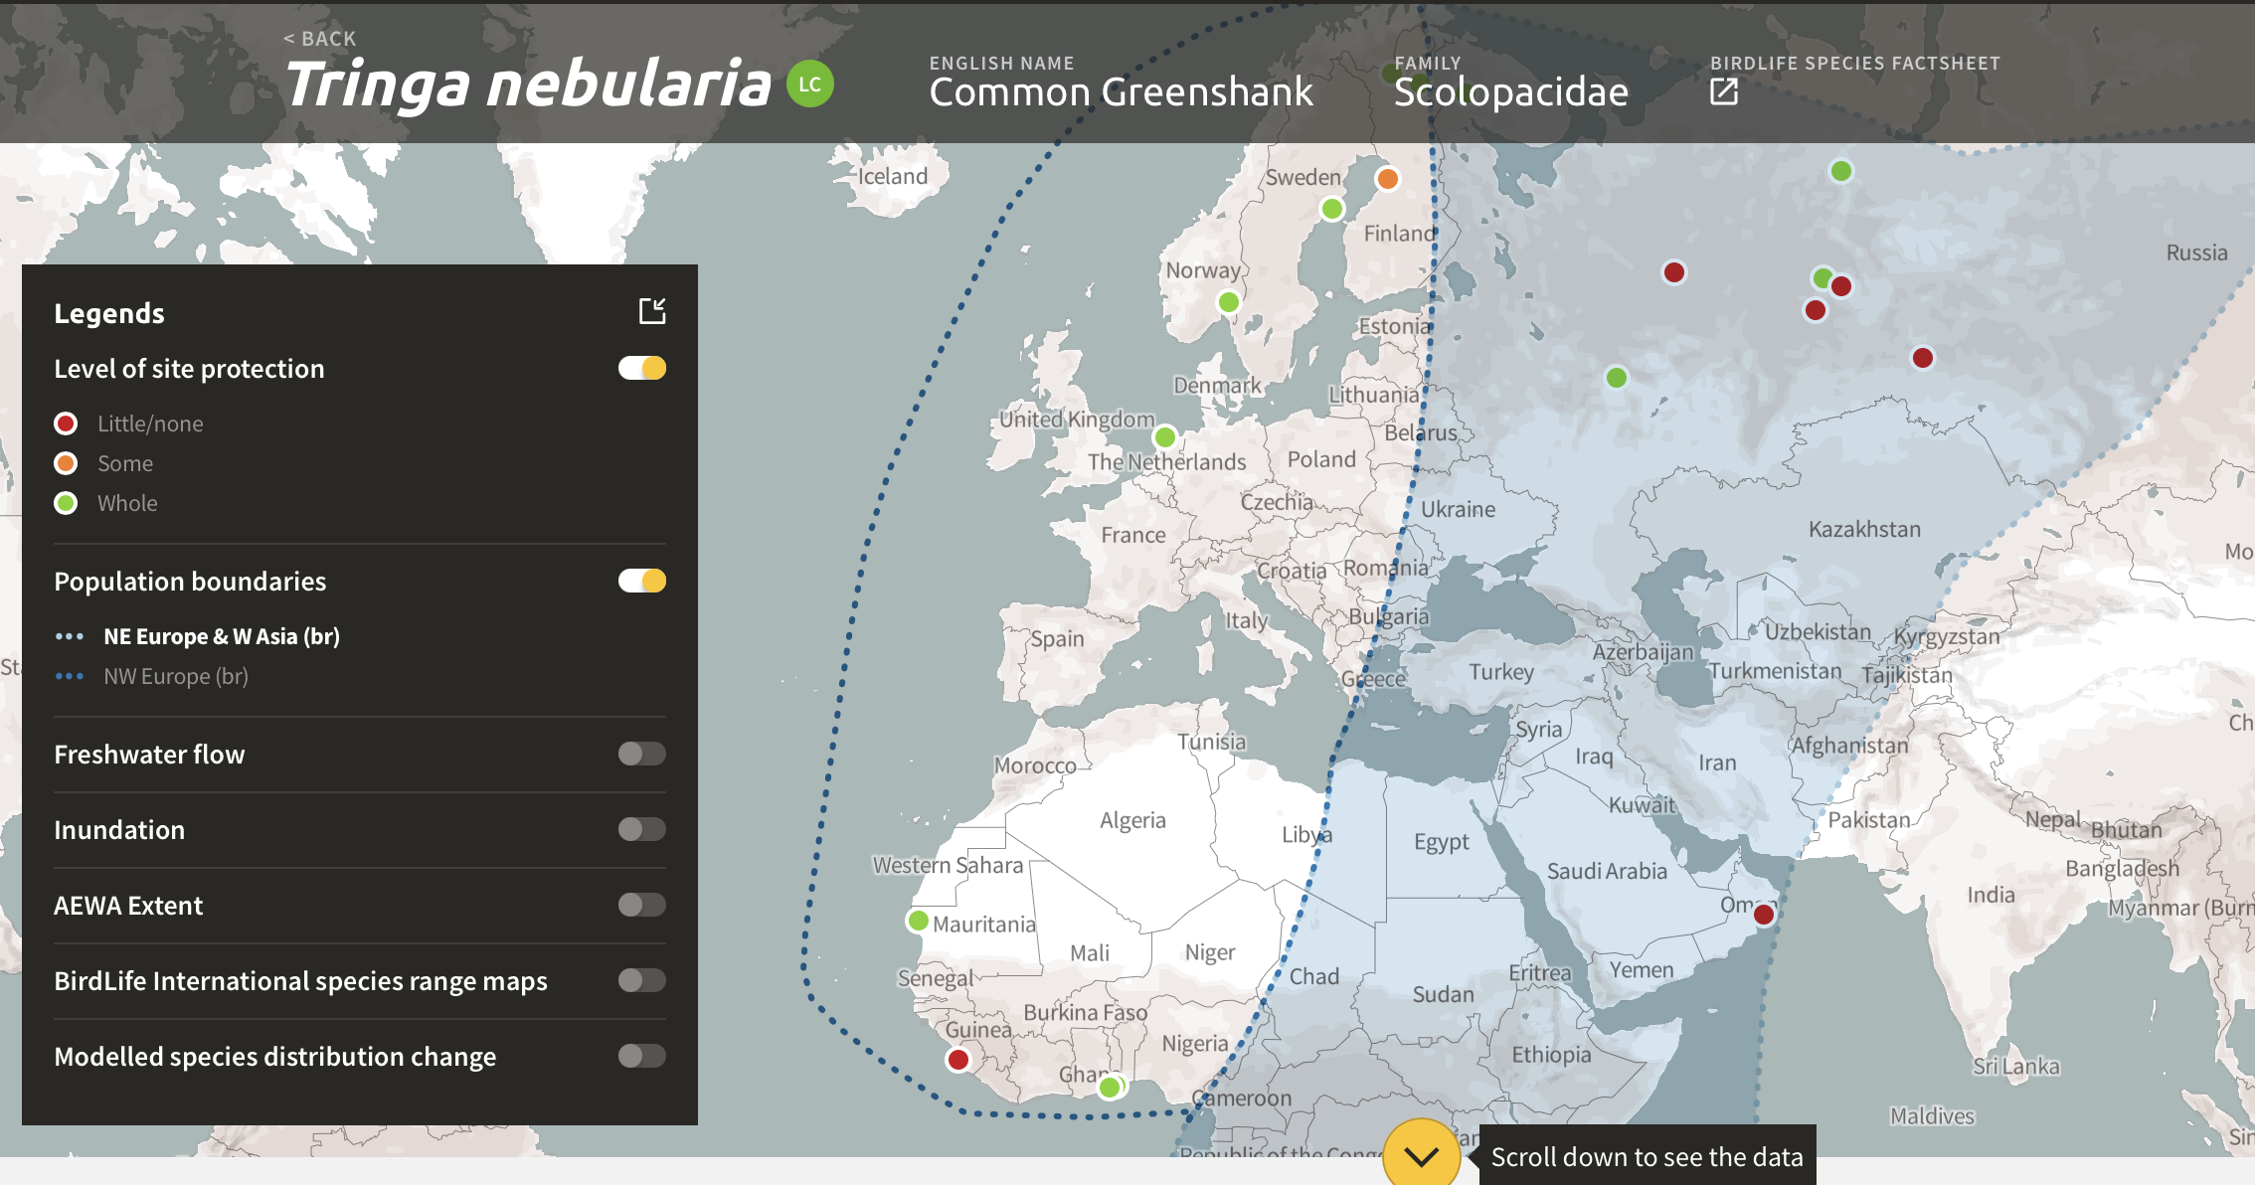
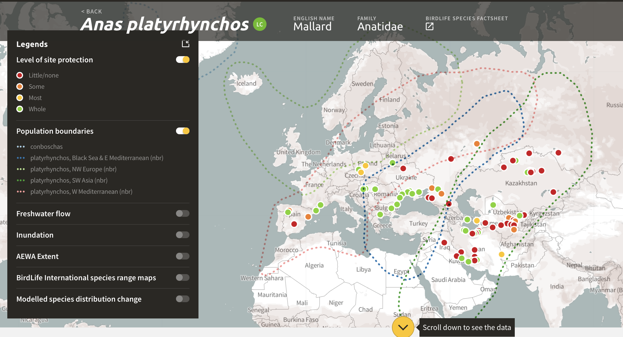
Population delineations are interpretations based on available data
Example: Common Greenshank
Example: Mallard
While a sharp population boundary between populations may be useful for management, it is a simplification, based on available data. It can hide gradual transitions, overlaps or data gaps between populations. Species with lots of populations overlapping more accurately indicate mixing or uncertainties of a species within the boundaries.
CMS Atlas of Animal Migration | AEWA
Notes:
But importantly, those population boundaries are themselves an interpretation of the evidence.
The Common Greenshank example on the left shows a very sharp boundary between populations. That is useful operationally, but biologically it is a simplification. There may be mixing, gradual transitions, or areas where information is weak. [In its original form, the boundary between the two population was marked with a dashed line to indicate uncertainty].
The Mallard example on the right makes some of that complexity more visible through overlapping population boundaries.
So if an Atlas presents population delineations, it should ideally also communicate where those boundaries are well supported and where they represent uncertainty or management convention.

Slide 6
Status, trends and thresholds give observations meaning
Red Knot Calidris canutus Wadden Sea
Dunlin Calidris alpina Ramsar Criterion 6
One site, different populations
through the year
A count only becomes meaningful when matched to the correct population threshold
Baltic
population
Large
alpina population
Winter
Spring/autumn
Management
1% threshold
≈ 10 birds
1% threshold
≈ 13,300 birds
mainly
Greenland/
Canada
islandica
Taymyr peninsula → West Africa
canutus staging
season determines
which population matters
Same species, very different site-designation implications
Implication: an atlas should connect movement/use to season and population, not only species occurrence.
CMS Atlas of Animal Migration | AEWA
Notes:
Knowing the population then changes how we interpret observations at a site.
The Red Knot is a useful example. In the Wadden Sea, different populations are present at different times of the year. In winter, many of the red knots present belong to the islandica population associated with Greenland and Canada. During migration, the Wadden Sea is also an important staging area for canutus population, moving between the Taymyr region and West Africa.
So even at the same site, the relevant population can change with season.
The Dunlin example makes the policy consequence even clearer. The 1% threshold under Ramsar Criterion 6 differs enormously between populations. For the Baltic population, 10 birds already represent 1% of the population, whereas for the alpina population, the 1% threshold is 13,000
So species and count alone are not enough. Population, season and the relevant framework are needed to interpret what observations mean.

Slide 7
CSN Tool: interpreted information for policy users
Species occurrence
& counts
Which population
occurs here?
Population
boundaries
CSN
Tool
Internationally important sites?
Estimates, status
& trends
Thresholds (1%)
What should users
check or prioritise?
Practical checks
e.g. look-alike species
The added value comes from organising information around conservation questions.
CMS Atlas of Animal Migration | AEWA
Notes:
This is the idea behind the Critical Site Network Tool [developed by Wetlands International and BirdLife International comes in. It was developed under the Wings over Wetlands project to support the work of AEWA and the Ramsar Convention on Wetlands.
Its added value is not just bringing more datasets together. It connects occurrence and count data with population boundaries, estimates, status and trends, thresholds and practical information, and organises them around questions that conservation practitioners need to answer.
So it provides an existing example of what I mean by an interpretation layer

Slide 8
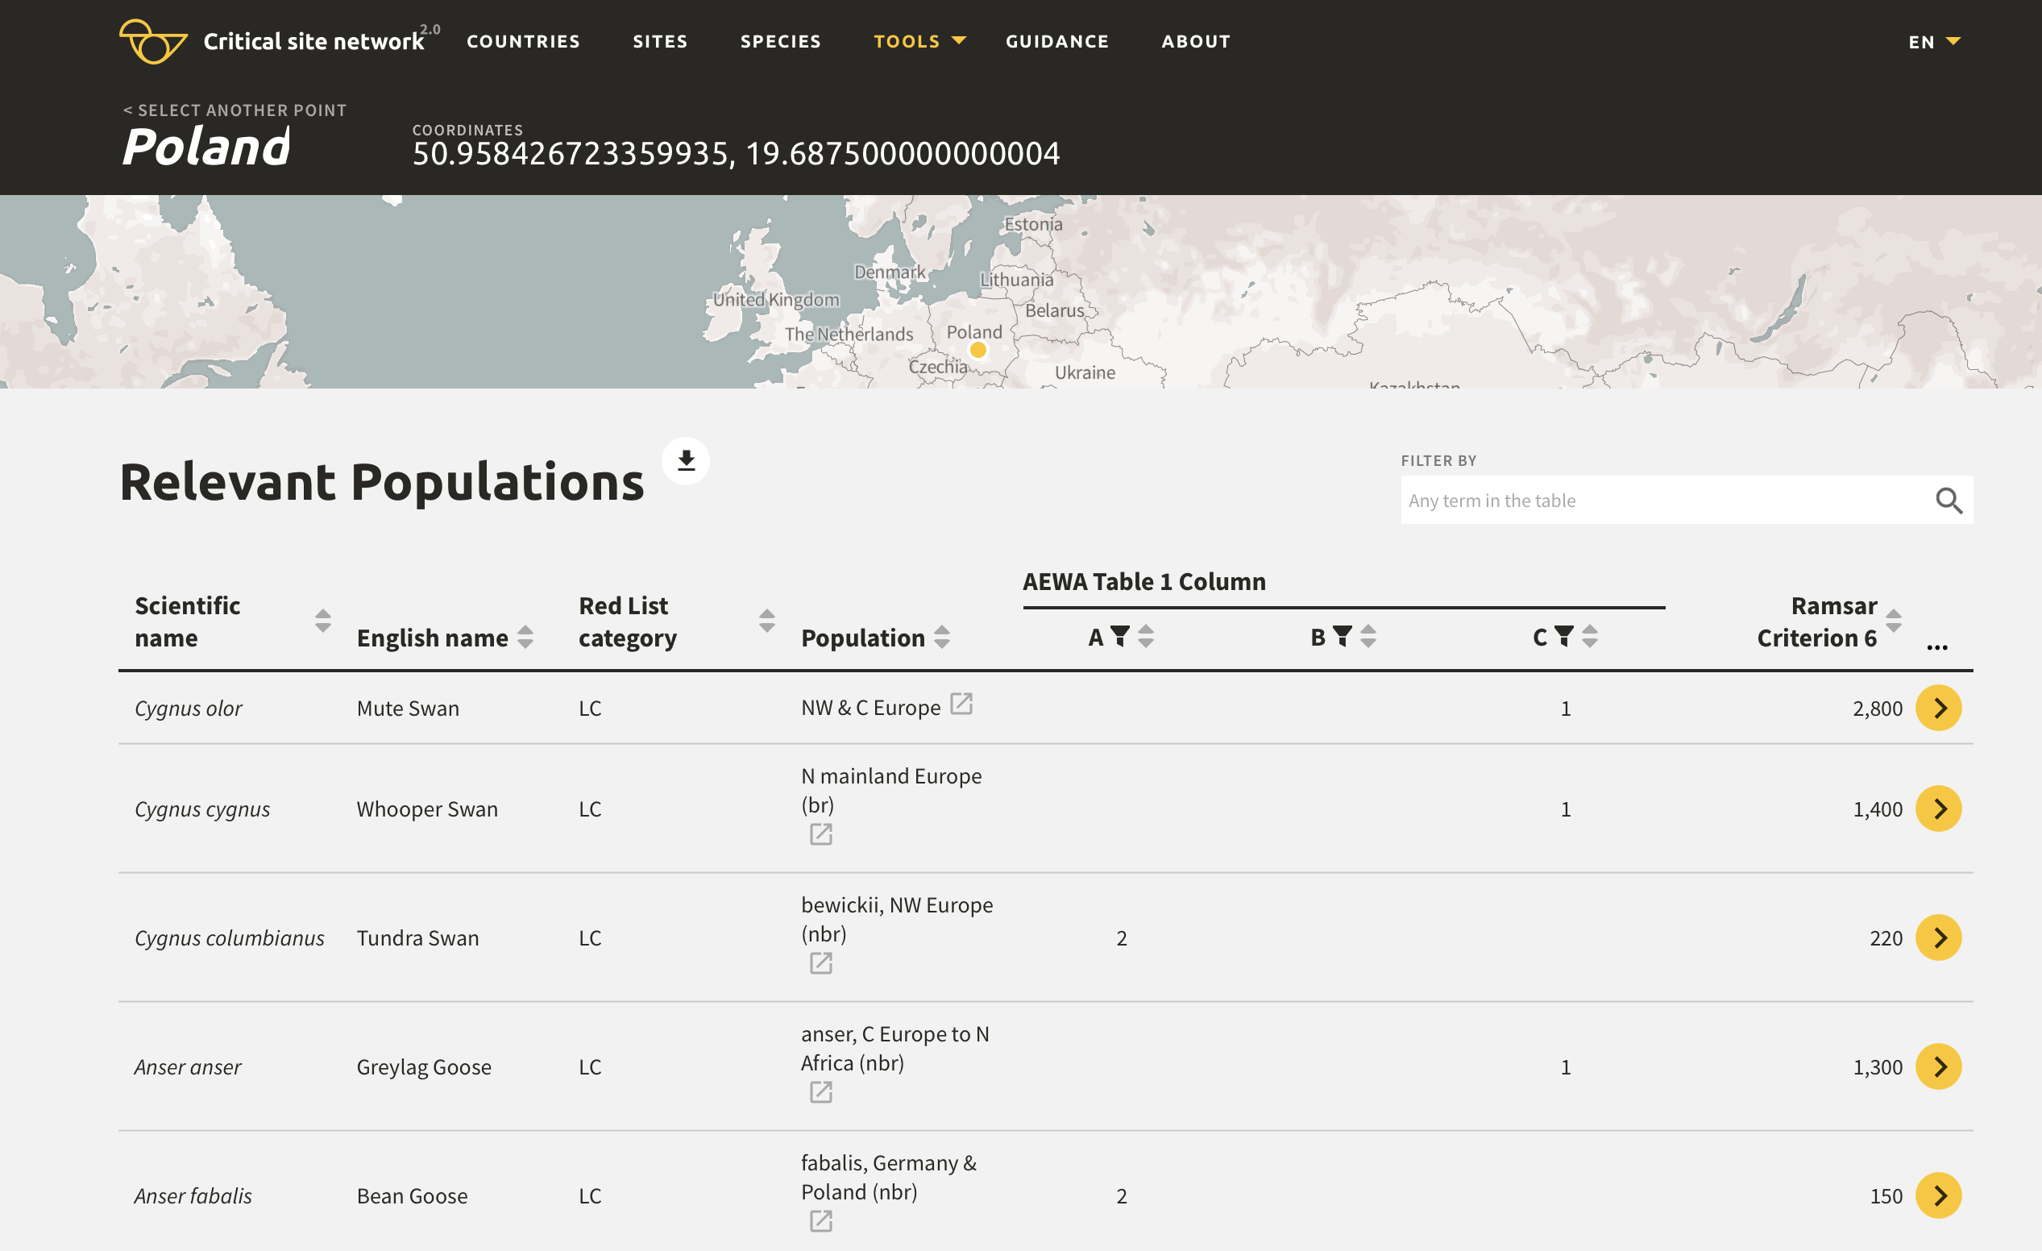
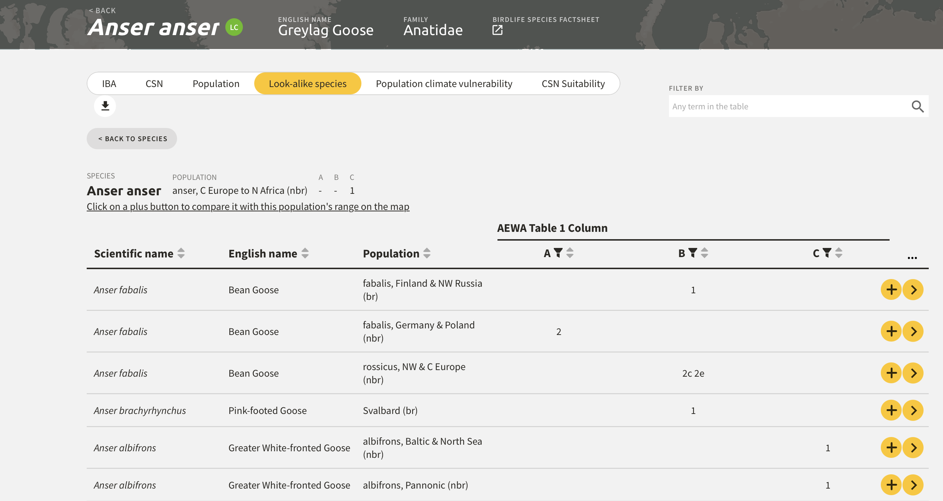
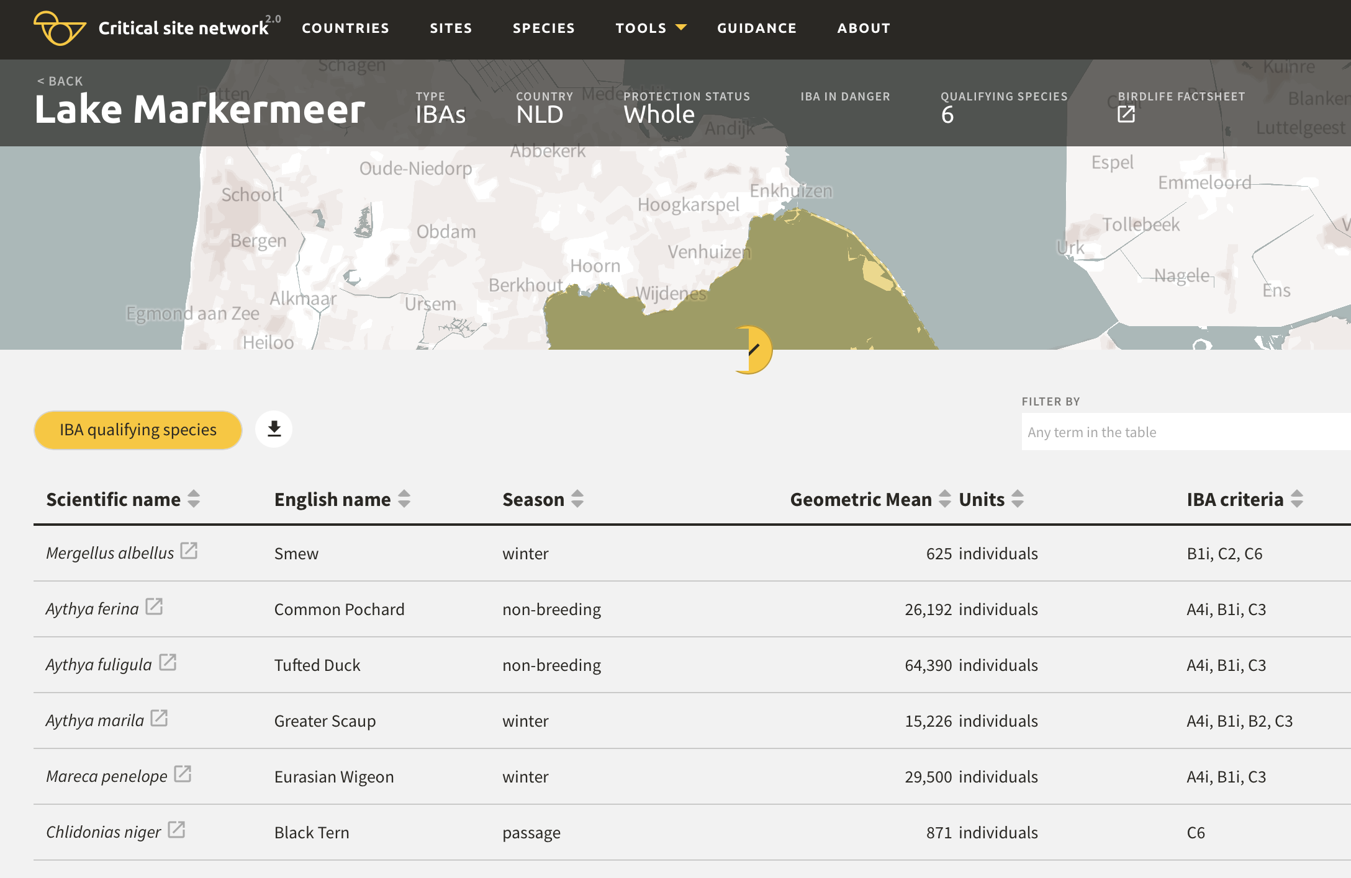
CSN Tool: Interpretation in practice
Population boundaries
Ramsar Criterion 6
Look-alike species
Site summary
Which biogeographic population(s) may occur here?
Which 1% threshold applies at this site?
Which similar species might cause identification errors?
Which species/populations use this site?
Implementation need
Implementation need
Implementation need
Implementation need
CMS Atlas of Animal Migration | AEWA
Notes:
For example, the tool can help answer four quite different implementation questions from the same underlying information. Here are just some of the ‘interpretation layers’ available on the CSN tool.

Slide 9
Population boundaries
Which biogeographic population(s) may occur here?
Ramsar Criterion 6
Look-alike species
Which 1% threshold applies at this point/site?
Which similar species might cause identification errors?
Implementation need
Implementation need
CMS Atlas of Animal Migration | AEWA
Notes:
Not only can you view global population delineations as showed earlier, you can also Click on the map
Gives you relevant species & relevant populations in that area/coordinates

Slide 10
CSN Tool: Interpretation in practice
Population boundaries
Ramsar Criterion 6
Look-alike species
Site summary
Which biogeographic population(s) may occur here?
Which 1% threshold applies at this site?
Which similar species might cause identification errors?
Which species/populations use this site?
Implementation need
Implementation need
Implementation need
Implementation need
CMS Atlas of Animal Migration | AEWA
Notes:
Up next… Ramsar criterion 6

Slide 11
Ramsar Criterion 6
Which 1% threshold applies at this site?
Which 1% threshold applies at this point/site?
Implementation need
CMS Atlas of Animal Migration | AEWA
Notes:
For [the designation of Ramsar sites or the AEWA Flyway Network Sites - which 1% threshold is relevant at this site?

Slide 12
CSN Tool: Interpretation in practice
Population boundaries
Ramsar Criterion 6
Look-alike species
Site summary
Which biogeographic population(s) may occur here?
Which 1% threshold applies at this site?
Which similar species might cause identification errors?
Which species/populations use this site?
Implementation need
Implementation need
Implementation need
Implementation need
CMS Atlas of Animal Migration | AEWA
Notes:
But the tool also aims to reduce probabilities of unintentional targeting of species through the look a like species tab.

Slide 13
Look-alike species
Which similar species might cause identification errors?
Implementation need
CMS Atlas of Animal Migration | AEWA
Notes:
For monitoring and identification: which look-alike species might occur and should be taken into account when listing huntable species or defining their open season to reduce the risk of shooting species or population in higher conservation status because of misidentification.

Slide 14
CSN Tool: Interpretation in practice
Population boundaries
Ramsar Criterion 6
Look-alike species
Site summary
Which biogeographic population(s) may occur here?
Which 1% threshold applies at this site?
Which similar species might cause identification errors?
Which species/populations use this site?
Implementation need
Implementation need
Implementation need
Implementation need
CMS Atlas of Animal Migration | AEWA
Notes:
But, you can also start at a specific site and work from there.

Slide 15
Site summary
Which species/populations use this site?
CMS Atlas of Animal Migration | AEWA
Notes:
For a particular wetland: which species and populations use this site? When in their annual cycles do they use this site?
These are quite different outputs, but the principle is the same: start with the conservation or implementation question, and organise the biological information so that it helps answer it.

Slide 16
Connectivity reveals shared responsibility
Breeding
area
Wintering
area
Staging
site
Alternative
site
Country A
Country B
Country C
Country D
A national site becomes part of a transboundary network; responsibility is shared across the full migration route
CMS Atlas of Animal Migration | AEWA
Notes:
Movement data offer an opportunity to strengthen our understanding of connectivity. We may already know that several sites are individually important. Movement data can demonstrate that those sites form part of the same ecological network and are used by the same population during different stages of its migration.
That creates a different policy perspective: a site within one country is no longer viewed only as an isolated national conservation area. It becomes part of a network that may depend on appropriate management in several countries. So movement information can change how we think about responsibility.. [Conservation NGOs, national governments often wants to know where to invest into site protection, collaboration, capacity building to increase the winter survival of their breeding population. Or countries with more limited technical and financial capacity, often want to know where can they ask help because the bounds migratory birds create between countries]
For migratory species, conservation responsibility is therefore inherently transboundary.

Slide 17
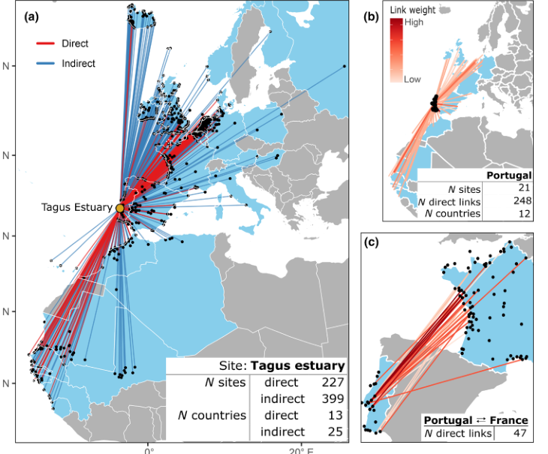
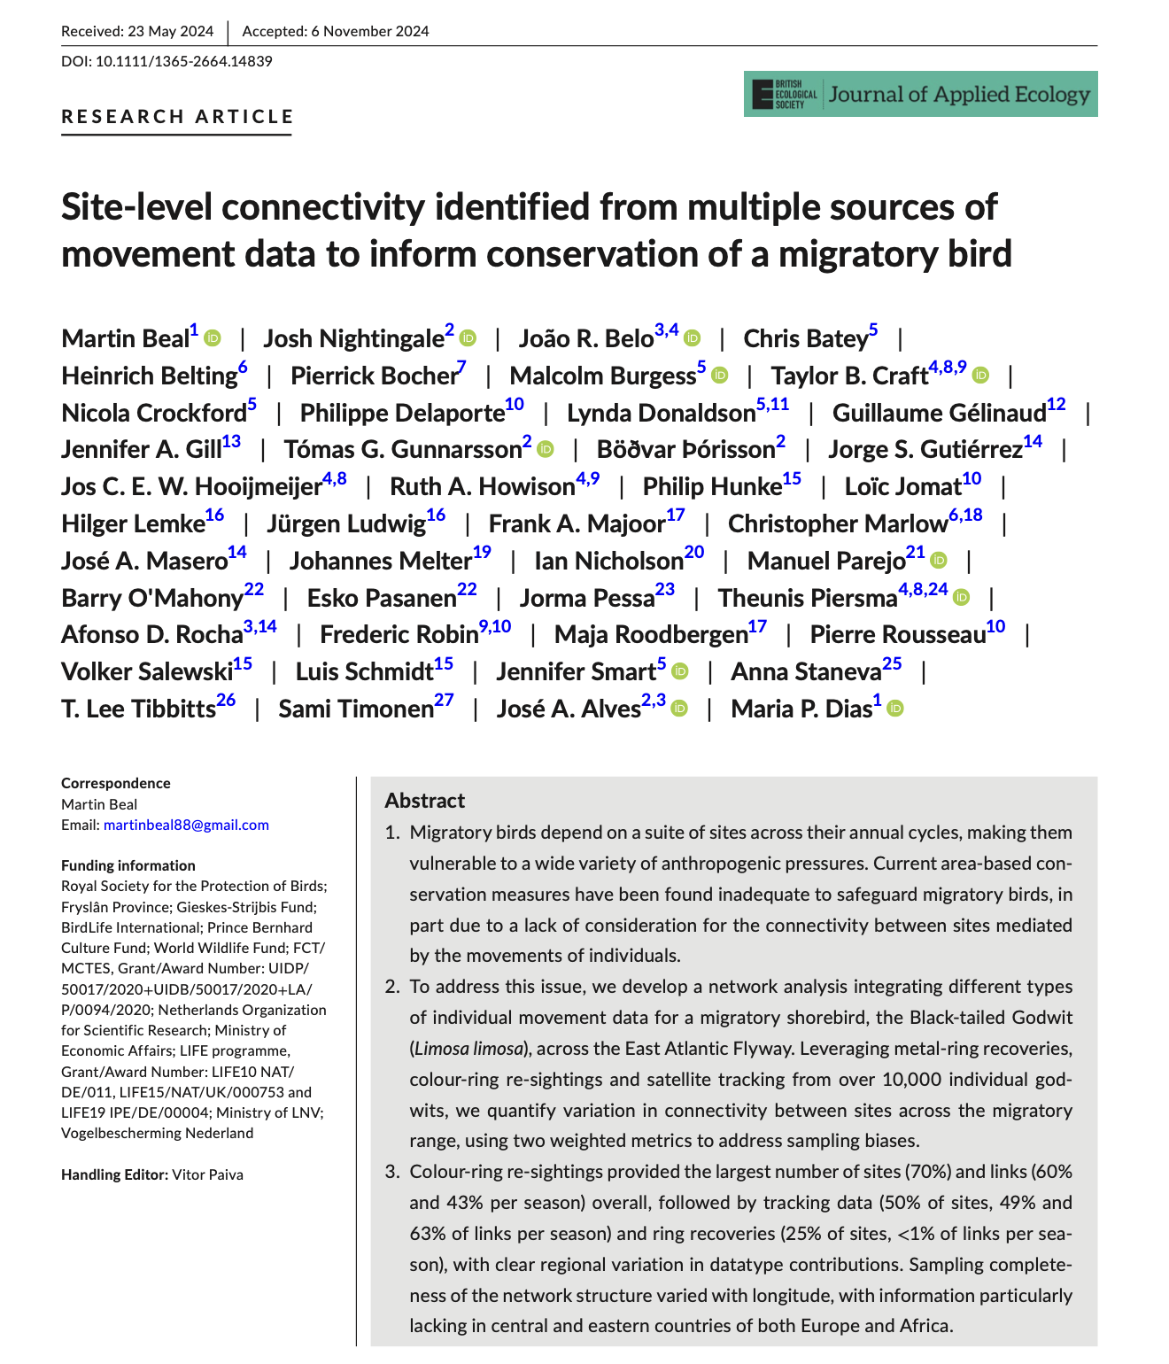
Connectivity changes the value of a site
Movement data can turn a local site into part of an international responsibility network.
Tagus Estuary as a focal site
Direct and indirect links reveal which sites and countries are connected
Useful for assessing threats, planning cooperation and justifying site importance
Figure from Beal et al. 2025, Journal of Applied Ecology: site-level connectivity in Black-tailed Godwit.
CMS Atlas of Animal Migration | AEWA
Notes:
The Black-tailed Godwit research by Beal and colleagues provides a good example. You may remember this example was discussed by Nicola on the first day as well.
The Tagus Estuary is treated as the focal site in the study as it is under massive pressure. By combining individual movement information, the analysis shows both direct and indirect connections between birds using the Tagus and sites across the flyway.
That means we can ask more than, “How many godwits occur here? How important is this specific site for the godwits here?”
We can ask: where are the godwits using this site connected to, which other countries share them, and what parts of the network could be affected if this site were degraded?
That is a different way of demonstrating the conservation significance of a site.

Slide 18
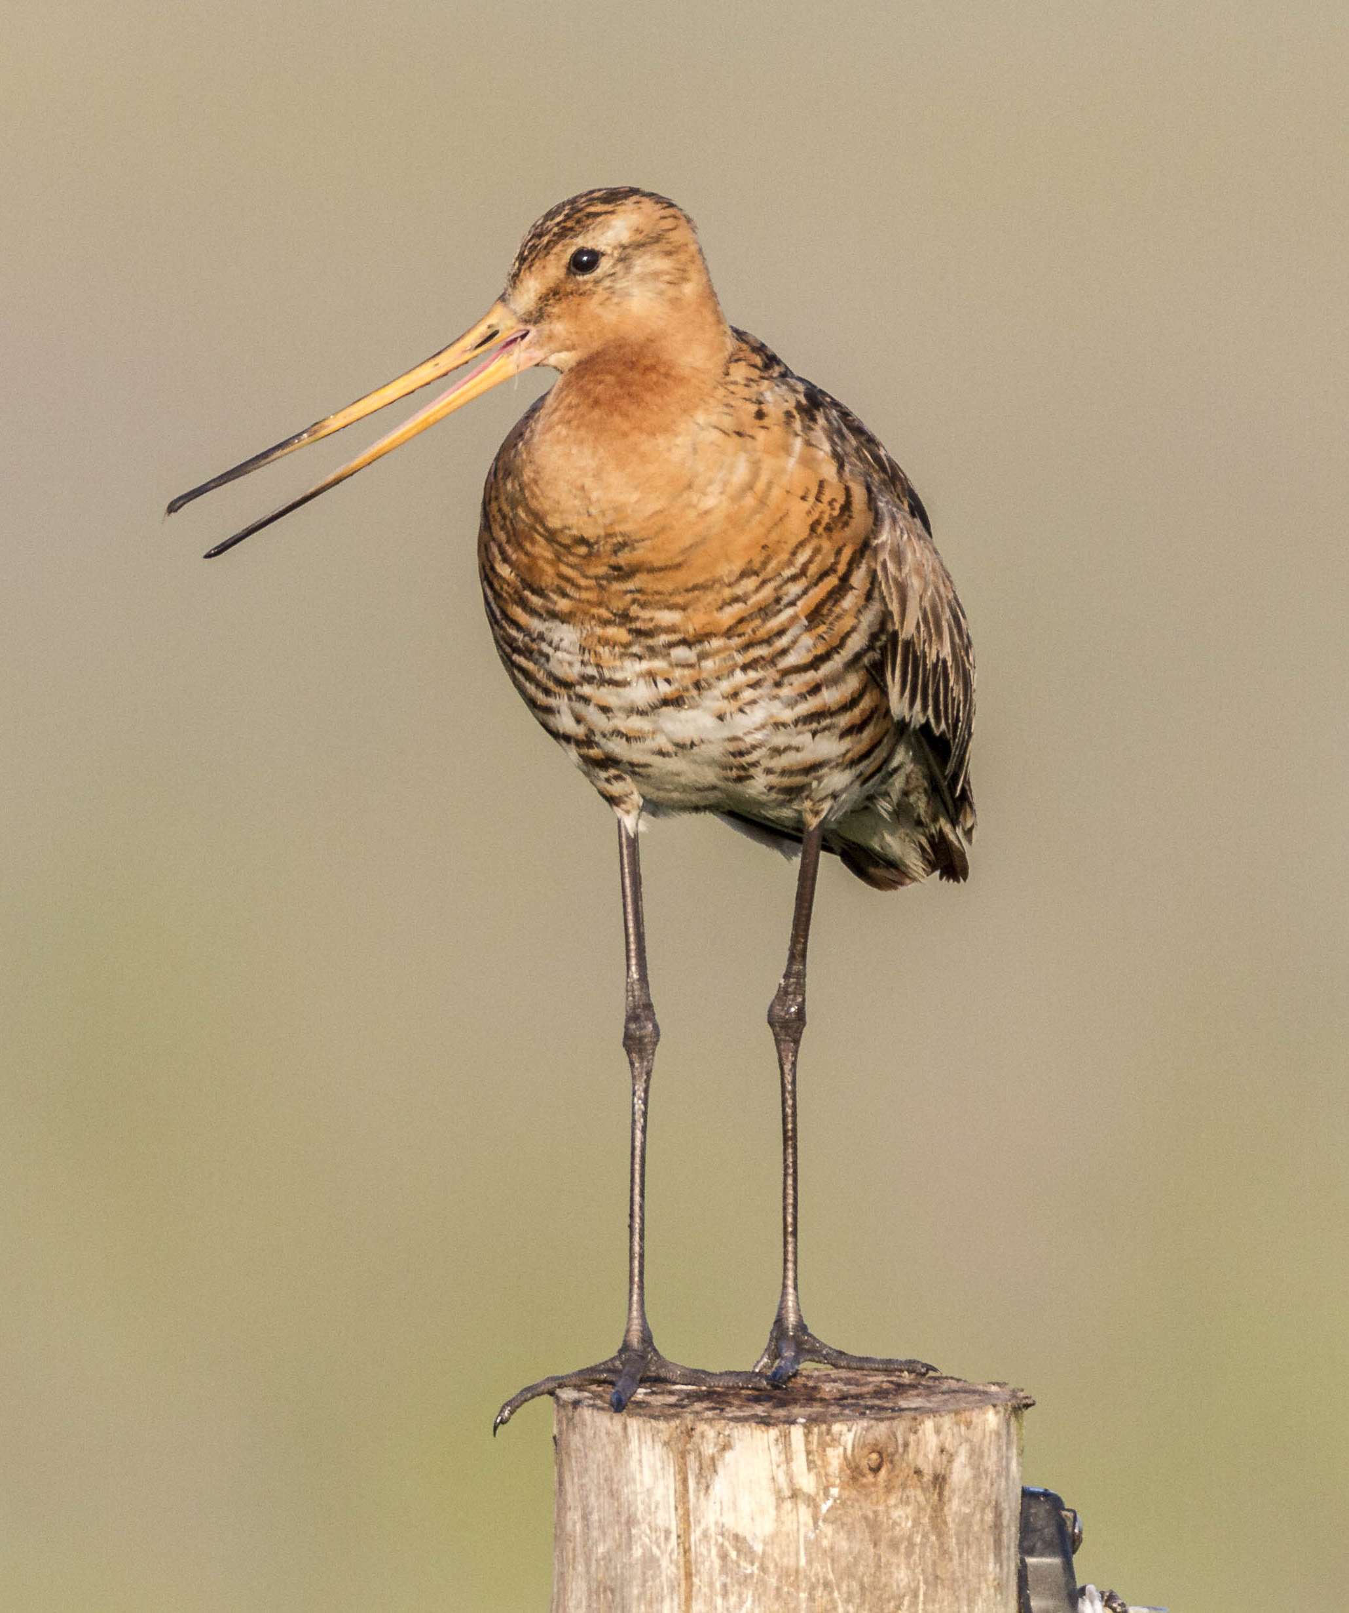
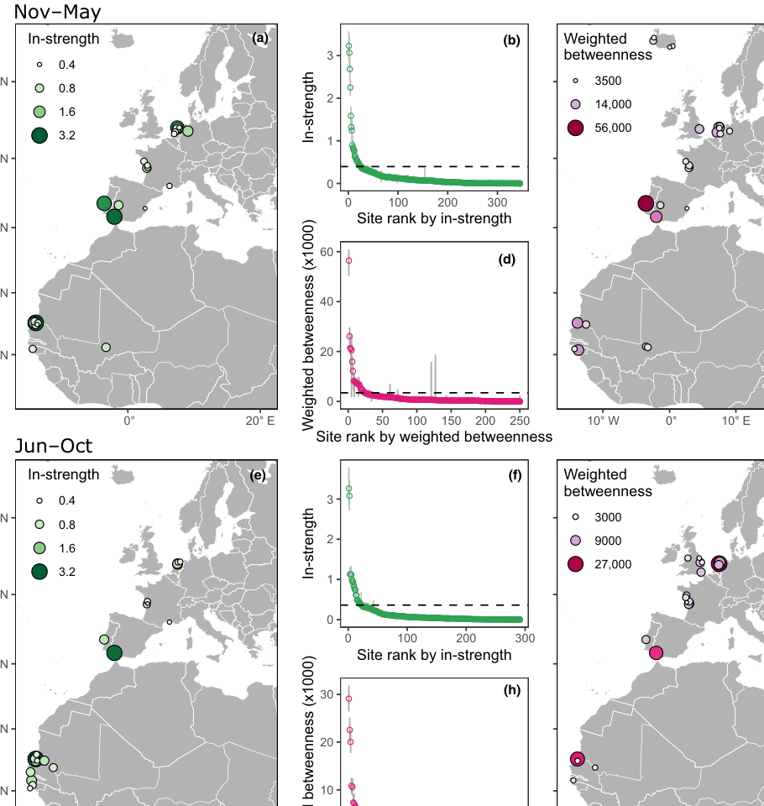
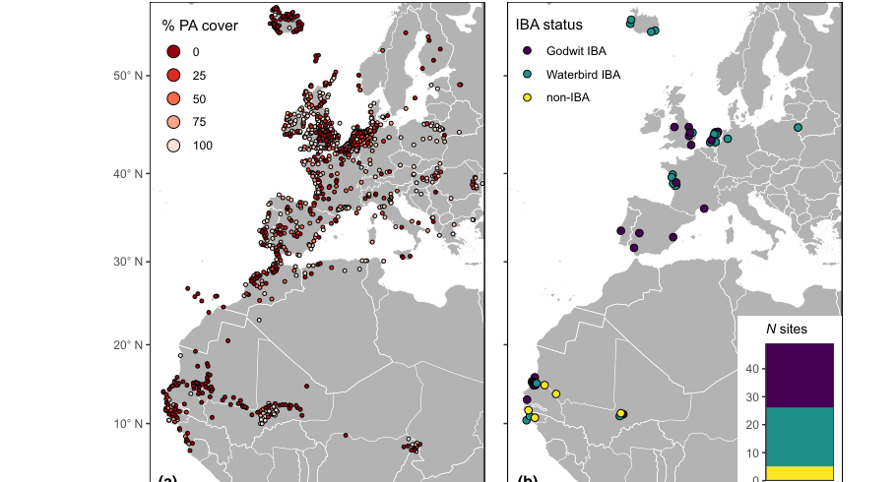
Connectivity changes the value of a site
Connectivity identifies functional roles of sites
Photo by Szabolcs Nagy
Key takeaways:
49 top connectivity sites identified across the flyway
Top sites linked to many other sites/countries
Some top connectivity sites lacked species-specific recognition or formal protection
Connectivity adds a missing layer to site prioritization
Beal et al. 2025.
Figures: Beal et al. 2025. The study integrated metal-ring recoveries, colour-ring resightings and tracking data for Black-tailed Godwit.
CMS Atlas of Animal Migration | AEWA
Notes:
The same study by Beal and colleagues also identifies sites according to their role within the network.
Some function as highly used arrival hubs; others have high ‘betweenness’, meaning that they act as stepping-stones connecting different parts of the network.
The study identified 49 top connectivity sites across the flyway, and some of these lacked species-specific recognition or formal protection.
So abundance (of birds) is not the only way a site can be important. Its position within the network can reveal a conservation value that conventional site-by-site assessments may miss.

Slide 19
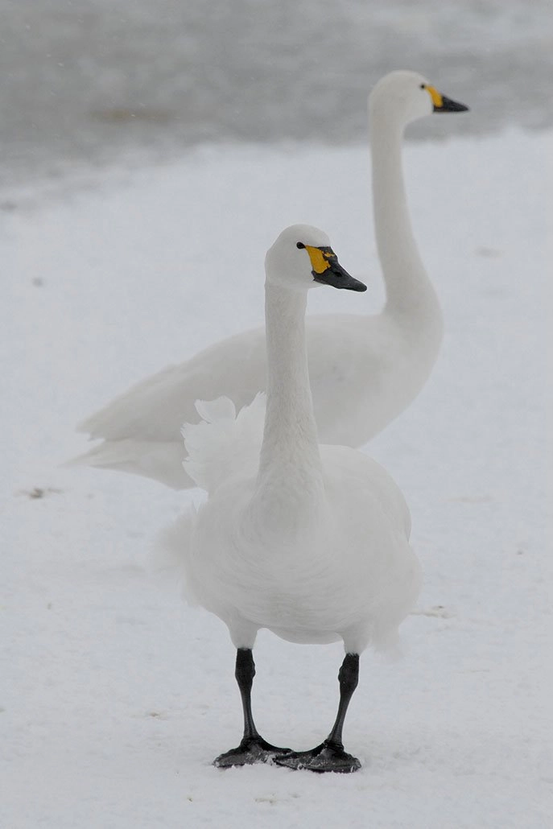
Bottlenecks and hidden dependencies
Functional bottleneck
Example: Bewick’s Swan at Dvina Bay / White Sea
Dvina Bay
last staging area
32–60% of flyway population
estimated to pass through Dvina Bay
Wintering
area
Arctic
breeding area
A map of routes alone may not reveal that this site is a critical refuelling dependency before breeding.
Nolet et al. 2001, Ibis: Bewick’s Swan spring staging at Dvina Bay / White Sea.
A site or corridor may be used briefly, but still be functionally critical if many migratory routes depend on it.
Bottlenecks may not be obvious from distribution maps
Local pressures at one point can affect a much wider migratory route.
CMS Atlas of Animal Migration | AEWA
Notes:
This leads to the idea of bottlenecks or hidden dependencies.
A site may only be used for a relatively short period, but still be functionally critical if a substantial part of a population depends on it at a particular point in migration
The example here is Bewick's Swan at Dvina Bay in the White Sea. In the study shown here by Nolet and colleagues, an estimated 32 to 60 percent of the flyway population passed through Dvina Bay during spring.
Its importance is not obvious from visualizing migration routes on a map. The site functions as an important final staging and refuelling area before movement towards the Arctic breeding grounds, becoming an ecological bottleneck, is what reveals the dependency.
So we should not only think about where movement occurs, but about where the migration system may be particularly vulnerable.

Slide 20
Bias, gaps and confidence
Strong evidence
repeated observations · multiple sources · good coverage
Partial evidence
connection observed, representativeness uncertain
Data gap
?
no record may mean no effort or available data, not no connection
Absence of evidence ≠ evidence of absence
Uncertainty should be mapped or labelled
CMS Atlas of Animal Migration | AEWA
Notes:
And that brings us to uncertainty.
Not every point on a migration map has the same evidential basis.
Sometimes we have repeated observations, several data sources and good geographic coverage. Sometimes a connection has been observed, but we do not know how representative it is. And sometimes there is a data gap.
The critical point is that absence of evidence is not evidence of absence.
An Atlas should therefore help users distinguish between strong evidence, partial evidence and areas where insufficient information exists.

Slide 21
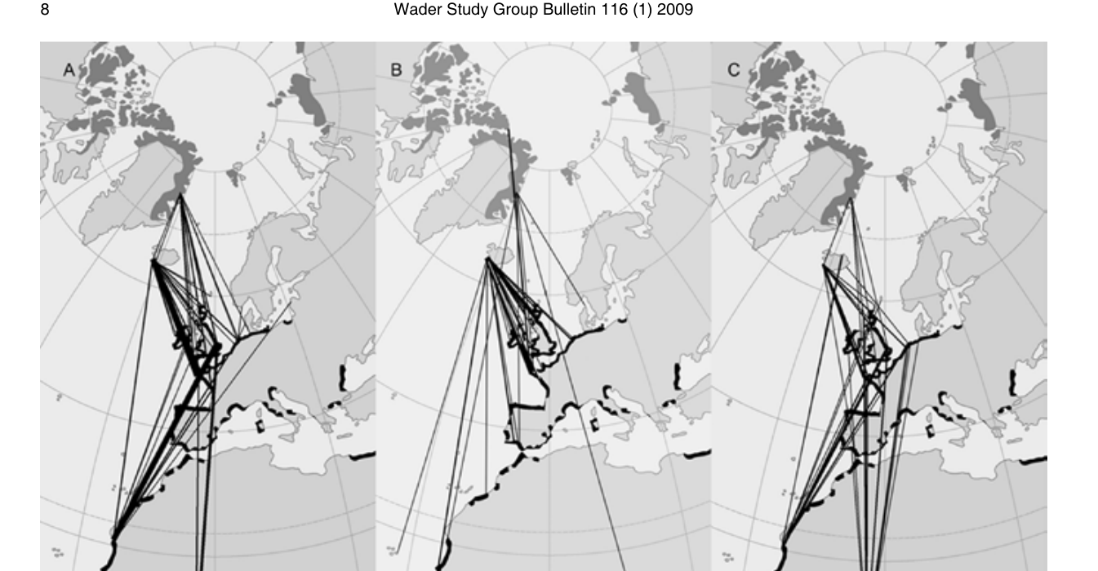
Observed connectivity ≠ population-wide connectivity
Observed connection
NE Greenland-marked Sanderlings were resighted as far south as Namibia.
This confirms that at least some Greenland-breeding birds use southern Africa.
What it supports
The Greenland population has a broad non-breeding range along western Europe and Africa.
What proportion of Greenland birds use Namibia, or what proportion of birds in Namibia originate from Greenland.
Siberian birds also reach southern Africa, but Russian breeding areas are much less well sampled.
What remains unknown
Reneerkens et al. (2009), Fig. 5. Straight lines connect ringing and resighting locations; they do not show the route travelled.
A documented link shows that a connection exists, but not how representative it is of the population.
Observed link → supported inference → population-level uncertainty
CMS Atlas of Animal Migration | AEWA
22
Notes:
Sanderling provides a useful example of this problem.
Sanderlings marked in northeast Greenland have been resighted as far south as Namibia by Reneerkens and colleagues.
This observation supports the conclusion that at least some Greenland-breeding Sanderlings use southern Africa, and it contributes to evidence of a broad non-breeding distribution along western Europe and Africa.
But it does not tell us what proportion of the Greenland population uses Namibia, nor does it tell us what proportion of Sanderlings in Namibia originate from Greenland.
Siberian birds also reach southern Africa, while the Russian breeding areas have historically been much less intensively sampled, or at least no data has been available.
So we need to distinguish cautiously between an observed link, the inference that link supports, and a conclusion about the population as a whole.

Slide 22
Take-home: Build the interpretation layer
1
Movement
data
2
Interpretive
layers
3
Decision
support
4
Coordinated
action
tracks · ringing · counts
Population definitions · status · thresholds
season · connectivity · uncertainty
which populations, sites, countries
and actions?
protect · restore · manage · monitor
The Atlas should clarify what migration movements mean for conservation decisions across borders.
CMS Atlas of Animal Migration | AEWA
Notes:
The main message I would like to leave you with is that movement data are the starting point.
Between movement observations and conservation action sits an interpretation layer: population definitions, status and trends, thresholds, season, connectivity and uncertainty.
That interpretation helps us identify which populations, sites and countries are relevant, and ultimately where coordinated action, protection, restoration, management or monitoring, is needed.
For the CMS Atlas, the opportunity is therefore not only to show where species move, but to clarify what those movements mean for conservation decisions across borders.

Slide 23


Thank you for your attention!
Luca.guitink@wetlands.org
Funded by the European Union.
Views and opinions expressed are
however those of the author(s) only and
do not necessarily reflect those of
the European Union or CINEA.
Neither the European Union nor
CINEA can be held responsible for them
Photo by Sergey Dereliev
Notes:
We do not have an active user monitoring on the CSN tool, but it is well used considering its specialised nature.
We are using it all the time when we work on the CSR or for many other works, and you can come across its use often. Even EIFAAC has used it in their latest report.
Unfortunately, we have not yet got funding to get it updated. that isan issue

