Slide 1
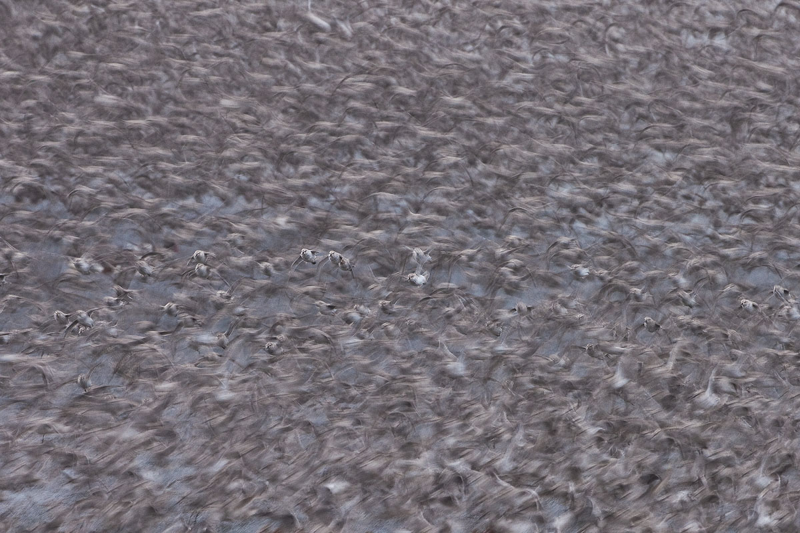


Using information on ecological connectivity to drive conservation action
CMS Expert Workshop on devising the CMS Atlas of Animal Migration
Vasto, Italy, 9 October 2026
Nicola.Crockford@RSPB.org.uk
As Alex saw the TED Speech from Levon Biss
Notes:
It’s a great pleasure and honour to be invited to this beautiful place, with all you esteemed people, in what promises to be a fascinating few days. Huge thanks to Ferna for convening us.
I’d like to share some ideas from the last 20 or so years of working on international policy to conserve the world’s migratory birds and their flyways, including as BirdLife’s focal point for CMS. I’m very much in the user camp in terms of migration atlases. Which can be absolute conservation gold.
22
the count information we have on areas of international importance to help identify additional sites for conservation, and show how they connect, prioritise sites for conservation, adding value to traditional protected area approaches.
54

Slide 2
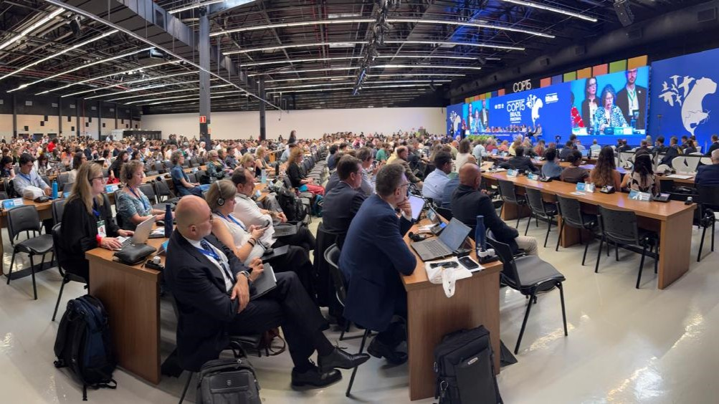
How to conserve migratory species?
Protect, effectively manage and restore their migratory ecological networks to ensure the ecological connectivity necessary to maintain and restore population sizes and geographic ranges
Stop/minimise causes of additional mortality eg from illegal/unsustainable use and barriers to movement such as poorly placed or designed energy infrastructure
Notes:
My job has been trying to get the best deal for migratory birds from governments. Which means conserving the places they use and preventing anthropogenic causes of direct mortality, maintaining and restoring ecological connectivity. This workshop is of course relevant to both, but particularly the spatial side of the equation which I’ll focus on now.
To achieve ecological connectivity, we need to foster human connectivity along the flyway and other migratory ecological networks to leverage enhanced conservation commitment and delivery. The ecological connectivity concept can be harnessed to add value to traditional protected area approaches.
It’s important to understand that birds need a different approach to ensuring their ecological connectivity than animals that can’t fly nor swim in the sea. The concept of corridors is often not applicable to birds, which may migrate over a very broad front, using key sites that aren’t physically connected. Although they do sometimes have migratory bottlenecks, for example soaring birds at short crossings of seas such as the Mediterranean.
1:28

Slide 3


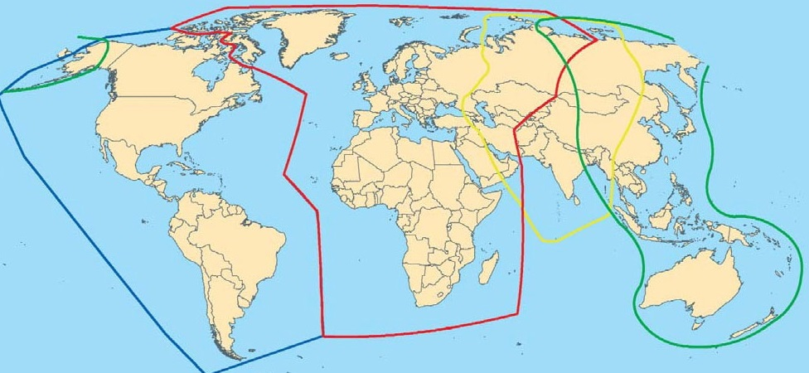

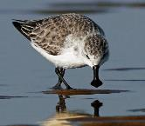
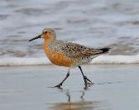









Intergovernmental migratory waterbird relevant agreements
Americas
African-Eurasian
Central Asian
East Asian Australasian
Notes:
Here’s a broad generalisation of the 4 great flyways of the world and some of the alphabet soup of migratory waterbird relevant conservation agreements.
Unlike the EU Nature Directives which have real legal teeth, these are soft law, operating primarily by diplomatic peer pressure. With the recent decline in multilateralism, I feel the concept of ecological connectivity, and the human connectivity necessary to secure it, is a secret weapon that conservationists have under-used to ramp up pressure on reluctant governments and others to do what is needed to conserve migratory species. The CMS Atlas should be a critical tool to help fill that gap.
2:04

Slide 4
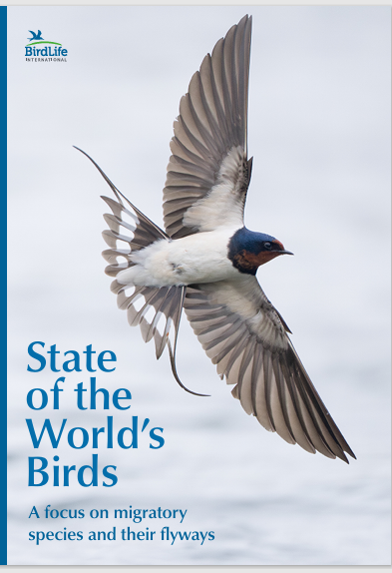
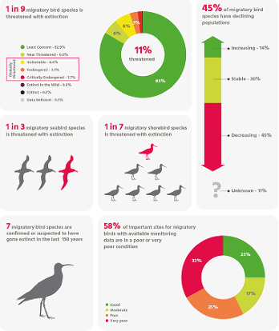
URGENT: 11% (200) migratory bird species threatened with extinction, (7 already extinct, 6% NT), 45% declining, 58% sites in poor condition!
Notes:
And the situation’s really urgent. BirdLife just published the 6th edition of the State of the World’s Birds, focussed on migratory species, showing that 11% are threatened with global extinction, nearly two thirds of their known sites being in poor condition.
2:19

Slide 5
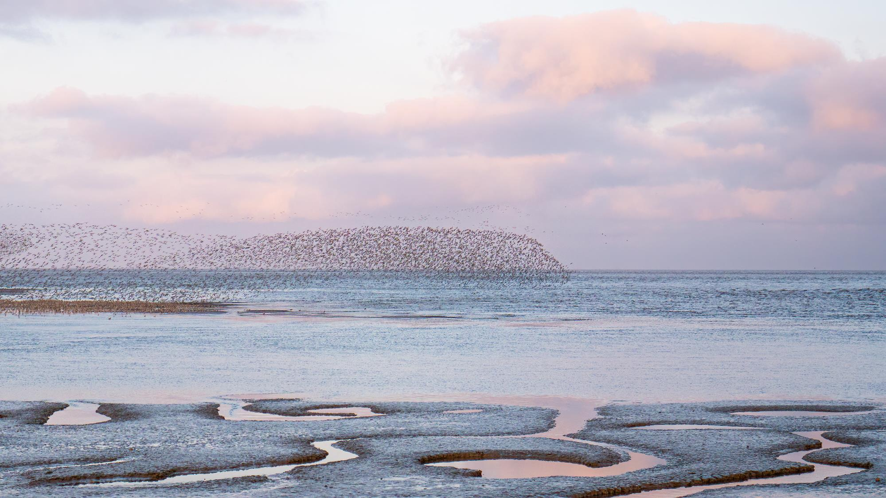
How can the CMS Atlas help to maintain and enhance the conservation status of migratory species, by securing ecological connectivity among the key sites in migratory ecological networks?
Notes:
So how can the atlas help maintain and enhance the conservation status of migratory species, by securing ecological connectivity among key flyway or other ecological network sites that are the most vital rungs on their migratory ladders.
2:35

Slide 6
Problems in protecting/effectively managing/restoring key flyway/migratory network sites before they’re destroyed:
unprotected eg due to lack of political will and lack of prioritisation of sites eg from international perspective
lacking enforcement of protected status
overlooked eg in areas not covered by bird counters, at least during passage periods, or importance underestimated due to rapid turnover of birds
lacking effective conservation management and restoration eg due to lack of finance and evidence-based capacity.
Notes:
Which boils down to increasing the number of protected, effectively managed and restored areas before they’re destroyed.
Which means overcoming the problems listed here.
The fact that known important areas are often unprotected, for example due to a lack of political will, some countries, say, being overwhelmed by the sheer number of sites they need to protect.
That even when a site is protected on paper, it isn’t enforced on the ground.
That surprisingly – as revealed for example by satellite tagged birds – too often we don’t even know where key sites are, because they are in areas not covered by bird counters, or used at times when counters aren’t there, or because counters underestimate the numbers of birds, for example during the migration period when high turn over means many more birds use the site than are present on any one day.
And that too commonly, protected areas aren’t effectively managed and restored, deploying evidence-based methodology, often due to lack of financial and human resources.
3:26

Slide 7
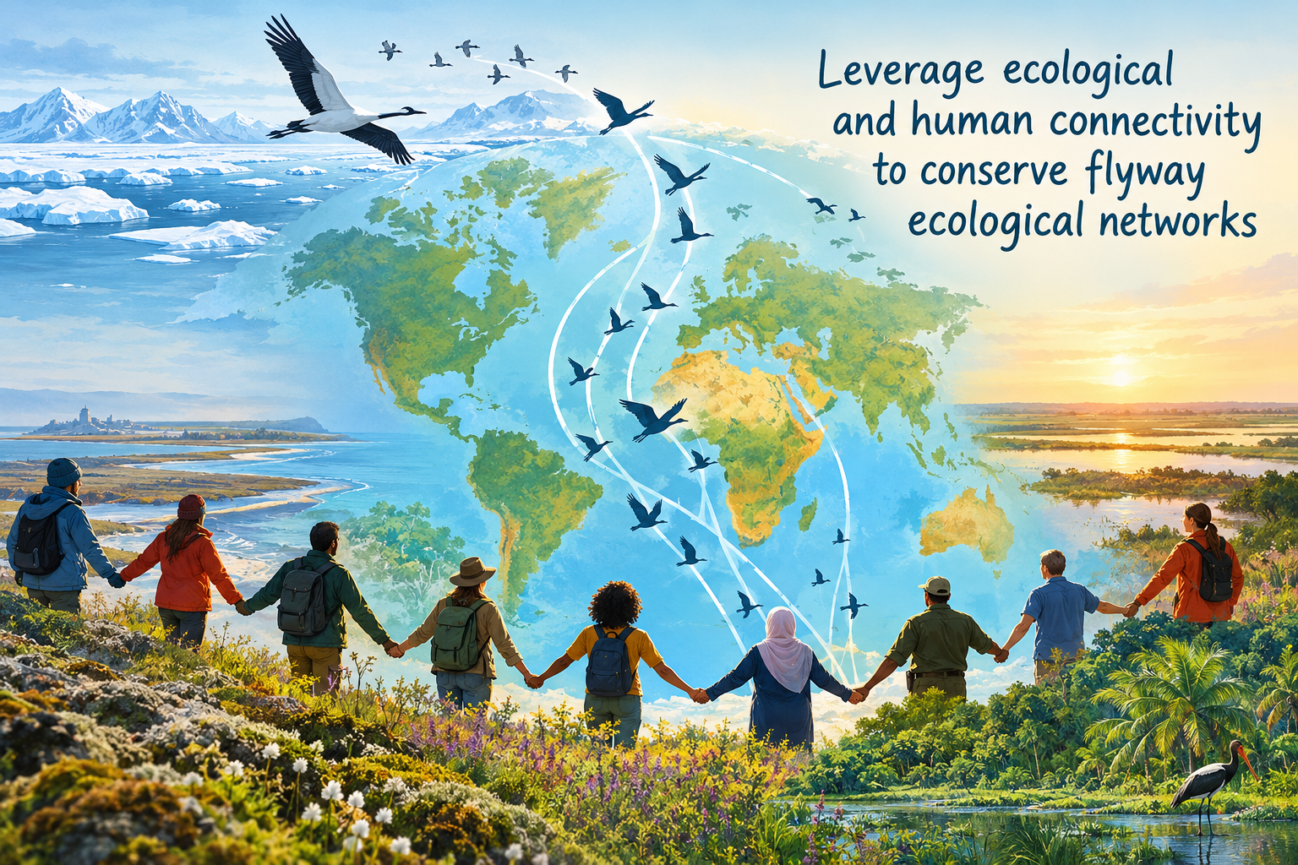
Solutions – use the CMS Atlas to help eg
Notes:
In the rest of my talk, I’ll flag some newish approaches to solving these problems as a basis for thinking how to develop the CMS Atlas to contribute to such solutions. All these approaches are underpinned by thinking how to leverage ecological and human connectivity to conserve flyway ecological networks.
3:44

Slide 8
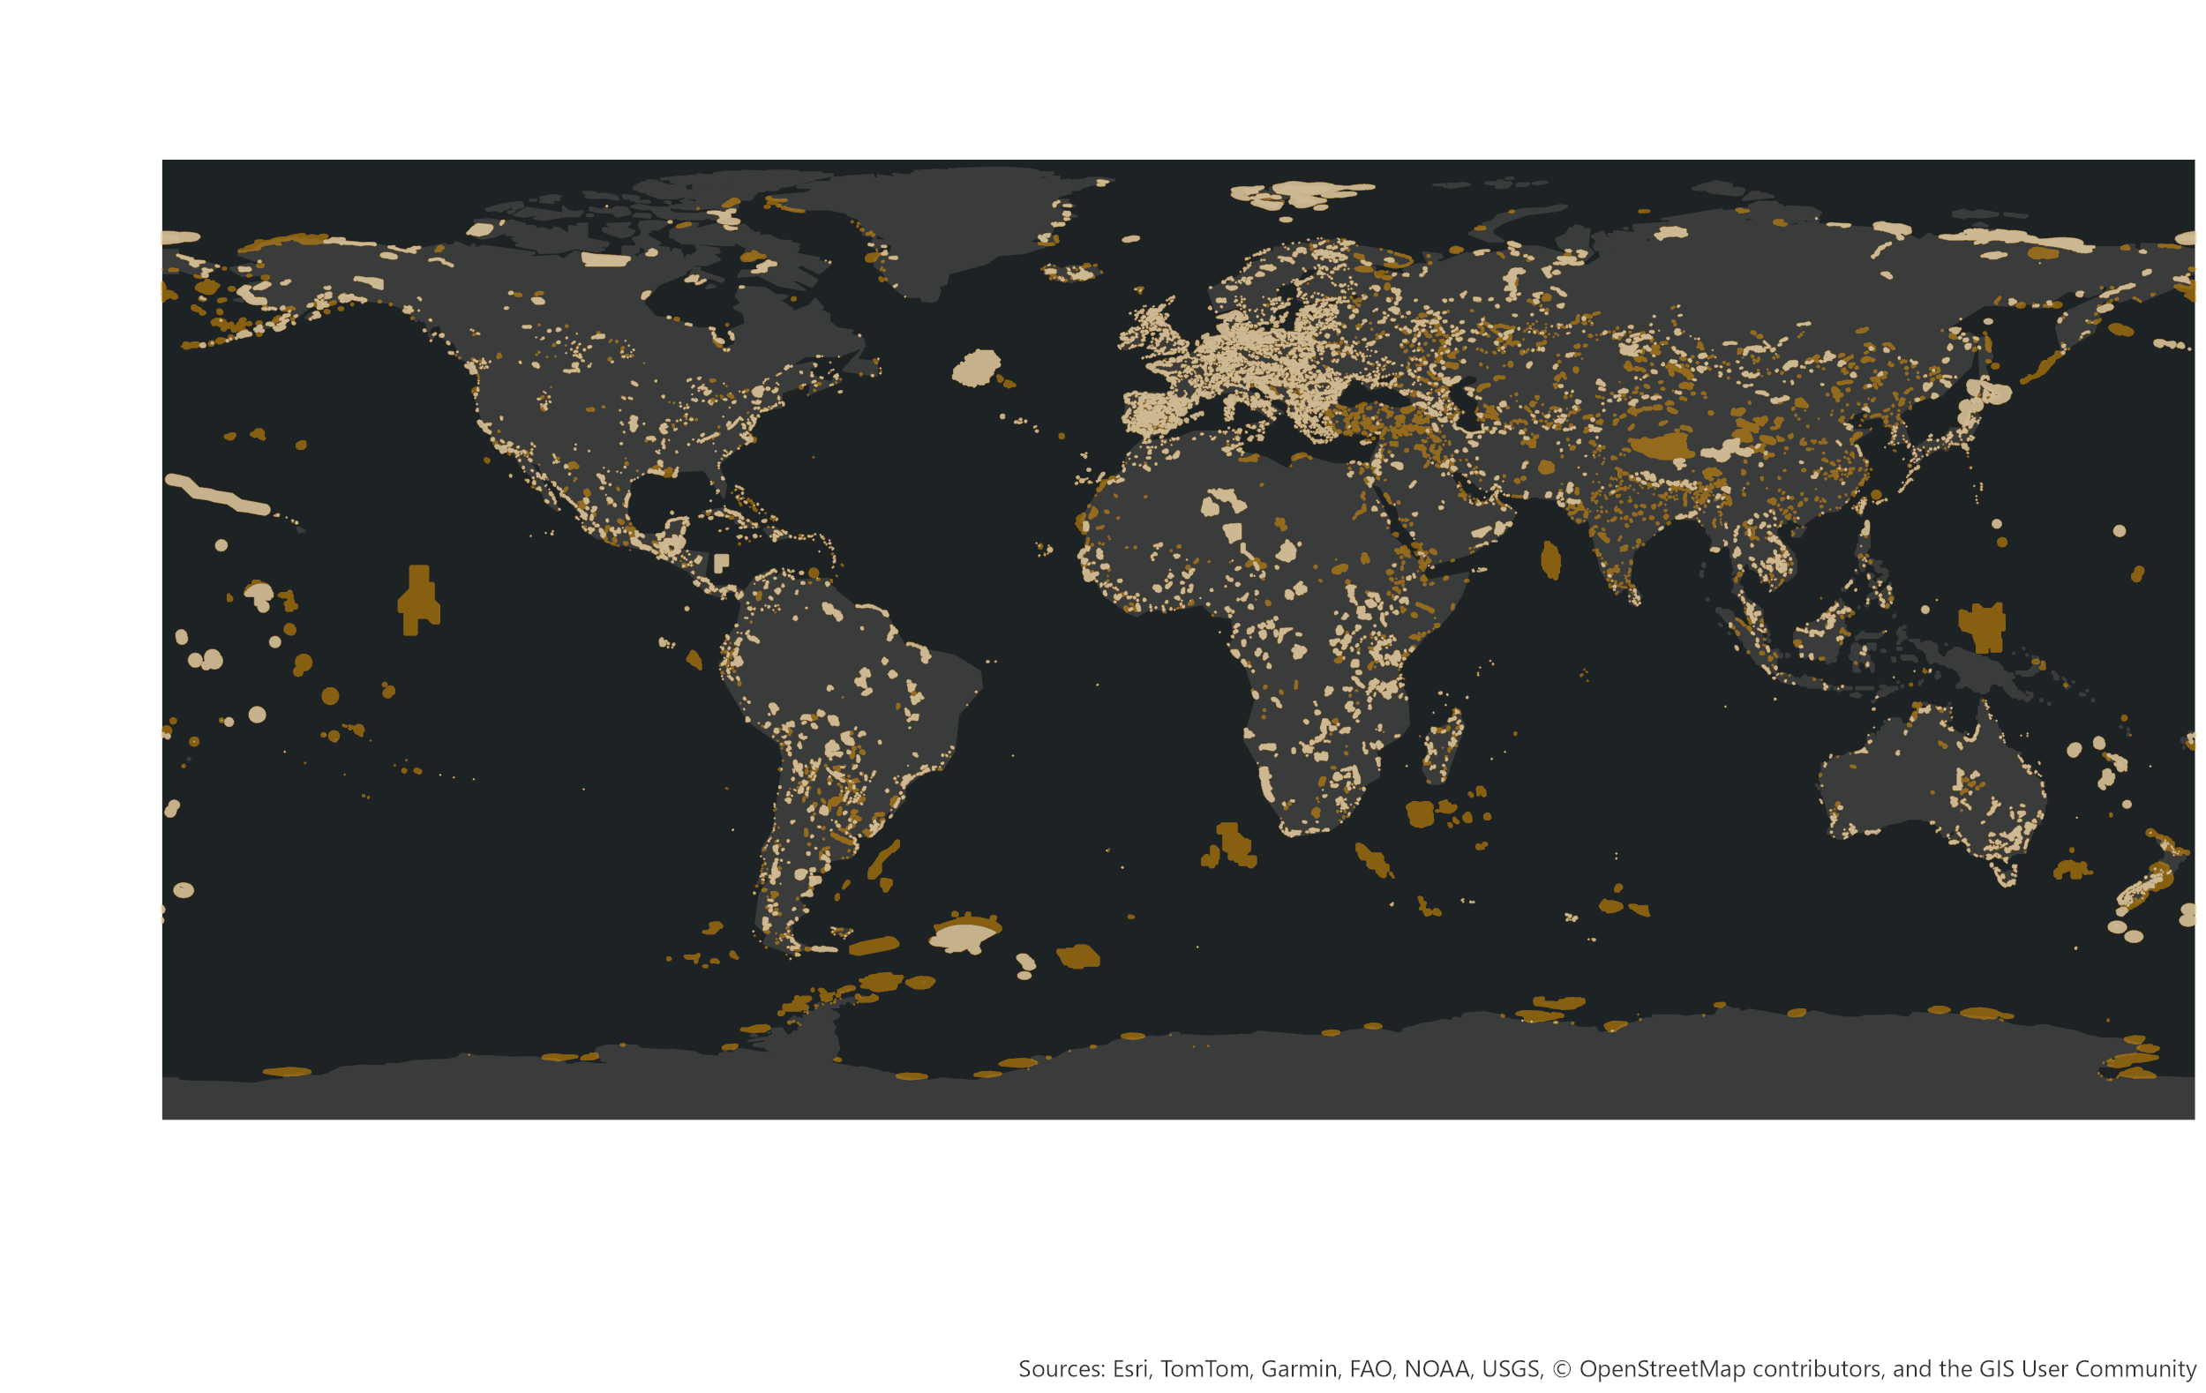
Problem 1: Key sites unprotected
10,656 Key Biodiversity Areas (KBAs) identified for migratory birds
Only c9% of migratory bird species are adequately protected in terms of site coverage across their full annual cycle, compared with 45% of non-migratory species
Yellow = Protected, Orange = Unprotected
Notes:
First to elaborate on the problem of lack of protection. We’ve already identified nearly 11,000 KBAs of international importance for migratory birds, but only quarter are completely protected, half being completely unprotected.
The CMS State of the World’s Migratory Species states that only around 9% of migratory birds are adequately protected in terms of site coverage compared with 45% of non-migratory species.
Given that on average the world’s 195 nations each have 55 KBAs for migratory birds, my contention is that often they have so many unprotected sites, they don’t know where to start in filling the gaps.
3:44 +24 = 4:08

Slide 9
Solution 1: Protection
Focus conservation effort on protecting known top sites
by identifying (using traditional count data supplemented with movement data), proposing and nominating
serial, transnational World Heritage Sites,
protecting other internationally important sites with other designations such as Wetlands of International Importance.
Notes:
So, could the Atlas develop as a mechanism for further prioritising sites for protection or other effective management by identifying the absolutely key sites for migratory species, the nodes in the network that are most essential to the survival of at least one biogeographic population. If such a map was recognised by all the relevant treaties, NGOs, banks, other donors etc then surely this would help accelerate protection, including by, for example, facilitating agreement on a strategic division of labour as to who was going to work to secure the future of which sites in a chain – World Heritage for the top sites, Convention on Wetlands for the next tier down and so on.
Countries could look at the map and support each other to protect sites for species for which they share responsibility.
For example, Country A – let’s say the Netherlands could approach Country B, for example Senegal, saying in our country we are protecting these key sites for particular migratory birds, say Black-tailed Godwits, that we share with you, please will you also protect their key sites in your country. And even, we are prepared to support you with human or financial resource to put this in place.
4:08 + 1:09 = 5:17

Slide 10
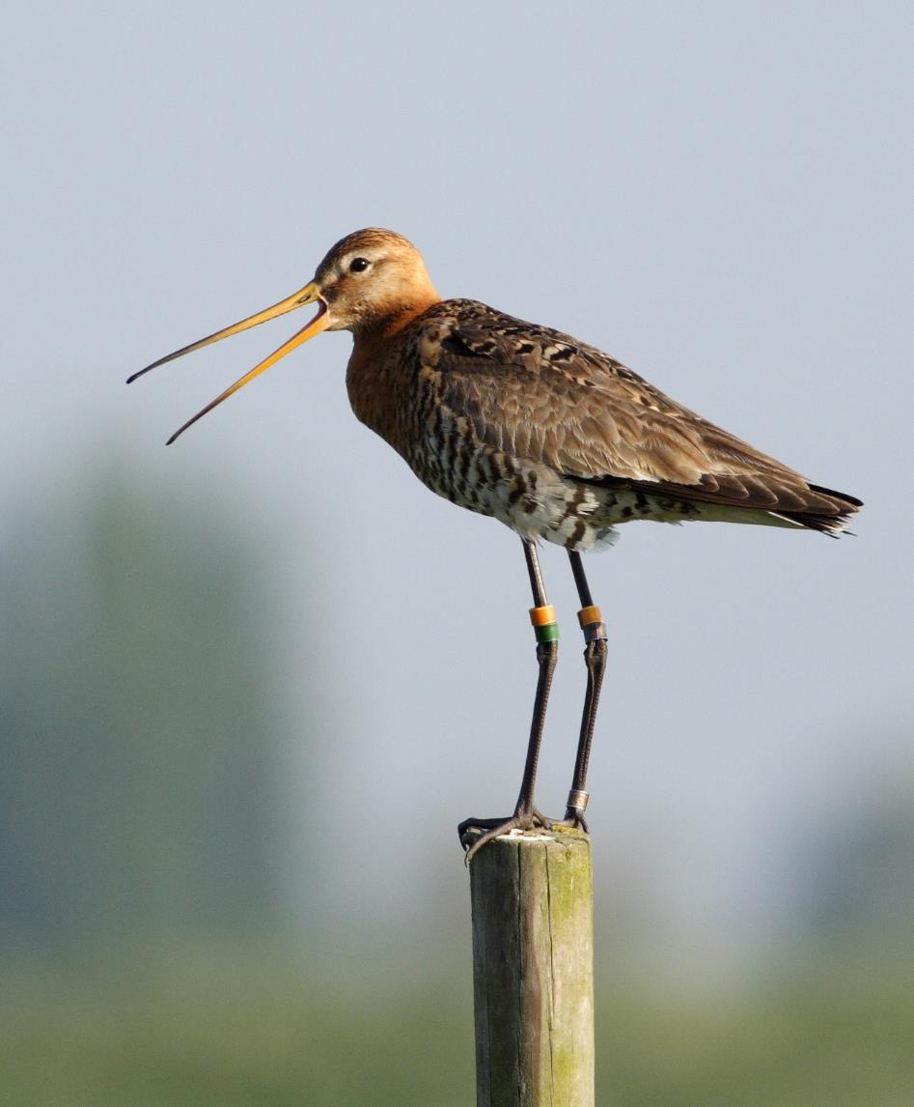
Solution 1: Protection
(Serial, transnational)
Natural World Heritage Sites
Strongest international protection outside EU
Sites without OUV solo can be WHS
Sites can be managed as ecological network
Secure resilience to climate change etc
Peer pressure between sites
Imperative to help conserve other flyways sites that share same birds
Mobilise finance eg bilateral, development banks
KMGBF 30x30
Notes:
The World Heritage Convention is the most powerful mechanism for facilitating chains of protected sites, being the strongest international site protection mechanism outside the EU and with a superpower that many are unaware of.
It can inscribe serial transnational World Heritage Sites, where each component of a site may not have the Outstanding Universal Value necessary to qualify for World Heritage listing, but collectively they may, even if the components are in different countries, and they must be covered by a single management plan. So one can imagine World Heritage Sites that link key sites along a flyway like strings of pearls, with particular birds as flagships for the many other species the sites protect.
Having coherent management of such site networks increases resilience to climate change and other threats, helping ensure there are places for birds to move to as conditions change.
And because a management plan must be agreed between all components, it makes it more politically difficult for any one site to let down the others by not meeting the shared objectives.
Likewise we’ve seen in recent years how such site networks attract big funding which they wouldn’t on their own.
And there’s never been more urgency to deliver well connected networks of key sites as countries strive to meet the 30 by 30 target.
5:17 + 1:13 = 6:30

Slide 11
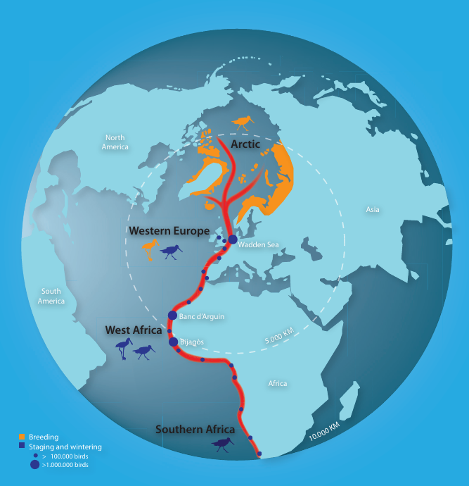
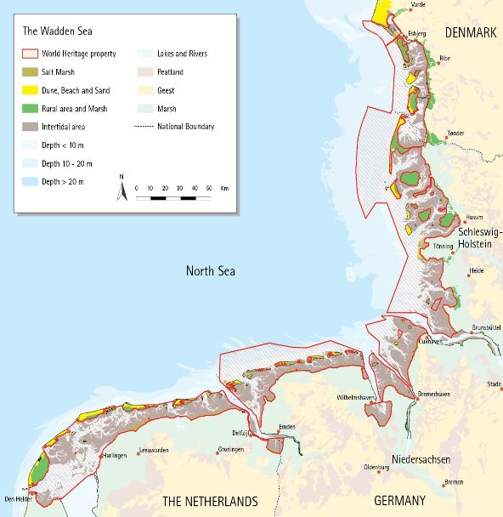
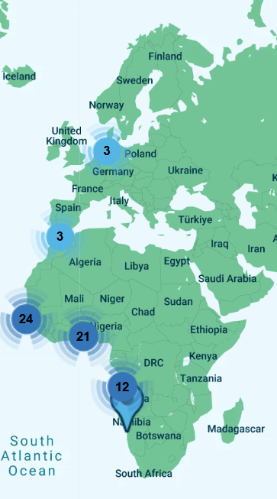
Solution 1: Protection
World Heritage: a solution for top flyway sites
Notes:
For example World Heritage inscription of the Wadden Sea has enabled the three nations which share it to manage it as a single unit. Furthermore, a condition of the inscription was that the Wadden Sea must establish an initiative to support conservation down the flyway for the birds they share. There are now 15 year’s worth of projects along the flyway, including supporting Guinea Bissau in their World Heritage inscription of the Bijagos Archipelago.
6:30+23 = 6:53

Slide 12
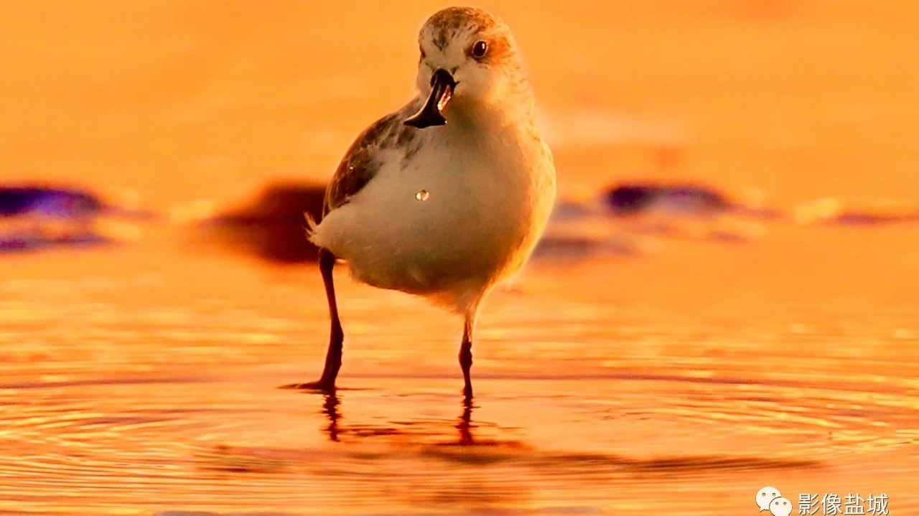
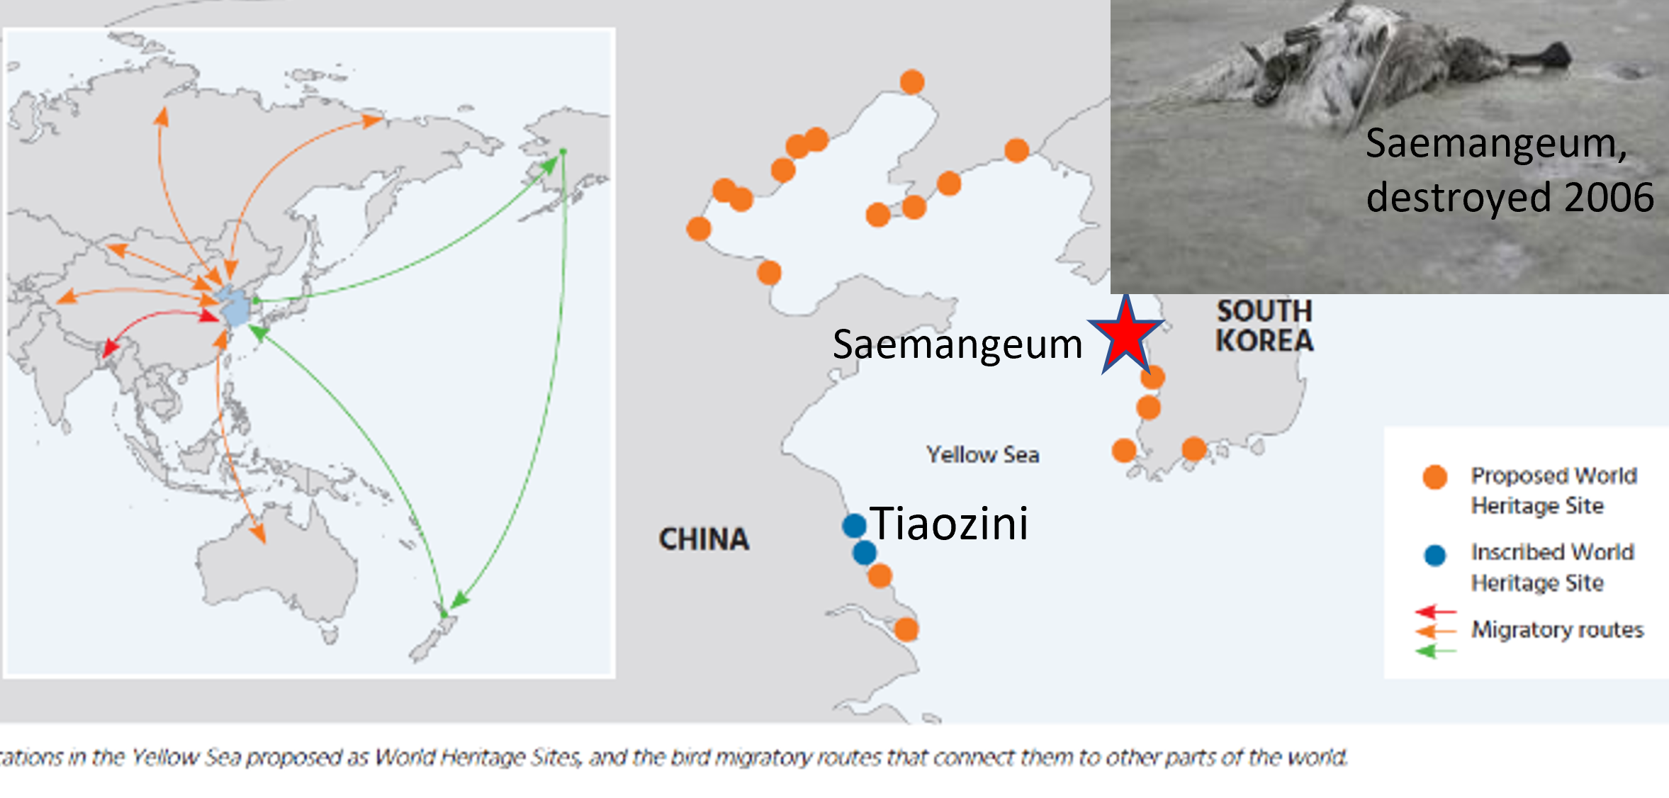
Solution 1: Protection
World Heritage: preventing site destruction
Notes:
What’s turned me quite messianic about World Heritage is also, due to its relatively high political capital, its ability to save sites from destruction. I’ve devoted quite a chunk of my life to trying to prevent extinction of the critically endangered Spoon-billed Sandpiper. Like many other waterbirds of the East Asian Australasian Flyway, it stages on the Yellow Sea. It’s most important site, Saemangeum, in South Korea was destroyed in 2006. A few years later, the next most important site was discovered at Tiaozini across the Yellow Sea in China, used by half the world population. But it already had all the permissions to be destroyed by an even bigger land claim than Saemangeum, then the world’s largest.
Court cases and socioeconomic arguments weren’t going to work with China. So, to cut a long story short, we proposed that instead of destroying Tiaozini it should be made a world heritage site. Indeed, as a silver lining from Saemangeum, South Korea, inspired by the Wadden Sea had already embarked on a process to protect its remaining tidal flats under world heritage.
6:53 + 1:01 = 7:54

Slide 13
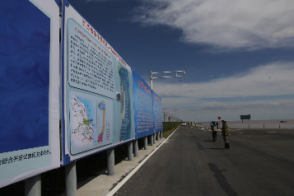
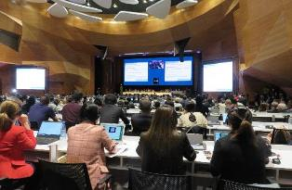
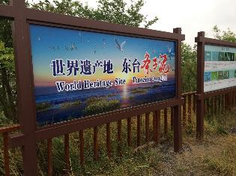
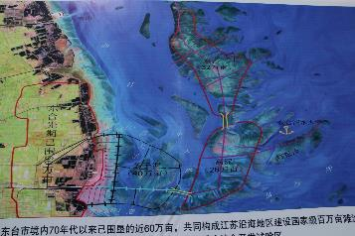
Solution 1: Protection World Heritage imperative for integrity
Tiaozini 2016: permitted reclamation
Tiaozini 2019: World Heritage Site
Notes:
Astoundingly, following a meeting I facilitated in Beijing in 2016, and not to be outdone by Korea – a little healthy competition can be a good thing, the hoardings at Tiaozini promoting the reclamation project were replaced in 2019 by information panels celebrating the new WH Site.
But in fact, initially China had excluded Tiaozini from the nomination, including only the adjacent Yancheng National Nature Reserve. It was only on the basis of movement data from satellite tagged birds that we were able to convince them that to meet the site integrity criteria of World Heritage, they must include Tiaozini.
Furthermore, at the World Heritage Committee meeting in Baku, shown above right, that inscribed this first phase of China’s YS WHS, purely on the basis of its globally important migratory waterbird populations - a number of countries, including Russia and Australia, expressed enthusiasm for serial, transnational WH nominations.
7:54 + 57 = 8:51

Slide 14
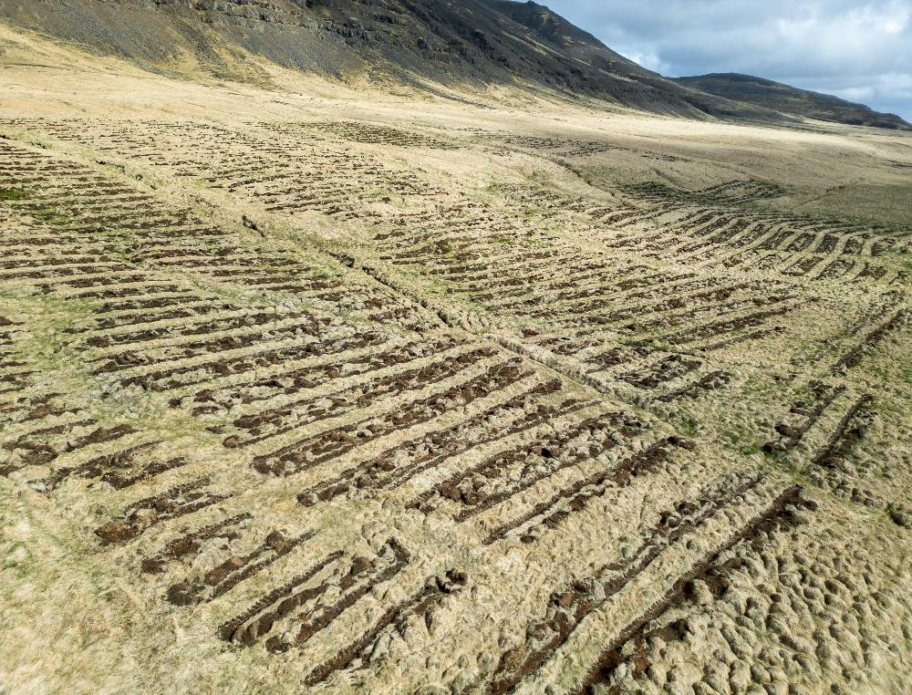
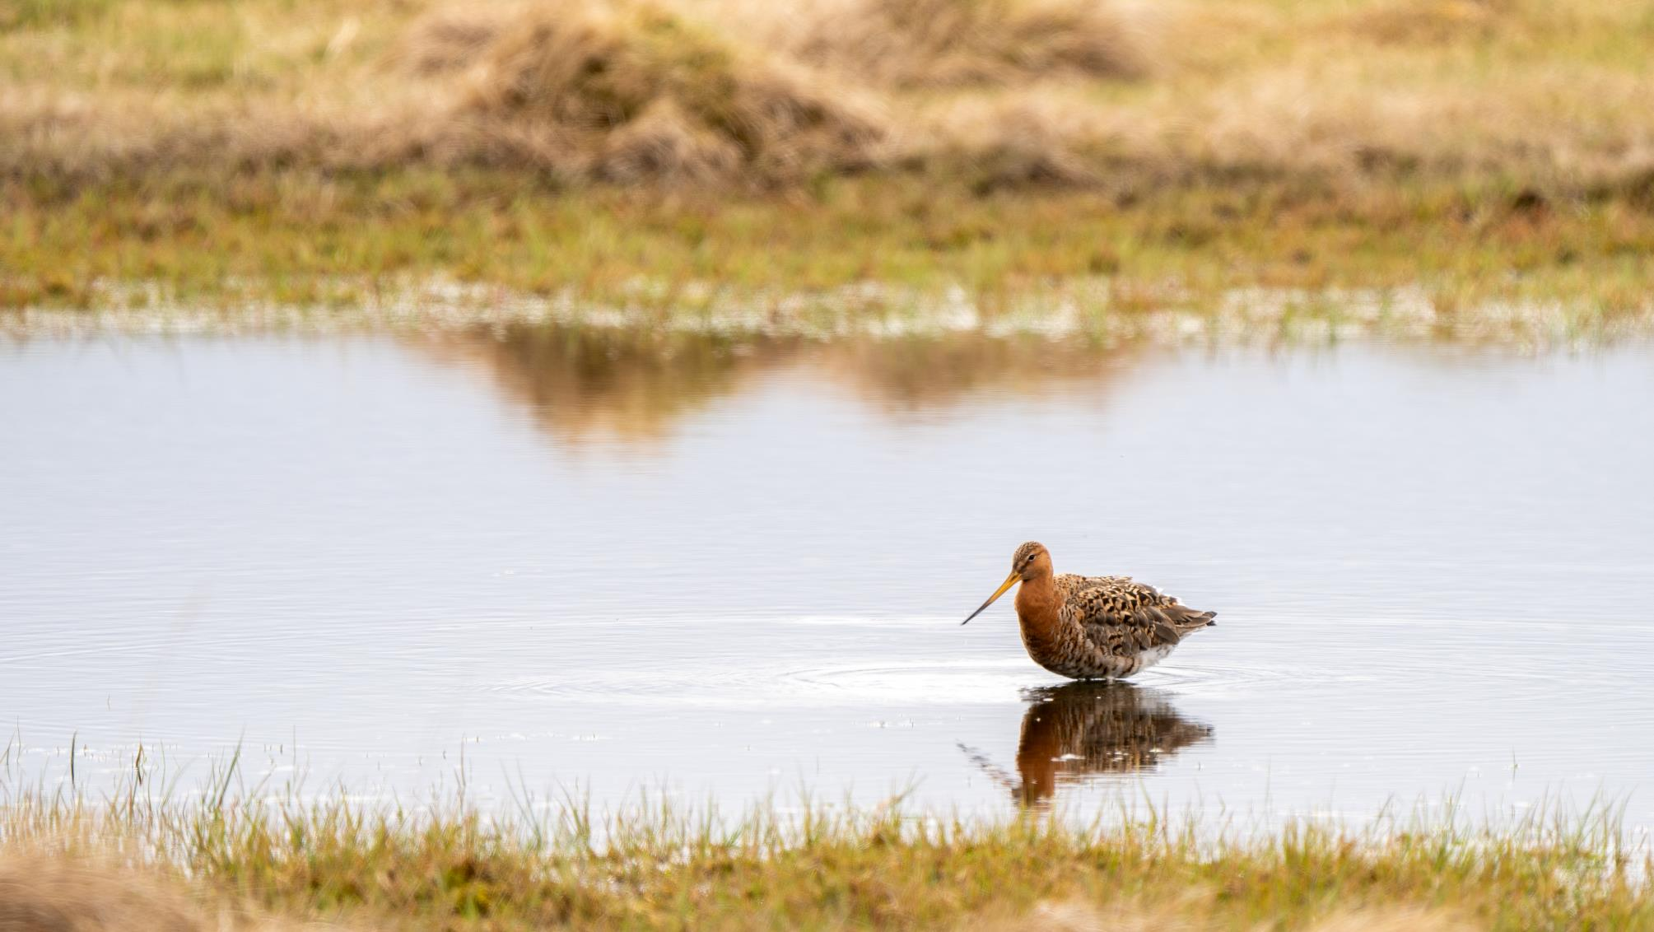
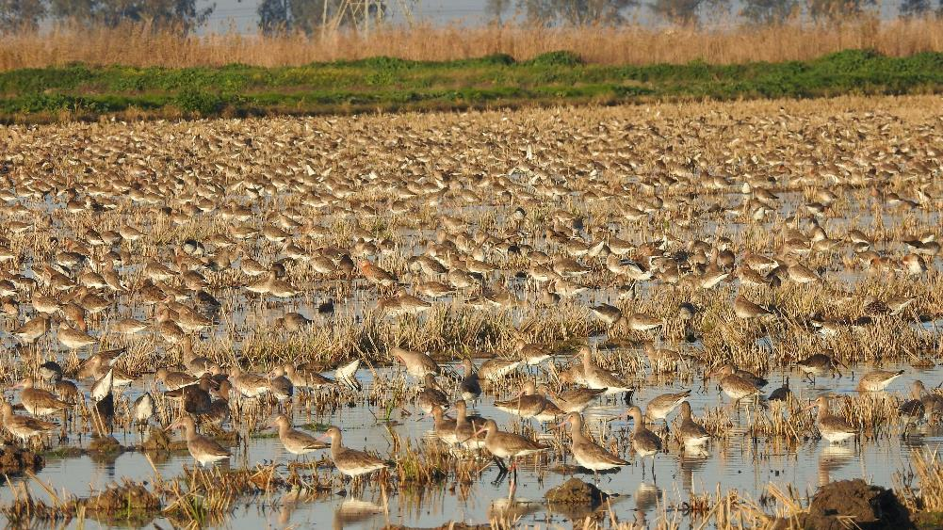
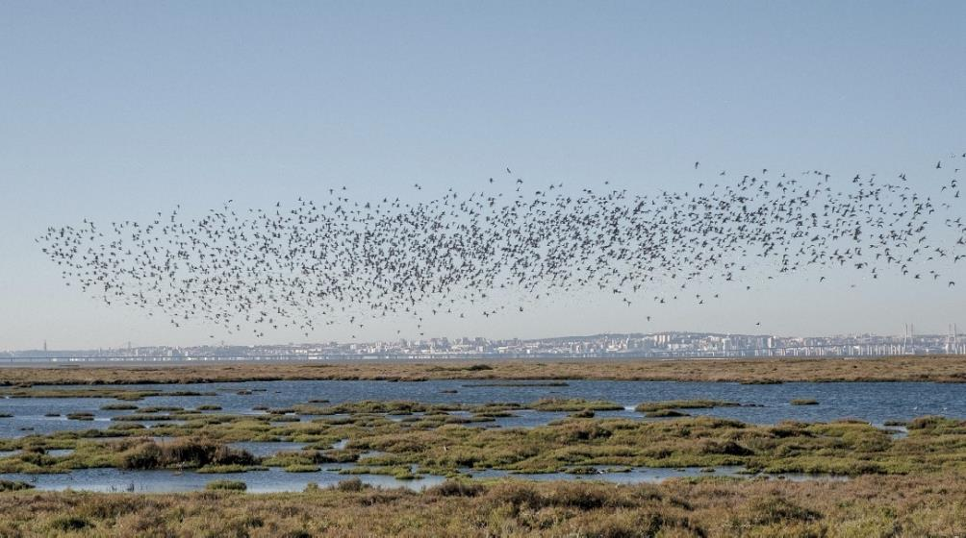
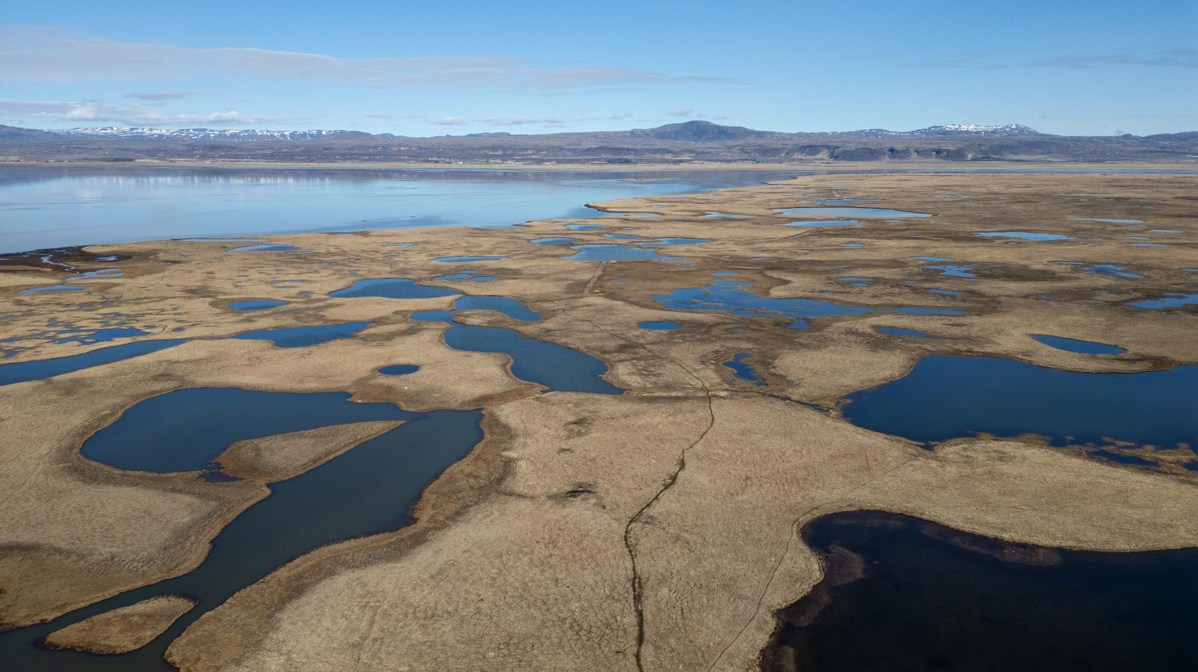
Solution 1: Protection
Serial Transnational World Heritage Sites
Notes:
Accordingly we’re working with Iceland to get serial transnational WH nomination of their lowlands which produce so many of the East Atlantic Flyway’s waterbirds, not least to prevent damaging afforestation, that has long been a concern of, for example, AEWA, the African-Eurasian Waterbird Agreement. Hopefully together with Portugal’s most important wetland, the Tagus Estuary, a critical staging and wintering site for Iceland’s breeding Black-tailed Godwits as well as many other species. We are also considering sites in France and maybe even eventually Senegal.
8:51 + 33 = 9:24

Slide 15
Solution 2: Enforcement
In national and international court cases, and other measures against proposed unsustainable developments in protected migratory ecological network sites, invoke negative impact the development will have on conservation efforts of countries with which the sites shares migratory species
Notes:
But the Tagus Estuary very nearly suffered terrible damage as the government was about to build Lisbon’s new airport there, despite it being Portugal’s top Ramsar Site. A classic case of protected status being disregarded, resulting in the need for enforcement action.
Movement data, deployed via a national court case, saved the Tagus. The government is now having to seek a less damaging location.
9:24 + 23 = 9:47

Slide 16
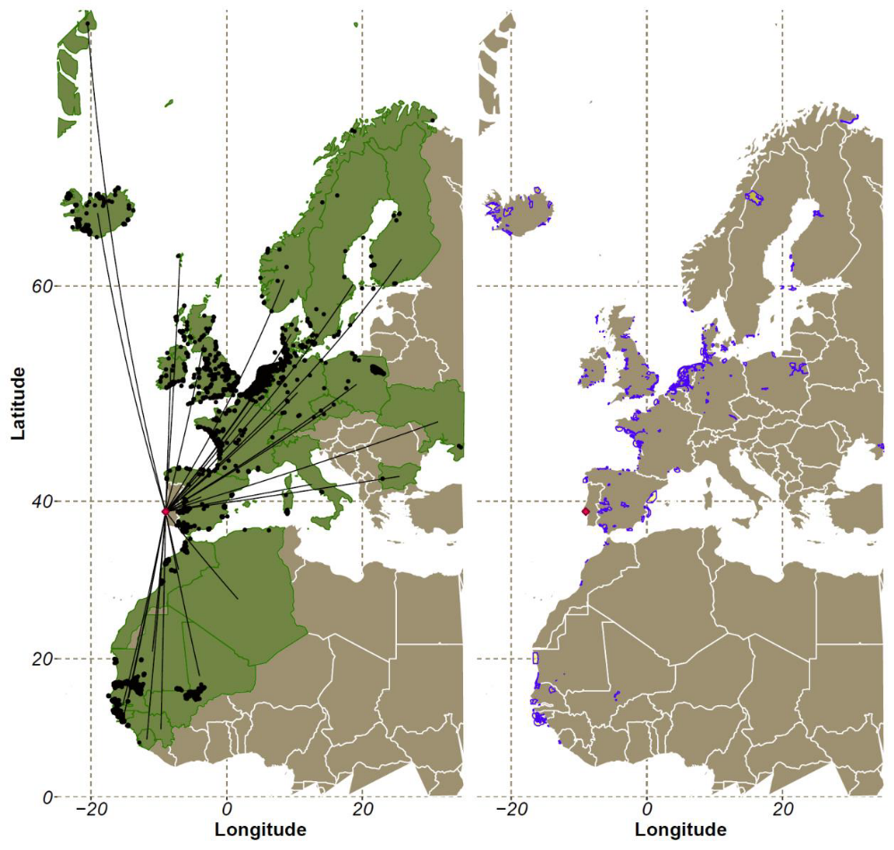
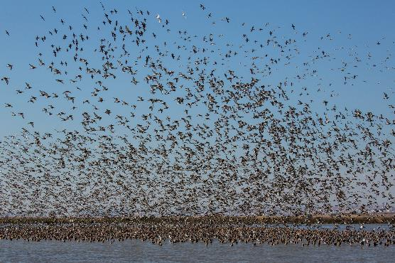
Solution 2: Enforcement
Tagus waders shared beyond Portugal with:
30+ countries
342 IBAs (16,707,050 ha) including 4 World Heritage Sites
Jan van der Kam
Notes:
How did we save the Tagus? SPEA, BirdLife in Portugal and ClientEarth lead the fight against the airport via a national court case and through complaints, to various treaties, Ramsar and Bern Conventions and AEWA.
I thought it would help to show how many country’s conservation investments would be undermined by the damage to wader populations from the airport. So I commissioned research by RSPB to collate all the ringing and tagging data of the thankfully well studied Tagus Estuary, to show the connectivity of waders that depend on it.
This was the stunning result which was embedded in the national court case and treaty compliance mechanisms. If the airport went ahead, it would likely harm the wader populations of nearly 350 important bird areas spread across 30 countries.
Wouldn’t it be amazing if the CMS Atlas could have such data on tap.
9:47 + 49 = 10:36

Slide 17
Solution 3:
Identify missing & most connected key sites
To identify overlooked key sites in migratory ecological networks, supplement traditional count data with movement (eg tracking/ringing) data, where sufficient data is available, using it to identify the most highly connected sites of key species, encouraging further data collection (for priority species) where sufficient data is lacking
Notes:
Inspired by this Tagus work I commissioned a pilot study on potential use of movement data to pinpoint overlooked key sites and add a layer of site prioritisation by identifying the most connected sites. So to identify the top areas of a migratory waterbird population’s ecological network to conserve to enable population survival, trying to help overcome knowledge gaps and limitations of reliance solely on bird count data. And possibly providing a further basis for serial transnational world heritage sites.
10:36 + 31 = 11:07

Slide 18
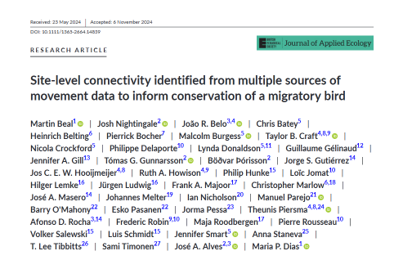
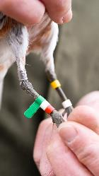
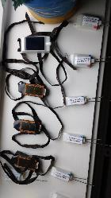
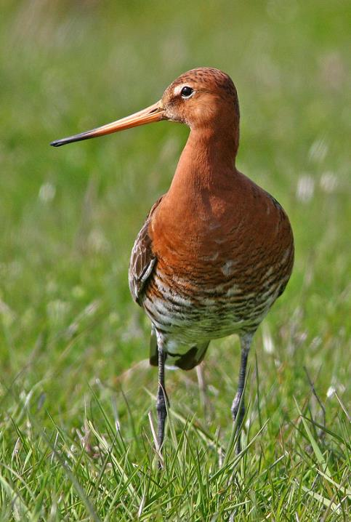





Connectivity for priority coastal waterbirds: a pilot project
Martin Beal, Josh Nightingale, José Alves & Maria Dias
Tomas Gunnarsson, Jennifer Gill, Peter Potts, Ruth Croger, Jennifer Smart, Taylor Craft, José Antonio Masero Osorio, Jorge Sánchez Gutiérrez, Manuel Parejo Nieto, Johannes Melter, Christopher Marlow, Heinrich Belting, Volker Salewski, Heike Jeromin, Philip Hunke, Luis Schmidt, Frederic Robin, Loic Jomat, Phillipe Delaporte, Ruth Howison, Pierre Rousseau, Pierrick Bocher, Guillaume Gélinaud, Barry O'Mahoney, Jorma Pessa, Sami Timonen Esko Pasanen, Hilger Lemke, Jürgen Ludwig, Jos Hooijmeijer, Theunis Piersma
Notes:
We were lucky to recruit Portugal’s Jose Alves and Maria Dias, with postdoc Martin Beal, to do the work just as they were starting to build the Global Wader Tracking Database.
The first paper focussed on the Near Threatened Black-tailed Godwit as it has much the most data in the East Atlantic Flyway. Suppliers of tracking and colour ring data are included as co-authors.
Even with a naturally collaborative community such as waderologists, the most time consuming element was obtaining the data. In any case, besides the Godwit, only for curlew was there really enough data to apply robust network analysis, though even in the two years of the project the amount of data out there did increase considerably.
11:07 +38 = 11:45

Slide 19
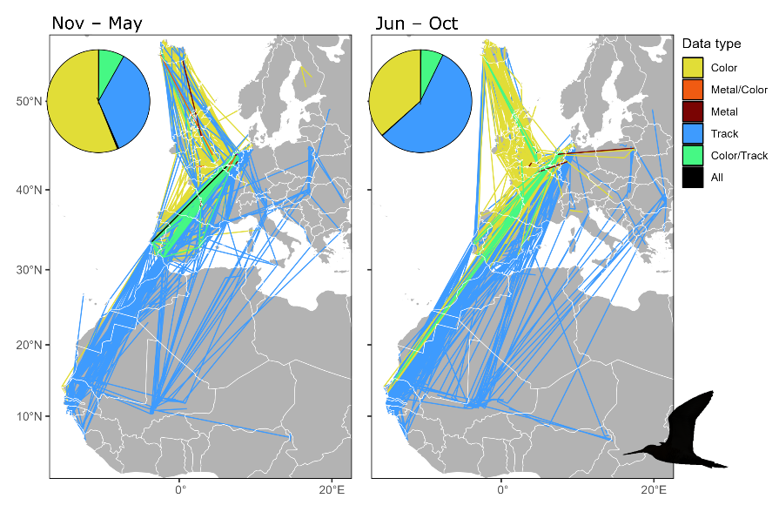
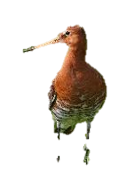
Black-tailed Godwit
Movement network
Identified 1058 sites,
with 4246 direct links
Notes:
Here’s some of the results from movement data of 10,000 individual black-tailed godwits, including tracks from nearly 500, and almost a third of a million sightings of nearly 30,000 colour ringed birds, covering three populations.
On the left are connections during the pre-breeding season, post breeding on the right.
Each line shows the sequential occurrence of at least 1 godwit at two sites within 20 days. Blue is tracking data, yellow’s colour-ring resightings.
From data on some 40,000 birds, more than 4000 tracks or resightings/recoveries pinpointed more than 1000 sites.
Colour ring sightings were good for understanding the birds’ movements in the western European lands of the waderologists whereas it was satellite tracks that showed how the birds used Africa and further east in europe. Metal rings were less prominent in showing the links.
11:45 + 37 = 12:17

Slide 20
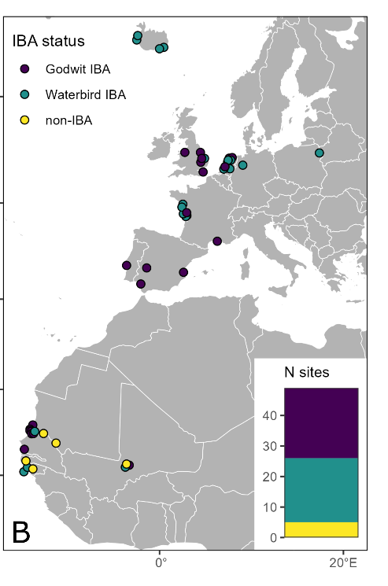
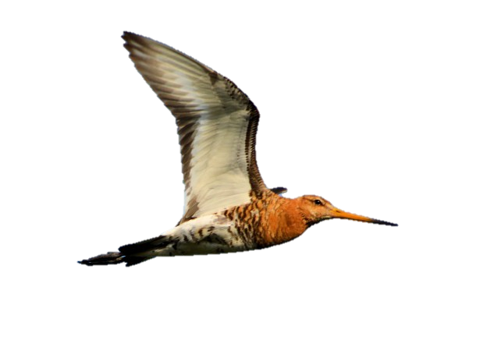
Black-tailed Godwit
49 top sites
On average linked to 48 sites & 8 countries
12 countries, Guinea-Bissau to Iceland
Top countries: NL (9), Senegal (7), France (7)
Top 3 sites (linked to >200 other sites:
Guadalquivir marshes (Spain),
Tagus estuary (Portugal)
Wonseradeel & Workum (the Netherlands)),
35 sites important for pre-breeding,
32 sites important for post-breeding,
18 being top sites in both seasons
47% recognized for importance for blackwit
Wonseradeel/Workum
Tagus Estuary
Guadalquivir marshes
Notes:
Here are the results that are conservation dynamite.
This shows the 49 top sites, out of the 1000, identified by network analysis to be the most connected, each with direct connections to 48 other sites and 8 countries, on average.
These 49 top sites were distributed between 12 different countries, from Guinea-Bissau in the south to Iceland in the north, led by the Netherlands with 9 sites and France and Senegal with 7 each.
The top 3 most connected sites, each linked to more than 200 others, were the Tagus and a site each in Spain and the Netherlands. An additional six sites were linked to >100 other sites
About three quarters of sites were important during the pre-breeding season and two thirds in the post breeding season with more than a third of sites being important in both.
We were a bit shocked to find that even for a bird as well studied as the Black-tailed Godwit, almost half these top sites aren’t recognized as Important Bird Areas for their international importance for this species, with 5, all in West Africa not being recognised as IBAs at all. Obviously these sites need to be ground-truthed by counters at the right time of year to see if they do actually support internationally important numbers.
12:17 + 59 = 13:16

Slide 21
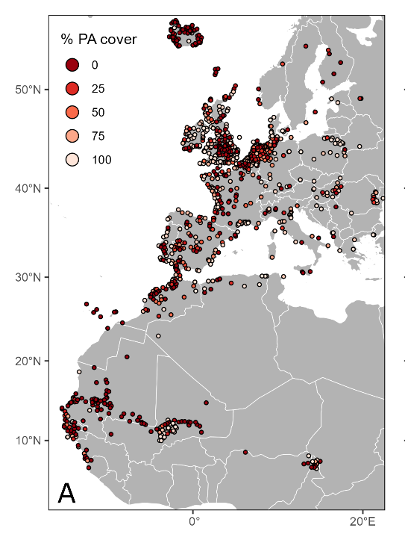
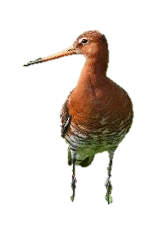
Black-tailed Godwit
20% of 1058 sites lacked Protected Area coverage.
44% of bird relocations fell within Protected Areas
Notes:
Of the 1000+ sites used by the godwits with data, 20% completely lacked any protected area coverage, and only 44% of bird relocations fell within protected areas.
13:16 + 11 = 13:27

Slide 22
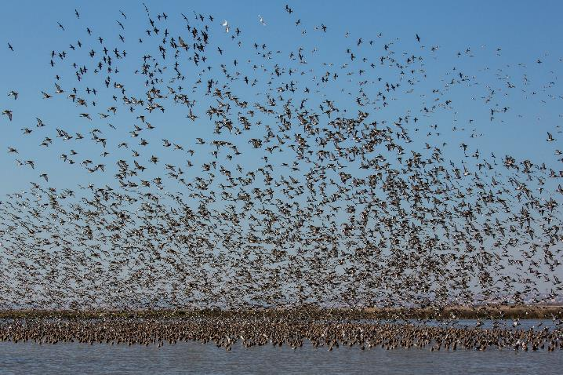

Network analysis can detect importance of sites missed by midwinter counts
Of the 34 top connectivity sites in godwit non-breeding countries 21 (62%) are either:
- outside the top 34 sites in terms of maximum mid-winter counts since 1990 or
- lack count information entirely.
Notes:
Furthermore, of the 34 most connected sites in non-breeding countries, 62% either aren’t in the top 34 sites identified by mid winter counts or lack count data entirely.
13:27+10 = 13:37

Slide 23
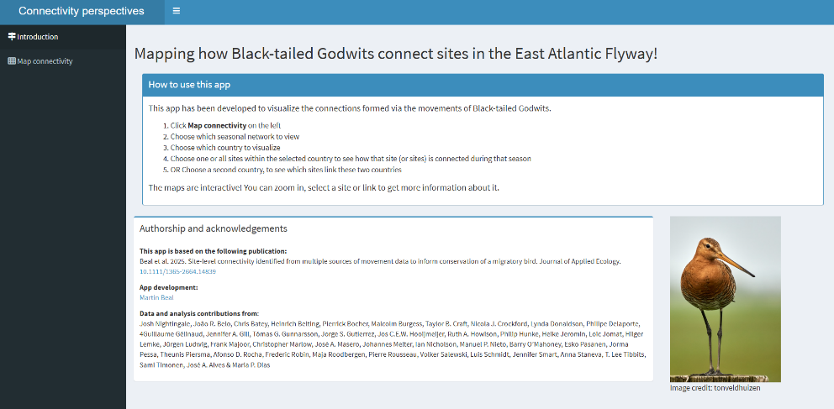
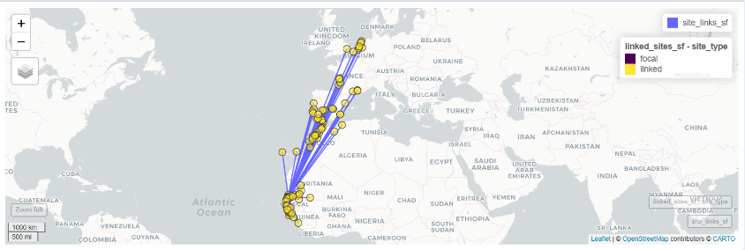
Black-tailed Godwit
Shiny App
https://itamartin.shinyapps.io/connectivity_perspectives/
Notes:
The project also produced an open access Shiny App, linked in the paper, so you can look up visualisations of the Godwit connectivity of a focal site to other sites, or of all sites in a country, or between a pair of countries.
Is this approach something that could contribute to the Atlas, especially as more and more movement data becomes available?
It’s certainly a good basis for using the black-tailed godwit as a flagship species for the serial transnational WH nomination I mentioned, focussed on the Icelandic southern lowland nesting grounds.
13:37+26 = 14:03

Slide 24
Solution 4: human connectivity
Develop human connectivity in sharing experience, expertise and encouragement along the route of ecological connectivity, for example through developing sister site relationships
Notes:
So, to the solution regarding human connectivity to deliver ecological connectivity of which workshops such as this are part.
14:03 + 8 = 14:11

Slide 25


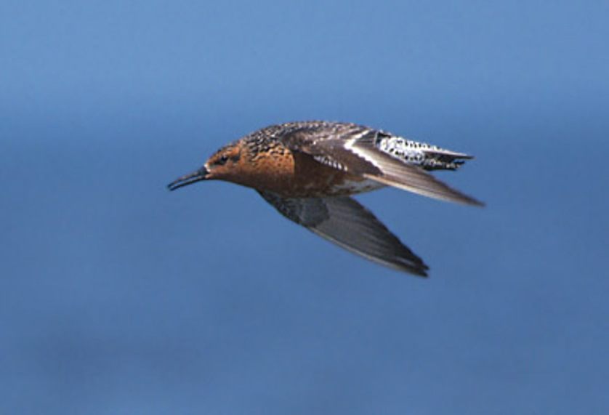
Solution 4: human connectivity
Developing the science, synergies and support for the conservation of the flyway ecological networks
common roadmap by synthesising information & filling data gaps
to prioritise site action to protect key ecological networks
for all relevant MEAs, governments & stakeholders,
mobilise large scale funds eg from development banks
Notes:
As is the CMS in general. It is brilliant that it’s taken on a major role in helping governments and others deliver the ecological connectivity component of 30x30, but of course unlike say Ramsar it has no site designation of its own. Perhaps instead, the Atlas can be a means of providing a common roadmap for us all: the CMS family, IUCN, World Heritage, Ramsar, the Development Banks etc to enable us to work together to deliver this ecological connectivity for migratory birds globally.
14:11 + 27 = 14:38
#########################
This includes using this work as a case study of an additional functional means of site prioritisation in an approach we are taking with IUCN, to map key flyway ecological network sites based on traditional bird count data. Hopefully this will also galvanise the gathering of more connectivity data especially on other species.
Ultimately the aim of this new project is to contribute to a common agenda, a roadmap for use by all, to cater for the protection and management of these threatened migratory birds at key sites and landscapes along their flyway.
This includes linking areas where they are concentrated in the non-breeding season which are suitable for formal protected area status, to their nesting areas where thy have a more dispersed distribution be it over arctic lowlands, or temperate meadows where #Other Effect Area-based Conservation Measures (OECMS),or agriculture policies maybe a more suitable means to provide their needs.
All this to contribute to actual joined up delivery of the ecological connectivity component of 30% protected areas by 2030 to which the world’s government’s have committed via the Global Biodiversity Framework!
So, IUCN and BirdLife has put together a project proposal in which IUCN would lead, convening all the relevant treaties, to steer the project and ensure use of its outputs for implementation to secure ecological connectivity for migratory birds worldwide. BirdLife would be on contract to IUCN to do the bulk of the technical work to provide a common roadmap for all to use, of the key flyway sites in the world (excluding seabirds for now), pinpointing those that could potentially be additional WHS for migratory birds, including transboundary and transnational, AND sites that need to be conserved to maintain the OUV of existing WHS such as the Wadden Sea. Plus, those that could be ramsar sites and other protected area designations and which could be OECMS.
So BirdLife will compile existing data, identify knowledge gaps, support BirdLIfe Partners and others to help fill those knowledge gaps – which is often just a question of mobilising existing data. We will evaluate coverage by protected areas and OECMs of the key sites in the flyway ecological networks, make recommendations on which may meet the criteria for WH and make the results freely available via easily accessible online tools..
The outputs would be disseminated among the various treaties and their Parties as priority areas of flyway ecological networks for additional protection and other effective area-based conservation measures, also to be embeded in NBSAPs under CBD and national planning to meet the KMGBF Goals and Targets;
Support will be provided for planning of that national implementation, including through national and regional workshops, as will seed money to start priority actions such as evidence-based protection, management and restoration with monitoring to ensure this is adaptive, plus emergency support.
25 34 + 3 10 – 28 44

Slide 26

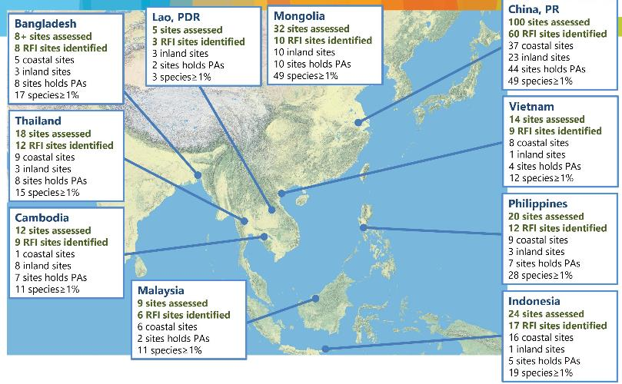
Solution 5: Scale up finance
Encourage mulit/bilateral finance between countries/sites sharing same birds
Eg Regional Flyway Initiatives
East Asian Australasian Flyway
10 countries
US$1.5-3 billion loans/grants
50-100 (coastal) wetlands
over 20+ years
Notes:
Another vital reason for this more connected approach is to scale up finance for the conservation of these ecological networks.
For example, bilateral funds being channelled from say, countries in Europe, to countries in West Africa that host the same birds.
Along similar principles, BirdLife’s been supporting development banks to put in place regional flyway initiatives. For example through, ADB, we selected about 50 mainly coastal wetland sites in about 10 Asian countries, for which 3 billion USD is being mobilised over 20 years to benefit the birds and people those sites support.
And we have a similar scheme up and running in the Americas with the Development Bank of Latin America, interest from ADB in the CAF and another in discussion for the African-Eurasian Flyway.
Donors like it when we think big. And conservation of ecological networks gives us a compelling rationale to do so. Can we design the CMS Atlas to help underpin such initiatives.
14:38+44= 15:22

Slide 27
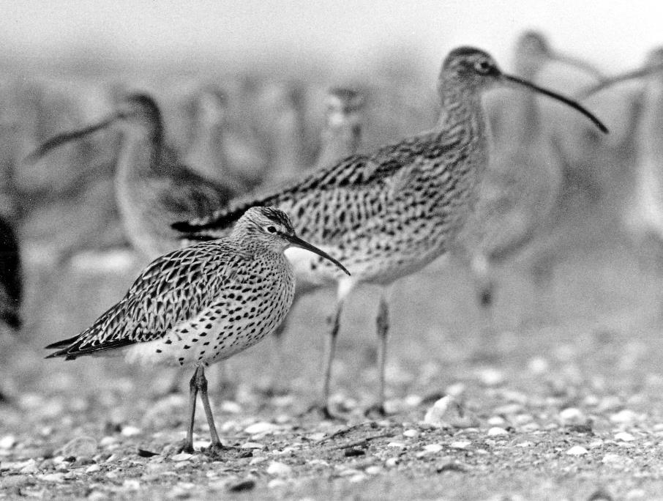
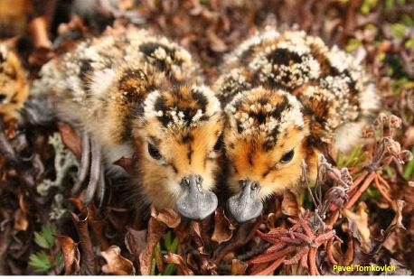
For no more extinctions, a CMS atlas that helps:
Foster human connectivity for ecological connectivity along migratory ecological networks to
leverage peer pressure for conservation of species among countries that share them
prioritise sites for protection eg via World Heritage & Ramsar Conventions & OECMS
identify missing and most-connected key sites
deploy movement data to defend key nodes in ecological network
scale up finance eg by identifying suitable site networks for projects
M Brosselin, 1968 Brittany
Notes:
Last year the Slender-billed Curlew was declared extinct, the first Western Palearctic mainland bird extinction since records began. Approaches such as we are discussing at this meeting are urgently needed to stop any more extinctions of migratory species. These approaches, and associated technological advances of the past 20 years came too late for the SBC. We have no such excuse if the SBS goes extinct on our watch. Which is among the reasons this meeting is so Important. Not least that 30 x 30 provides a particular window of opportunity for urgent action within the next 4 years.
15:22 +27 = 15:49.

