Slide 1

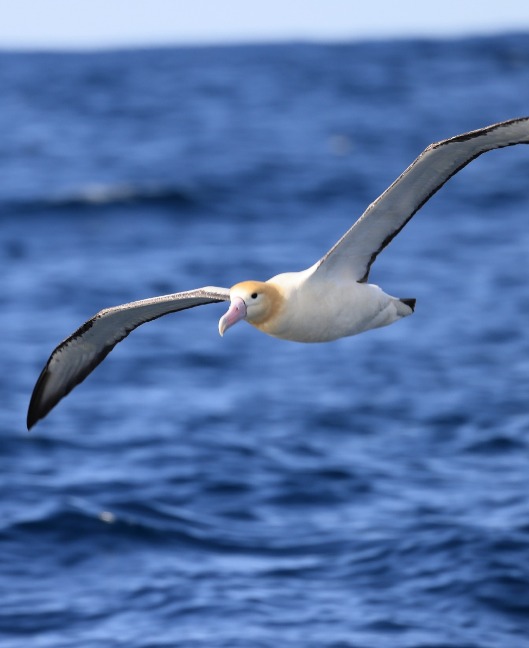
CMS Workshop on the Atlas on Animal Migration
Anouska Kinahan, Coordinator Global Partnership on Ecological Connectivty
8-12 October, Vasto, Italy

Slide 2

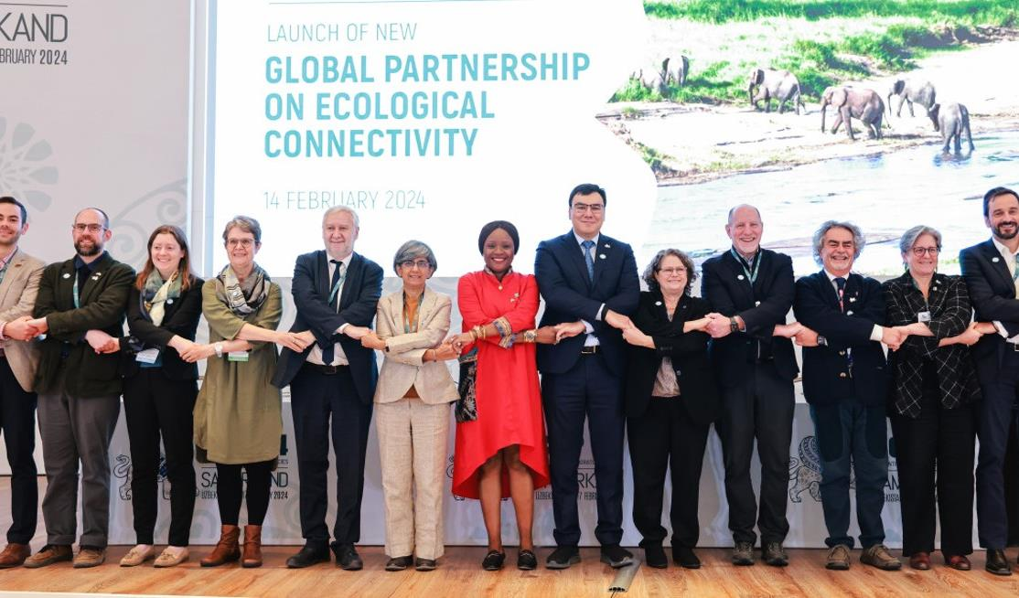

Global Partnership on Ecological Connectivity

Slide 3
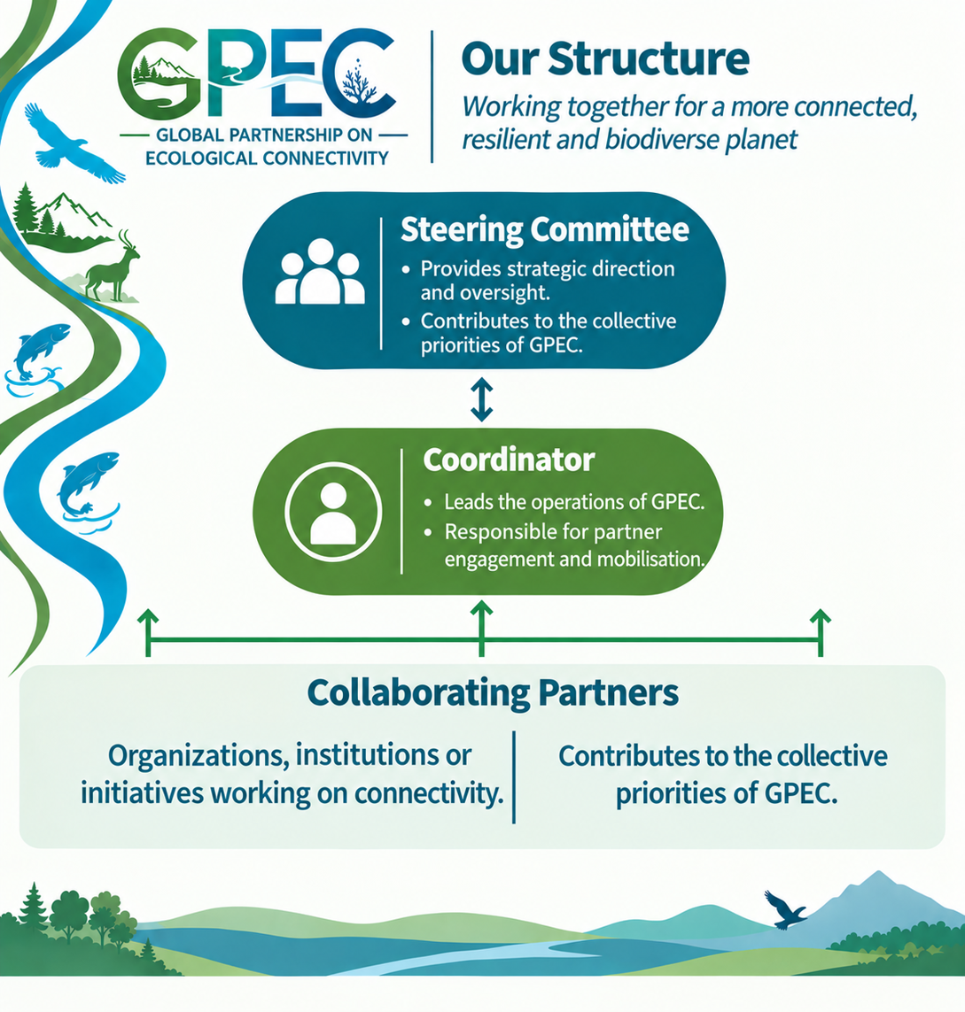










Scale up collective and coherent action to maintain, enhance and restore ecological connectivity
  Knowledge and information exchange
  Analyse and fill gaps
  Develop coherent and effective approaches
  Technical and policy support
  Identify priorities
  Mobilize funding and activities on the ground
Donors:

Slide 4

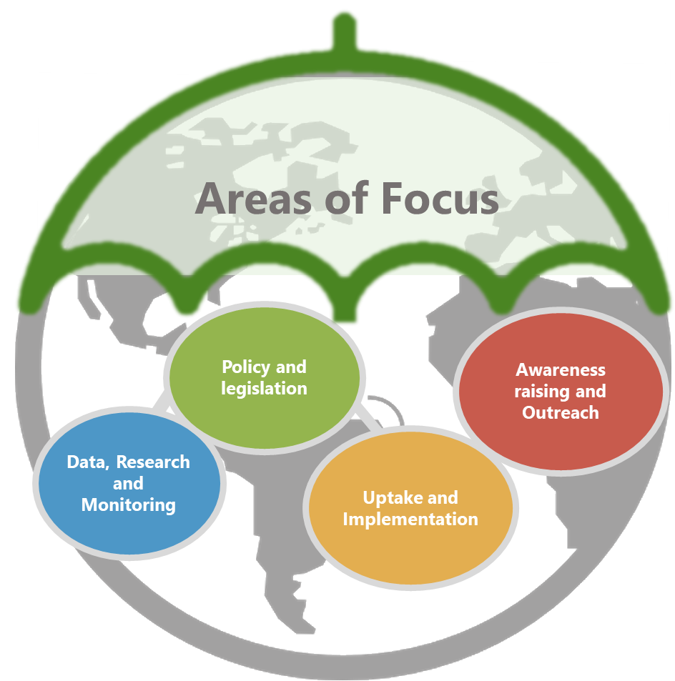
Data, Research and Monitoring
Ecosystem connectivity data, knowledge and information is available, readily accessible to all stakeholders and connectivity indicators are widely monitored
1.1 Identify gaps and support data collection to fill gaps on important habitats for, and climate change impacts on, terrestrial, inland water, and marine and coastal CMS listed species.
1.2 Consolidate existing migratory route and corridor maps, supporting the development of new ones where gaps exist across terrestrial, inland water and marine and coastal ecosystems and provide guidance on using these maps to support decision-making.

Slide 5
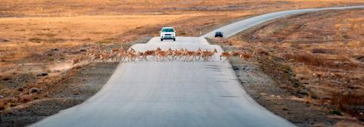
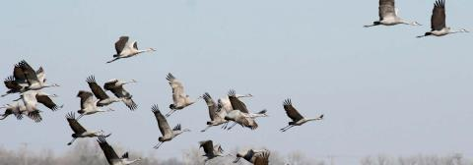
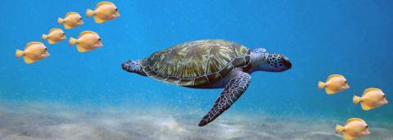

For More Information:
Website:
https://gpec-partnership.com/

