Slide 1

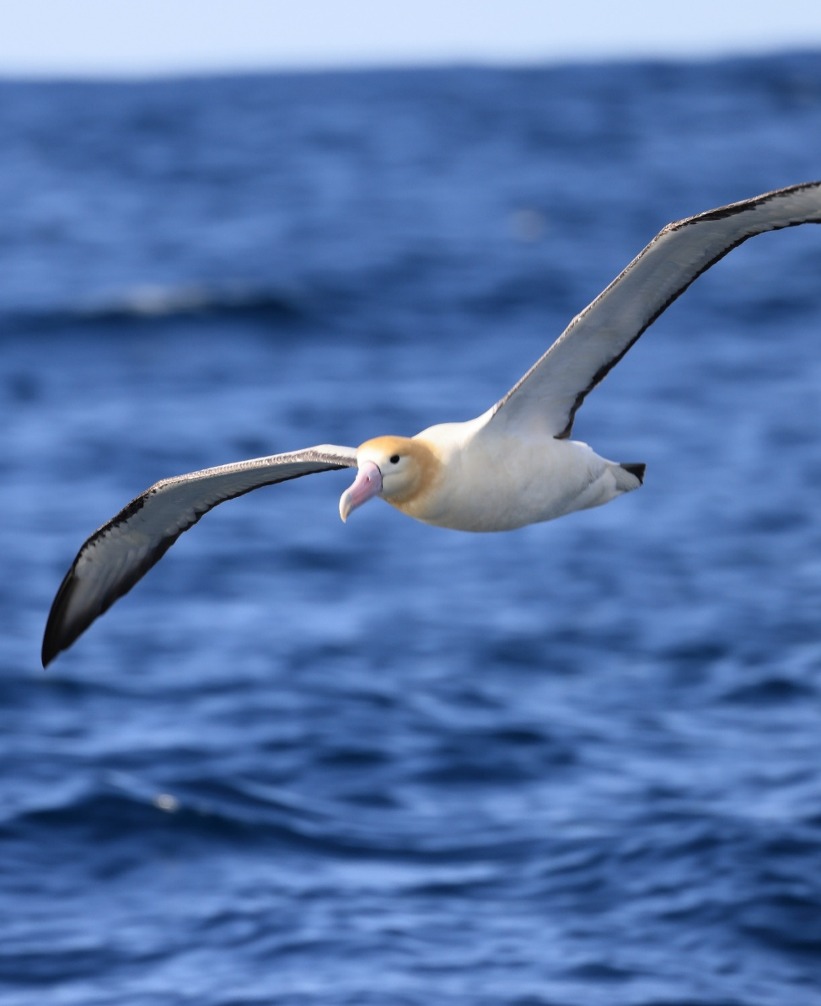
CMS Expert Workshop on devising the CMS Atlas of Animal Migration
Dagmar Zíková, CMS Secretariat
8-12 October, Vasto, Italy

Slide 2
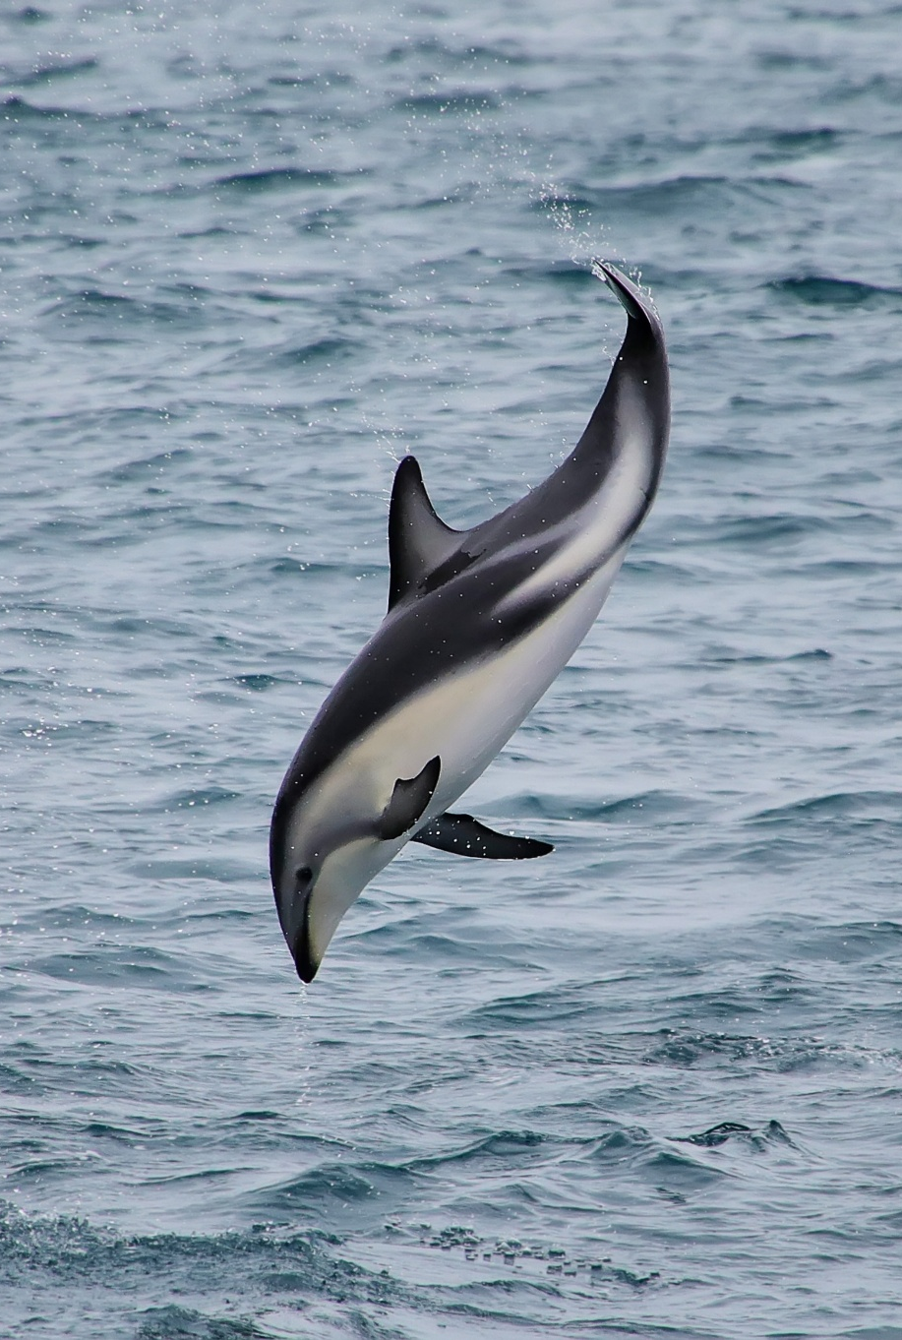
Convention on the Conservation of Migratory Species of Wild Animals (CMS)
Provides a global platform for the conservation and sustainable use of migratory animals and their habitats
133 Parties worldwide
Protects avian, marine, freshwater and terrestrial species and their habitats.
Facilitates international cooperation for protection of migratory species through concluding agreements, memoranda of understanding and other instruments
Adresses crosscutting issues (climate change, pollution, animal health, etc.)
8.- 12. October 2026
CMS Workshop on the Atlas of Animal Migration
Notes:
Introduce CMS and its mission.
Migratory species often cross country borders and therefore require international-level collaboration and protection.

Slide 3

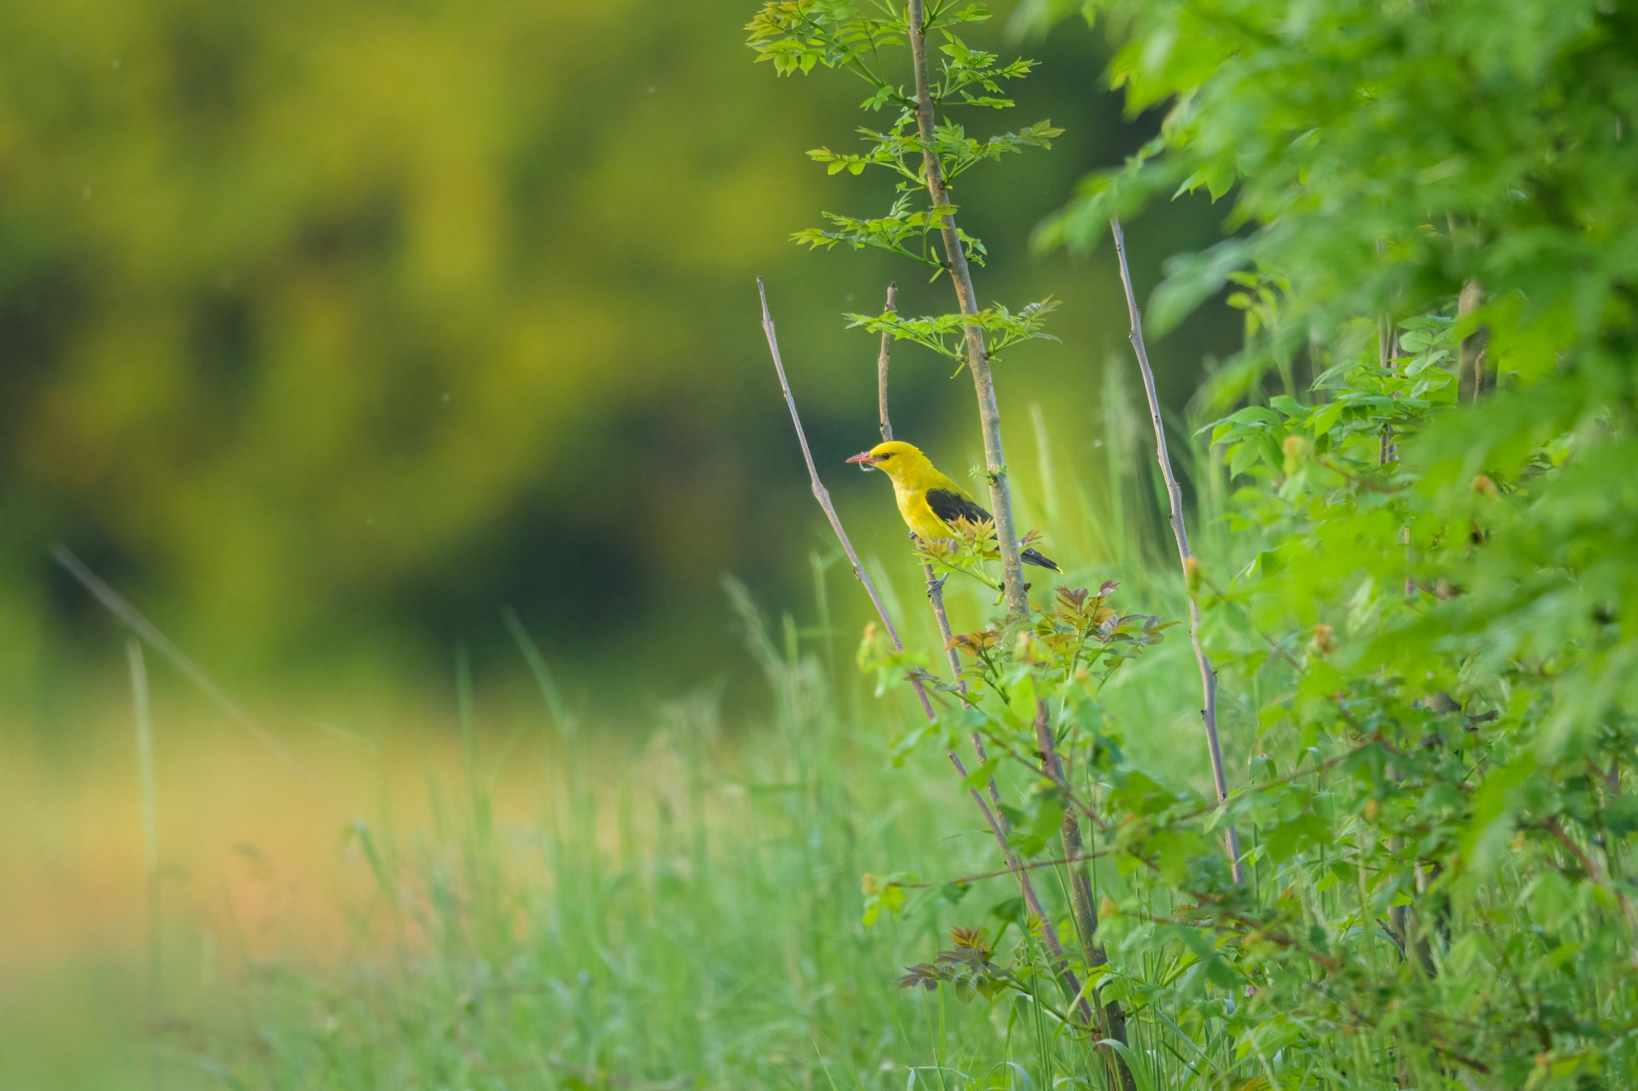
Current mandates to develop the CMS Atlas on Animal Migration

Slide 4
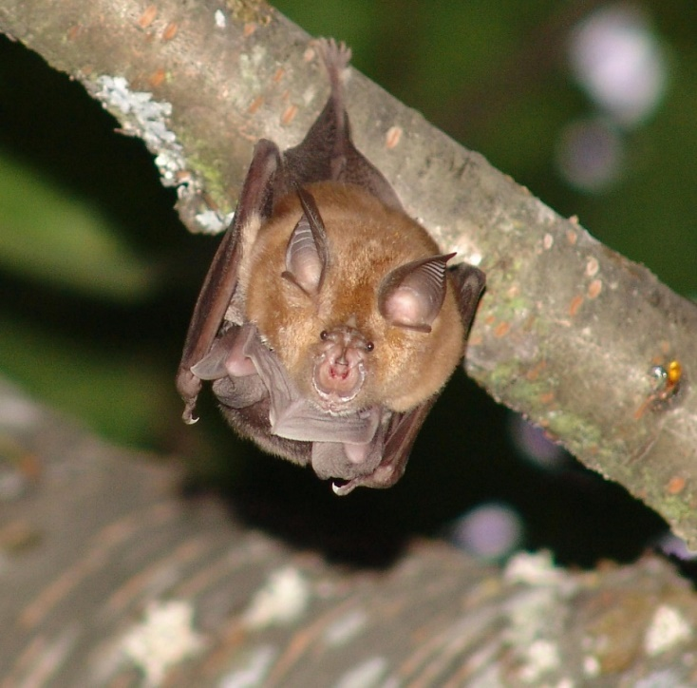
COP 15 Decisions relevant for the Atlas of Animal Migration
Atlas of Animal Migration
15.21 The Scientific Council is requested, subject to the availability of resources, to:
through its Working Group on Ecological Connectivity, make recommendations on the future development of the Atlas, including on:
  sharing experience from the Atlas of Bird Migration in the Eurasian-African Region and other existing Atlas modules with experts on other taxonomic groups regarding data hosting, methodology, analytical tools and the use of the best available data for the Atlas;
  options for a more comprehensive and effective approach to ensure the Atlas fulfils its purpose, including for enhancing the interoperability of the various data sets, and for improving its usability for conservation policies and translating movement data into policy/conservation action;
  how the existing and future modules of the CMS Atlas on Animal Migration can contribute to identification of key habitats, areas, corridors and networked sites that are of greatest global importance for the conservation of migratory species, taking into account the progress made in identifying KBAs, and other important habitats, such as IMMAs, ISRAs and the List of internationally important sites for migratory birds of prey in Africa and Eurasia;
b) promote the knowledge and the use of existing modules of the Atlas;
8.- 12. October 2026
CMS Workshop on the Atlas of Animal Migration

Slide 5
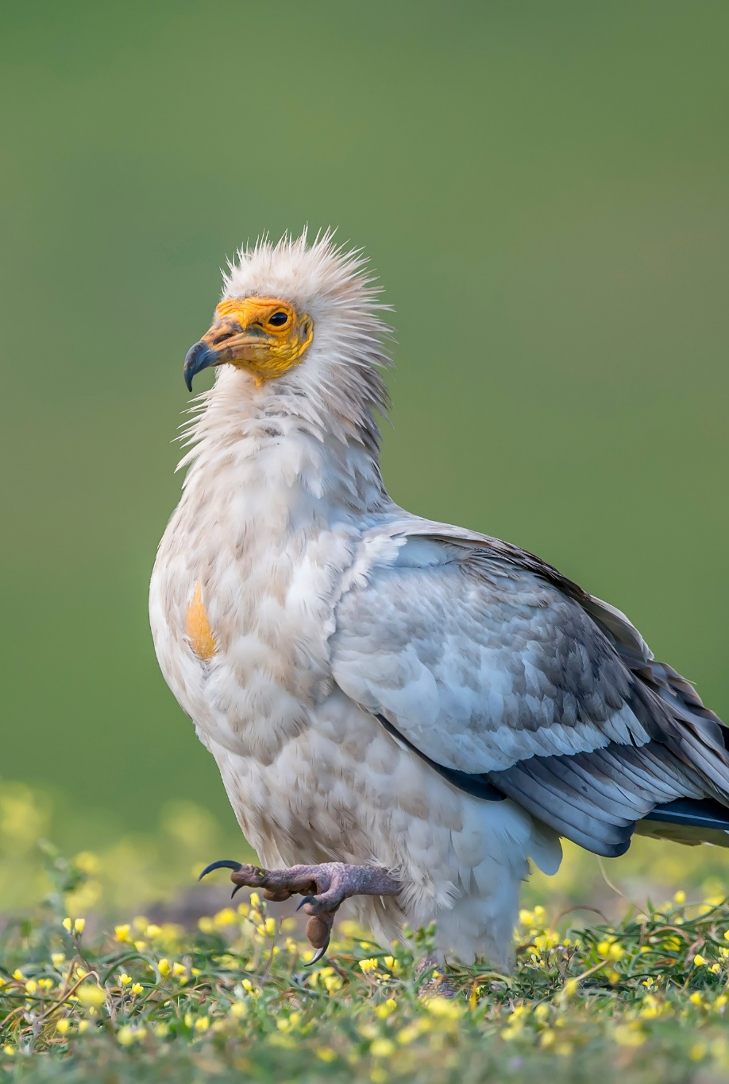
COP 15 Decisions (cont.)
Freshwater Fish
15.108 The Scientific Council is requested to, subject to the availability of resources:
work closely with the Secretariat on the possibility of developing a dedicated freshwater fishes’ module for the Atlas of Animal Migration;
Ecological Connectivity
15.197 The Secretariat shall, subject to the availability of resources:
convene, in cooperation with the Scientific Council and its Working Group on Infrastructure and Migratory Species, an expert workshop to consider options and develop proposals for creating relevant data- and knowledge-holding capacity and for enhancing analysis capabilities under the auspices of the CMS, building, inter alia, on the outcomes of the Survey on Ecological Connectivity and Infrastructure and the recommendations from the Scientific Council’s Working Group on Infrastructure;
8.- 12. October 2026
CMS Workshop on the Atlas of Animal Migration

Slide 6
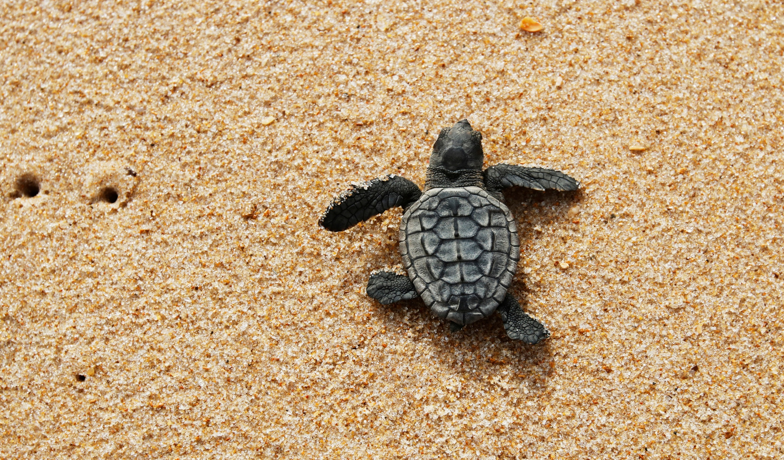
CMS Atlas on Animal Migration – past developments

Slide 7

Tracking Animal movement: Atlas of Animal Migration
Tracking animal migration to stimulate research on drivers, mechanisms, threats and conservation solutions for migratory species
Shows changes in animal movement over time (for example as a result of climate change)
The work started in 2014 at CMS COP11
Long-term project
Organised in species-specific modules
Five modules have been developed since 2014
8.- 12. October 2026
CMS Workshop on the Atlas of Animal Migration

Slide 8
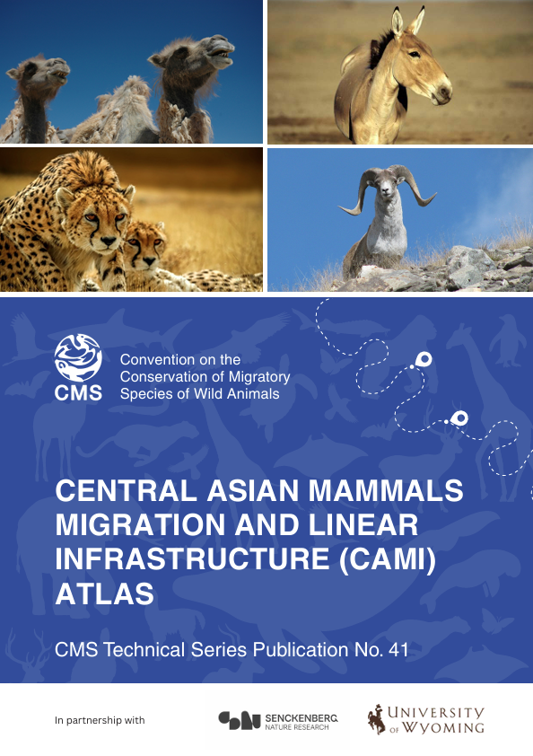
Central Asian Mammals Migration and Linear Infrastructure Atlas (2025)
First published in 2019 as CMS Technical Series No. 41; second edition launched in June 2025.
Features updated maps and data on ten migratory mammal species, ecological corridors and linear infrastructure across eight Central Asian countries.
Includes an interactive online web tool to enhance accessibility and support evidence-based decision-making.
Updated under the Central Asian Mammals and Climate Adaptation (CAMCA) project, funded by the International Climate Initiative (IKI) of the German Government.
8
8.- 12. October 2026
CMS Workshop on the Atlas of Animal Migration

Slide 9
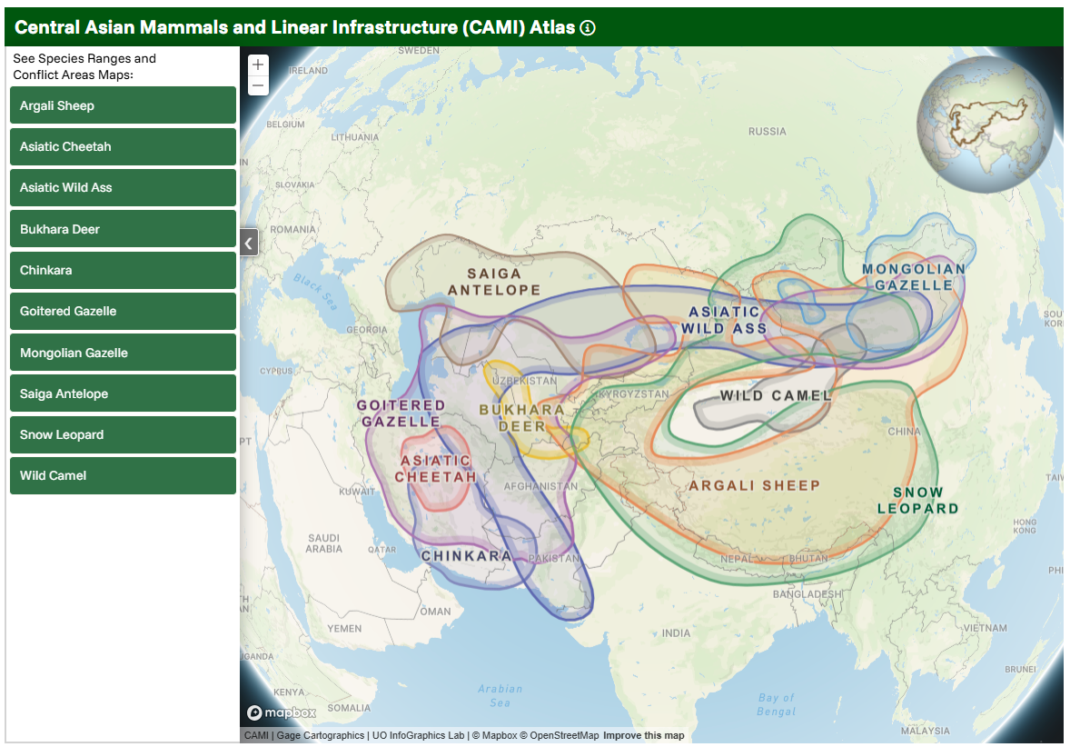
8.- 12. October 2026
CMS Workshop on the Atlas of Animal Migration

Slide 10
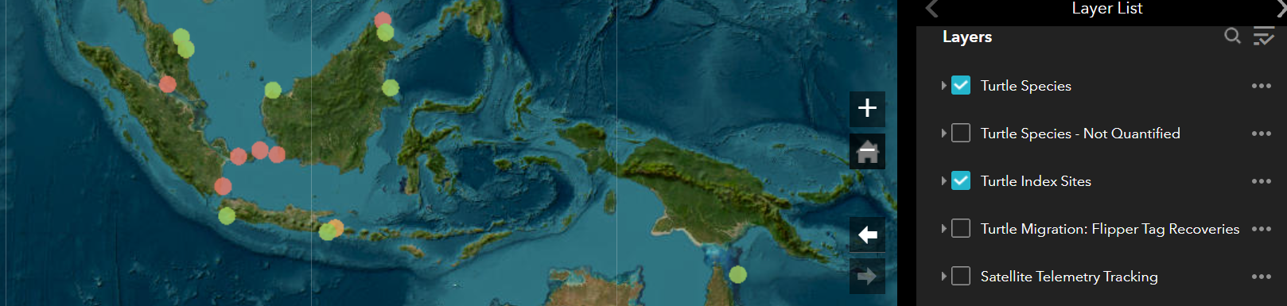
Marine Turtle Breeding and Migration Atlas "TurtleNet” (2021)
Developed by Queensland’s Department of Environment and Science (DES) in collaboration with CMS.
Builds on decades of Australian and global data on marine turtles biology and migration.
10
8.- 12. October 2026
CMS Workshop on the Atlas of Animal Migration
Notes:
Marine Turtle Breeding and Migration Atlas "TurtleNet” (2021)

Slide 11
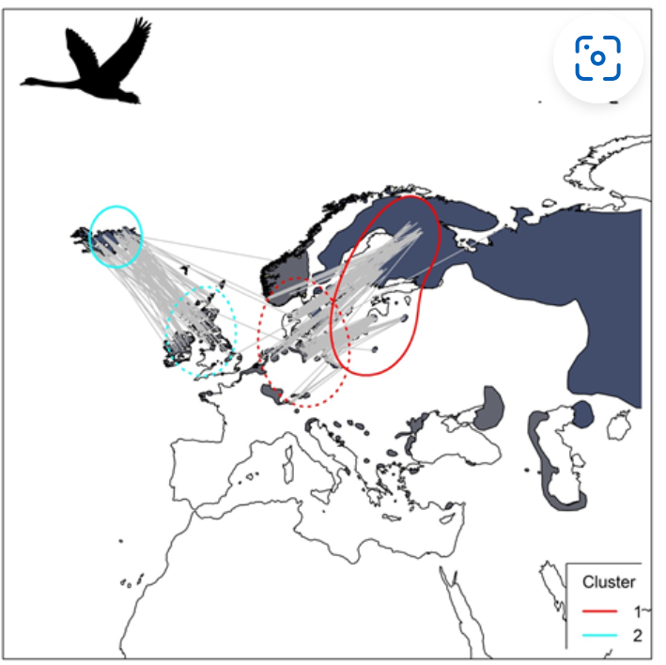
The Eurasian African Bird Migration Atlas (2022)
  Researchers from 10 institutions and data gathered by over 50 organizations
  Funded by the Italian Government
  Bird ringing data collected over more than 100 years on 300 species collated, analyzed, synthesized
  Four research modules address different aspects of bird migration and relationships between birds and people
    Historical changes in migration patterns
    Intentional killing of birds by man
    Migration seasons of hunted species
    Migratory connectivity within the European African migration system
  This module was developed by the European Union for Bird Ringing (EURING) in collaboration with the Max Planck Institute of Animal Behavior under an agreement with the CMS Secretariat
8.- 12. October 2026
CMS Workshop on the Atlas of Animal Migration

Slide 12
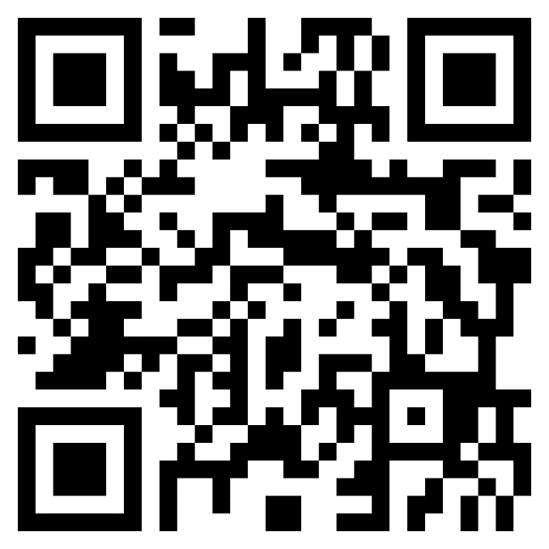
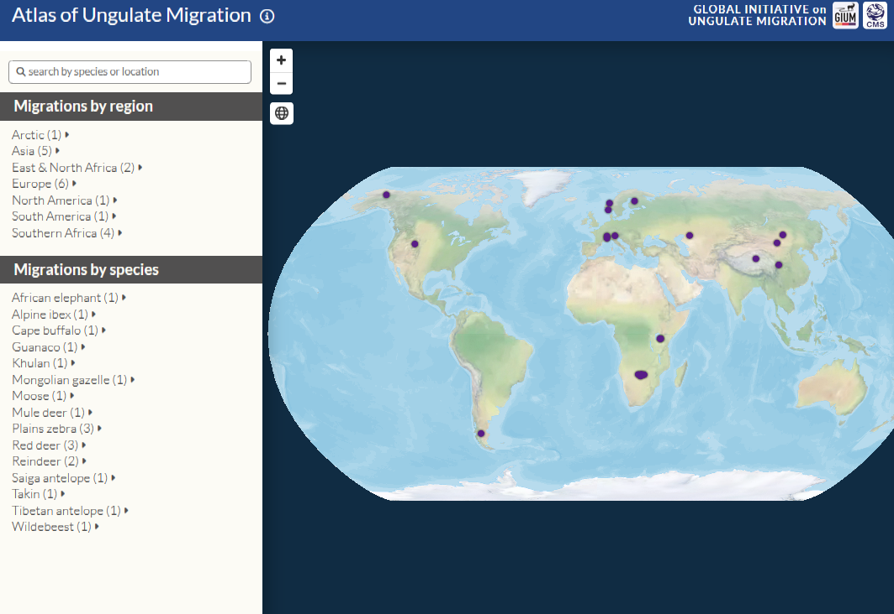
Atlas of Ungulate migration
Access to the Atlas:
Launched by GIUM (Global Initiative on Ungulate Migration) and CMS in 2024
20 migratory populations from around the world mapped
Documented impact of linear infrastructure on animal movement
8.- 12. October 2026
CMS Workshop on the Atlas of Animal Migration

Slide 13
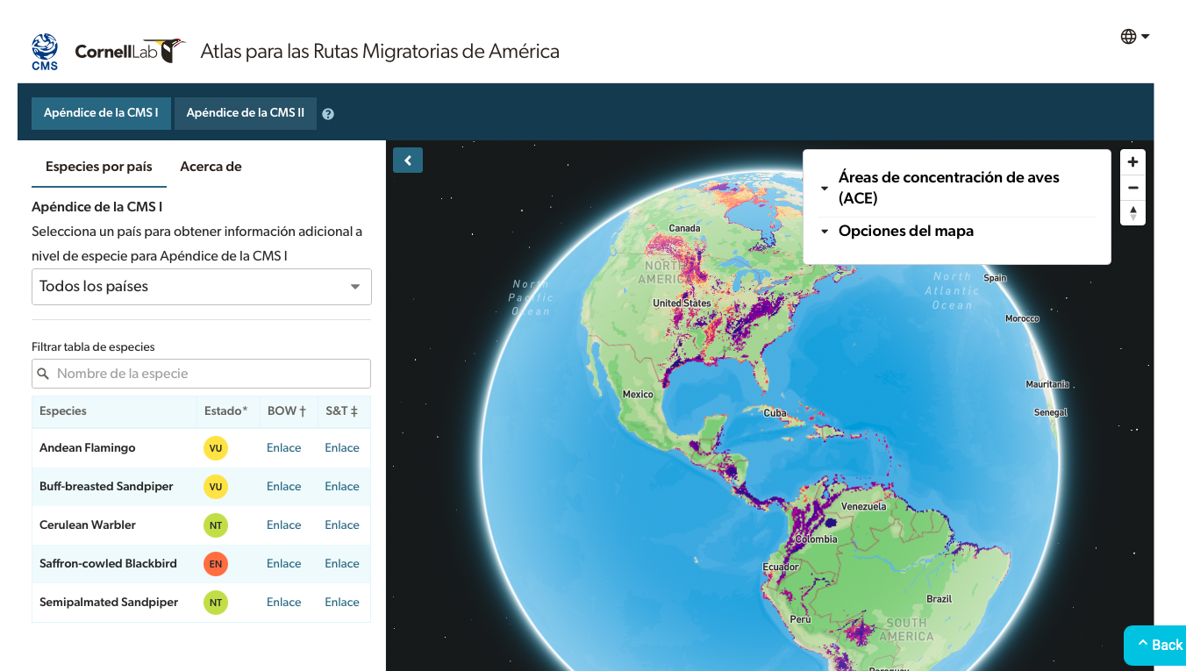
Atlas for the Americas Flyways
Using citizen science to support Americas Flyways Initiative

Slide 14

Atlas on Animal Migration and Ecological Connectivity
Data for conservation of migratory species provide background for:
Designation of protected areas
Identifying and removing problematic barriers
Conservation planning for energy and transport infrastructure development
Addressing threats (such as deliberate killing of animals)
Challenges
Bring scientific data from scientists to policy makers
Use of scientific data for conservation in policy formulation
Promote integration of ecological connectivity into spatial planning
8.- 12. October 2026
CMS Workshop on the Atlas of Animal Migration

Slide 15
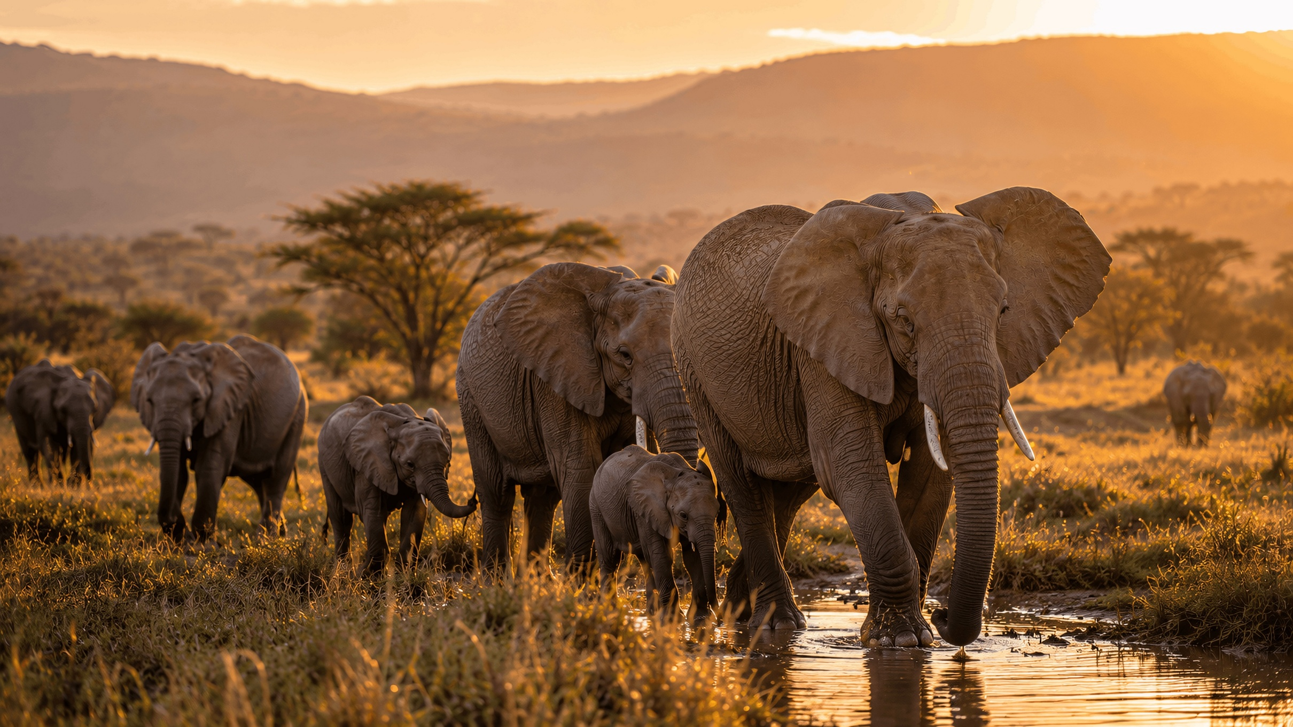
Atlas on Animal Migration and Ecological Connectivity

Slide 16
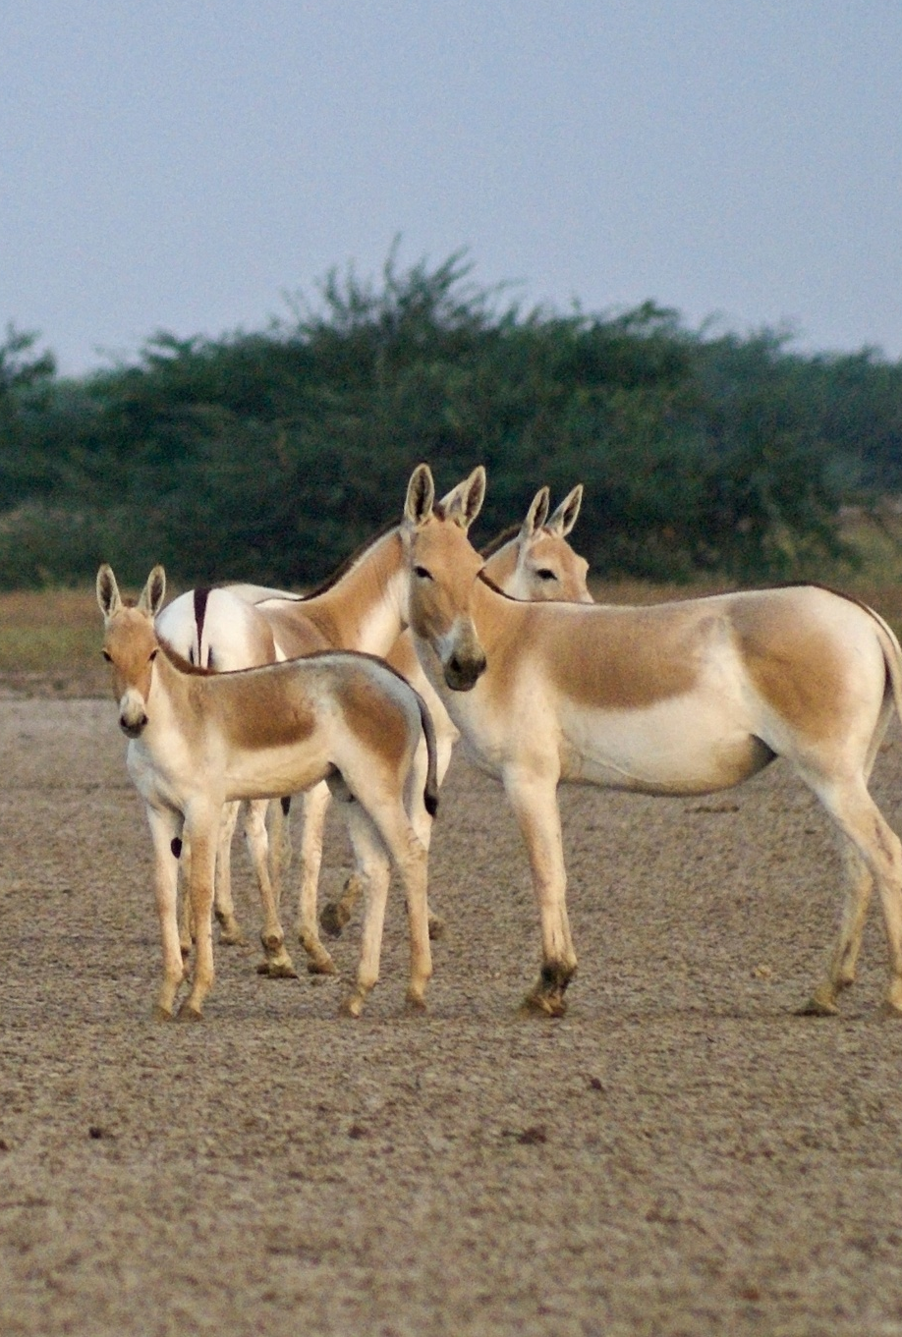
Animal movement data in support CMS Implementation
Information is needed on species movement, infrastructure and connectivity relevant for migratory species
CMS is developing an online library of existing databases on the movements, habitats, and presence and absence of migratory species
Online Library of Existing Databases on the Movements, Habitats, and Presence and Absence of Migratory Species | CMS
8.- 12. October 2026
CMS Workshop on the Atlas of Animal Migration

Slide 17
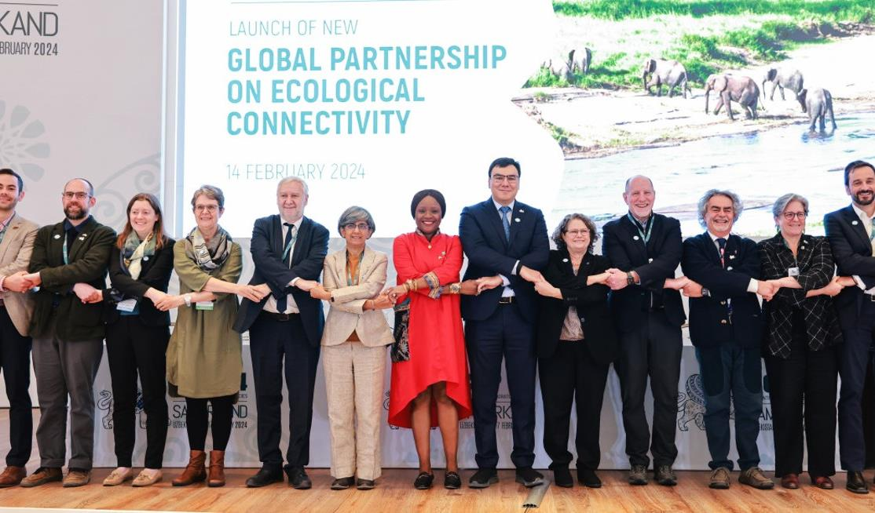

Global Partnership on Ecological Connectivity
8.- 12. October 2026
CMS Workshop on the Atlas of Animal Migration

Slide 18
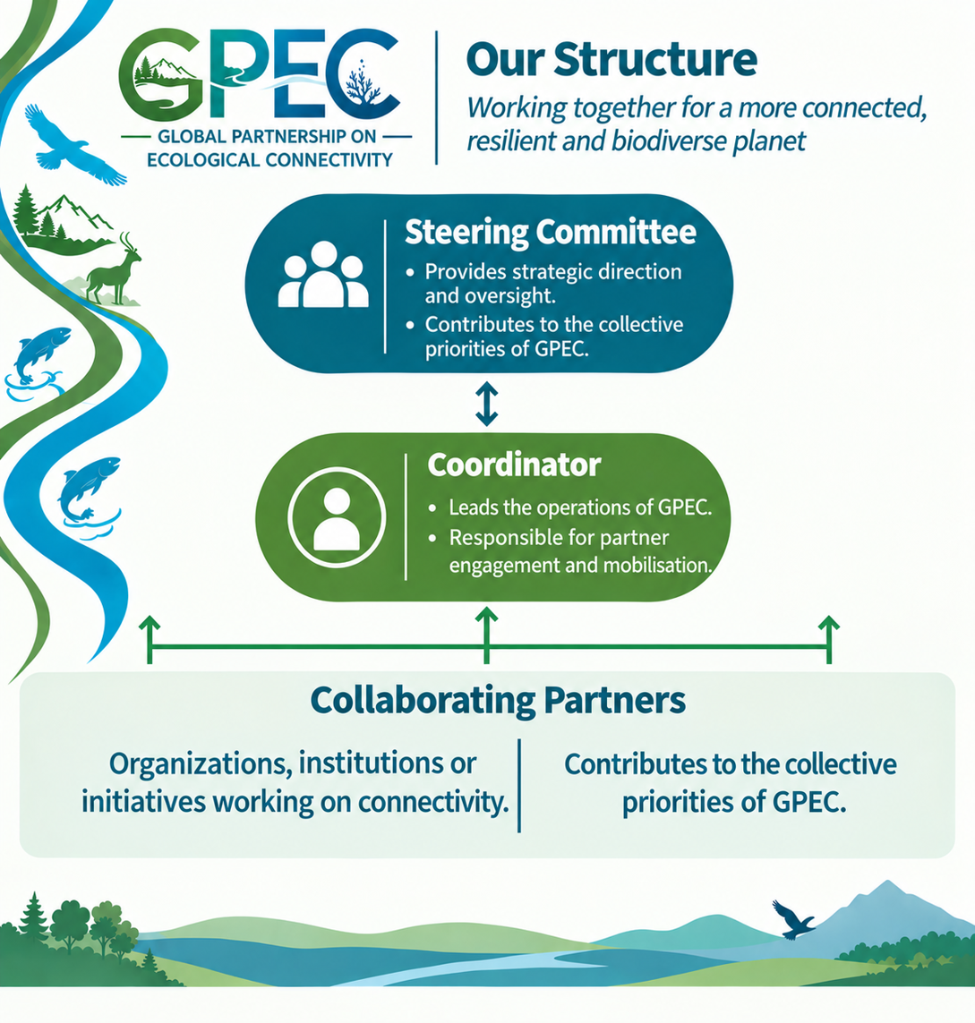










Scale up collective and coherent action to maintain, enhance and restore ecological connectivity
  Knowledge and information exchange
  Analyse and fill gaps
  Develop coherent and effective approaches
  Technical and policy support
  Identify priorities
  Mobilize funding and activities on the ground
Donors:
8.- 12. October 2026
CMS Workshop on the Atlas of Animal Migration

Slide 19

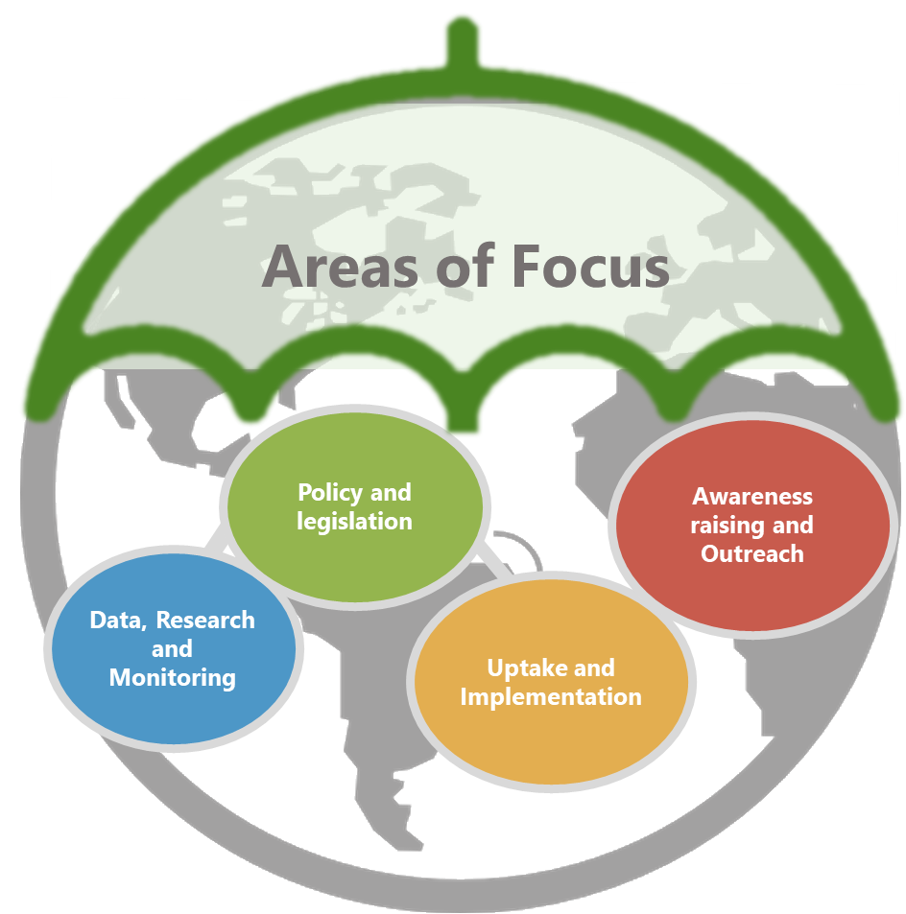
Data, Research and Monitoring
Ecosystem connectivity data, knowledge and information is available, readily accessible to all stakeholders and connectivity indicators are widely monitored
1.1 Identify gaps and support data collection to fill gaps on important habitats for, and climate change impacts on, terrestrial, inland water, and marine and coastal CMS listed species.
1.2 Consolidate existing migratory route and corridor maps, supporting the development of new ones where gaps exist across terrestrial, inland water and marine and coastal ecosystems and provide guidance on using these maps to support decision-making.
More Information: https://gpec-partnership.com/
8.- 12. October 2026
CMS Workshop on the Atlas of Animal Migration

Slide 20
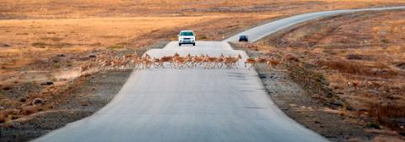
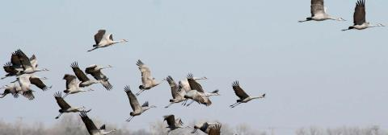
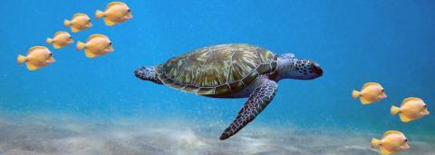

For More Information:
Website:
https://gpec-partnership.com/
8.- 12. October 2026
CMS Workshop on the Atlas of Animal Migration

Slide 21

CMS Atlas on Animal Migration – what next?

Slide 22
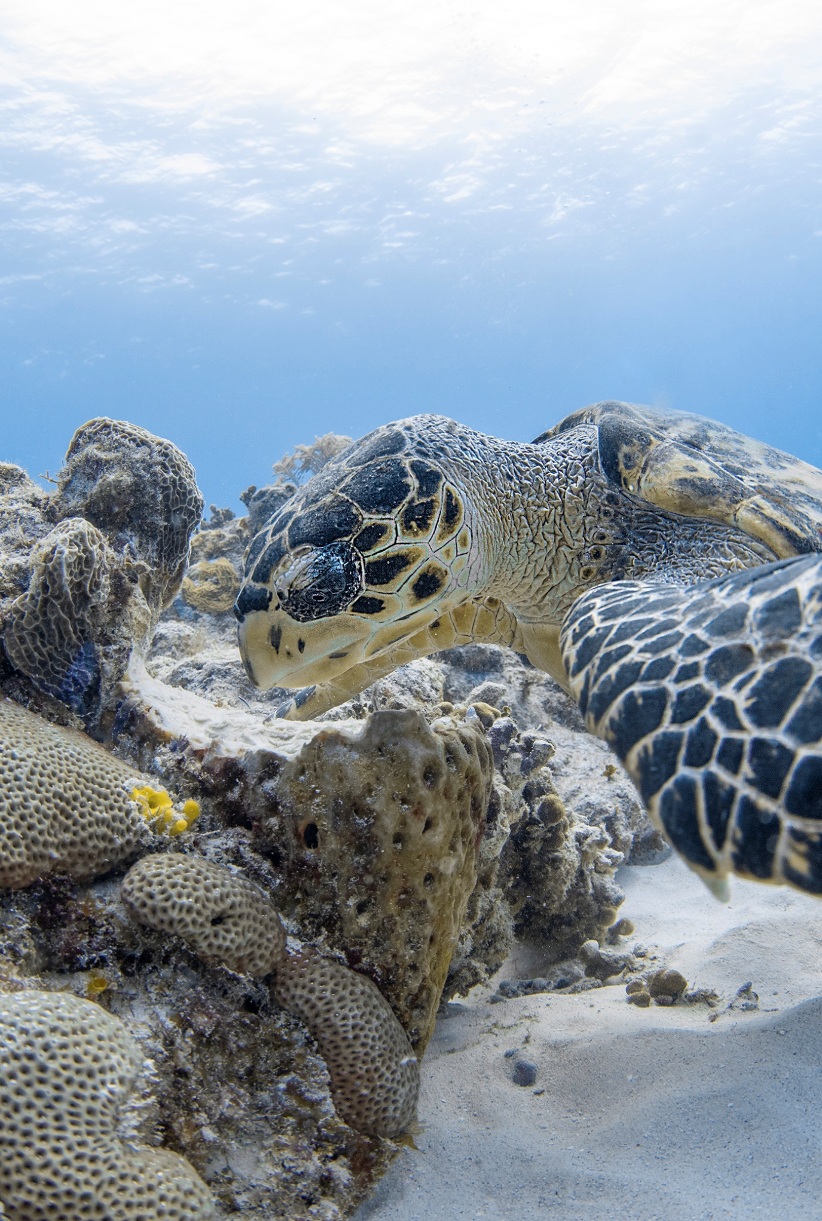
Workshop Objectives
Identify key uses and users of the Atlas and their data needs.
Identify transferable lessons and review technical approaches for data management and analysis.
Define priorities for future Atlas development.
Improve consistency across datasets.
Enhance accessibility and usability of Atlas outputs.
Identify monitoring approaches.
Strengthen collaboration frameworks.
Use the Atlas to contribute information to identify key protected areas.
Strengthen institutional and analytical capacity.
Agree on outcomes and next steps.
8.- 12. October 2026
CMS Workshop on the Atlas of Animal Migration

Slide 23
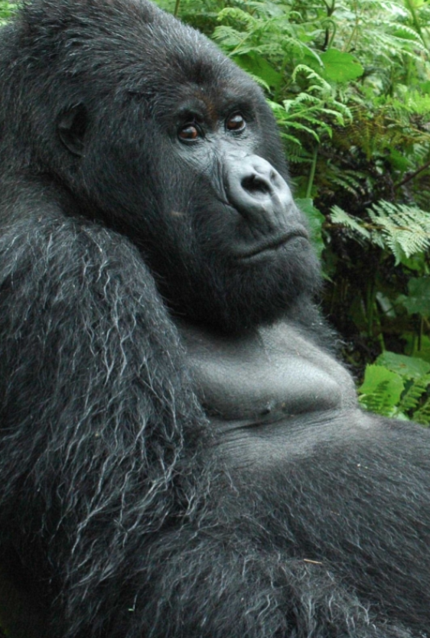
Workshop Agenda
Strategic Vision, Lessons Learned, and Policy Relevance
  Session 1: Needs Assessment and User Analysis
  Session 2: Lessons from Existing Atlas Initiatives
Data Integration, Tools, and Partnerships
  Session 3: Linking Data and Policy
  Session 4: Expanding and Updating the Atlas – Looking Ahead
  Session 5: Data Harmonization and Standards
  Session 6: Visualization and User-Oriented Tools
  Session 7: Monitoring Infrastructure Impacts
CMS data infrastructure and way forward
  Session 8: Partnerships and Institutional Alignment
  Session 9: Identifying Key Habitats, Corridors, Networks and Drivers
  Session 10: Knowledge Infrastructure
  Session 11: Consolidation of Recommendations and Roadmap
  Closing session
8.- 12. October 2026
CMS Workshop on the Atlas of Animal Migration

Slide 24
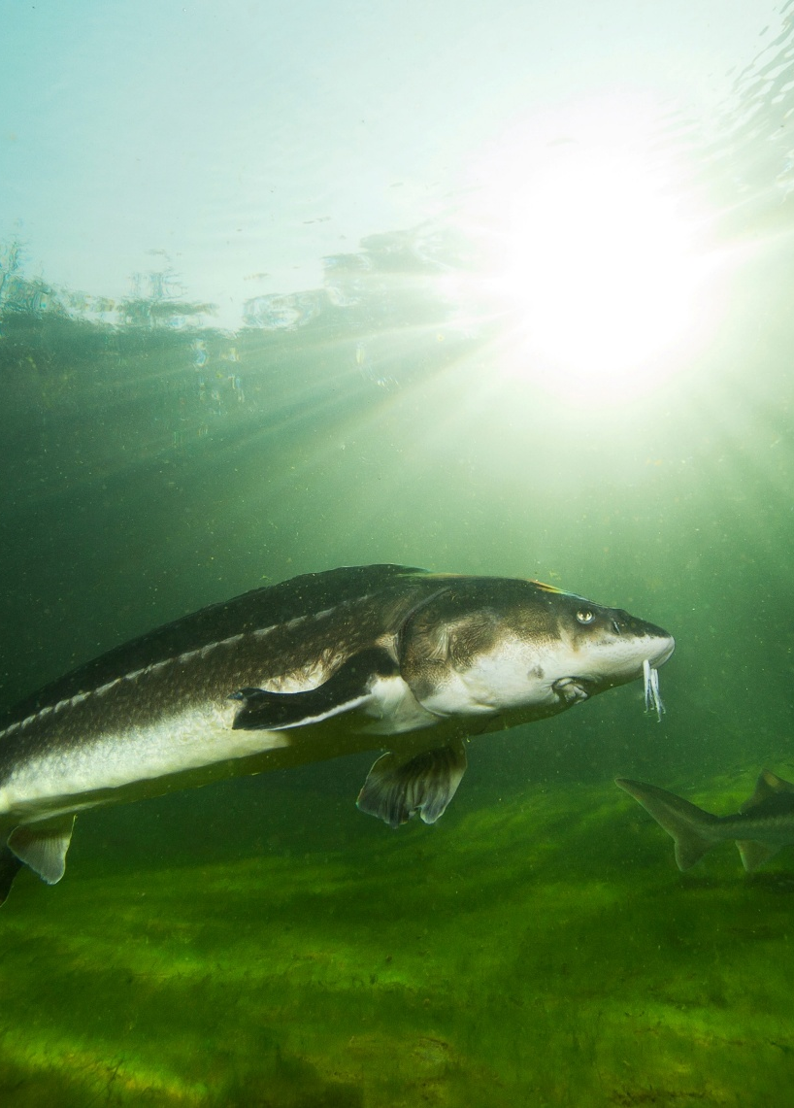
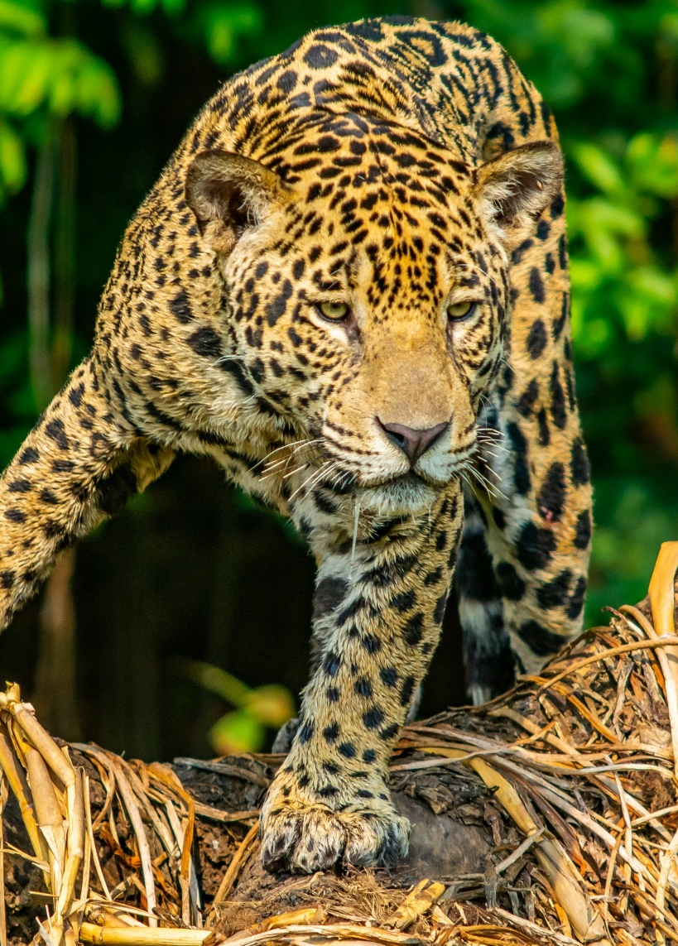
Thank you!

