Slide 1

The Italian Action Plan against illegal killing of birds (IKB)
Alessandro Andreotti
Fernando Spina
Bern SFPS Network and CMS MIKT Joint Meeting
Malta, 22-32 June 2017

Slide 2

In 2014, the Italian Ministry for the Environment (MATTM) decided to launch a national strategy to strengthen the fight against IKB through the approval of a national action plan
ISPRA was committed to prepare a background document, with updated information on:
- typologies and frequencies of illegal activities
their geographical and temporal distribution
black-spots
drivers of IKB
weakness of law enforcement
FINAL DRAFT
DECEMBER 2015
Bern SFPS Network and CMS MIKT Joint Meeting
Malta, 22-32 June 2017

Slide 3
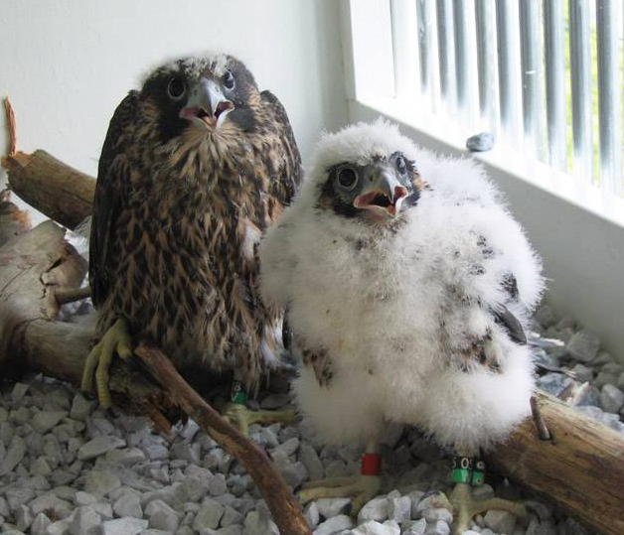
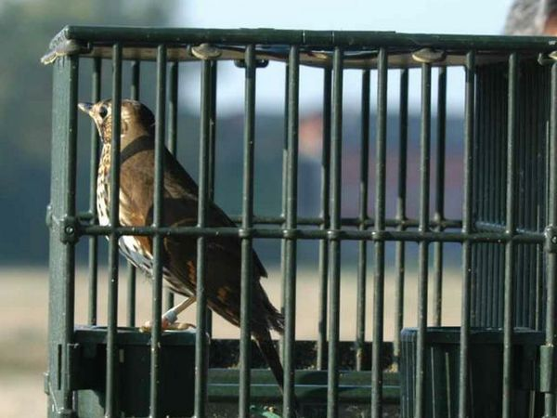
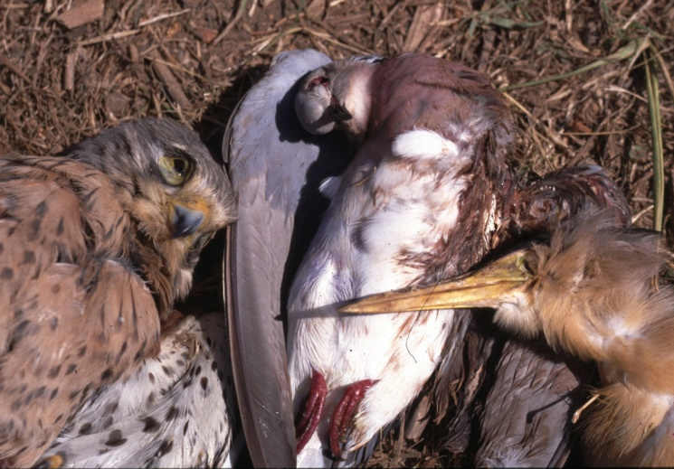
Main illegal activities and target species
catching - songbirds
nest poaching - songbirds, raptors
illegal shooting - raptors, game species, songbirds
poisoning - raptors
trade (illegal import/export) - gamebirds, songbirds, raptors
Bern SFPS Network and CMS MIKT Joint Meeting
Malta, 22-32 June 2017

Slide 4
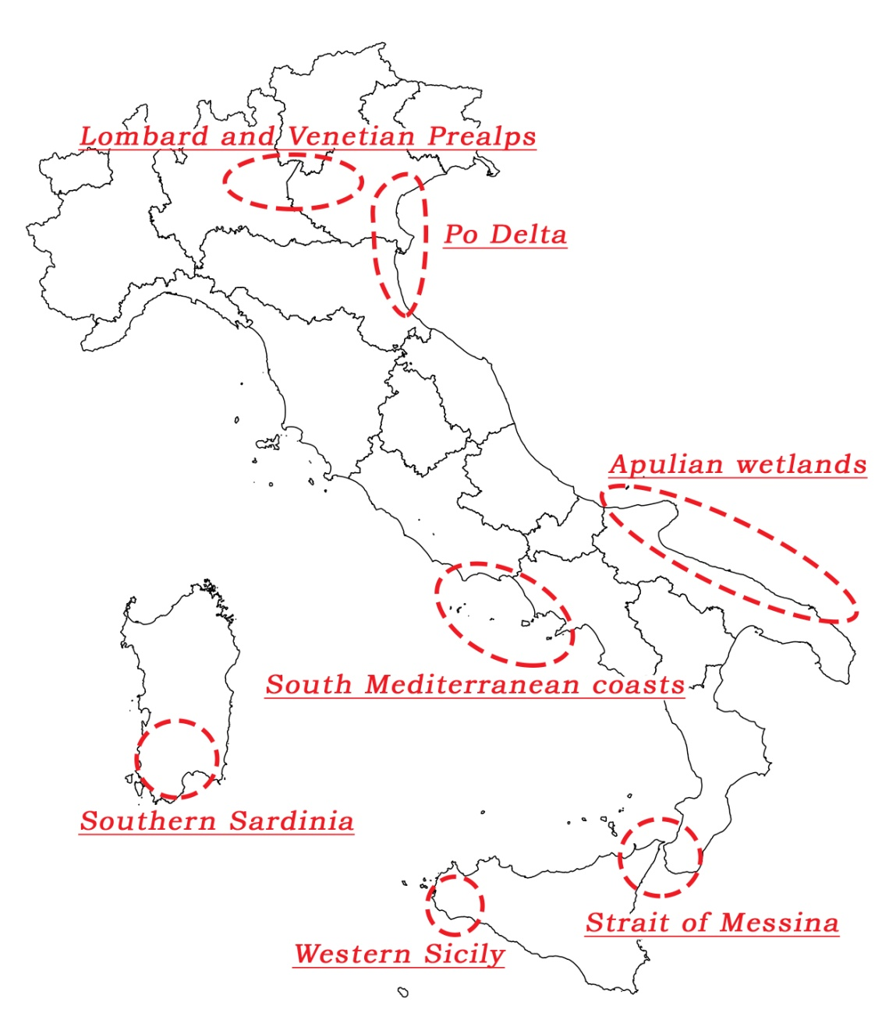
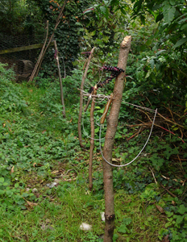
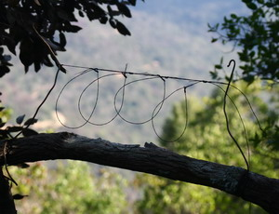
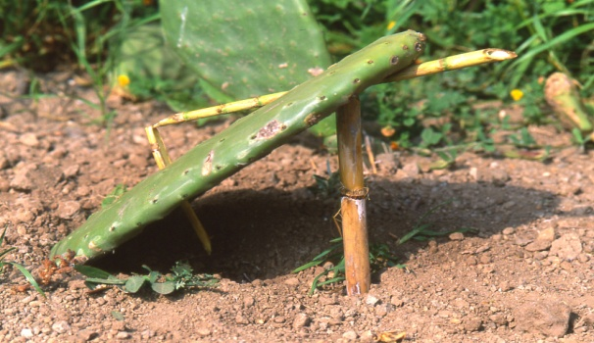
Catching of songbirds
snares, lime, nets
Bern SFPS Network and CMS MIKT Joint Meeting
Malta, 22-32 June 2017

Slide 5
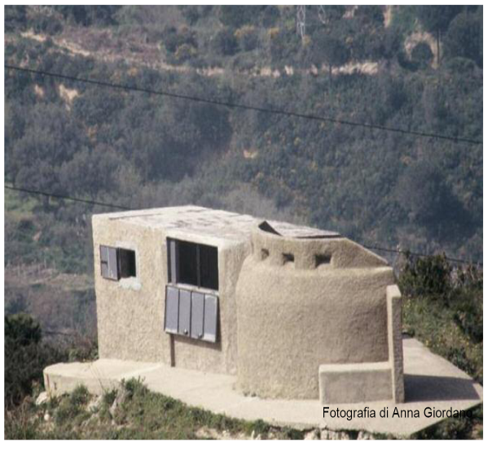
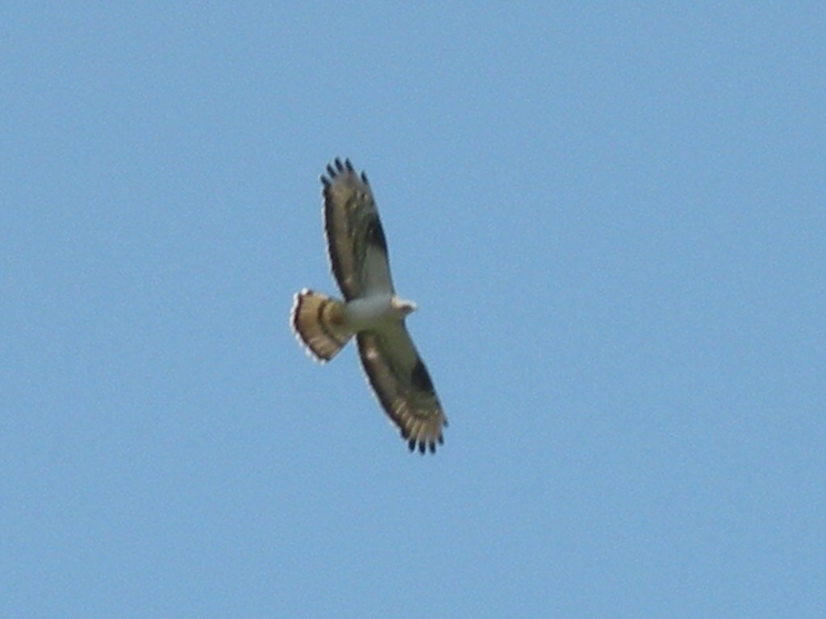
Shooting of raptors
Bern SFPS Network and CMS MIKT Joint Meeting
Malta, 22-32 June 2017

Slide 6
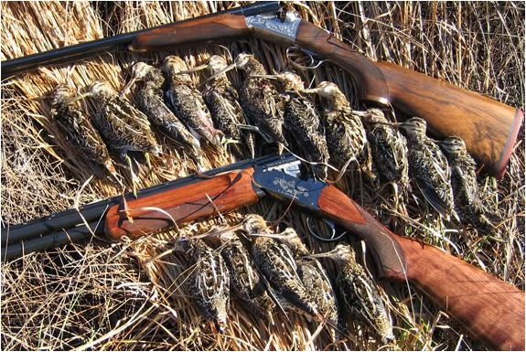

Shooting of waterbirds
infringement of hunting regulation
use of electronic calls
Bern SFPS Network and CMS MIKT Joint Meeting
Malta, 22-32 June 2017

Slide 7
Main drivers
catching of songbirds: commercial purposes (traditional gourmet cuisine, use as live decoys)
taking from nests of songbirds and raptors: commercial purposes (use as live decoys, ornamental purposes, falconry)
illegal shooting of raptors, game species, songbirds: local traditions, vandalism, taxidermy
poisoning of raptors: predator control (baits for carnivores)
illegal import of gamebirds, songbirds and raptors: commercial purposes
Bern SFPS Network and CMS MIKT Joint Meeting
Malta, 22-32 June 2017

Slide 8

The background document was circulated among institutions and stakeholders together with a preliminary list of actions to tackle IKB
A workshop was held to discuss main goals, targets and actions
TECHNICAL WORKSHOP
9-10 JUNE 2016
Veneto Po Delta Park
Bern SFPS Network and CMS MIKT Joint Meeting
Malta, 22-32 June 2017

Slide 9
Taking into account the inputs received, a national action plan was drafted and circulated to Ministries, Regional Governments and stakeholders
FIRST DRAFT
JULY 2016
FINAL DRAFT
NOVEMBER 2016
A revised version was finalized and sent to the Conferenza-Stato Regioni
Bern SFPS Network and CMS MIKT Joint Meeting
Malta, 22-32 June 2017

Slide 10
FINAL APPROVAL 30 MARCH 2017
Bern SFPS Network and CMS MIKT Joint Meeting
Malta, 22-32 June 2017

Slide 11
FIVE MAIN TARGETS (31 actions)
Strengthening of direct fight against IKB
Strengthening of indirect fight against IKB
Prevention
Monitoring of action plan implementation
Setting up of a Coordination Unit (Cabina di Regia)
Bern SFPS Network and CMS MIKT Joint Meeting
Malta, 22-32 June 2017

Slide 12
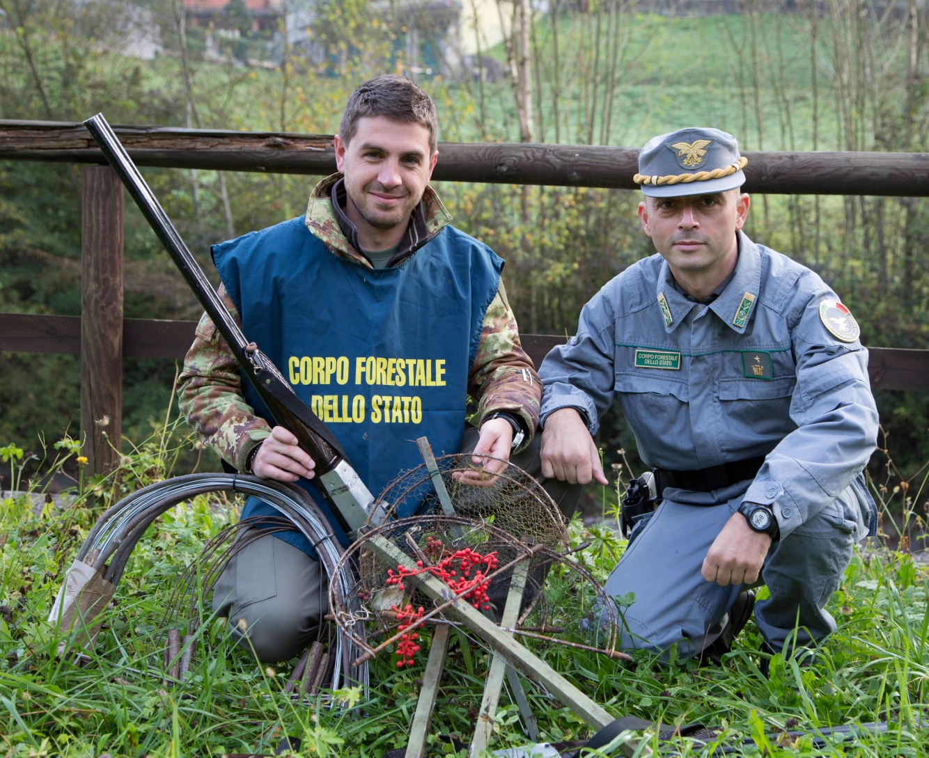
1 - STRENGTHENING OF DIRECT FIGHT AGAINST IKB
1.1 - Setting up or strengthening of central units to tackle:
illegal killing and catching
illegal trade
use of poisoned baits
Bern SFPS Network and CMS MIKT Joint Meeting
Malta, 22-32 June 2017

Slide 13
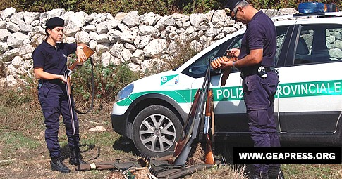
1 - STRENGTHENING OF DIRECT FIGHT AGAINST IKB
1.2 - Setting up or strengthening police corps/districts
National Environmental Police (Carabinieri)
Regional/provincial police corps
Anti-poisoning dog units
Bern SFPS Network and CMS MIKT Joint Meeting
Malta, 22-32 June 2017

Slide 14
1 - STRENGTHENING OF DIRECT FIGHT AGAINST IKB
1.3 - Improvement of coordination among police corps
Setting up of a national coordination unit
Setting up of a coordination unit in each black-spot
Bern SFPS Network and CMS MIKT Joint Meeting
Malta, 22-32 June 2017

Slide 15

2 - STRENGTHENING OF INDIRECT FIGHT AGAINST IKB
2.1 - Enhancement of law enforcement
Amendment of laws and hunting regulations
Training of judiciary
Bern SFPS Network and CMS MIKT Joint Meeting
Malta, 22-32 June 2017

Slide 16
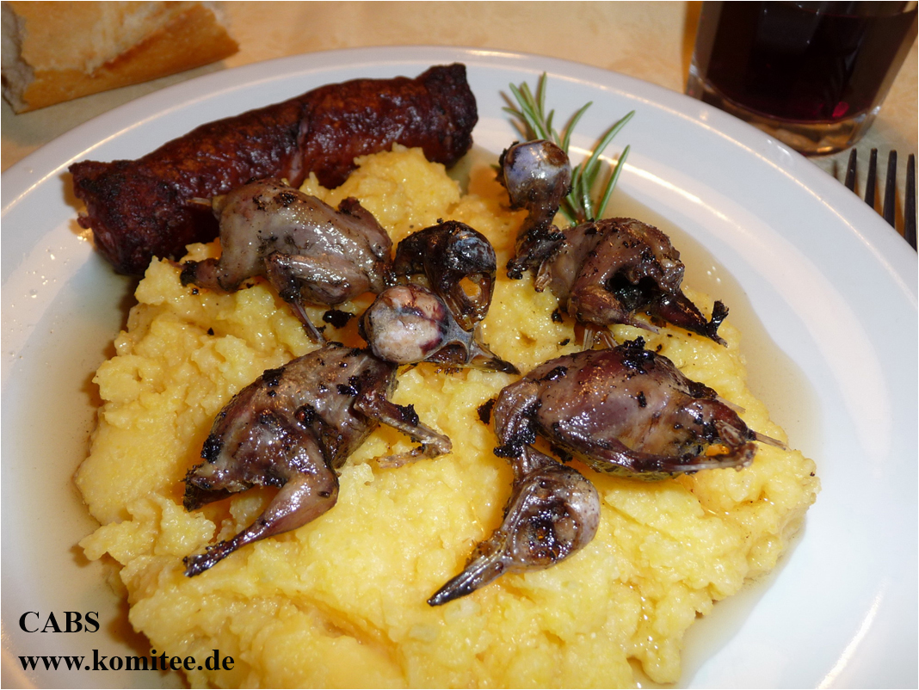
2 - STRENGTHENING OF INDIRECT FIGHT AGAINST IKB
2.2 - Combatting the drivers of IKB
Improvement of controls on trade, captive-breeding centres and restaurants in areas where birds are traditional food
Improvement of compensation procedures for damages caused by wild birds
Bern SFPS Network and CMS MIKT Joint Meeting
Malta, 22-32 June 2017

Slide 17
3 - PREVENTION
3.1 - Launch of awareness campaigns
on specific issues (poison baits)
in specific areas (black-spots)
among specific categories of persons (hunters, shepherds)
Bern SFPS Network and CMS MIKT Joint Meeting
Malta, 22-32 June 2017

Slide 18
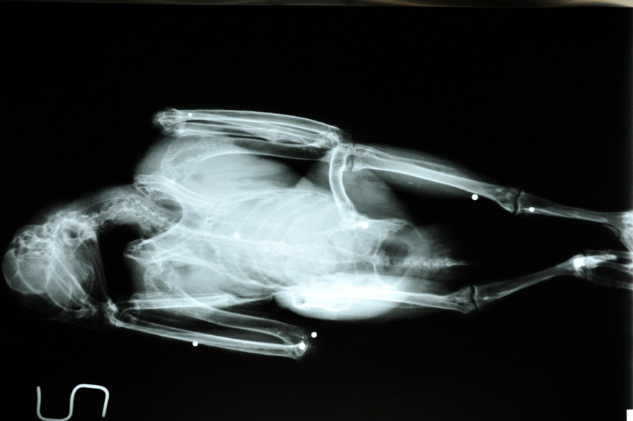
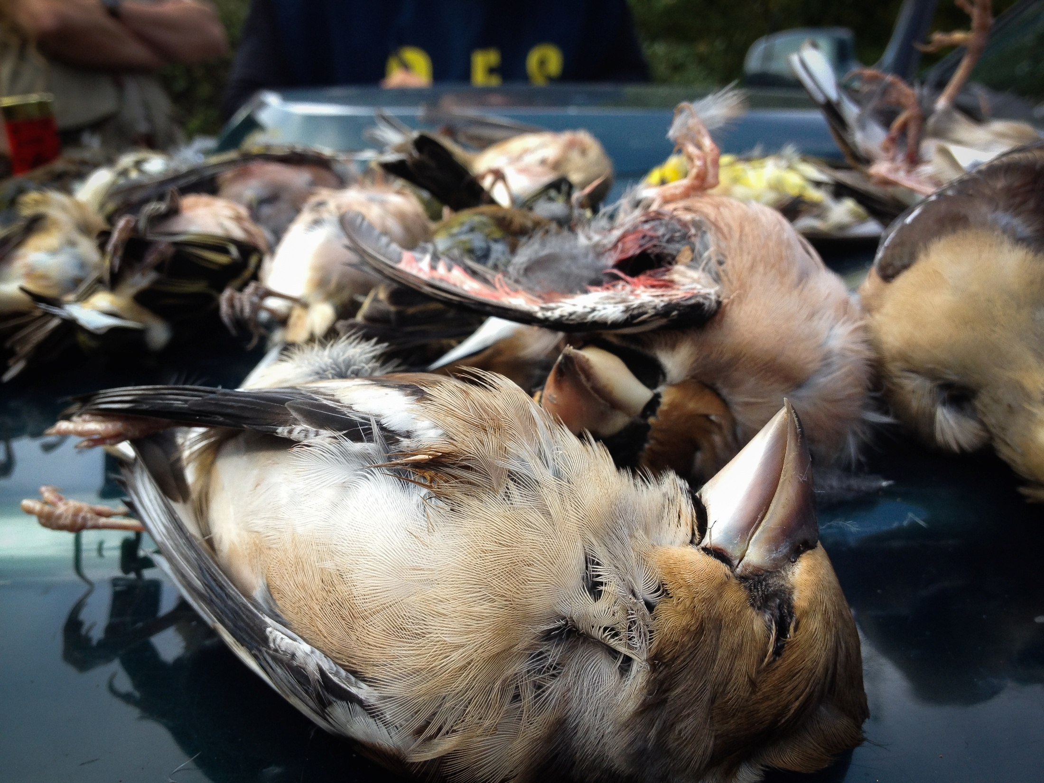
4 - MONITORING OF ACTION PLAN IMPLEMENTATION
4.1 - Implementation of national/regional data banks on:
crimes against birds
mortality causes (from wildlife rescue centres)
4.2 -Drafting of annual reports
Bern SFPS Network and CMS MIKT Joint Meeting
Malta, 22-32 June 2017

Slide 19
5 - SETTING UP OF A COORDINATION UNIT (CABINA DI REGIA)
5.1 - setting up of a national coordination unit
made of two distinct committees, addressing political and technical issues
supported by an administrative office managed by the Ministry of the Environment with the support of ISPRA
WORK IN PROGRESS
Bern SFPS Network and CMS MIKT Joint Meeting
Malta, 22-32 June 2017

Slide 20
KEY ACHIEVEMENTS
National Action Plan
Profile of IKB at the national level
Awareness on IKB by Authorities
Obstacles:
  Complexity deriving from the administrative/social(?) structure of the country
  Reluctance from some Authorities to get formally involved
  Hard positions against the NAP by some stakeholders
Bern SFPS Network and CMS MIKT Joint Meeting
Malta, 22-32 June 2017

Slide 21
OBSTACLES
  Complexity deriving from the administrative/social(?) structure of the country
  Reluctance from some Authorities to get formally involved
  Hard positions against the NAP by some stakeholders
Bern SFPS Network and CMS MIKT Joint Meeting
Malta, 22-32 June 2017

Slide 22
PRIORITIES
  Getting the Coordination Unit started asap
  Having the CU mandated with clear ToRs and prorities of action
  Give a clear signal from first concrete actions
  Improving synergies across different Authorities
Bern SFPS Network and CMS MIKT Joint Meeting
Malta, 22-32 June 2017

Slide 23
FINAL REMARKS
A positive outcome of the Bern Convention/CMS initiatives
A formal involvement of all relevant national Authorities on IKB in a country like Italy
An interesting study case at the Mediterranean level
An ongoing experience to share with other countries in the region and beyond
Bern SFPS Network and CMS MIKT Joint Meeting
Malta, 22-32 June 2017

