Slide 1
6.1 Provisional Agenda and documents & 21.1.25 Review of Decisions
CMS COP12 Regional Preparatory Workshop
for Asia
Melanie Virtue
UNEP/CMS Secretariat
15-17 August 2017
Bonn, Germany

Slide 2
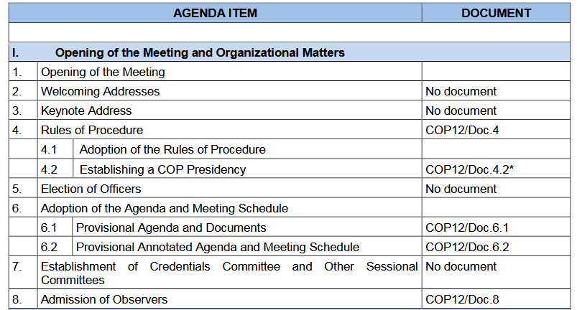
Provisional COP Agenda and documents

Slide 3
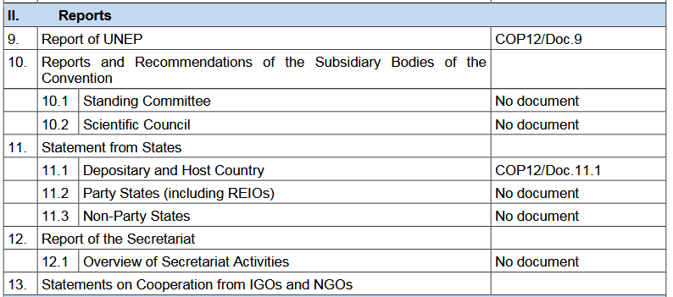

Slide 4
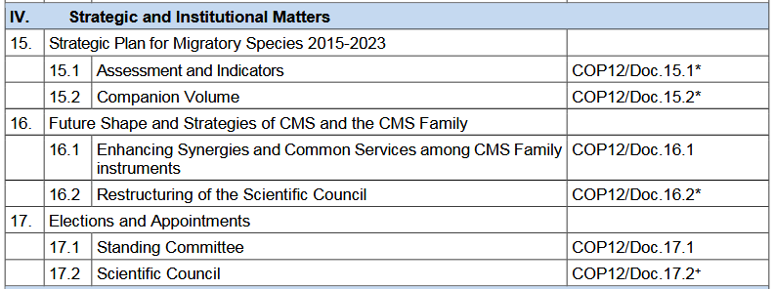

Slide 5
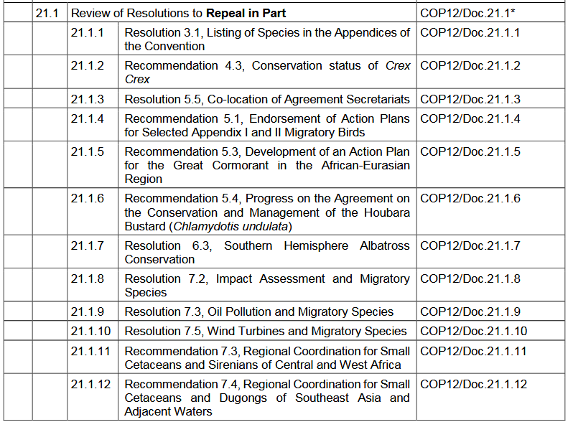

Slide 6
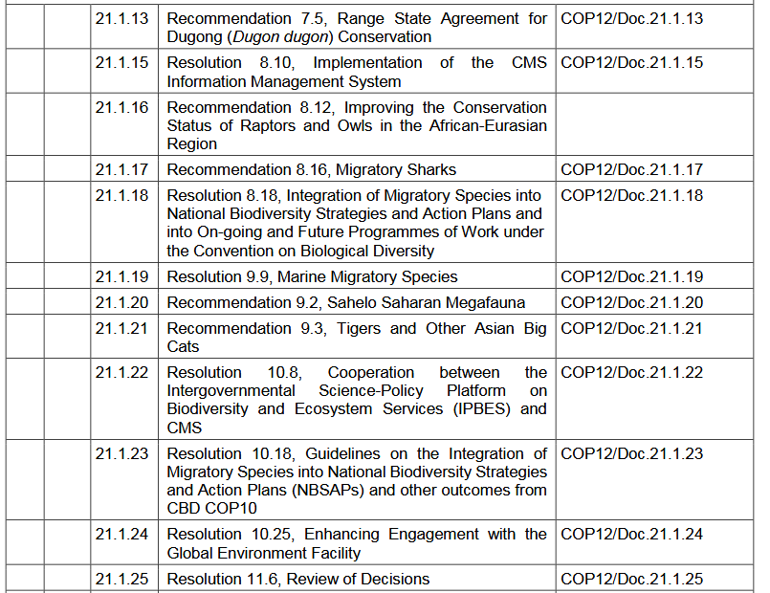

Slide 7
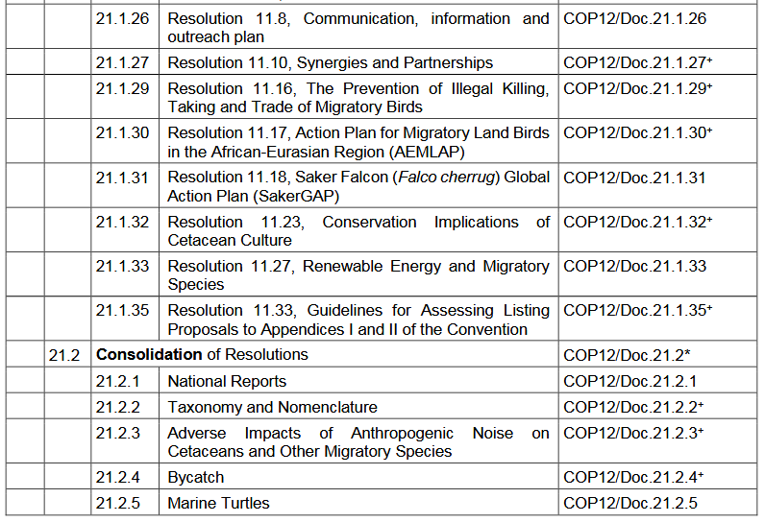

Slide 8
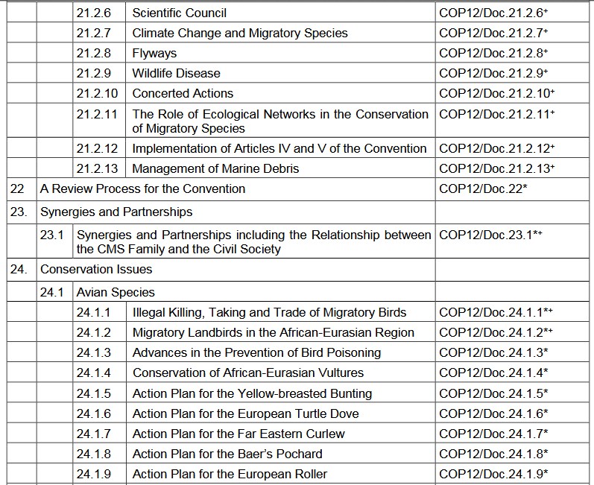

Slide 9
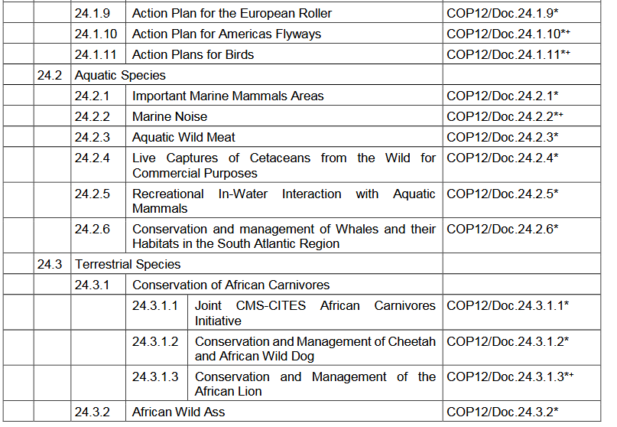

Slide 10
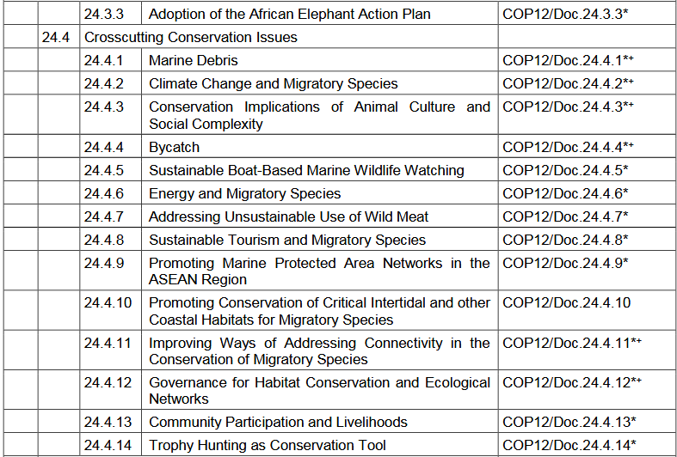

Slide 11
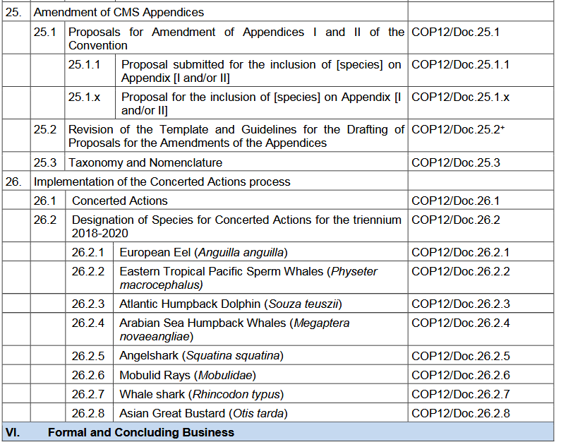

Slide 12
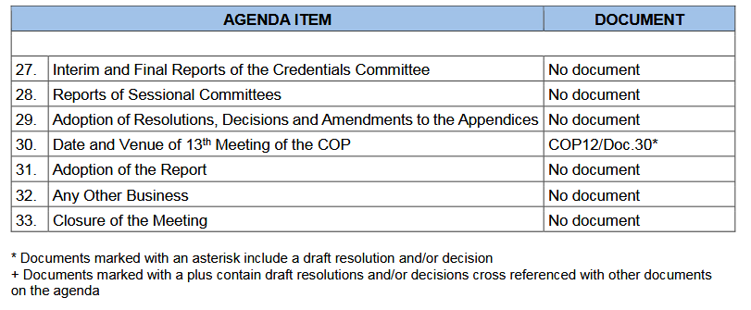

Slide 13
Resolution 11.6: Review of Decisions
Resolution 11.6 established a number of new ways of handling COP documentation:
Repeal of Resolutions and Recommendations
Decisions – in addition to Resolutions
Updating Existing Resolutions at subsequent COPs
Brings CMS in line with CITES document protocols

Slide 14
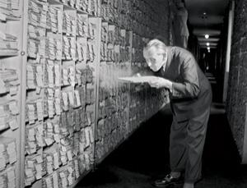
1. Repeal of Resolutions:
Objective: Housekeeping exercise to tidy up all existing Resolutions

Slide 15
1. Repeal of Resolutions:
Repeal in full resolutions that are out of date (Annex 2 of Doc.21)
Partially repeal resolutions that contain some out of date provisions (time-bound instructions) (Doc.21.1)
Consolidate multiple resolutions on the same subject into a single new resolution (repealing redundant provisions) (Doc.21.2)
So that all provisions on the same subject are in the same place.
Eg Bycatch: Res 6.2, Rec 7.2, Res 8.14, Res 9.18, Res 10.14 all consolidated into a single resolution, removing redundancies, completed actions, and out of date provisions.

Slide 16
Repeal of Resolutions:
At present: 178 Resolutions in force, this exercise will significantly reduce this number.
Result: manageable list of Resolutions, all of them relevant to Parties
This will simplify implementation of the Convention for Parties, the Secretariat, ScC and StC.

Slide 17
Mandate and process followed
Res 11.6: To review existing resolutions (and recommendations) and propose which ones (or parts thereof) should be repealed.
Report to StC 45 (2016)
StC45 requested Secretariat to go ahead as proposed and produce drafts for adoption at COP12.
Full history and process contained in Doc.21.
Modified drafts contained in Docs 21.1.x and 21.2.x

Slide 18
2. Decisions – an additional tool
Res 11.6 also created a new instrument; Decisions, as an additional tool to Resolutions.
Resolution – long standing guidance
eg: Urges Parties to enhance transboundary cooperation for the conservation of migratory species.
Decision – time-bound instructions or recommendations
eg: Requests Parties to provide the Secretariat with copies of their national legislation on the management of Migratory species, by COP13.
eg: Instructs the Secretariat to report to StC 48.

Slide 19
3. Updating Existing Resolutions at subsequent COPs
Res 11.6 further recommended that from now on Parties and Secretariat modify existing Resolutions with new provisions rather than creating a new Resolution on the same subject, as had been done in the past.
Eg. Res 11.29 Sustainable Boat-Based Marine Wildlife Watching
Proposed to be updated as: Res 11.29 (Rev.COP12) to include a provision to adopt draft Guidelines on BBWW.

Slide 20
Why do some topics appear twice in the COP agenda?
Topics appearing in both Agenda item 21 and 24 (or 23, 25)
Bycatch
Ocean Noise
Marine Debris
Flyways
Illegal Killing of Birds
Conservation of Land birds
Taxonomy
Climate Change
Ecological Networks
Animal Culture
Scientific Council
Guidelines/template for Listing Proposals (25)
Synergies and Partnerships (23)

Slide 21
Why do some topics appear twice in the COP agenda?
COP 12 Agenda item 21 (Review of Decisions):
No substantive changes, just the housekeeping exercise to remove obsolete provisions
COP 12 Agenda items 23, 24 or 25:
Starts with clean copy of 21.x, the partly repealed or consolidated resolution, and adds new topics, adopts guidelines, or updates existing provisions.
Parties should focus their attention on these modifications, shown in underlined or strikethrough text.
Parties should not seek to reopen previously negotiated text.

Slide 22
Thank you for your attention!
Follow us!
@bonnconvention
#CMSCOP12
@bonnconvention

