Slide 1
Scoreboard to assess the progress in combating illegal killing, taking and trade of wild birds
Umberto Gallo-Orsi
Joint Meeting
Bern SFPs Network – MIKT
Sliema, Malta 22nd - 23rd June 2017

Slide 2
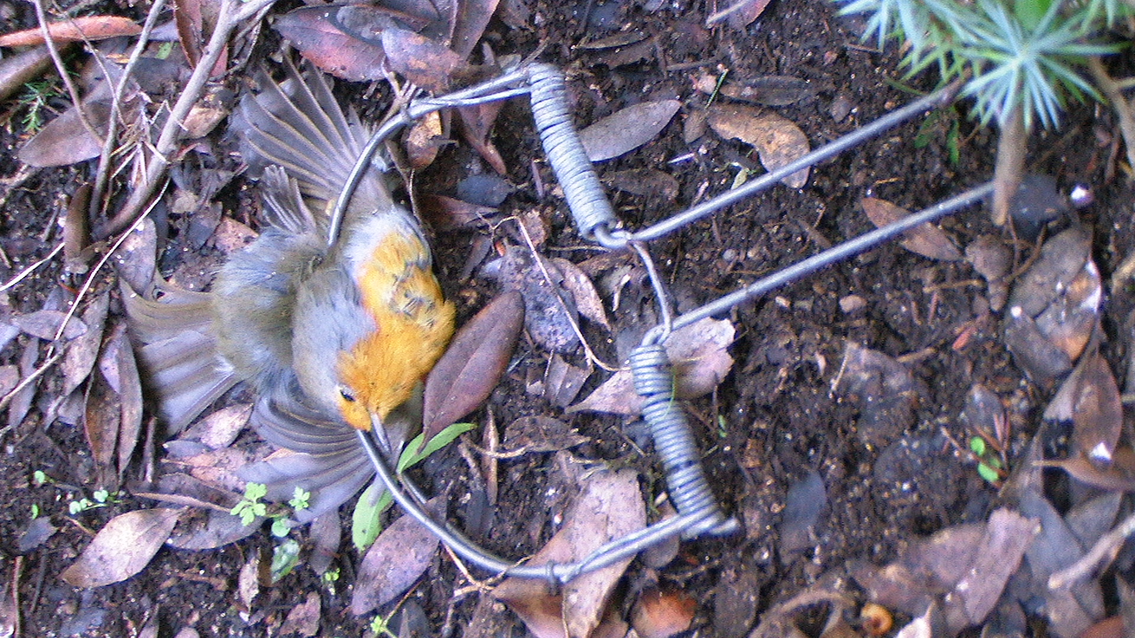
Mandate
Aim
Scope
Harmonization
Indicators
Scoring

Slide 3
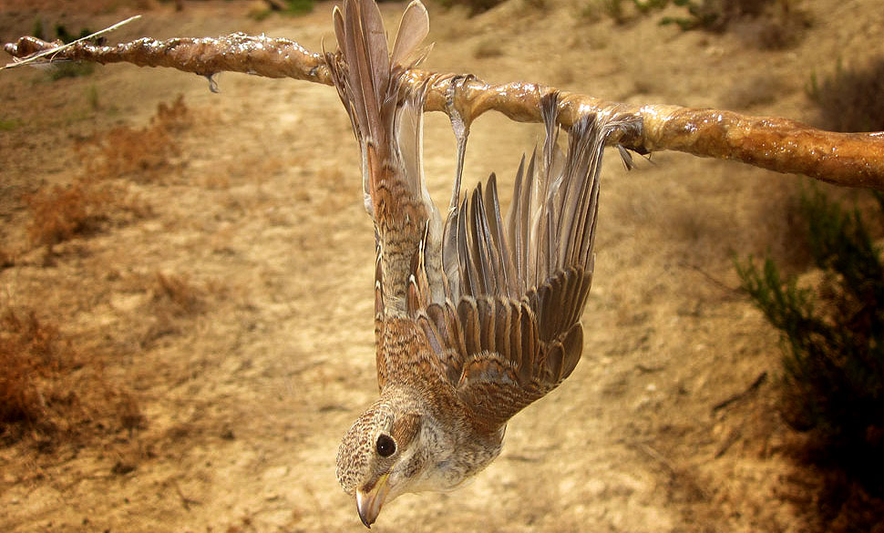
Tunis Action Plan
MIKT PoW
EU Roadmap
EU AP Wildlife Traffiking
Notes:
Over the past few years, the issue of illegal killing of birds (IKB) has became more and more important in the international agenda.
This resulted in a number high profile international instruments and commitments, involving Bern Convention, CMS, CITES and EU
The Bern Convention Tunis Action Plan (TAP), the EU Roadmap on the Eradication of Illegal Killing, Trapping and Trade in Wild Birds, the EU Action Plan Against Wildlife Trafficking and the CMS Mediterranean Task Force on Illegal Killing, Taking and Trade of Migratory Birds (MIKT) are amongst the main examples of such commitments. A common feature of such instruments is that they envisage regular monitoring of progress.

Slide 4
Mandate
MIKT POW 2016 – 2020
Obj. 1.4: Measure progress
Act. 1.4.1 Create a scoreboard to measure and allow benchmarking of concrete progress on eradication of IKB at national level
A mechanism to evaluate IKB ranking of Mediterranean countries is established
Data for the elaboration of the scoreboards is compiled on a regular basis
(10) Progress on implementation of the POW will be monitored at least every three years, including through a scorecard to track national trends in IKB and enforcement measures to eliminate it.
Notes:
The proposal to develop a scoreboard emerged in Cairo at the first MIKT in order to monitor concrete progress on eradication of IKB at national level and was included in the Programme of Work of the MIKT. The progress should be measured at least every 3 years.

Slide 5
Mandate
TAP 2013 – 2020
Monitoring, evaluation, and follow-up to the actions set in the AP
Enforcement and Legal Aspects
Biological and Institutional Aspects
Awareness Aspects
every 2 years since 2015
Notes:
Also the Tunis Action Plan calls for monitoring the activities and their impact. The Contracting Parties should report every 2 years.
The need to develop such a tool to be used jointly by the Bern Convention and the CMS was also raised by the Chair of the Special Focal Points Network of the Bern Convention at the 36th meeting of the Standing committee to the Convention in November 2016. The Standing Committee welcomed the “increased coordination efforts shown in the past year by different organisations, Conventions and stakeholders, aimed to increase synergies in the work of their respective platforms and initiatives, as these efforts support the implementation of the Tunis Action Plan”.

Slide 6
Notes:
The geographical scope of the present document is the entire area covered by the Bern Convention and MIKT. In Orange, the Bern Convention Contracting Parties and members of MIKT; in Red, the Bern Convention Contracting Parties and observers of MIKT; in Green, members of the MIKT and not Contracting Parties to the Bern Convention; in Yellow, other observers of MIKT, and not Contracting Party to Bern Convention.
Observers of MIKT are referred to Interested Parties and/or Non-Parties to CMS (namely, Germany, Portugal, Bosnia-Herzegovina and Turkey).

Slide 7
Aims
Monitoring tool
International recognition
Easy and informative
Notes:
The present IKB Scoreboard proposal is intended to provide the national governments with a tool that, when endorsed by the Bern Convention and CMS, would be an internationally recognized method to provide a tailor-made, objective, fact-based assessment of the current status of illegal killing of birds at national level, and measure the progress of the implementation by States of their commitments related to this area.
This will replace the reporting on the TAP and the MIKT PoW.
IKB is defined for the purpose of this Scoreboard as: those unlawful activities committed intentionally resulting in the death, injury, disturbance or removal of specimens of wild birds from the wild either dead or alive, including their parts or derivatives.
This tool has links with , but is not an action planning tool or a toolkit to identify national priorities.

Slide 8
Beyond monitoring
Show leadership, capacity & transparency
Supports / builds on NAP development process
Resource mobilization (nationally and internationally)
International collaboration / sharing of best practices
Notes:
The most important feature of this tool is that it aims to be more than a reporting system but a way to encourage countries to join efforts, promote good practice to address IKB and centralize this information by both Conventions to assess the progress at regional level.
It offers the national authorities an opportunity to show leadership and the capacity and willingness of being proactive and transparent regarding their efforts to tackle an issue which is far more common than previously recognized.
The process leading to its compilation promotes cooperation and sharing of experience and know-how between governmental bodies and national stakeholders. The cooperation developed among stakeholders and the information gathered for compiling the scoreboard can be the basis for the development of a national action plan.
Furthermore, the IKB Scoreboard provides the opportunity for national administrations, as well as for various stakeholders at national and international level, to raise political profile, commitment and mobilize resources towards the eradication of IKB.
At international level the IKB Scoreboard promotes collaboration and sharing of experience because several countries facing the same obstacles in improving their scores in a particular area may want to work together to define strategies, deliver training and share experiences.

Slide 9
Harmonization
MIKT PoW 2016 - 2020 (10) Progress on implementation of the POW will be monitored at least every three years, including through a scorecard to track national trends in IKB and enforcement measures to eliminate it.
TAP 2013 - 2020
Monitoring, evaluation, and follow-up to the actions set in the AP [...] every 2 years since 2015
Notes:
The MIKT WOP and the TAP can be harmonized by reporting every 2 years.

Slide 10
Annual
 | 2017 |  |  |  | 2018 |  |  |  | 2019 |  |  |  | 2020 |  |  |  | 2021 |  |  |  | 2022 |  |  |  | 2023 |  |  |  | 2024
 | I | II | III | IV | I | II | III | IV | I | II | III | IV | I | II | III | IV | I | II | III | IV | I | II | III | IV | I | II | III | IV | I | II | III | IV
IKB Scoreboard |  |  |  |  |  |  | B |  |  |  | T1 |  |  |  | T2 |  |  |  | T3 |  |  |  | T4 |  |  |  | T4 |  |  |  | T6
TAP
Bern Conv. SC
SFP meeting
MIKT meeting
CMS COP
EU Art 12
Notes:
This graphs shows IKB relevant meeting and reporting needs of the EU, Bern Convention and CMS.
TAP requires a report every 2 year.
The Bern Convention Standing Committee meets yearly and calls for “general reports” on the national implementation of the Convention every four years, on a voluntary basis and biennial reports on exceptions.
The PoW every three years but no clear stat date is defined
Both the SFP and MIKT meet yearly and calls for short reports from the members Both have a major deadline in 2020.
CMS COP takes place every 3 years and require a report
The next EU Art 12 reporting deadline is set for June 2019.

Slide 11
Biennial
 | 2017 |  |  |  | 2018 |  |  |  | 2019 |  |  |  | 2020 |  |  |  | 2021 |  |  |  | 2022 |  |  |  | 2023 |  |  |  | 2024
 | I | II | III | IV | I | II | III | IV | I | II | III | IV | I | II | III | IV | I | II | III | IV | I | II | III | IV | I | II | III | IV | I | II | III | IV
IKB Scoreboard |  |  |  |  |  |  | B |  |  |  |  |  |  |  | T1 |  |  |  |  |  |  |  | T2 |  |  |  |  |  |  |  | T3
TAP
Bern Conv. SC
SFP meeting
MIKT meeting
CMS COP
EU Art 12

Slide 12
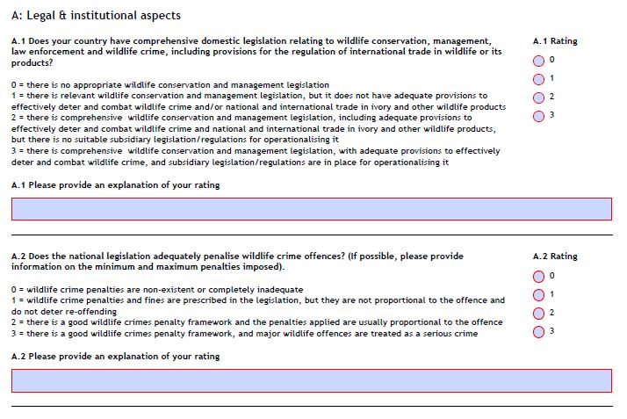
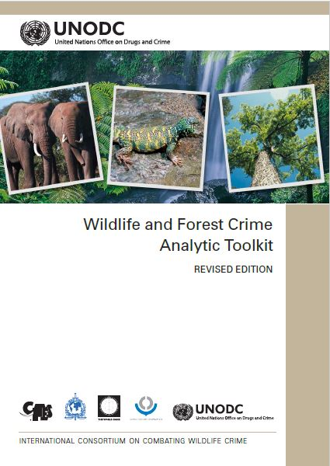
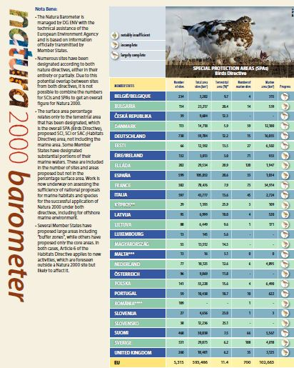
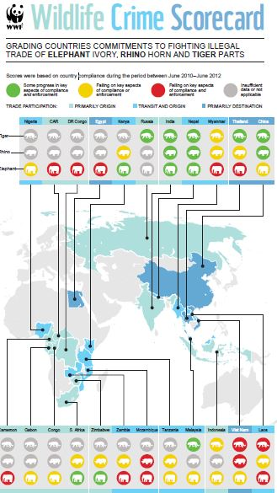
Notes:
During the initial drafting stages, the consultative group looked for inspiration in other tools available, including CITES tool, WWF, EU Natura 2000 Barometer, ICCWC and others. The tool developed by the International Consortium in Combating Wildlife Crime (ICCWC) was taken as a blueprint. It’s important to realize that the scope of IKB scoreboard is very specific and different from ICCWC tool.
The scoreboard therefore does not attempt to replicate or overlap with ICCWC tool, but to provide a specific solution that is tailor-made for IKB specificities. So we are not “reinventing a bicycle” so to say.
The present scoreboard makes use of the format of the ICCWC self assessment tool.
The ICCWC indicators are a more overarching national self assessment tool and the IKB scoreboard as more of a targeted tool to measure and rate the response to IKB.
(The ICCWC pays special attention to international wildlife and timber trade. Since IKB is only a limited component of wildlife crime and the international trade is a limited part of the issue).
(This document stems from Wildlife and Forest Crime Analytic Toolkit which aims at supporting National governments in assessing administrative, preventive and criminal justice responses to wildlife and forest crime. The only country within the geographic scope of the present exercise that has just started to use the ICCWC Toolkit is Bosnia Herzegovina. The ICCWC indicators framework includes 50 indicators organized in 8 outcomes. The Toolkit has 151 tools organized in 5 areas)

Slide 13
A. National monitoring of IKB 4 indicators
B. Comprehensiveness of national legislation
8 indicators
C. Enforcement response
6 indicators
D. Prosecution and sentencing
4 indicators
E. Prevention
5 indicators
Notes:
The IKB indicators are organised in 5 areas (Groups) for a total of 28 indicators.
The areas assess the quality of legislation, the effectiveness and capacity of the Enforcement of existing legislation, the effectiveness of the prosecution and sentencing. A fourth group looks at other actions which should be part of an integrated approach to address IKB. Group A aims at monitoring the level of IKB in each country.

Slide 14
Process
Planning
Data Collection
Analysis and recording
Reporting, peer review & aggregation
Notes:
The proposed process foresees the establishment of a Team with a clearly defined lead agency. The team should involve from the early stages all stakeholders and experts in order to ensure agreed inputs into the indicators matrix.
Although the report is at national level, sub-national administrations may need to be involved or consulted while carrying out the assessment.
The data required fro the indicators should be identified and agencies custodians of the data should be formally requested as soon as possible. Once the data and documentation are available and reviewed its is suggested to hold a workshop to complete the assessment.
A final analysis will assess the scores and identify possible process improvements.
Once the results are sent to the Bern Convention and CMS Secretariats it is proposed that the data will be aggregate and peer reviewed by the representative of the Bern Convention SFP Network and MIKT. Comments will be considered only if properly substantiated.
The Secretariats will eventually publish the final Scoreboard and the national reports.

Slide 15
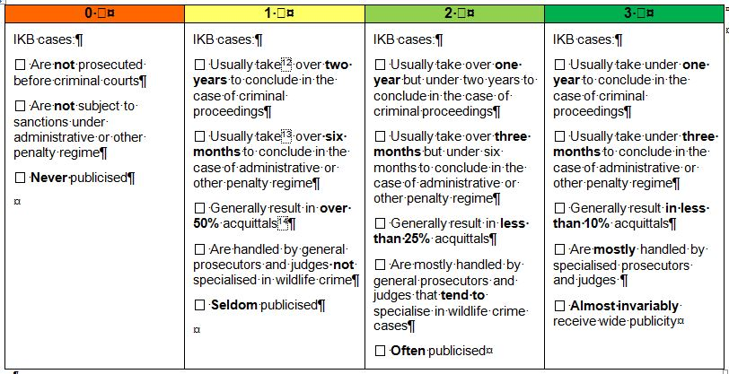
Notes:
Examples also clarify how to score each indicators also in the case of split results or lack of agreement.
The report is a National report and therefore sub-national administrations may need to be involved or consulted while carrying out the assessment.
For each indicators compilers are requested to fill the ‘comments’ space clarifying methods, challenges and uncertainties of the at provided or replies given.

Slide 16
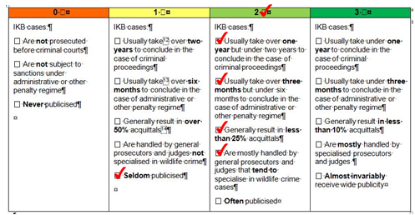
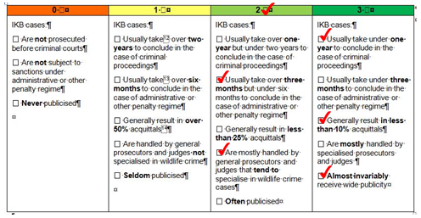

Slide 17
National monitoring of IKB
Data management of scope and scale of IKB
B. Comprehensiveness of national legislation
C. Enforcement response
Preparedness of law enforcement bodies and coordination of national institutions
D. Prosecution and sentencing
Effectiveness of judicial procedures
E. Prevention
Other instruments used to address IKB

Slide 18
National monitoring of IKB
Data management of scope and scale of IKB
B. Comprehensiveness of national legislation
C. Enforcement response
Preparedness of law enforcement bodies and coordination of national institutions
D. Prosecution and sentencing
Effectiveness of judicial procedures
E. Prevention
Other instruments used to address IKB

Slide 19
1. Extent of IKB cases known to justice
The extent to which data on illegal activities at national level are available.
Are data on the status and scale of IKB cases available and are they analysed?
0 􀜆 | 1 􀜆 | 2 􀜆 | 3 􀜆
􁃱 Data on IKB cases number and distribution are not available. 􁃱 Data on IKB cases number and distribution are available but have not been used to assess IKB scale and distribution. | 􀜆 National estimate on numbers and distribution of cases of IKB is based entirely on expert opinion / modelling / other indirect methods | 􀜆 National estimates on the scale and distribution of cases of IKB are extrapolated on the basis of partial IKB disclosed crime statistics | 􁃱 National data on IKB cases are available and is based on official and comprehensive IKB crime disclosure statistics.
Notes:
This indicator looks at data availability and quality regarding prosecuted cases of IKB. It refers specifically to the number of cases subjected to either criminal or administrative prosecution.

Slide 20
2. Number of IKB cases prosecuted in the last year
The extent of cases of IKB prosecuted in the last year
How many IKB cases have been prosecuted in the last year in your country?
Category of IKB offence | Number of persons prosecuted in the last year | Number of bird specimens involved in the offence (specimens seized)
Illegal killing of protected birds (shooting, poisoning, other methods of killing)
Illegal taking of protected birds (trapping using any means)
Illegal possession of live / dead protected birds
Illegal importation or transport of live / dead protected birds
Illegal taxidermy of protected birds
Illegal trade in protected birds (including trafficking for sale, marketing for sale of any live or dead protected birds or their parts)
Serving / offering of protected species in restaurants
Use of prohibited methods of hunting (bird callers, snares, nets, lights, gas, etc)
Illegal hunting outside open season or during unpermitted hours
Hunting without a license, breach of license conditions (e.g. exceedance in hunting quotas, failure to report birds caught, etc)
Hunting in prohibited areas (game reserves)
Deliberate disturbance to nests, breeding grounds, removal of eggs
Total
Notes:
Indicator no. 2 aims at collect data on the type of cases and the number of people and birds involved in Illegal activities. The definition of IKB is: “Those unlawful activities committed intentionally resulting in the death, injury, disturbance or removal of specimens of migratory birds from the wild either dead or alive, including their parts or derivatives”.
The list includes activities that in some countries are legal (eg. Hunting without a licence): iIn such cases no prosecution takes place.
To fill the table respondents should indicate the number of cases of IKB-related offences for each offence category disclosed over the past year (or last year from which data are available) as well as, wherever applicable, the number of bird specimens involved in the offence. (“Unlawful” means for this purpose infringing national, regional or international law.
In case an offence was committed by a group of persons, the number of offences to be reported in the second column of the table should be multiplied by the number of persons involved / prosecuted for that offence.
In case a single person faced multiple charges for different offence categories (for instance illegal killing of a protected bird and using prohibited methods of hunting), such case should be reported under each offence category for which that person has been charged / prosecuted.
“Disturbance” refers for this purpose to any disturbance on the breeding and rearing grounds or during their journeys to them.
“Specimen” means an animal whether dead or alive
“Disclosed” implies cases of IKB offences where sufficient material evidence was collected to enable identification of suspects and prosecution of the offence in accordance with the applicable criminal or administrative proceedings. )

Slide 21
3. Status and scale of IKB
The extent to which data on illegal activities at national level are available.
Has bird mortality due to IKB been estimated?
0 􀜆 | 1 􀜆 | 2 􀜆 | 3 􀜆
􁃱 Data on number of bird mortality due to IKB are not available. | 􀜆 National estimate on annual bird mortality due to IKB is based on expert opinion and anecdotal information. | 􀜆 National estimate on annual bird mortality due to IKB is based partially on quantitative data and records and partially on estimates and extrapolation. | 􁃱 National estimates on annual bird mortality due to IKB is based largely on quantitative data and records.

Slide 22
4. Number, distribution and trend of illegally killed, trapped or traded birds
The extent, trend, seasonal and geographic distribution of illegally killed birds in your country including overseas territories.
How many birds and in which season are estimated to be illegally killed, trapped or traded every year in your country including overseas territories?
What is the trend?
 | Spring | Summer | Autumn | Winter | Total
National level

Slide 23
National monitoring of IKB
data management of scope and scale of IKB
B. Comprehensiveness of national legislation
C. Enforcement response
preparedness of law enforcement bodies and coordination of national institutions
D. Prosecution and sentencing
effectiveness of judicial procedures
E. Prevention
other instruments used to address IKB

Slide 24
5. National wildlife legislation
The comprehensiveness of national legislative provisions in force for wildlife conservation, management and use, including prohibition of IKB
Is there comprehensive national legislation for wildlife conservation, management and use, including provisions for the regulation of international trade in wildlife or its products?
0 􀜆 | 1 􀜆 | 2 􀜆 | 3 􀜆
National wildlife legislation: 􀜆 Has not been enacted | National wildlife legislation: 􀜆 Does not have adequate provisions to deter and combat IKB 􀜆 Is not supported by suitable subsidiary legislation and/or regulations | National wildlife legislation: 􀜆 Has adequate provisions to deter and combat IKB. 􀜆 Is not supported by suitable subsidiary legislation and/or regulations | National wildlife legislation: 􀜆 Has adequate provisions to deter and combat IKB 􀜆 Is supported by suitable subsidiary legislation and/or regulations

Slide 25
6. Hunting legislation
The comprehensiveness of national legislation concerning sustainable use of wildlife.
Through which measures and controls do the national legislations regulate the killing and taking of wild birds?
0 􀜆 | 1 􀜆 | 2 􀜆 | 3 􀜆
National legislation: 􀜆 Does not specifically regulate hunting of birds from conservation / sustainable use points of view. Some legislation concerning hunting of birds may exist, however it mainly addresses the activity from arms control / public safety points of view and does not delve into wildlife conservation issues | National legislation: 􀜆 Concerning hunting exists and sets basic parameters that apply to various huntable species including birds: 􀜆 Establishes and defines hunting seasons 􀜆 Lists species that can be hunted 􀜆 Regulates methods of hunting | National legislation: 􀜆 Concerning hunting exists separately from national legislation concerning conservation of wildlife and lays down comprehensive provisions concerning: 􀜆 Establishing and defining hunting seasons 􀜆 Listing species that can be hunted 􀜆 Defining hunting areas. 􀜆 Regulating and defining which methods are allowed for hunting 􀜆 Providing for effective licensing mechanism and criteria for obtaining a hunting licence 􀜆 Establishing bag limits and quotas for huntable species 􀜆 Providing for basic hunting bag reporting requirements 􀜆 Controls related to implementation | National legislation: 􀜆 Concerning hunting is fully integrated within national conservation of wildlife legislation therefore ensuring the taking into account of biological and conservation aspects in hunting-related decisions and lays down comprehensive provisions concerning: 􀜆 Establishment and definition of hunting seasons 􀜆 Listing species that can be hunted 􀜆 Definition of hunting areas 􀜆 Regulation and definition of which methods are allowed for hunting 􀜆 Provision for appropriate licensing mechanism and criteria for obtaining a hunting license, including requirements for compulsory examination of hunting license applicants 􀜆 Establishment of bag limits and quotas for huntable species on the basis of biological and conservation considerations 􀜆 Provision for the timely collection of hunting bag data and reporting mechanisms 􀜆 Controls related to implementation, including enforcement (for instance providing enforcement powers to game wardens, park rangers, hunting marshals etc)
Notes:
Legislation concerning protection of wildlife is very often intimately related to legislation concerning its use, including through hunting.
The indicator looks at how comprehensive and detailed the hunting legislation is, because a good law is a clear law which does not leaves ‘grey areas’ with space for interpretation or misunderstanding.
A law with clearly defined seasons, list of game species, timing, places, methods allowed and not, based on scientific data and with effective provisions for reporting and controls will not put hunters at risk of being prosecuted due to different interpretations of the law. Such law will also, ensure that the prosecutors have a strong legal basis to fight illegal activities.

Slide 26
7. Prohibitions under national legislation
The extent of activities forbidden under national legislation
To what extent are activities related to the killing of wild birds prohibited under national law?
0 􀜆 | 1 􀜆 | 2 􀜆 | 3 􀜆
National legislation does not generally forbid: 􀜆 Deliberate killing of wild birds 􀜆 Taking of wild birds 􀜆 The use of means such as nets, traps, lime sticks, sound-devices, etc for capturing birds 􀜆 Disturbance of any kind during periods of rearing and reproduction 􀜆 Taxidermy 􀜆 Possession of live or dead wild birds or their parts 􀜆 Importation or transport of wild birds or their derivatives 􀜆 Sale of wild birds | National legislation generally prohibits: 􀜆 Deliberate killing of wild birds 􀜆 Taking of wild birds | National legislation generally prohibits: 􀜆 Deliberate killing of wild birds 􀜆 Taking of wild birds 􀜆 Disturbance of any kind during periods of rearing and reproduction 􀜆 Taxidermy | National legislation generally prohibits: 􀜆 Deliberate killing of wild birds 􀜆 Taking of wild birds 􀜆 The use of means such as nets, traps, lime sticks, sound-devices, etc. for capturing birds 􀜆 Disturbance of any kind during periods of rearing and reproduction 􀜆 Taxidermy 􀜆 Possession of live or dead wild birds or their parts 􀜆 Importation or transport of wild birds or their derivatives 􀜆 Sale of wild birds

Slide 27
8. Exceptions under national legislation
The extent of regulatory scrutiny concerning any authorisation of exemptions
To what extent does national law make it possible to authorize and regulate exemptions from the general prohibitions outlined in the previous question?
0 􀜆 | 1 􀜆 | 2 􀜆 | 3 􀜆
National law: 􀜆 Makes it possible for authorization of exemptions involving any or some activities that are generally prohibited under national legislation 􀜆 Does not include specific criteria or processes for granting / monitoring such exemptions are prescribed in the national law | National law: 􀜆 Makes it possible for authorization of exemptions involving some of the activities generally prohibited under national legislation 􀜆 Defines the basic criteria upon which such exemptions can be granted by the responsible authority; however such criteria for granting exemptions do not fully correspond to the criteria for exemptions stipulated in Bern Convention / CMS / EU Birds Directive (for EU MS only) 􀜆 Does not include specific regulatory mechanism for monitoring / reporting upon exemptions granted | National law: 􀜆 Makes it possible for authorization of exemptions involving some of the activities generally prohibited under national legislation 􀜆 Defines comprehensive criteria upon which such exemptions can be granted by the responsible authority; such criteria fully correspond to the criteria for exemptions stipulated in Bern Convention / CMS / EU Birds Directive (for EU MS only) 􀜆 Does not include specific regulatory mechanism for monitoring / reporting upon exemptions granted | National law: 􀜆 Makes it possible for authorization of exemptions involving some of the activities generally prohibited under national legislation 􀜆 Defines comprehensive criteria upon which such exemptions can be granted by the responsible authority; such criteria fully correspond to criteria for exemptions stipulated in Bern Convention / CMS / EU Birds Directive (for EU MS only) 􀜆 Establishes, for each exemption granted on an annual basis, a specific regulatory mechanism that ensures strict supervision of compliance, monitoring and reporting 􀜆 Requires that data on all exemptions granted, is compiled on an annual basis and is publically available including information on affected species, number of specimens, justification, the responsible authorities, permitting and licensing procedures, compliance monitoring and supervision
Notes:
Indicator 8
Under the EU the Bern Convention (in both cases under Art. 9) and CMS (Art III.5) exceptions are possible.
Therefore national exceptions have to ensure that regime governing their authorization and supervision is sufficiently robust.
The aim of this particular indicator is to measure the robustness of such national regimes for granting any exceptions, and not to offer value judgment on the exceptions themselves.

Slide 28
9. Sanctions and penalties
The extent to which penalties for IKB are comprehensive
Which penalties and sanctions are imposed by law regarding the killing and taking of wild birds and their use and trade?
0 􀜆 | 1 􀜆 | 2 􀜆 | 3 􀜆
National legislation: 􀜆 Does not specifically define IKB-related offences and does not foresee specific penalties for such offences 􀜆 Does not specifically penalize IKB-related offences unless these are coupled with breaches of other legislation such as arms control laws | National legislation: 􀜆Provides basic definition of IKB-related offences that encompasses illegal killing, trapping and trade of wild birds 􀜆 Stipulates maximum penalties for most IKB-related offences but does not stipulate a minimum penalty 􀜆 Provides for a limited spectrum of criminal and administrative sanctions including: 􀜆 Fines 􀜆 Imprisonment (usually suspended jail terms in the most severe cases IKB) 􀜆 Suspension of license. 􀜆 Confiscation of corpus delicti | National legislation: 􀜆 Provides a comprehensive definition of specific IKB-related offences that encompasses illegal killing, trapping, trade, possession, transport, importation and taxidermy of wild birds 􀜆 Stipulates both the minimum and a maximum penalty for some categories of offences 􀜆 Provides for a wide spectrum of criminal and administrative sanctions including: 􀜆 Fines 􀜆 Imprisonment (usually suspended jail terms in the most severe cases IKB) 􀜆 Suspension of license. 􀜆 Confiscation of corpus delicti 􀜆 Permanent revocation of licence 􀜆 Community service 􀜆 Other sanctions | National legislation: 􀜆 Provides a comprehensive definition of specific IKB-related offences that encompasses illegal killing, trapping, trade, possession, transport, importation and taxidermy of wild birds 􀜆 Stipulates both the minimum and a maximum penalty for all offence categories except those where a level of penalty is fixed permanently in the law 􀜆 Provides for a full spectrum of criminal and administrative sanctions including: 􀜆 Fines 􀜆 Imprisonment (both effective and suspended jail terms are usually automatic for the most severe cases of IKB) 􀜆 Suspension of license 􀜆 Permanent revocation of license in the case of IKB involving highly protected birds 􀜆 Confiscation of corpus delicti 􀜆 Community service 􀜆 Other sanctions
Notes:
Sanctions and penalties are the ‘teeth’ of the law. A good law clearly defines the offenses and offers a full range of sanctions, both criminal and administrative. Indicator 9 explores whether the offences are clearly defined, and the extent of sanctions in place.

Slide 29
10. Proportionality of penalties
The extent to which severity of IKB cases is reflected in the relevant national legislation
Does national legislation adequately penalize IKB offences?
0 􀜆 | 1 􀜆 | 2 􀜆 | 3 􀜆
Penalties for IKB: 􀜆 Only make provision for administrative penalties (e.g. fines, bans, suspensions) 􀜆 Are not proportional to the nature and severity of IKB 􀜆 Are inadequate as they do not provide an effective deterrent | Penalties for wildlife crime: 􀜆 Are prescribed in legislation and provide for criminal prosecution 􀜆 Do not differentiate offences on the basis of gravity factors, leaving a wide margin of judiciary discretion in the determination of the magnitude of penalties meted out 􀜆 Are inadequate as they do not provide an effective deterrent | Penalties for wildlife crime: 􀜆 Are prescribed in legislation and provide for criminal prosecution 􀜆 Provide a penalty structure that somewhat reflects severity of offences on the basis of basic gravity factors; however leaving a wide margin for judiciary discretion 􀜆 Are generally seen as providing an adequate and proportionate deterrent for most cases of IKB | Penalties for wildlife crime: 􀜆 Are prescribed in legislation and provide for criminal prosecution 􀜆 Fully reflect severity of offences on the basis of gravity factors recommended as part of Bern Convention Tunis Action Plan 􀜆 Are generally seen as providing an adequate and proportionate deterrent for all IKB cases, as evidenced through sustained IKB crime decline (sustained decline in IKB cases observed over at least 3 years) 􀜆 Treat wildlife crime offences involving organized criminal groups as serious crime carrying a minimum term of four years imprisonment
Notes:
The Bern Convention Recommendation N° 177 (2015) s calls for the use of the gravity factors and sentencing principles for the evaluation of IKB.
Although measuring and estimating the effects of criminal sanctions on subsequent criminal behaviour is very complex and there is no agreement on the deterrence of sanctions on criminal behaviours, it is clear that a link between severity of the crime has to be linked with an adequate and proportional sentence. This indicator aims at assessing the adequacy of the law, not the effectiveness of the judicial system (which has also an impact on the deterrence of a law). It is therefore a matter of expert opinion, but should be backed by facts to be reported in the ‘comments’ section.

Slide 30
11. Use of criminal law
The extent to which a combination of relevant national legislation and criminal law are used to prosecute IKB in support of legislation enacted to combat wildlife crime.
Are IKB cases prosecuted under a combination of relevant national legislation and criminal law in support of legislation enacted to combat wildlife crime, to ensure that wherever possible and appropriate offenders are charged and tried under relevant laws that carry the highest penalties?
0 􀜆 | 1 􀜆 | 2 􀜆 | 3 􀜆
Relevant criminal law: 􀜆 Cannot be applied to IKB offences 􀜆 IKB cases are either not penalized at all or are penalized only administratively | Relevant criminal law: 􀜆 Is rarely applied to IKB crime cases 􀜆 Most IKB cases except the most severe are penalized administratively 􀜆 Wherever criminal law is evoked in the most severe IKB cases, this usually stems from laws unrelated to wildlife conservation, such as arms control or public safety laws | Relevant criminal law: 􀜆 Is sometimes applied to IKB crime cases 􀜆 Generally describes which IKB-related offence categories are subject to criminal liability and which categories are subject to administrative sanctions | Relevant criminal law: 􀜆 Is usually applied in most IKB crime cases, as required 􀜆 Clearly describes offence categories that are subject to criminal as opposed to administrative liability 􀜆 Is supported by mechanisms that harmonize wildlife and other key domestic legislation such as criminal law
Notes:
Wildlife and Hunting Legislation penalties often do not take into considerations that the illegal activities results in significant economic gain for the those who commit the crimes. Often the criminal activities break criminal laws as well. It is important that person arrested for involvement in IKB are charged and tried – whenever possible and appropriate - with a combination of relevant criminal law that carry higher penalties that the Wildlife protection legislation.

Slide 31
12. Organized crime legislation
The extent to which specific legislation to address organized crime is used to combat IKB
How is national legislation to address organized crime being used in the investigation and prosecution of IKB?
0 􀜆 | 1 􀜆 | 2 􀜆 | 3 􀜆
National legislation on organized crime 􀜆 Has not been enacted 􀜆 Cannot be used for prosecuting IKB | National legislation on organized crime 􀜆 Is in place but is rarely used in IKB cases prosecution 􀜆 Does not have provision for special investigation methods | National legislation on organized crime 􀜆 Is in place and is sometimes used in IKB cases 􀜆 Special investigation methods used for organized crime are not available for IKB cases | National legislation on organized crime 􀜆 Is in place and used as appropriate in IKB cases 􀜆 Special investigation methods used for organized crime are applied also to IKB cases
Notes:
The United Nations Convention against Transnational Organized Crime defines an organized criminal group as a structured group of three or more persons, existing for a period of time and acting in concert with the aim of committing one or more serious crimes or offences established in accordance with the Convention, in order to obtain, directly or indirectly, a financial or other material benefit. As for the previous indicator also this, No. 12, assesses how the use of organized crime Legislation is used in IKB cases.

Slide 32
13. Transposition of international law and commitments into national legislation
The comprehensiveness of national legislative provision to transpose international commitments related to IKB to which the State is party.
To what extent the national legislation transposes the commitment regarding IKB made by joining the Convention of Migratory Species, the Bern Convention and the EU?
0 􀜆 | 1 􀜆 | 2 􀜆 | 3 􀜆
The country: 􀜆 Is not a member of CMS 􀜆 Is not a member of Bern | National legislation for CMS: 􀜆 Has not been enacted. National legislation for Bern Convention: 􀜆 Has not been enacted 􀜆 EC has open infringement procedures related to incorrect / incomplete transposition of the EU Birds Directive or any legal provisions stemming from EU’s ratification of Bern / CMS Conventions related to birds into national law | 􀜆 CMS commitments regarding the fight against IKB have been partially transposed into the existing national legislation 􀜆 Bern Convention commitments regarding the fight against IKB have been partially transposed into the existing national legislation 􀜆 The country has pending / unresolved case files / complaints under Bern Convention related to incorrect or incomplete transposition of the provisions of the Convention into national law 􀜆 No open infringement procedures exist related to incorrect / incomplete transposition of the EU Birds Directive or any legal provisions stemming from EU’s ratification of Bern / CMS Conventions related to birds into national law | 􀜆 CMS commitments regarding the fight against IKB have been fully transposed into the existing national legislation 􀜆 Bern Convention commitments regarding the fight against IKB have been fully transposed into the existing national legislation 􀜆 The country has no pending / unresolved case files / complaints under Bern Convention related to incorrect transposition of the provisions of the Convention into national law 􀜆 No open infringement procedures exist related to incorrect / incomplete transposition of the EU Birds Directive or any legal provisions stemming from EU’s ratification of Bern / CMS Conventions related to birds into national law²¹
Notes:
Indicator 13 assesses whether the international commitments have been made (by signing into international treaties) and transposed into national legislation. The reference to international assessment procedure such as infringement procedures and case files offers strength to the self –assessments.

Slide 33
National monitoring of IKB
data management of scope and scale of IKB
B. Comprehensiveness of national legislation
C. Enforcement response
preparedness of law enforcement bodies and coordination of national institutions
D. Prosecution and sentencing
effectiveness of judicial procedures
E. Prevention
other instruments used to address IKB
Notes:
The next group of 6 indicators looks at the enforcement of the national and international legislation.

Slide 34
14. National Action Plan for combating IKB
The existence of a national strategy or action plan for IKB.
Is there a national action plan to tackle IKB?
0 􀜆 | 1 􀜆 | 2 􀜆 | 3 􀜆
A national IKB action plan: 􀜆 Has not been developed 􀜆 IKB is not covered by any other relevant enforcement strategies or action plans | A national IKB action plan: 􀜆 is in the process of being developed 􀜆 IKB is covered by other relevant enforcement strategies or action plans | A national IKB action plan: 􀜆 Has been developed 􀜆 Has been adopted by some relevant national enforcement agencies 􀜆 Is not actively implemented by all relevant enforcement agencies 􀜆 Has not been regularly updated | A national IKB action plan: 􀜆 Has been developed 􀜆 Has been adopted by all relevant national enforcement agencies 􀜆 Is actively implemented by all relevant enforcement agencies 􀜆 Is being monitored and reviewed to ensure it remains up to date
Notes:
The national action Plan is a action the MIKT Programme of Work (1.1). The development of such document will help in identify the priorities and build a constituency of stakeholders and as mentioned earlier has direct links with this self-assessment.

Slide 35
15. Enforcement priority
The recognition of combating wildlife crime as a high priority for national law enforcement agencies.
Is combating IKB identified as a high priority for national law enforcement agencies?
0 􀜆 | 1 􀜆 | 2 􀜆 | 3 􀜆
IKB crime: 􀜆 Is rarely identified as a high priority among national law enforcement agencies | IKB crime: 􀜆 Is sometimes identified as a high priority among national law enforcement agencies | IKB crime: 􀜆 Is usually identified as a high priority among national law enforcement agencies 􀜆 Has not been formally adopted and/or acknowledged as a high priority | IKB crime: 􀜆 Is usually identified as a high priority among national law enforcement agencies 􀜆 Has been formally adopted and/or acknowledged as a high priority
Notes:
In order to ensure proper enforcement by Police forces IKB needs to be recognized as a priority.
This action is included in the Tunis Action Plan (Identification of national priorities)

Slide 36
16. Stakeholders and policy-making
The level of stakeholder participation to IKB-related policy-making
To what extent and through which means are stakeholders involved in policy-making to address IKB
0 􀜆 | 1 􀜆 | 2 􀜆 | 3 􀜆
Stakeholders’ participation: 􁃱 Is limited and informal 􁃱 Largely limited to information of the policies that will be developed | Stakeholders’ participation: 􀜆 Is limited to consultation 􀜆 Is achieved through ad hoc meetings as no formal committee is established 􀜆 Is achieved via consultation with academics through the national wildlife agency (or similar technical body) | Stakeholders’ participation: 􀜆 Ensures that their inputs are treated as advise and are taken into consideration in the policy-making process 􀜆 Is achieved through formal structures and committees which meets infrequently 􀜆 Is incomplete as one or more stakeholders’ group is not involved or willing to participate | Stakeholders’ participation: 􀜆 Ensures that they are considered as equal policy makers, although the final decision remains in the political domain 􁃱 is ensured by formal structures and committees that meet with the appropriate frequency 􁃱 Is complete as all stakeholders are involved
Notes:
Extensive and comprehensive stakeholders involvement and engagement is crucial to ensure ownership in the processes of priority setting, national action planning and enforcement.

Slide 37
17. Staffing and recruitment
The level of staff resources in national law enforcement agencies to combat wildlife crime.
What staff resources do national law enforcement agencies have to combat IKB
0 􀜆 | 1 􀜆 | 2 􀜆 | 3 􀜆
Law enforcement agencies: 􀜆 Are significantly under-staffed 􀜆 Are rarely able to recruit and/or attract additional staff | Law enforcement agencies: 􀜆 Sometimes have a full complement of staff 􀜆 Usually experience staffing and/or skills shortages 􀜆 Usually experience recruitment delays and/or difficulties | Law enforcement agencies: 􀜆 Usually have a full complement of staff, although it has not always kept up with changing wildlife crime trends 􀜆 Sometimes experience staffing and/or skills shortages 􀜆 Sometimes experience delays in recruitment and/or difficulties attracting suitably qualified candidates | Law enforcement agencies: 􀜆 Usually have a full complement of staff, which has generally kept up with changing wildlife crime trends 􀜆 Usually have an appropriate mix of staff and skills 􀜆 Usually process recruitment vacancies as they arise with suitably-qualified candidates
Notes:
An assessment of enforcement capacities (Not actual effort) requires a basic stocktaking of the human resources available to police IKB and Wildlife in general.
Staffing includes factors such as whether there is an appropriate mix of full-time, part-time and casual staff; experienced and less experienced staff; and professional, technical, investigative and administrative staff as needed to discharge the required activities.
Whether the staff level is sufficient of not is matter of expert opinion. Evidence and rational should be given in the ‘Comments’ section.

Slide 38
18. Specialized training
The percentage of enforcement officers trained in IKB-related aspects.
How many of the enforcement officers have received training in IKB-related aspects?
0 􀜆 | 1 􀜆 | 2 􀜆 | 3 􀜆
􀜆 None | 􀜆 Less than 10% | 􀜆 Less than 50% | 􀜆 More than 50%
Notes:
it is crucial that staff at all levels be adequately trained and skilled to meet the many challenges and hazards associated with combating IKB.
If the alleged IKB offence is investigated by officers not sufficiently familiar with the relevant background, techniques, processes and legal requirements, it is possible that the integrity of the investigations may be compromised, with potential implications for subsequent prosecutions
and trials.

Slide 39
19. Field enforcement effort
The intensity of efforts devoted by law enforcement agencies to combat IKB.
How many person/days per year have law enforcement agencies invested to combat IKB?
Notes:
The policing effort is a crucial statistic to measure the effort a State is putting into fighting IKB. There is no ‘ideal’ policing effort as it will need to be proportionate with the size and severity of the IKB issue in each country and in general density of crime is linked with many factors including Human population density and size of the country. So this is a ‘Data’ indicator which will not generate a score but will allow monitor national progress over time.
Along side data respondent are requested to provide explanation on how the figures were generated and the source of the information.

Slide 40
National monitoring of IKB
data management of scope and scale of IKB
B. Comprehensiveness of national legislation
C. Enforcement response
preparedness of law enforcement bodies and coordination of national institutions
D. Prosecution and sentencing
effectiveness of judicial procedures
E. Prevention
other instruments used to address IKB
Notes:
The fourth group of indicators attempts to measure the effectiveness of the judiciary system in dealing with IKB.
Even if the capacity to detect and investigate wildlife and forest offences is high, the potential deterrent effects of prosecutions
are close to non-existent so long as the judicial system is weak and not effective.

Slide 41
20. Quality of judicial processes
Effectiveness and efficiency of administration of sanctions for IKB offences
Are sanctions for IKB-related offences administered effectively and efficiently?
0 􀜆 | 1 􀜆 | 2 􀜆 | 3 􀜆
IKB cases: 􀜆 Are not prosecuted before criminal courts 􀜆 Are not subject to sanctions under administrative or other penalty regime 􀜆 Never publicized | IKB cases: 􀜆 Usually take over two years to conclude in the case of criminal proceedings 􀜆 Usually take over six months to conclude in the case of administrative or other penalty regime 􀜆 Generally result in over 50% acquittals 􀜆 Are handled by general prosecutors and judges not specialized in wildlife crime 􀜆 Seldom publicized | IKB cases: 􀜆 Usually take over one year but under two years to conclude in the case of criminal proceedings 􀜆 Usually take over three months but under six months to conclude in the case of administrative or other penalty regime 􀜆 Generally result in less than 25% acquittals 􀜆 Are mostly handled by general prosecutors and judges that tend to specialize in wildlife crime cases 􀜆 Often publicized | IKB cases: 􀜆 Usually take under one year to conclude in the case of criminal proceedings 􀜆 Usually take under three months to conclude in the case of administrative or other penalty regime 􀜆 Generally result in less than 10% acquittals 􀜆 Are mostly handled by specialized prosecutors and judges 􀜆 Almost invariably receive wide publicity
Notes:
Effective sentencing is the result of a rapid trial, implemented on well documented cases presented and judged by specialized prosecutors. If the results are well publicized the sentence is likely to have an impact on public opinion and potential offenders.

Slide 42
21. Sentencing guidelines
The existence of national guidelines for the sentencing of offenders convicted for wildlife crime.
Are there clearly-defined national guidelines for the sentencing of offenders convicted for wildlife crime?
0 􀜆 |  |  | 3 􀜆
NO |  |  | YES
Notes:
Sentencing guidelines and gravity factors have been developed under the TAP, so they should be endorsed and used by national authorities – while respecting judicial independence.

Slide 43
22. Judicial awareness
The extent of awareness of wildlife crime among the judiciary and the appropriateness of the verdicts handed down.
Is the judiciary aware of the serious nature of IKB and does it hand down appropriate sentences?
0 􀜆 | 1 􀜆 | 2 􀜆 | 3 􀜆
The judiciary: 􀜆 Has no awareness of the nature and prevalence of IKB, and the impact and potential profits of wildlife crime 􀜆 Has no awareness of IKB-related charges 􀜆 Usually treats IKB as a minor offence 􀜆 Does not adhere to sentencing guidelines where they exist | The judiciary: 􀜆 Has limited awareness of the nature and prevalence of wildlife crime, and the impact and potential profits of wildlife crime 􀜆 Has limited awareness of wildlife crime-related charges 􀜆 Hands down verdicts that are sometimes appropriate to the nature and severity of the crime 􀜆 Rarely adhere to sentencing guidelines where they exist | The judiciary: 􀜆 Has some awareness of the nature and prevalence of wildlife crime, and the impact and potential profits of wildlife crime 􀜆 Has some awareness of wildlife crime-related charges 􀜆 Hands down verdicts that are usually appropriate to the nature and severity of the crime 􀜆 Sometimes adhere to sentencing guidelines where they exist | The judiciary: 􀜆 Is aware of the nature and prevalence of wildlife crime, and the impact and potential profits of wildlife crime 􀜆 Has a high level of awareness of wildlife crime-related charges 􀜆 Hands down verdicts that are appropriate to the nature and severity of the crime 􀜆 Routinely adhere to sentencing guidelines where they exist
Notes:
Indicator 22 aims to measure the level of awareness of the judges on the gravity and impact of IKB crime looking at the use of sentencing guidelines and severity and appropriateness of sentences.

Slide 44
23. Judiciary training
The percentage of judiciary trained in IKB-related aspects.
How many of the members of the judiciary have received training in IKB-related aspects?
0 􀜆 | 1 􀜆 | 2 􀜆 | 3 􀜆
􀜆 None | 􀜆 Less than 10% | 􀜆 Less than 50% | 􀜆 More than 50%
Notes:
Also judges need to be trained on this specific set of crimes. Indicator 23 aims at measuring the percentage of judges exposed to specific trainings.

Slide 45
National monitoring of IKB
data management of scope and scale of IKB
B. Comprehensiveness of national legislation
C. Enforcement response
preparedness of law enforcement bodies and coordination of national institutions
D. Prosecution and sentencing
effectiveness of judicial procedures
E. Prevention
other instruments used to address IKB
Notes:
The fifth and last group of indicators looks at non-legal approaches to addressing IKB, such as stakeholders awareness and agagement, the level of understanding of drivers of IKB and international cooperation.

Slide 46
24. International cooperation
The extent to which national institutions take advantage of the international initiatives and working groups on IKB
Do national institutions participate actively in IKB-related international initiatives?
0 􀜆 | 1 􀜆 | 2 􀜆 | 3 􀜆
National government does not participate in: 􀜆 Meetings of the CMS Intergovernmental Task Force on Illegal Killing, Taking and Trade of Migratory Birds in the Mediterranean 􀜆 Meetings of the Special Focal Point on Eradication of Illegal Killing, Trapping and Trade in Wild Birds 􀜆 CITES initiatives 􀜆 EU initiatives 􀜆 Any bilateral initiatives | National government rarely participates (less that 50% of meetings in the last 3 years) in: 􀜆 Meetings of the CMS Intergovernmental Task Force on Illegal Killing, Taking and Trade of Migratory Birds in the Mediterranean 􀜆 Meetings of the Special Focal Point on Eradication of Illegal Killing, Trapping and Trade in Wild Birds 􀜆 CITES initiatives 􀜆 EU initiatives 􀜆 Any bilateral initiatives | National government regularly participates (more than 50% of the meeting in the last three years) in: 􀜆 Meetings of the CMS Intergovernmental Task Force on Illegal Killing, Taking and Trade of Migratory Birds in the Mediterranean 􀜆 Meetings of the Special Focal Point on Eradication of Illegal Killing, Trapping and Trade in Wild Birds 􀜆 CITES initiatives 􀜆 EU initiatives 􀜆 Any bilateral initiatives | National government takes an active role in: 􀜆 Meetings of the CMS Intergovernmental Task Force on Illegal Killing, Taking and Trade of Migratory Birds in the Mediterranean 􀜆 Meetings of the Special Focal Point on Eradication of Illegal Killing, Trapping and Trade in Wild Birds 􀜆 CITES initiatives 􀜆 EU initiatives 􀜆 Any bilateral initiatives
Notes:
International treaties and initiatives offer the opportunity to build support to national governmental agencies dealing with IKB. Indicator 24 looks at how and to what extent CPs or MSs take advantages of such opportunities.

Slide 47
25. Drivers of wildlife crime
The extent to which the drivers of IKB in the country are known and understood.
Is there awareness of the drivers of IKB in your country, including drivers of both supply of illicit products and consumer demand?
0 􀜆 | 1 􀜆 | 2 􀜆 | 3 􀜆
Knowledge of the drivers of IKB: 􁃱 Is limited, as very little information is available | Knowledge of the drivers of IKB: 􀜆 Is basic 􀜆 Is typically anecdotal 􀜆 Is based on limited sources | Knowledge of the drivers of IKB: 􀜆 Is reasonable 􀜆 Involves gaps in knowledge 􀜆 Is based on information from multiple sources | Knowledge of the drivers of IKB: 􀜆 Is good 􀜆 Is reasonably comprehensive 􀜆 Is based on information from a variety of sources including scientific research
Notes:
Understanding the drivers behind each form of IKB is crucial to be able to address them properly. Indicator 25 is designed to measure the level of knowledge on this issue.
’Drivers’ are the underlying factors that are behind IKB. It can be driven by multiple factors, including rural poverty, food insecurity, economic interests, as well as social upheavals such as war and famine

Slide 48
26. Demand-side activities
The extent to which activities to address the demand of illicit wildlife products are implemented.
Are activities implemented to address the demand for illegally obtained wild birds?
0 􀜆 | 1 􀜆 | 2 􀜆 | 3 􀜆
Demand-side activities: 􁃱 Have neither been developed nor Implemented 􀜆 There is no information available on the demand for illegally obtained wild birds in the country. | Demand-side activities: 􀜆 Have been developed 􀜆 Are rarely implemented in full due to a lack of available resources (e.g. technical, human, financial) 􀜆 Are based on information confirming demand for illegally obtained wild birds in the country | Demand-side activities: 􀜆 Have been developed and Implemented 􀜆 Are rarely reviewed to identify the outcomes achieved 􀜆 Are based on information confirming demand for illegally obtained wild birds in the country | Demand-side activities: 􁃱 Have been developed and implemented 􀜆 Are usually reviewed to identify the outcomes achieved 􀜆 Are not needed as data confirms that there is very little demand for illegally obtained wild birds in the country
Notes:
Demand (and its economic advantaged to some) is often the main reason for IKB. Restaurants are often the main players for the supply of IK birds, but also taxidermists are involved in the illegal chain linked to IKB. These linkages need to be understood and addressed strengthen and complement the Law enforcement efforts.

Slide 49
27. Regulated community
The extent of awareness-raising materials and/or programmes are in place to increase the awareness of the regulated community, of the laws that apply to the sustainable use of wild birds.
Are efforts taken to increase the awareness of the regulated community, of the requirements of legislation related to the sustainable use of wildlife and the penalties for non-compliance?
0 􀜆 | 1 􀜆 | 2 􀜆 | 3 􀜆
Efforts to increase awareness of the regulated community: 􁃱 Are not undertaken | Efforts to increase awareness of the regulated community: 􀜆 Are usually informal and reactive 􀜆 Are not comprehensive or widespread | Efforts to increase awareness of the regulated community: 􀜆 Are based on awareness raising materials that have been developed 􀜆 Are sometimes up-to-date 􀜆 Are sometimes comprehensive or widespread | Efforts to increase awareness of the regulated community: 􁃱 Are based on well-developed and up-to-date awareness raising materials 􀜆 Comprehensively target the different types of user and permit holder(s)
Notes:
Engaging with the stakeholders is crucial to ensure they feel responsible and committed to law enforcement and contribute to distance themselves from those who break the law.
The regulated community could include harvesters, sellers, traders (including on-line traders) and/or any individual or group that is issued a permit and/or licence to take, use and/or trade in wild birds and their products, and/or that conducts business activities related to the trade in wild birds.

Slide 50
28. Public awareness actions
The extent of awareness-raising materials and/or programmes are in place to increase public awareness of IKB.
Are efforts taken to increase public awareness of IKB and its environmental, social and economic impacts?
0 􀜆 | 1 􀜆 | 2 􀜆 | 3 􀜆
Efforts to increase public awareness: 􀜆 Are not undertaken | Efforts to increase public awareness: 􀜆 Are usually informal and reactive 􀜆 Are neither comprehensive nor widespread 􀜆 Are not based on a national communication strategy on IKB | Efforts to increase public awareness: 􀜆 Are based on awareness raising materials that have been developed by conservation NGOs 􀜆 Are sometimes implemented by governmental bodies 􀜆 Are sometimes comprehensive or widespread 􀜆 Implement only partially a national communication strategy on IKB | Efforts to increase public awareness: 􀜆 Are based on well-developed and up-to-date awareness raising materials developed by governmental bodies 􀜆 Comprehensively target the different types of user and permit holder(s) 􀜆 Fully implement a national communication strategy on IKB
Notes:
Last but not least Public awareness raising is fundamental to deliver societal changes which will reduce tolerance toward IKB.
Such actions need to be well designed, well targeted based on a communication strategy. One size–fits all public awareness actions are unlikely to be cost-effective if effective at all.
This is an area where collaboration between Governmental agencies and non governmental organizations is often beneficial.
Awareness-raising activities may include public campaigns, awareness-raising materials, public meetings, and/or the promotion of crime notification hotlines.

Slide 51
^{[1]} Sum of the score of all indicators of the same group excluding those for which numerical data are requested (i.e. indicators No. 2, 4 and 19)
Notes:
Three indicators (Number of prosecuted cases (2), No. Of bird illegally killed (4) and policing effort (19) do not produce a score and therefore are not used to generate the total score and the groups’ scores.
No attempt was made to weight the importance of each indicator as its importance may vary across the countries.

Slide 52
Scoring
Country | A. | B. | C. | D. | E. | Size of IKB problem
XXX
YYY
ZZZ
....
Red - National score <25% of maximum possible score
Yellow - National score between 25% and 50% of maximum possible score
Light green - National score between 50% and 75% of maximum possible score
Green - National score >75% of maximum possible score
Notes:
At international level the data will be presented through a visual tools with allows comparison between countries, ranking the results of each group. This will help identify at regional level areas where further effort may be required.
The shortcoming of this graph is that countries with low level of IKB may score poorly in several indicatirs because there is no need fo certain actions.

Slide 53
Scoring
Country | A. | B. | C. | D. | E. | Size of problem
XXX
YYY
ZZZ
....
Class I (Red) - Annual IKB estimate >2.5 million;
Class II (Yellow) - Annual IKB estimate 750,000 – 2.5 million;
Class III (Light green) - Annual IKB estimate 100,000 – 750,000;
Class IV (Green) - Annual IKB estimate <100,000.
Notes:
Using the information provided by Indicator 4 (Number of birds illegally killed) will give the results a more clear prospective.
IKB Data will be assigned to Severity Classes.
This approach, used actual estimates of number of killed birds and does not take into consideration the size of each country or its human population size, because these three parameters are not proportionally linked to each other. This make very complex to measure the ‘probability of a bird to be illegally killed’ in each country. Using the total number of birds provide information on the likely conservation impact ok IKB in each country.

Slide 54
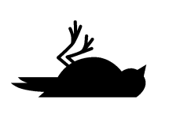
Overall assessment
 | IKB still requires significant effort
 | IKB requires more effort
 | IKB largely addressed
Notes:
It is suggested that each country will eventually be allocated to one of these three categories taking into account the score of each group and the IKB severity, similarly to what the EU Natura2000 Barometer does.

Slide 55
National use
Country X | A. | B. | C. | D. | E. | Size of IKB problem
First
Second
Third
....
Notes:
The assessment scores can also be sued at national level to track the improvement over time.

Slide 56
National use

Slide 57
Summarizing
Internationally recognized tool
Monitor progress
Reduce reporting burden on IKB
Show leadership, capacity & transparency
Supports / builds on NAP development process
Support resource mobilization to fight IKB

Slide 58
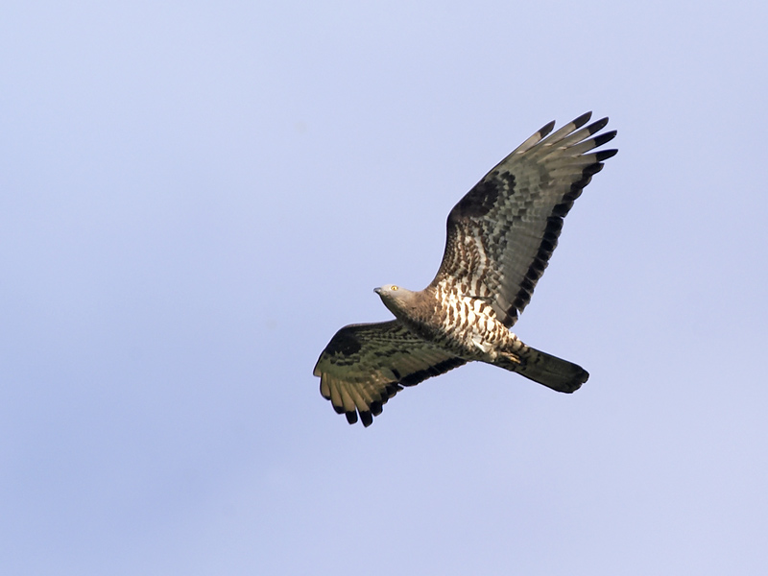
Thank you for the attention

