Slide 1
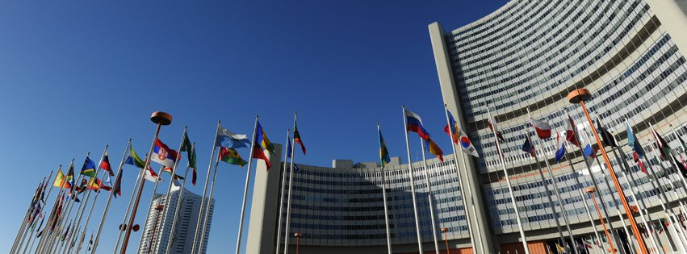
United Nations Office on Drugs and Crime

Slide 2
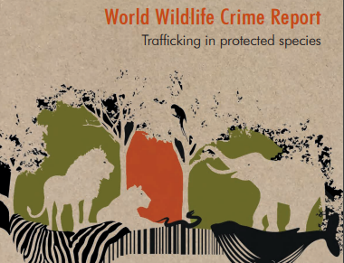
164,000 seizures
120 countries
80 nationalities
7,000 species

Slide 3
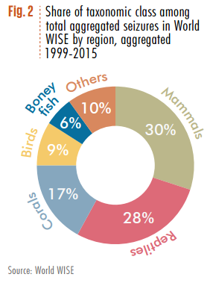

Slide 4
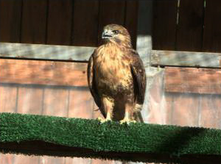
Recent case: bird trafficking criminal network dismantled
Notes:
RECENT CASE (March 2017): Raptors like this falcon were seized from a criminal network trafficking thousands of endangered birds operating from France and Belgium. Following a surveillance operation of several months, investigators seized cages, snares, nets, falsified marking rings, and hundreds of birds. These wild birds ranged from small species (European Goldfinch, Eurasian bullfinch, Bluethroat, Eurasian Golden Oriole, Hoopoe, Red-billed leiothrix) to large raptors (Eurasian sparrowhawk, Golden eagle). Four individuals were indicted; they are facing each up to seven years of imprisonment and a 750,000 Euro fine.

Slide 5
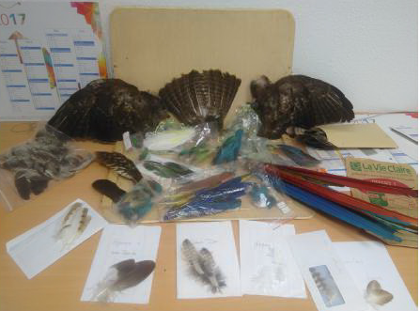
Recent case: feathers of protected birds
Notes:
RECENT CASE (June, 2017): French customs officers discovered numerous feathers of protected birds (species listed in Annex I, II CITES and Annex A, B of the amended EU Regulation 338/97)
110 feathers of Scarlet Macaw ;
405 feathers of Eurasian Buzzard ;
- 2 feathers of Goshawk ;
- 2 feathers of Hawk ;
- 5 feathers of Eurasian Eagle Owl ;
- 2 feathers of Snowy owl ;
- 2 feathers of White-tailed Eagle ;
- 10 feathers of Barn Owl ;
- 2 wings and 1 tail of Eurasian Buzzard ;
- 12 feathers of Cockatoo ;
- 2 feathers of Harris’s Hawk.
Total value: 1 064 euros.

Slide 6
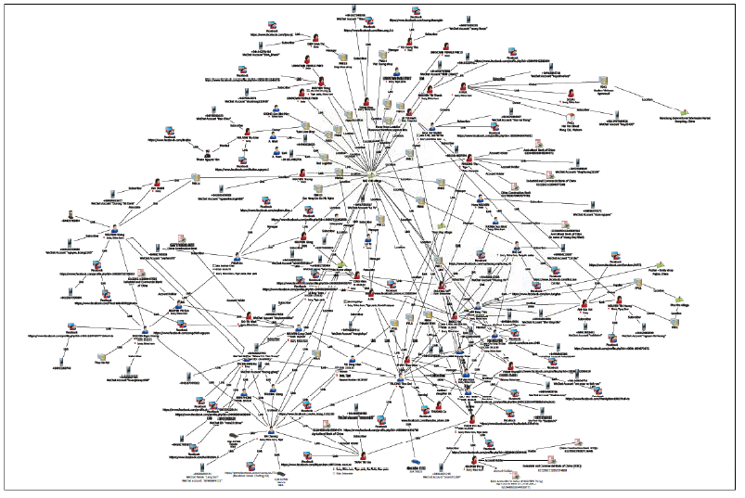
Sentencing in Ireland
Source: Wildlife Justice Commission

Slide 8
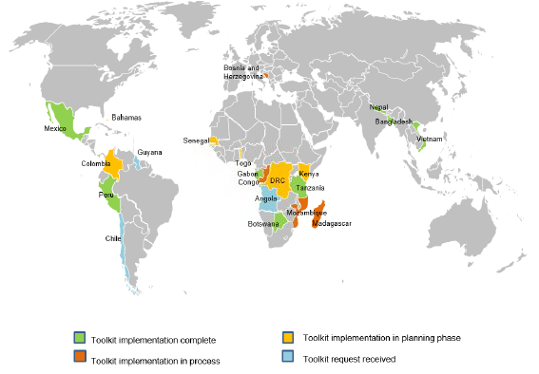

Slide 9
Toolkit process
Notes:
Toolkit process

Slide 10
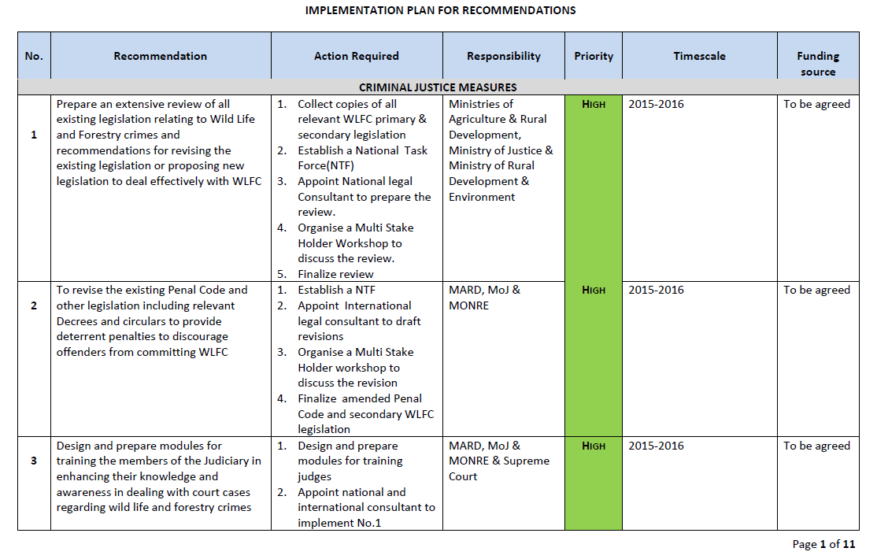

Slide 11
Main findings
Underequipped staff
Weak investigative and prosecutorial capacity
Lack of inter-agency cooperation
Lack of prioritization
Outdated/inadequate laws
Corruption
Weak forensics
Lack of awareness

Slide 12
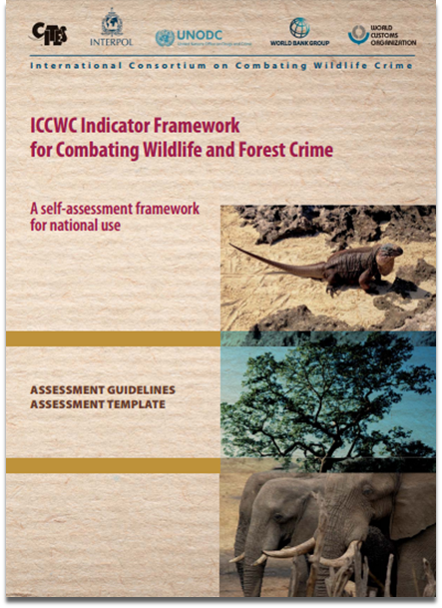

Slide 13
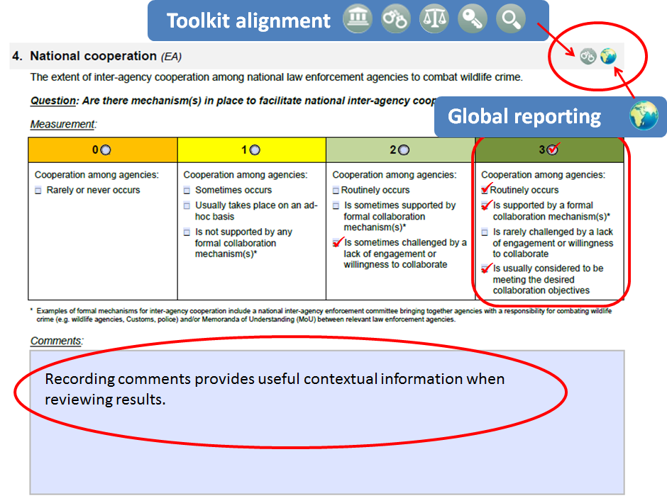
Notes:
A closer look at the assessment template

Slide 14
Going Forward

Slide 15
Thank You Jorge E. Rios Chief, UNODC Global Programme for Combating Wildlife and Forest Crime jorge.rios@unodc.org

